Slide 1
Medium Term Financial Plan (MTFP) 2026/27 – 2029/30
Update
16 October 2025

Slide 2
Financial Sustainability of the UK Fire Sector
A perfect storm of rising costs, increased demand and declining funding
Key challenges facing the Authority:
Inflationary/cost pressures - operational equipment, capital spend, IT costs
Pay and pensions - national agreements, employer pension/NI contributions
Growing demand for services - wildfires, floods, response to Grenfell
Real-terms funding cuts - Spending Review, Fair Funding Review
HMICFRS latest inspection gradings for Kent FRS (August 2025)
- Making the FRS affordable now and into the future = Outstanding
- Making the best use of resources = Good

Slide 3
Key Findings from HMICFRS Inspection
Making the FRS affordable now and in the future = Outstanding
Promising practice – “The Service robustly reviews projects to make sure they achieve their goals”
Main findings:-
“The Service makes good use of public money and is planning ahead for future financial challenges”
“The Service has a clear and transparent plan to use reserves sustainably”
“The Service fleet and estates strategies meet future needs and support long-term sustainability
“The Service is investing in technology and transformation programmes to improve effectiveness and efficiency
“The Service exploits opportunities to produce additional income”
This Fire Authority has no external debt as at 31 March 2025

Slide 5
Key Findings from HMICFRS Inspection
Making best use of resources = Good
Main findings:-
“The Service’s financial and workforce plans are effective, but on-call availability remains low”
“The Service manages staff productivity well”
“The Service works well with other fire and rescue services and partner agencies”
“The Service demonstrates sound financial management”
“The Service has effective Business Continuity arrangements but should strengthen its plans for industrial action”
Examples:
Fire and Rescue Indemnity Company – Insurance Mutual with 13 other Fire Authorities (continuing to grow)
Control room co-located with Kent Police
Fire Control partnership with 3 other Fire Authorities – shared system and call-handling arrangements
Joint procurements with other Fire Authorities e.g. Breathing Apparatus
Previous Fire Authority decisions on Council Tax charges have contributed to the Fire Authority receiving these inspection outcomes
The challenge will be to maintain these inspection outcomes

Slide 6
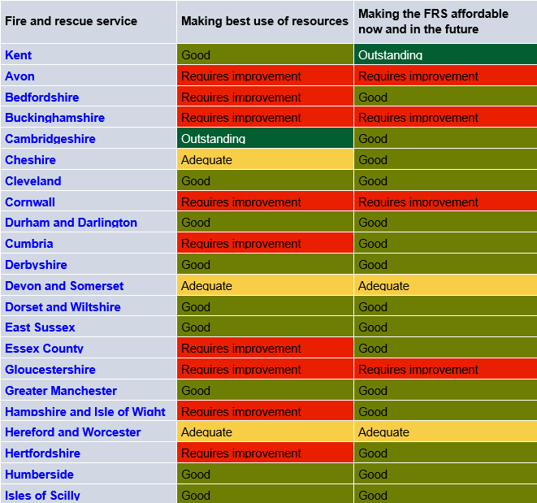
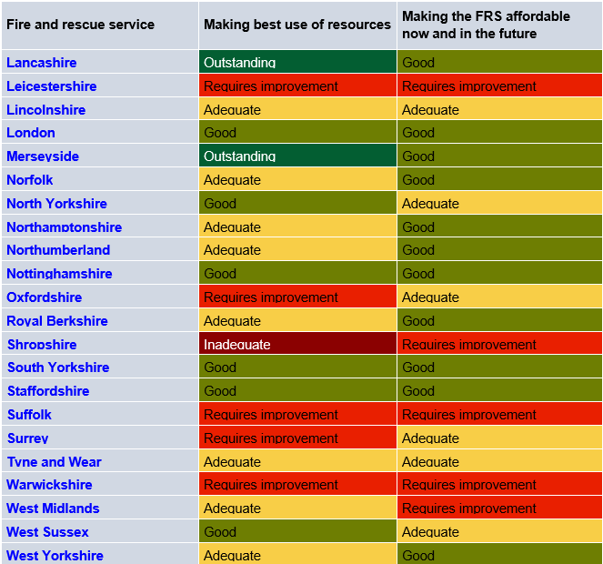
HMICFRS Inspection Scores - Comparison to other FRAs

Slide 7
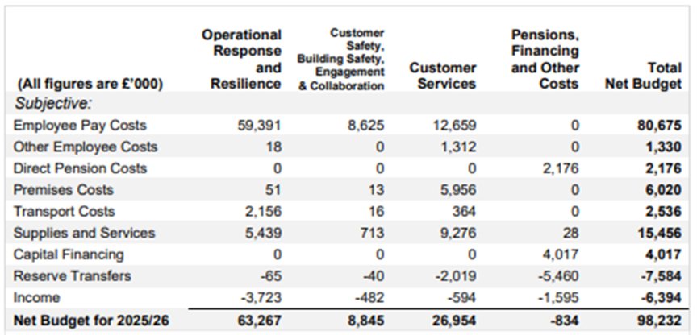
2025/26 Revenue Budget - Summary
82% of budget spend on Pay
73% of budget spent directly on Frontline

Slide 8
Brief note on charging
Fire Authorities are very limited in what services they can charge for and cannot charge for their core, statutory duties.
The Fire and Rescue Services Act 2004 outlines the following core activities, which are considered essential public services and therefore, not chargeable:
Attending Fires
Emergency Response
Road Traffic Collisions
Rescuing people or animals where there is an immediate threat to life
Flooding incidents that post a danger to life
Hazardous materials spillages where a threat to life or health exists
Rescues from water or other emergencies involving trapped individuals
Building collapse or other structural incidents
Providing emergency medical assistance
Fire Safety Promotion including providing advice and fitting smoke alarms
Enforcement of Fire Safety Law including the issuance of enforcement notices
Fire Authority Trading Companies > must be ‘function-related’ > many have been dissolved
EU State Aid rules replaced by UK Subsidy Control Regime

Slide 9
2025/26 Revenue Budget - Income
The £6.394m income budget is comprised of the following:
Specific government grants - £4.312m
Investment income - £1.594m
Solar panel feed-in tariff income - £20k
Rental of masts to telecoms companies - £119k
Sales of obsolete vehicles and equipment (proceeds <£10k) - £40k
Insurance recoveries - £20k
Kent Business Rates pool - £160k
Cross border recharging - £15k
Apprenticeship levy drawdown - £114k

Slide 10
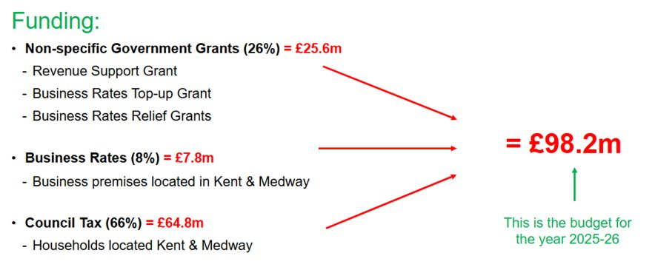
2025/26 Revenue Budget - Funding

Slide 11
Funding Scenarios

Slide 12
Key Funding Considerations - 2026/27 (short-term)
Scenario 1 – Low end
Scenario 2 – Top end
Settlement Funding Assessment (SFA) and Business Rates (Reduced by £1.1m or Reduced by £0.3m)
£27.919m (2025/26) (28% of total funding)
Services Grant (Removed or Removed) = Outcome of Spending Review and Fair Funding Review
£0.6m (2025/26)
Council Tax Charge Increase (£0 or £4.95) – assumes referendum limit is £5 for Fire Authorities
£4.95 for 2025/26 (66% of total funding)
Council Tax Base Increase (0% or 0.5%)
Increased by 1.23% in 2025/26 but most Districts are consulting on changes to their Council Tax Reduction Schemes
Collection Funds (£0m or £0.4m)
£0.4m 2025/26 and £0.5m 2024/25

Slide 13
Funding Changes for 2026/27 | Scenario 1 (low end) C Tax Base +0% C Tax Charge +£0 |  | Scenario 2 (top end) C Tax Base +0.5% C Tax Charge +£4.95
 | Change Assumption | 2026/27 Impact £’m | Change Assumption | 2026/27 Impact £’m
Settlement Funding Assessment (SFA) and Business Rates | Cuts front loaded in yr 1 | -1.1 | Cuts spread over SR period | -0.3
Services Grant | Removed | -0.6 | Removed | -0.6
Council Tax Base | No change | 0.0 | +0.5% | 0.3
Council Tax Charge (Band D) | No change | 0.0 | +£4.95 | 3.4
Collection Funds | No surplus | -0.4 | No change | 0.0
Total Potential Funding Changes from 2025/26 to 2026/27 |  | -2.1 |  | +2.8
Total Potential Funding Available for 2026/27 |  | 96.1 |  | 101.0

Slide 14
Key Funding Assumptions 2027/28 to 2029/30 (medium-term)
National - Spending Review and Fair Funding Review - How will government funding cuts be implemented?
Scenario 1 assumes front loaded in 2026/27 / Scenario 2 assumes evenly spread over 3-year Spending Review period
Current assumptions for 2027/28 – 2029/30:
.
 | Scenario 1 (low end) | Scenario 2 (top end)
SFA and Business Rates | FRONT LOADED REDUCTIONS 2027/28 > 1/3rd cut 2028/29 > cash flat 2029/30 > +2% (outside SR period) | REDUCTIONS SPREAD EVENLY 2027/28 > 1/3rd cut 2028/29 > 1/3rd cut 2029/30 > +2% (outside SR period)
Council Tax Base | +0.5% each year | +1% each year
Council Tax Charge (Band D) | No increase each year | 2027/28 > +£4.95 2028/29 > +£4.95 2029/30 > +2% (outside SR period)
Collection Funds | No Surplus or Deficit

Slide 15
Potential funding changes for 2027/28 to 2029/30 | Change Assumption (each year) | 2027/28 Impact £’m | 2028/29 Impact £’m | 2029/30 Impact £’m
Scenario 1 – lower end
SFA and Business Rates | Cuts front loaded | -0.9 | 0.0 | 0.6
Council Tax Base | +0.5% | 0.3 | 0.3 | 0.3
Council Tax Charge | +£0 | 0.0 | 0.0 | 0.0
Collections Funds | No surplus or deficit | 0.0 | 0.0 | 0.0
Total Potential Funding Change from Prior Year |  | -0.6 | 0.3 | 0.9
Scenario 2 – top end
SFA and Business Rates | Cuts spread over SR period | -0.9 | -0.9 | 0.6
Council Tax Base | +1% | 0.7 | 0.7 | 0.8
Council Tax Charge | +£4.95 (2029/30 > +2%) | 3.4 | 3.5 | 1.5
Collections Funds | No surplus or deficit | -0.4 | 0.0 | 0.0
Total Potential Funding Change from Prior Year |  | 2.8 | 3.3 | 2.9

Slide 16
Budget Pressures and Savings

Slide 17
2026/27 to 2029/30 – Budget pressures and savings
Pay awards (every 1% adds around £850k pressure to the budget)
2026/27 - the 2025/26 pay awards settled at 3.2% (budgeted 2% = c. £1m pressure)
2026/27 - 3% pay award assumption for all pay groups (c. £2.6m pressure)
2027/28 - 2029/30 - 2% pay award assumption for all pay groups (c. £1.7m pressure per year)
Inflation
Contractual commitment, Actual increase or 2%
Working with Budget Managers to identify Savings and Pressures
Investment Income / Grants
2025/26 budget £1.6m
Increased investment income has offset increased costs recently - but this will reduce as cash balances are utilised to fund planned expenditure, resulting in a budget pressure

Slide 18
Pay related budget pressures and savings – 2026/27 to 2029/30
CONFIRMED TO BE CONFIRMED | 2026/27 Impact £’m | 2027/28 Impact £’m | 2028/29 Impact £’m | 2029/30 Impact £’m
2025/26 pay award – Budget 2% v Settled at 3.2% | 1.0
Future years pay awards/increments – 3% for 2026/27 then 2% each year | 2.8 | 1.9 | 1.9 | 1.9
LGPS employer contribution rate (triennial valuation) – 18.5% current | X | X | X
FFPS employer contribution rate (quadrennial valuation) – 37.6% current |  | X | X | X
Other pressures – pension opt-outs, vacancy rate adjustment etc. | 0.5
Other savings – posts deleted / restructures | -0.5
Net impact on base budget | 3.8 | 1.9 | 1.9 | 1.9

Slide 19
Non-pay budget pressures / reduced income – 2026/27 to 2029/30
CONFIRMED TO BE CONFIRMED | 2026/27 Impact £’m | 2027/28 Impact £’m | 2028/29 Impact £’m | 2029/30 Impact £’m
IT systems, subscriptions, and licences | 0.8
FF pensions scheme sanction charges | 0.1
Property budgets | 0.2
Operational equipment budgets | 0.1
Water hydrant repairs | 0.2
Borrowing costs |  | 0.1 | 0.3 | 0.3
Reduction in investment income budget | 0.6 | 0.6 | 0.2
Loss of grants / income (Building Safety grant / Kent Business Rates Pool) | 0.3
Inflation and other base budget reviews | 0.7 | 0.5 | 0.6 | 0.6
Net impact on base budget | 3.0 | 1.2 | 1.1 | 0.9

Slide 20
Budget savings / additional income - 2026/27 to 2029/30
CONFIRMED TO BE CONFIRMED | 2026/27 Impact £’m | 2027/28 Impact £’m | 2028/29 Impact £’m | 2029/30 Impact £’m
Reduction in charges for Airwaves contract | -0.5
Vehicle fuel budget | -0.1
Review of HR contracts (occupational health, eyecare plan etc.) | -0.1
IT budgets | -0.1
Control system |  | -0.1 | -0.1
Other base budget reviews | -0.2
Net impact on base budget | -1.0 | -0.1 | -0.1 | 0.0

Slide 21
Non-pay budget pressures / reduced income – 2026/27 to 2029/30
CONFIRMED TO BE CONFIRMED | 2026/27 Impact £’m | 2027/28 Impact £’m | 2028/29 Impact £’m | 2029/30 Impact £’m
General Reserves Adjustment | -0.1
Other Reserve Adjustments | 0.5 | 0.3 | 0.2 | 0.2
Other one-off budgets | 0.2 | 0.3 | -0.1
One-off impact on budget | 0.6 | 0.6 | 0.1 | 0.2

Slide 22
Summary MTFP – 2026/27 to 2029/30
Scenario 1 – low end (no Council Tax increases) | 2026/27 | 2027/28 | 2028/29 | 2029/30 | Total
Base Budget b/f | 98.2 | 95.5 | 94.9 | 95.7
Pay related budget pressures/savings (tbc) (slide 19) | 3.8 | 1.9 | 1.9 | 1.9
Non-pay budget pressures/reduced income (tbc) (slide 20) | 3.0 | 1.2 | 1.1 | 0.9
Savings/Additional income – identified (tbc) (slide 21) | -1.0 | -0.1 | -0.1 | 0.0
Savings – Options to be considered | -8.5 | -3.6 | -2.1 | -2.0 | -16.2
Base Budget c/f | 95.5 | 94.9 | 95.7 | 96.5
One-off Budgets (tbc) (slide 22) | 0.6 | 0.6 | 0.1 | 0.2
Net Revenue Budget | 96.1 | 95.5 | 95.8 | 96.7
Scenario 2 – top end (£4.95 / 2% C Tax increase) | 2026/27 | 2027/28 | 2028/29 | 2029/30 | Total
Savings – Options to be considered | -3.6 | -0.2 | 0.9 | 0.0 | -2.9
Base Budget c/f | 100.4 | 103.2 | 107.0 | 109.8

Slide 23
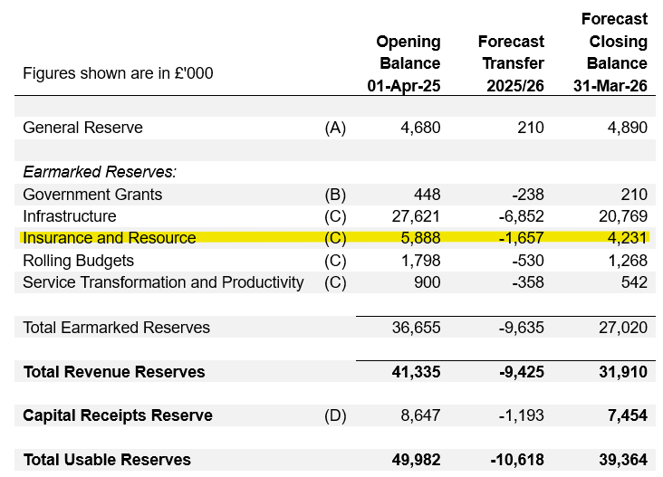
2025/26 Forecast Reserve Balances
2025/26 Revenue Budget Forecast Underspend £1.166m

Slide 24
Example Costings
All areas of spend will be reviewed but if the scale of savings is as currently anticipated this will inevitably impact frontline response and, prevention and protection teams.
- No Council Tax increases could mean c.£16m of base savings must be delivered over the MTFP period.
- £4.95 Council Tax increases could mean c.£3m of base savings must be delivered over the MTFP period.
Example costs | Annual base saving
Crewing on-call pump attached to 24/7 wholetime shift station (15) | £120k each
Crewing stand-alone on-call station (34) | £170k each
Crewing second pump at multi-pump wholetime shift station (4) | £1m each
Crewing wholetime day-crewed shift station (9) | £750k each
Capital cost of a fire appliance (95 in fleet - life of 15-years) | £300k each (capital cost)
Cost of a Building Safety Inspector (20) – including employers NI & Pension | £52k each
Cost of a Home Fire Safety Visit Officer (10) – incl. employers NI & Pension | £45k each
A Fire Cover Review that considers the level of risk to the public will be undertaken

Slide 25
Recap on Council Tax
£ Band D Council Tax
Charge
for 2025-26
Annual Bill
£ increase in Band D Council Tax
for 2026-27
Annual Bill
Impact on Band D Council Tax Charge
Weekly Bill
Council Tax income generated from £ increase
Level of expected savings still needed in 2026-27
£94.86
The Fire charge equates to around 4% of the average Council Tax bill
£0
£0
£0
£7.0m - £8.5m
£4.95
(£5 referendum limit)
£0.09
£3.4m
£3.6m - £5.4m
KCC = £1,691.19 (72%)
District or Borough = £299.67 average (13%)
Medway Council = £1,842.32 (85%)
Kent Police = £270.15 (11%)
As the Kent Fire charge represents only 4% of the total Council Tax bill, a £4.95 annual increase on the Kent Fire Band D charge equates to a 0.2% annual increase in the overall bill.

Slide 26
Recommendation:
Members are asked to:
Agree the assumptions currently being used in developing the Authority’s Medium Term Financial Plan (MTFP).
Note the potential budget gap and savings requirement under each scenario when considering the Council Tax public consultation paper which appears later on the agenda.

