Slide 1
C2 Activity update
1. Operational incident
2. Building Safety prosecution
February 2026
For further information please contact:
Matt Deadman, Director – Response and Resilience
Leanne McMahon, Director – Prevention, Protection, Customer Engagement and Safety

Slide 2
Operational Incident
Odeon Cinema, St George’s Place, Canterbury
14th February 2026

Slide 3
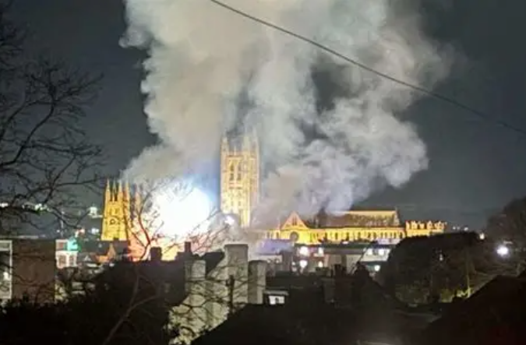
Background
At 14:03 on Saturday 14th February 2026 Fire Control received the first of 14 calls to smoke issuing from the roof of the former Odeon Cinema in St. George’s Place, Canterbury.
Due to the close proximity of the incident to Canterbury Fire Station crews were in attendance promptly (152 seconds), and an early assistance message was sent to “make pumps 6, height vehicle 1”.
A member of the public reported youths entering but not seen exiting, so the incident was made persons reported.
Entry was made via a ground floor emergency exit, with multiple BA teams entering the complex building for firefighting and search and rescue.

Slide 4
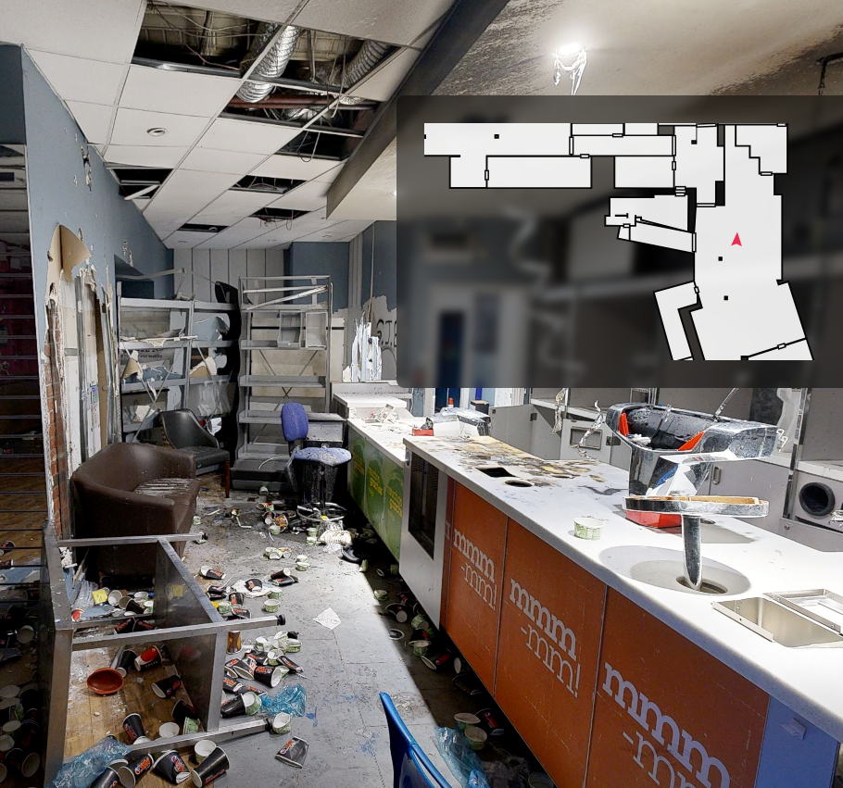
Pre-Planning
The risk of derelict buildings across the county has previously been identified in our CRMP process.
We had done significant preplanning work, including mapping the entire building with immersive camera imagery, allowing crews to ‘walk through’ the building remotely. This information was used in tactical planning and for briefing breathing apparatus teams.
We had also previously created a Site Specific Risk Information record, detailing the hazards and command considerations for attending an incident in the building.
We have worked with local authorities across the county, including Canterbury City Council, in identifying and managing derelict buildings.

Slide 5
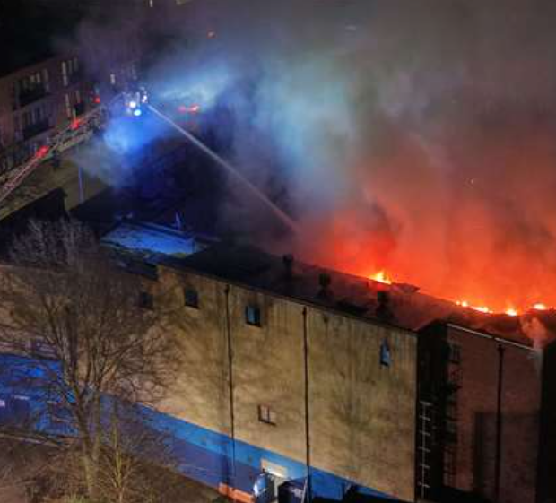
Operational Notes
19 fire engines, 2 height vehicles, technical rescue, command support and other specialist vehicles were in attendance at the height of the incident.
Access was difficult and hazardous. Building collapse occurred.
KFRS attendance at the incident ran for 3 days.
Resourcing the incident was challenging given low on call availability during the day.
We called on established mutual aid arrangements from neighboring counties to provide fire cover at key locations across North and West Kent.
We enacted internal processes for increasing availability, including recall to duty.
A major incident was declared due to the need to implement these special arrangements.

Slide 6
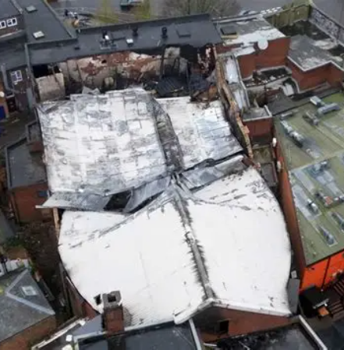
Outcome
Close liaison was undertaken with Canterbury City Council and other agencies.
Whilst significant local disruption was experienced by local residents and businesses a plan was put in place to return individuals to their homes and get businesses open as quickly as possible.
The premises suffered extensive structural collapse and measures had to be put in place to manage public safety – particularly given the location of the building in the center of Canterbury on a major road.
All persons were accounted for and there were no fatalities or serious injuries to members of the public or KFRS colleagues.
A full debrief was conducted to capture lessons learnt.

Slide 7
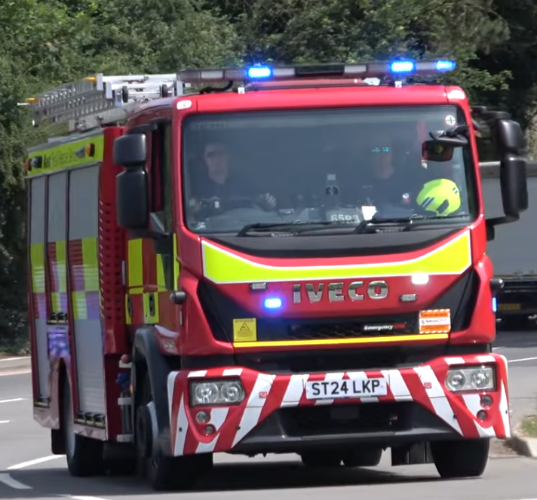
Resourcing
The scale of the incident meant that the Service entered into degradation of service – a level that means it becomes difficult for us to resource other incidents quickly.
Management processes were put in place quickly to alleviate this and return to normal operating levels as soon as possible.
However, the incident underlines the need to increase the number of resources available to respond during the day, including ensuring we maximise the number of guaranteed wholetime fire engines available. Matching resources to demand is critical in ensuring operational resilience.
Our Resourcing Review (2026) looks to address exactly this issue and, in conjunction with our On Call Project, will provide more reliable day time availability of fire engines.

Slide 8
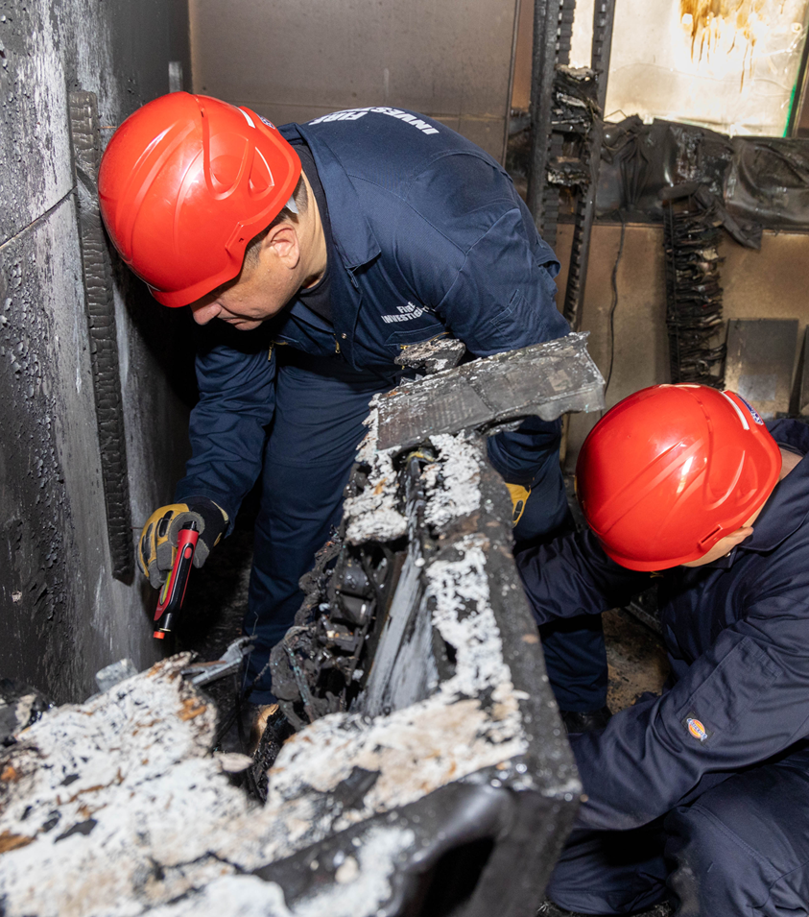
The fire investigation was conducted on Day 3 (Monday).
Due to the fire origin area being unsafe to enter, and the known presence of asbestos within the building, a limited (Tier 2) investigation was undertaken by KFRS.
The investigation focused on gathering available scene evidence to determine the fire's origin and cause beyond reasonable doubt.
Initial observations from attending crews indicated that the fire had developed within Screen 2, the lower of the two auditoriums within the building.
Building Safety – Fire Investigation

Slide 9
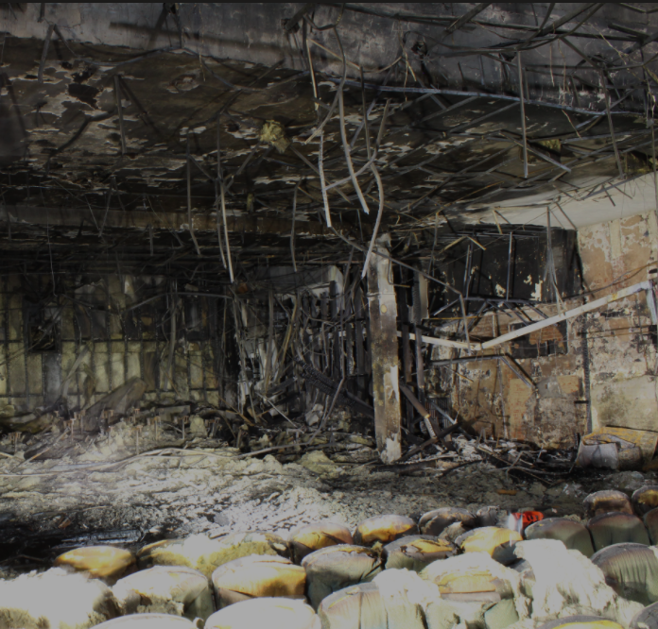
The new 3D scanning technology did not only support operational response activities but also played a key role in the fire investigation.
The technology provided detailed pre-fire imagery of the suspected area of origin, enabling investigators to compare pre and post-fire conditions and support the determination of the fire's origin and cause.
Based on the available evidence, the area of fire origin has been identified as combustible materials within the seating area of Screen 2 that were set alight.
The fire spread rapidly to the rear of Screen 2 before extending into Screen 1 and subsequently venting through the roof of the building.
Building Safety – Fire Investigation

Slide 10
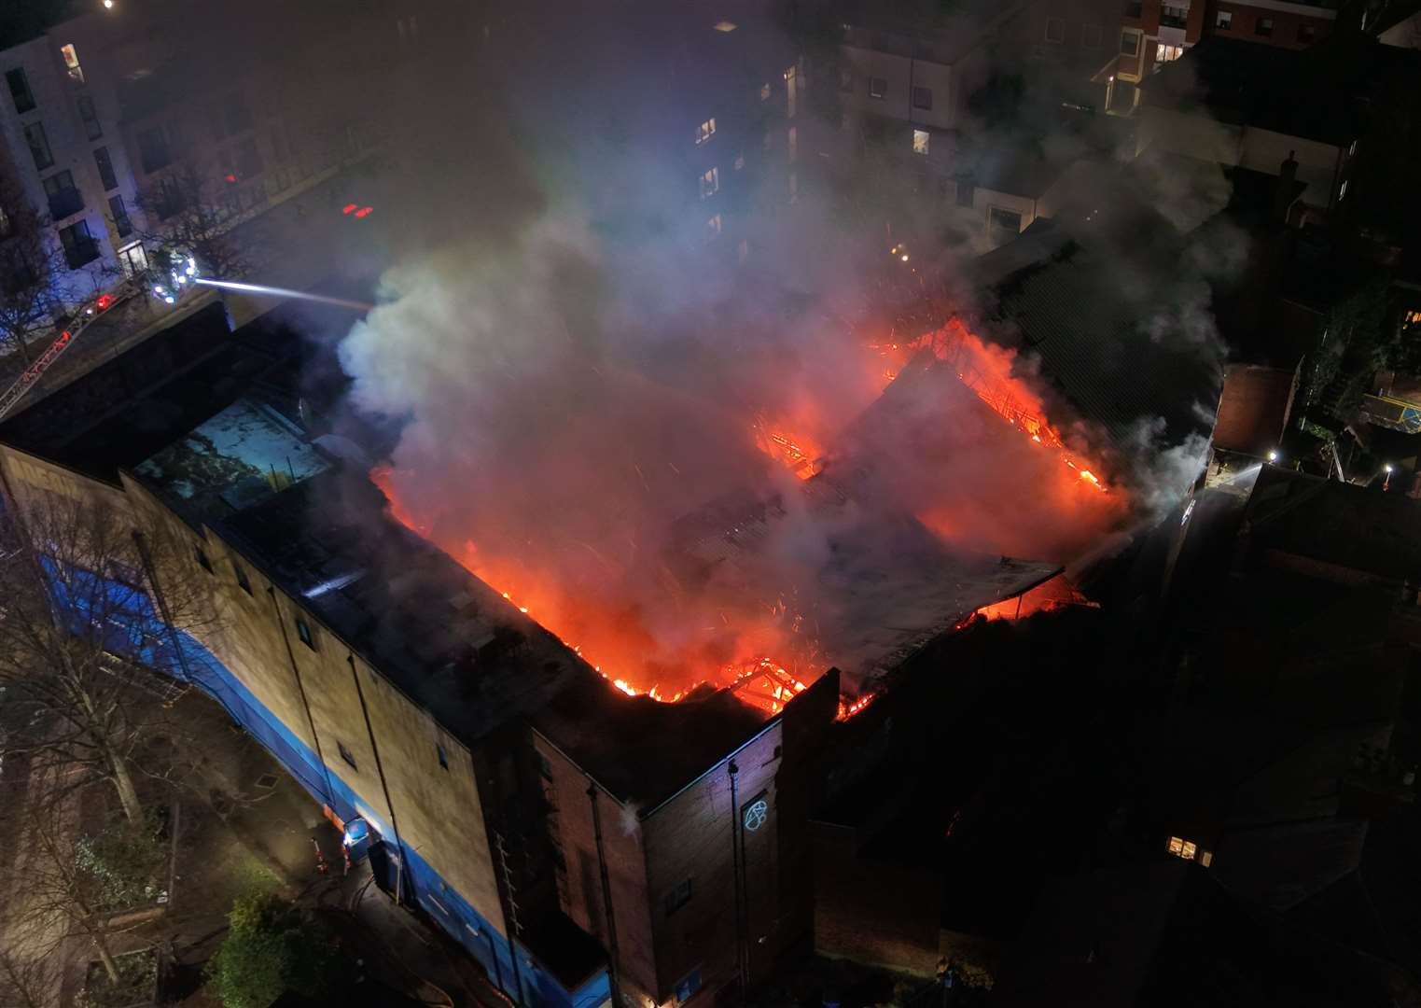
Building Safety – Business Engagement – The Odeon

Slide 11
On the Monday 16th February 2026 the business engagement team were tasked to carry out post incident duties in response to the Odeon Cinema incident.
The team engaged with business in the vicinity of the fire to provide reassurance, offer fire safety advice and guidance, and whilst there validate information to update Dynamics.
A total of 40 business premises were visited over 3 days. Seven businesses were impacted by the fire due to restrictions on the use of their rear fire exits. Additional advice was provided regarding occupancy capacity, evacuation procedures, and the updating of Fire Risk Assessments.
A small number of businesses were provided with specific advice regarding defects identified during visits, namely blocked fire exits and missing or misplaced fire extinguishers.
One business was escalated due to concerns with fire detection and a sleeping risk above the premises. This premises is now subject to a full regulatory inspection.
One of the visits was to a business centre containing 50 individual business premises. Following joint work with the building manager, all occupiers are in the process of receiving fire safety advice.
Building Safety – Business Engagement – The Odeon

Slide 12
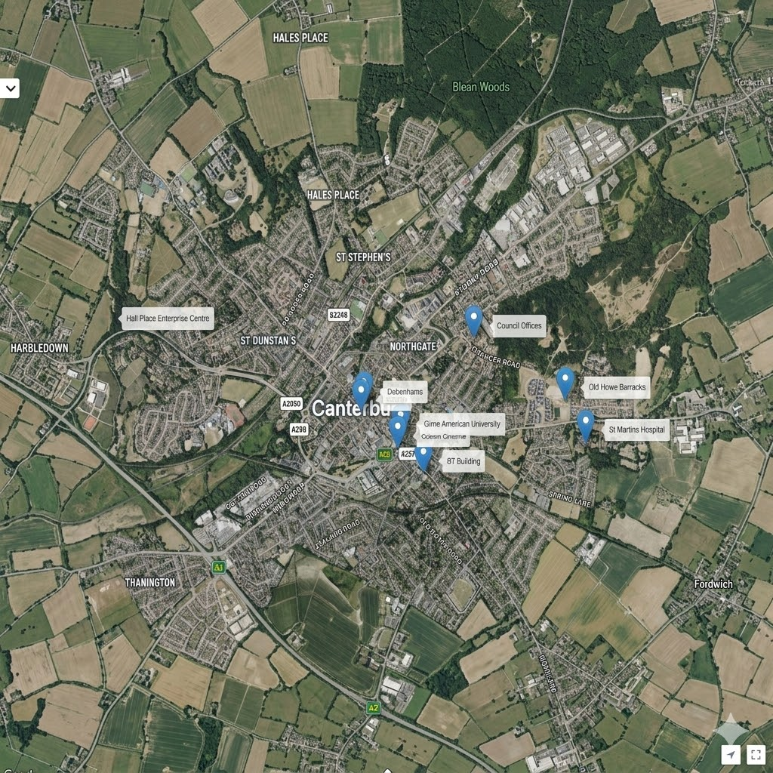
Managing the Risk: Derelict Buildings
Managing the risk posed by derelict buildings in Canterbury requires coordinated approach balancing heritage consideration, public safety and urban regeneration
Through partnership work we identify at risk premises and choose the most appropriate action from monitoring to enforcement, coordinated with building control, planning departments and other stakeholders
The challenges are in identifying ownership and absentee landlords as well as challenges posed by enforcement
In Canterbury the partnership team are monitoring 16 premises by attending bi-monthly meetings with Kent Police and Canterbury City Council
Community Intelligence and Partnership – Derelict premises

Slide 13
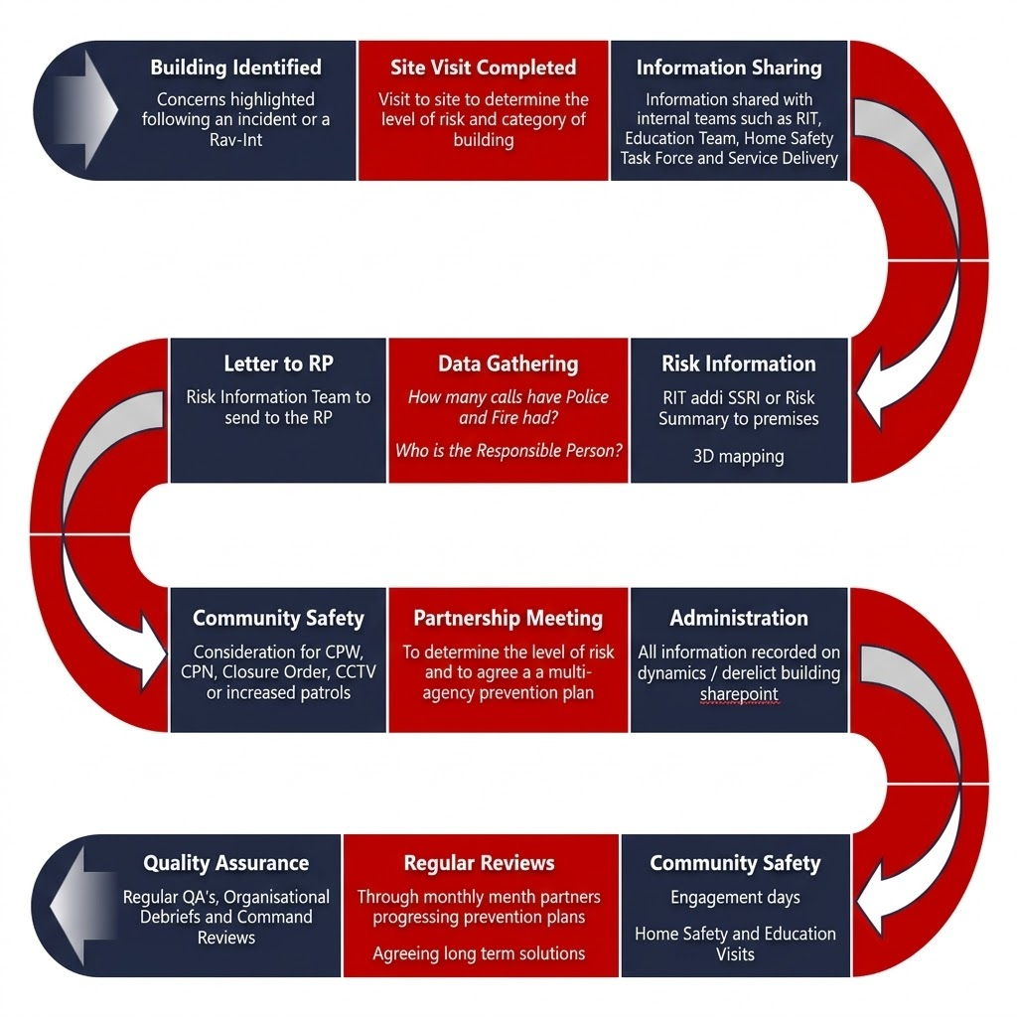
Our Approach
Identification - Building are identified following incidents, reports and referrals from partner agencies
Site assessment - visit is undertaken to determine the level of risk and categorise the premises
Information sharing – Relevant information is shared internally with operational, prevention and protection teams and community safety team as well partner agencies
Data Collection - incident history, antisocial behavioure trends, ownership details
Multi -agency working – Partnership meetings held to develop co-ordinated prevention plans
Community safety measures – increased patrols of the area, CCTV, community engagement activities
Monitoring – regular review with prevention plans updated and long-term solutions pursued
Community Intelligence and Partnership – Derelict premises

Slide 14
Building Safety Enforcement
Miller Heights, Maidstone

Slide 15
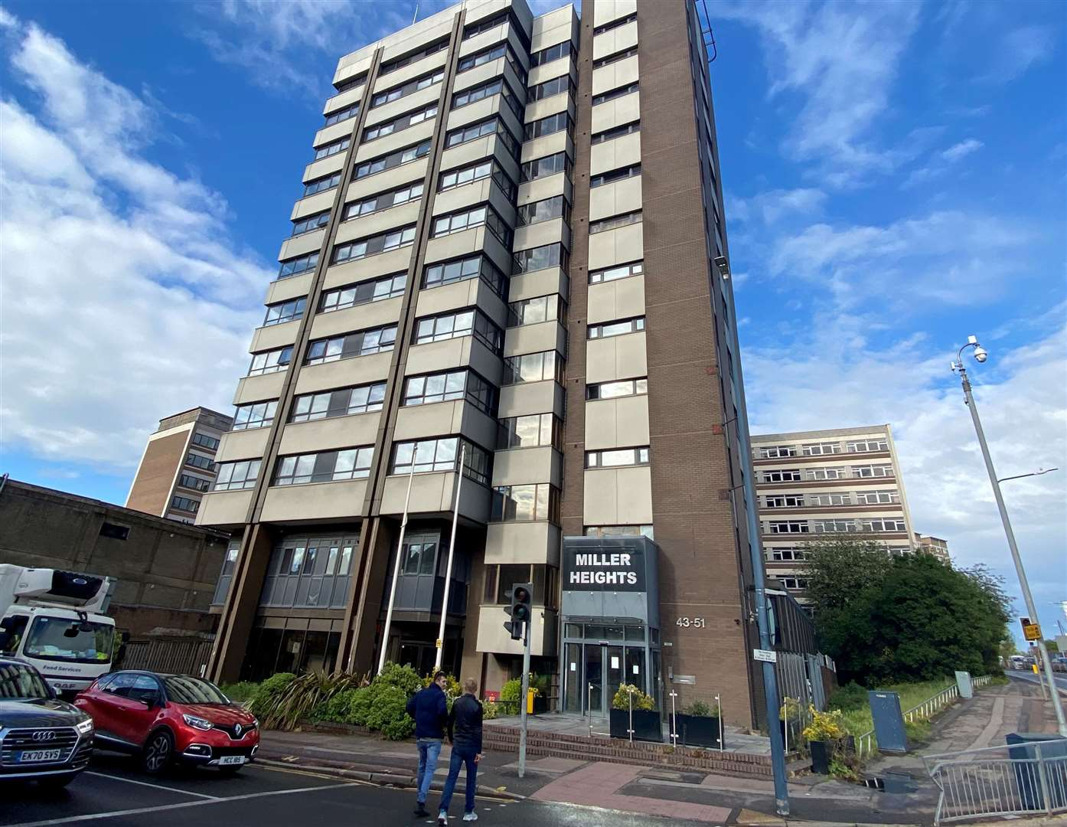
Background
On Monday, May 11, 2026, KFRS responded to reports of a burst pipe in the basement of Miller Heights, a converted multi-story block of flats in Maidstone town centre.
KFRS was originally called to support pumping water from the flooded basement; however, the incident escalated beyond water removal and developed into a wider operational issue affecting all residents in Millers Heights.
The flood heavily impacted the building's critical electrical infrastructure, wiping out the power supply and triggering widespread fire safety concerns.
The impact on the power supply was critical, requiring UK Power to terminate the supply to the entire building
Miller Heights

Slide 16
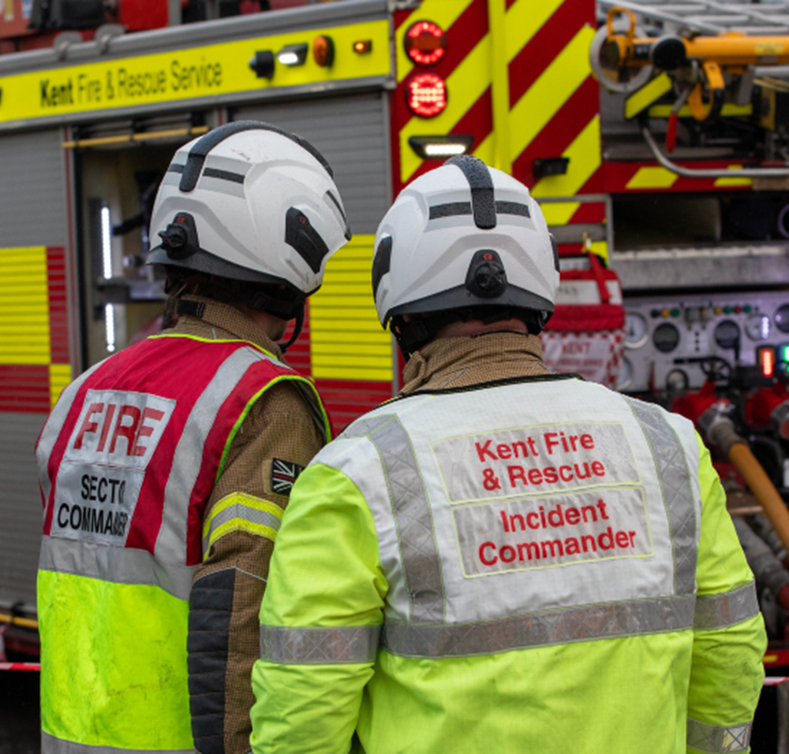
Enforcement
The power loss affected basic necessities for the residents. The lack of water, electricity, toilet or cooking facilities resulted in a number of humanitarian issues.
Over 24 hours the immediate life safety systems, such as fire alarms, automatic opening vents, emergency lighting, firefighting lifts, and sprinklers, became non-operational due to the power failure. This posed a serious risk to the residents in the building.
KFRS took the necessary steps to prohibit people entering or staying in the building, implementing the major decant process.
Miller Heights

Slide 17
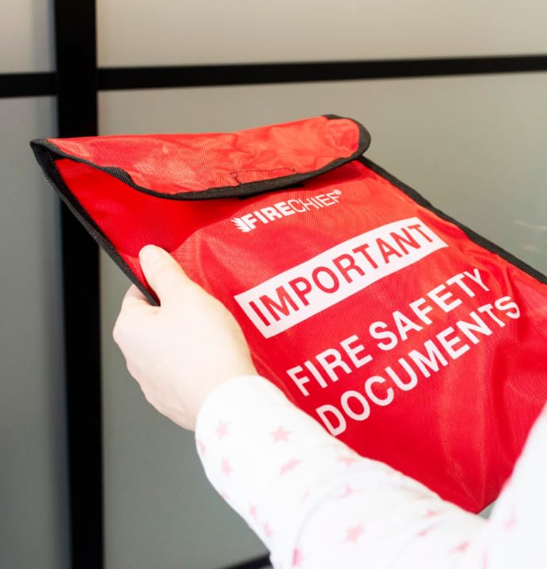
Enforcement
Working as a multi-agency partnership through the Local Resilience Forum command and control structure, KFRS coordinated the serving of the notice and the provision of support required for residents being displaced.
The Prohibition Notice legally prevents anyone from living, sleeping, or entering the premises for anything other than strictly supervised remedial works.
Around 250 residents were displaced from their homes due and were relocated to either the welfare centre set up by the local authority or to temporary accommodation provided by landlords.
Maidstone Borough Council (MBC) initially declared a major incident and worked to arrange emergency temporary accommodation and animal welfare support for displaced families.
Miller Heights

Slide 18

Decision Making
When KFRS serves a prohibition notice on a high-rise residential building, this is not something taken lightly and is always a last resort to protect the life and safety of residents. All available mitigation options are explored first to ensure residents are protected.
Prior to serving the notice, KFRS consulted with the Government Liaison Officer and MHCLG (Resilience and Emergencies Division). Our decisions were peer reviewed by Essex Fire and Rescue Service and the National Fire Chiefs Council.
The premises has a range of other fire safety defects which will form a schedule of works detailed by a number of enforcement notices.
Miller Heights

Slide 19
Recovery
The electrical intake systems have suffered significant damage, causing issues with a return of the power supply.
The managing agents are unable to address concerns relating to the life safety systems until power has been restored.
KFRS continues to work with the Local Resilience Forum Recovery Co-ordination Group to ensure the safety of residents remains the priority, alongside the building being remediated.
We know that anxiety can arise when concerns are identified within tall buildings. Our customer safety teams supported neighbouring residents of tall buildings and completed a number of home fire safety visits.
Miller Heights

Slide 20
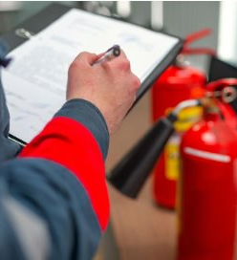
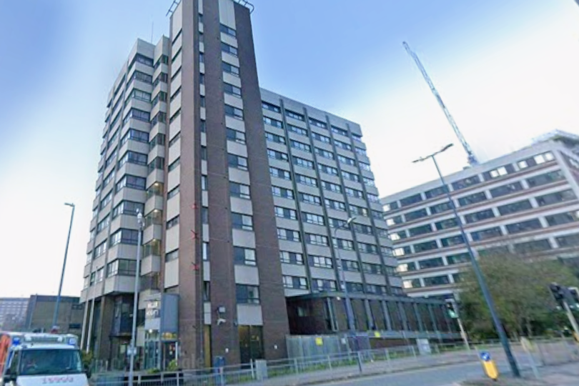
Recovery
Welfare centres have been stood down, but the recovery phase is complex.
KFRS supported the managing agents between 12 and 24 May opening heavily restricted, supervised access windows for residents to retrieve essential belongings and pets.
Following detailed investigations, specialist engineers have confirmed that the building's electrical system cannot be repaired, and a full replacement is required. It is predicted that Miller Heights is predicted to be uninhabitable for some time.
KFRS continue to work with Maidstone Borough Council, the Building Safety Regulator, MHCLG, and our Government Liaison Officer to ensure the building issues are resolved swiftly, so that residents can return to their homes.
Miller Heights

