Slide 1
Partnerships
KMFRA Audit and Governance
January 2026
Leanne McMahon
Director Protection, Prevention and Customer Engagement

Slide 2
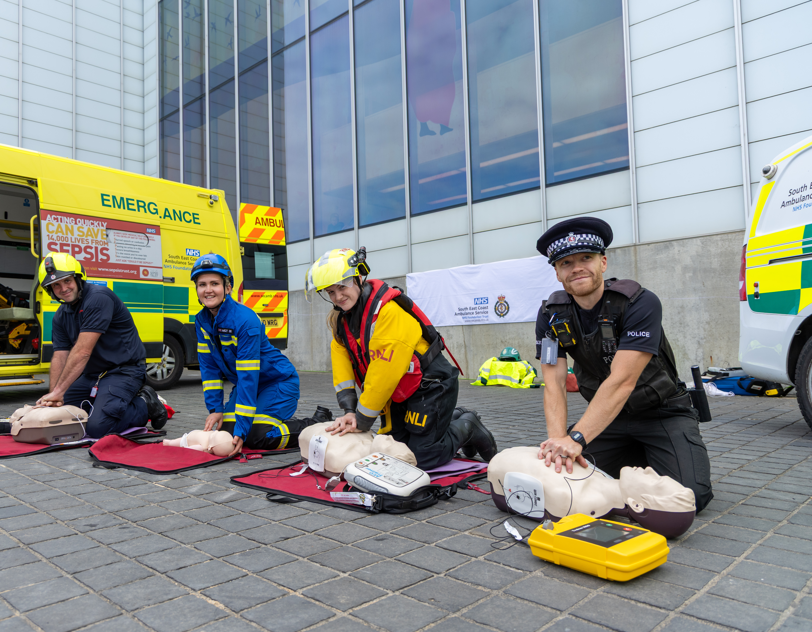
Partnerships
Approach to partnerships
Types of partnerships we have
Key partnership areas
Focus on ongoing benefits
Benefit examples

Slide 3
Approach to partnerships
Where there is customer benefit
Allow us to achieve our objectives
Provide a better service through collaboration
Duty to collaborate - Police and Crime Act 2017
  ‘statutory duty on police, fire and rescue and emergency ambulance services to keep under consideration opportunities to collaborate with one another, and further, where it would be in the interests of efficiency or effectiveness of at least two of the services, for those services to give effect to such collaboration’.

Slide 4
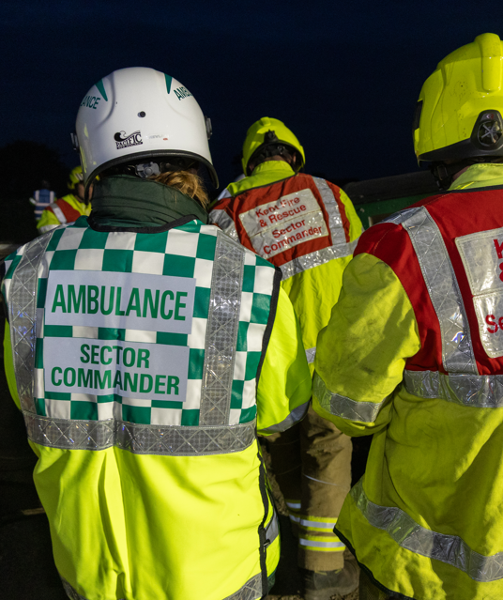
Types of partnership
Collaborative problem solving
MOUs
Sharing information – risk information
Strong relationships - RBIP
Premises sharing
Campaigns – battery disposal
Procurement

Slide 5
Key areas where we have on-going partnerships
Trading Standards
CQC
Building Safety Regulator
Local authority housing and licensing departments
Sharing risk information with neighbouring fire services
Community Safety Partnerships / Units / Neighbourhood Task Forces
KMSRP
Safe and Well Referrals
Armed Forces Network
Serious Violence Duty
Safeguarding Boards / Domestic Abuse
SECAMB
4Fs – Kent, Surrey, East and West Sussex FRS
Police and Fire Control location and software / Joint Control project
Kent Search and Rescue (KSAR)
Procurement – PPE; breathing apparatus
Charities and community groups – Porchlight, Red Cross, Green Doctors, RAYNET
Police, SECAmb, Local Authorities
Kent Association of Local Councils (KALC)
Kent and Medway Resilience forum
Second line of response (SLOR) Channel Tunnel
Water companies
Environment Agency
Community Resilience Group
KVSEG
Protection
Prevention
Response
Resilience
Internal Services

Slide 6
Benefits
More efficient use of resources
Greater impact
Enhanced customer safety
Co-ordinated comms with greater reach
Deeper community intelligence = more effective services
Tailoring services to be more effective = equality of access
Stronger community resilience

Slide 7
Outcomes of collaboration
Since 2019
Co-Responder incidents: 15,108
ROSC achieved: 77
Assist other agencies: 11,061
  of which MISPER: 233
Attended incidents with KSAR: 71 (since Jan 2020)
Safe & Well visits: 75,426
Safeguarding referrals: 1,946 (since Jan 2021)

Slide 8

Questions

Slide 9
Partnerships
KMFRA Audit and Governance
November 2024
Jon Quinn
Director Protection, Prevention and Customer Engagement

