Slide 1
Kent and Medway Fire and Rescue Authority
C5. Information Update
25 June 2026

Slide 2
A. Inspection update
June 2026
For further information please contact:
Nicola Harryman, Head of Data and Intelligence and KFRS Service Liaison Officer for HMICFRS

Slide 3
HMICFRS have now begun the 2025-2027 round of inspections and have now published the first four reports. These reports are for:
  Bedfordshire
  Essex
  Greater Manchester
  Merseyside
It is expected that our next inspection will be, as usual, at the very end of the inspection programme and likely to be in spring 2027.
HMICFRS have also carried out a thematic inspection on cyber security with three fire and rescue services and three police forces. The three fire and rescue services selected were North Yorkshire, Humberside and West Sussex. It is anticipated that this report will be published in the Summer.

Slide 4
B. Performance update
June 2026
For further information please contact:
Nicola Harryman, Head of Data and Intelligence and KFRS Service Liaison Officer for HMICFRS

Slide 5
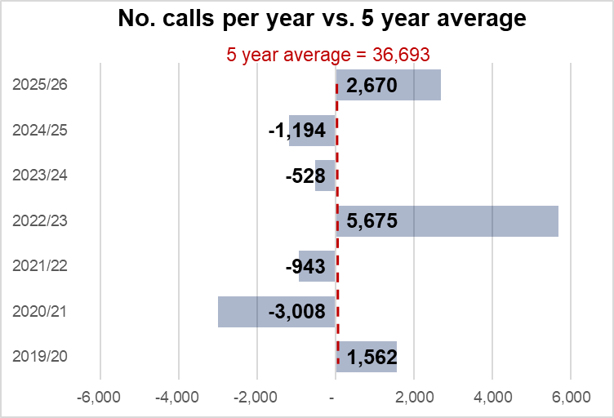
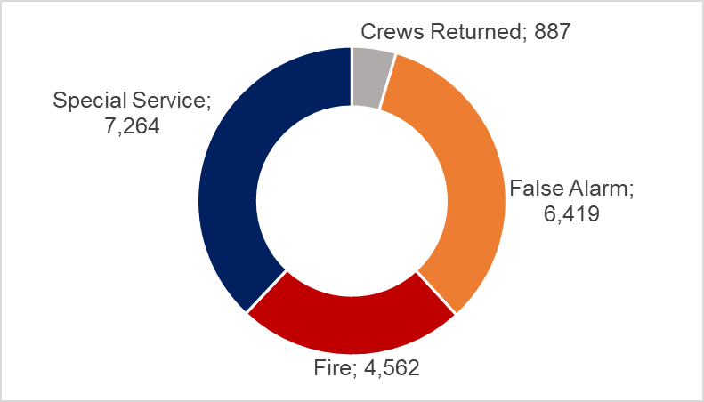
Overview of the Authority’s performance for April 2025 – March 2026
Emergency Calls
Between April 2025 and March 2026, 39,363 emergency calls were received in Authority’s control room. It is evident that call volumes vary year to year. Low call volumes in 2020/21 and 2021/22 were affected by the pandemic. The high numbers recorded in 2018/19 and 2022/23 are linked to hot summers increasing outdoor fires and related calls. This year’s call volumes are higher than the previous year and are higher than the five-year average
Incidents Attended
The calls received into the Control room resulted in mobilising to 19,132 incidents between April 2025 and March 2026
The majority of fires attended were outdoor and rubbish fires
24% of special service incidents were to gain entry, and a further 21% were to assist other agencies.
Most of the false alarms attended were to automatic fire alarms in domestic properties.
Please note: these figures include over the border attendances which are not included in performance indicator reporting. They will not match the totals shown on subsequent slides

Slide 6
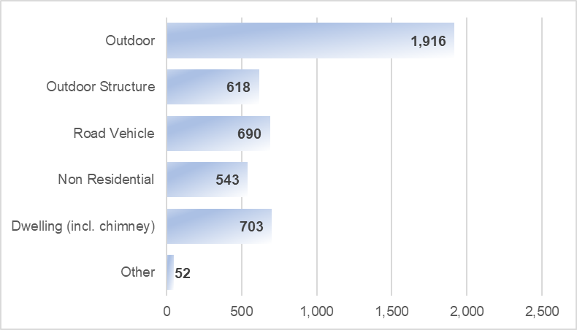
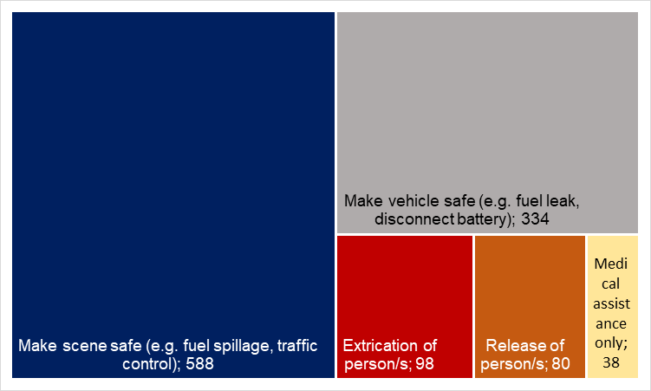
Road Traffic Collisions
1,140 road traffic collisions were attended (excluding those where no action was needed) between April 2025 and March 2026. The vast majority of incidents have needed our attendance to make either the scene or the vehicle safe only.
Fire Incidents
Attended 4,522, fires of all types; which is 13% more than the previous year, owing to more outdoor fires predominantly.
Attended 554 accidental fires in the home (not including chimney fires); which is slightly lower than the number attended in the previous year (556). This Authority reported the lowest ever number of fires in the home in 2023/24, and despite the increase in the last two years, overall the number of fires in the home remains low.
Accidental fires account for 61.9% of the total fires attended. As a result of these fires, four people died, ten people suffered serious injuries and 86 people have suffered ‘slight’ fire-related injuries.
Two people have died, one person has been seriously injured and 11 people have been slightly injured in deliberate fires
As a result of these incidents 19 people died and 108 were seriously injured.

Slide 7


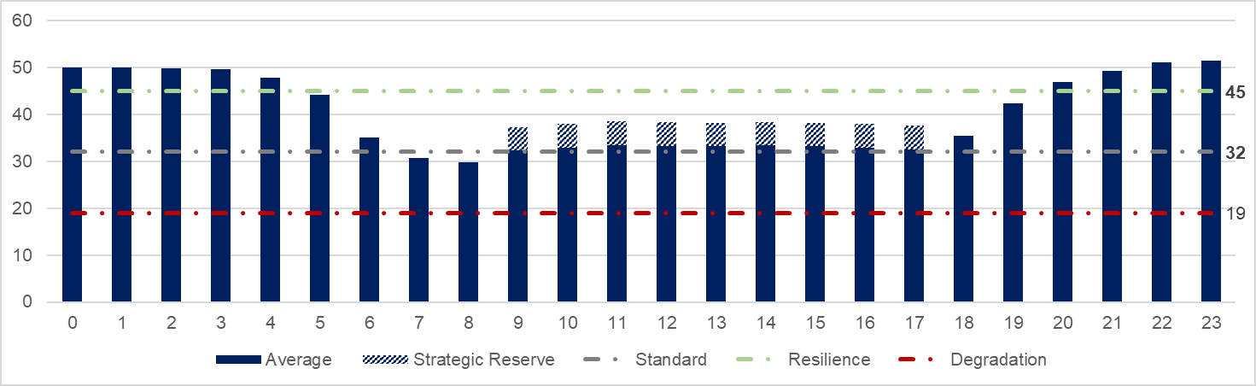
Response times
% Emergency urban incidents within 9 minutes (target 75%)
Average time from mobilisation to attendance – 7 minutes 49 seconds
  % Emergency rural incidents within 15 minutes (target 75%)
Average time from mobilisation to attendance – 12 minutes 52 seconds
Availability
So far this year the average number of fire engines available has been 33 during the day (9am-6pm) and 44 in the evening (6pm to 9am). We aim to have 32-44 fire engines available, known as our standard operating level. We often exceed this level at night.
4.6% of all contracted hours have been lost due to sickness. Operational colleagues have lost 5.1% of contracted hours to sickness and employees in Customer Service teams have lost 3.6%.

Slide 8
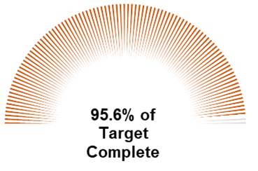
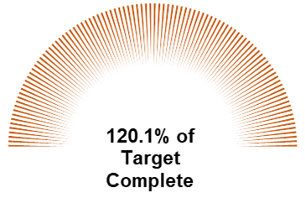
Home Fire Safety Visits and Safe & Well Visits
14,333 Home Safety Visits carried out
95.6% of the target of 15,000
12,006 Safe and Well Visits carried out
Exceeded target of 10,000 by 20.1%
Building Safety
99.8% of building consultations received (2,335 of 2,340) were completed within 21 days.
1,164 audits were carried out in total, of which 643 were satisfactory and 521 were unsatisfactory in outcome.

Slide 9
C. Response and resilience update
June 2026
For further information please contact:
Matt Deadman, Director – Response and Resilience

Slide 10
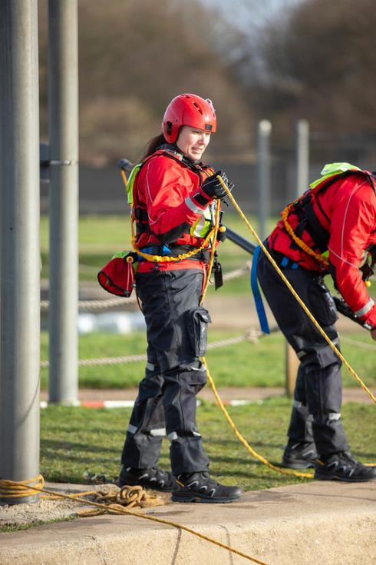
Technical training and professionalism
The new live fire training facility at Ashford is 98% complete – full possession on 26 June.
Full training is planned to commence in January 2027 – this allows the completion on the support facilities to enhance colleague wellbeing and safety through effective decontamination.
Hot commissioning carried out in May - All tests were completed successfully with the building and systems performing well throughout.
Final commissioning W/C 22nd of June prior to the full handover of site.
Access to live fire for colleagues doubled with the facility at Ashford, following review of current course structure and amendments made
Lean review: 466 hours pa, saved through better processes/automation and enhanced reporting. Other gains such as improved data quality, reliability and timeliness.
Integration of a new Curriculum and Assurance function to enhance oversite of training quality, standardisation and audit.
The Service continues to collaborate with the national group developing aligned competence frameworks for the fire and rescue sector. A local review of role competencies is complete and new electronic tracking due in place by 2027
Two new driving school vehicles delivered – testing June and planned for training July 2026

Slide 11

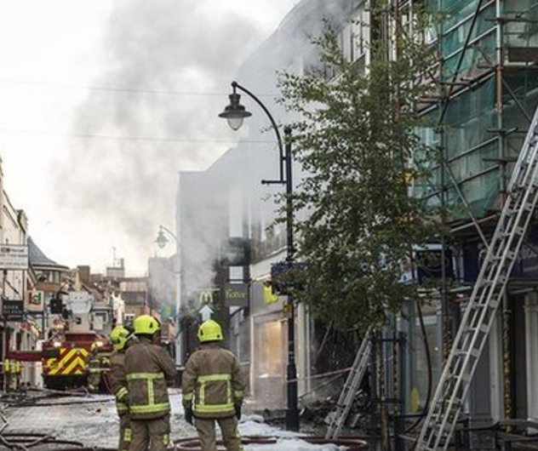
Operational Services
New equipment
Replacement thermal imaging cameras (TICs) have been rolled out across the service, these are more compact and user-friendly units, enhancing the capability of both locating/sizing up fires and locating casualties in reduced visibility environments
All stations now have secure external collection points for collection of used firefighting PPE – this reduces the exposure to fire contaminants by it being stored inside our fire stations before it is cleaned

Slide 12
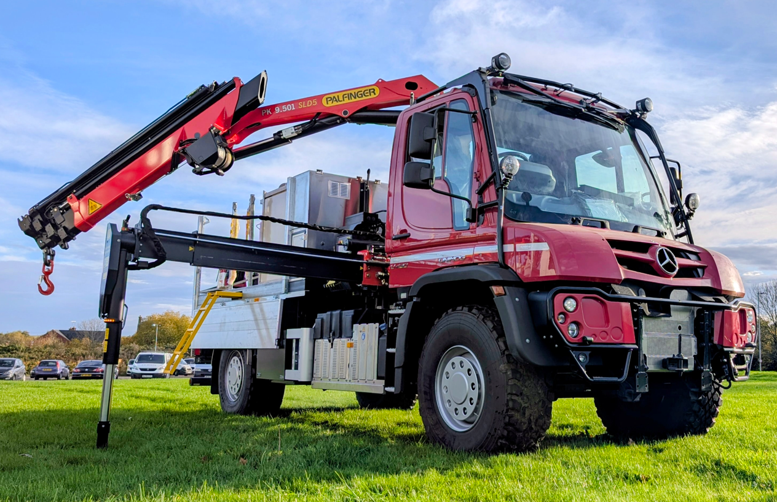
Fleet and equipment services
ATRU
A replacement All Terrain Rescue Unit (ATRU) is due for delivery in July 2026.
The ATRU will provide water supply, winching and heavy‑lifting capability at off‑road incidents.
Introduction of modern cordless power tools and lighting provides lighter, more portable and safer equipment.
Equipment selection has been informed by firefighter feedback and analysis of incident data.
New Fire Engines
Contract awarded to E1 for new appliances in April with first delivery expected in July 2027.
Based on an 18tonne chassis with 5-star direct vision standard, between 1,750 and 3,300 litres of water and improved welfare for colleagues such as air conditioning, fridge for water and contaminated PPE separation.

Slide 13
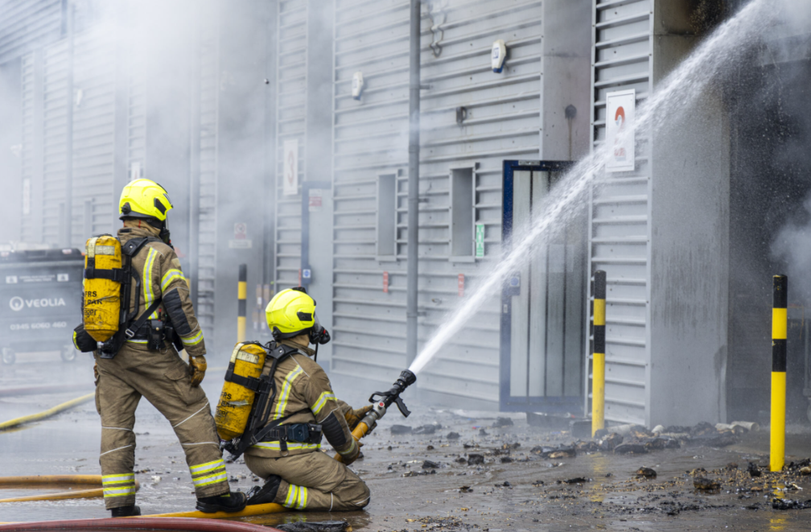
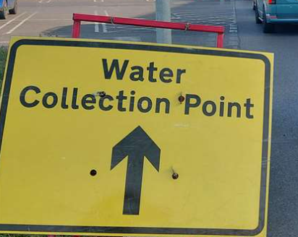
Resilience
Summer Preparedness
Regular meetings have been held internally and with key stakeholders, including the Met Office, to prepare for the wildfire season and the wider summer period.
This has included raising awareness across the Service, alongside the review and update of relevant guidance (Summer Guidance) and response plans (Severe Weather Response Plan).
In collaboration with the Kent and Medway Resilience Forum (KMRF), KFRS colleagues, trade unions, and the voluntary sector, a plan is currently being developed to strengthen how colleague welfare is supported and delivered at operational incidents.
Water Disruption
The County continues to experience multiple periods of water disruption, which has needed the activation of external command and control arrangements.
Ongoing engagement with water companies, through regular meetings, has enabled the sharing of key data to support effective planning and response to operational incidents across Kent and Medway.
Some key learning from the earlier outages (November/December 2025) has been embedded within the response, although it is recognised that there are still gaps in the information shared by Water Companies during a disruption.
Incident/Event Response
Several incidents/events has seen the Service stand up their enhanced Command, Control & Communications (C3C) procedures recently, these include business continuity events, critical incidents, and building safety enforcement activity.

Slide 14
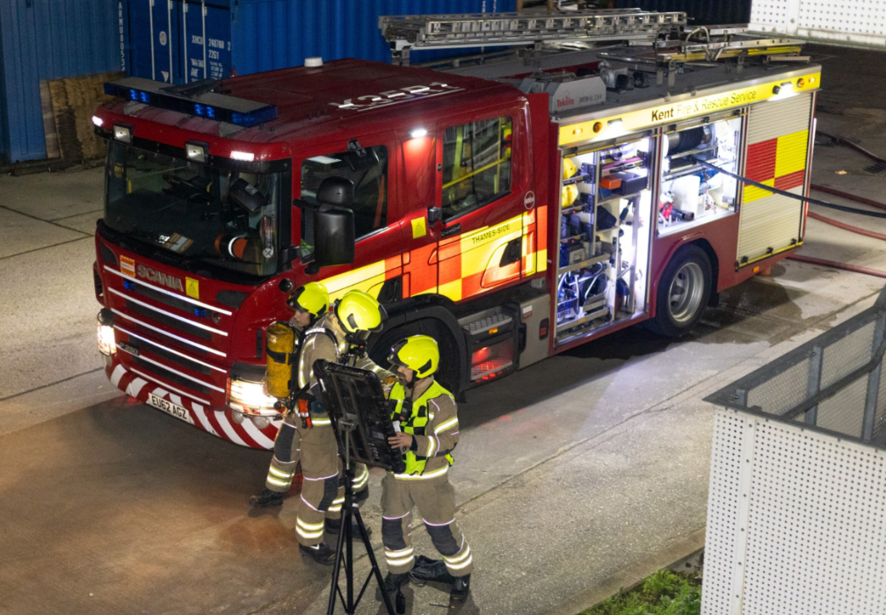
Resilience through exercises​
KFRS participated in 160 Exercises during 2025/2026.
47 of these exercises involved multi-agency partners (Kent Police, SECAmb, Local Authority)
23 Where undertaken with neighbouring/other Fire & Rescue Services as part of our cross-border arrangements or through National Resilience (NR).
A number of the exercises included colleagues from Ministry of Housing, Communities & Local Government (MHCLG) ​
To date, 25 exercises have been delivered and 43 booked/planned for 2026/2027 to date. ​
So far in 2026, we have attended 26 high-risk sites across the County to raise awareness and ensure colleagues are familiar with the site-specific plans for each of the premises.

Slide 15
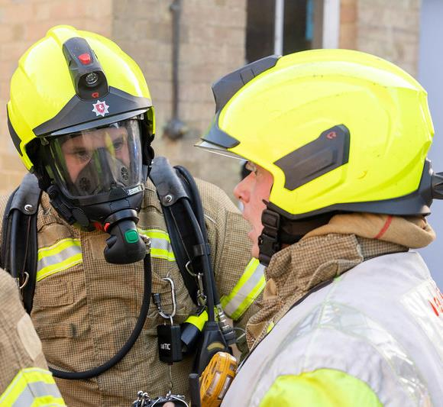
Assurance and professionalism
The new Organisational Learning Register now triages learning submissions and tracks the learning lifecycle from analysis and evaluation through to assurance against the desired outcomes.
The new Organisational Standards Framework is now used to evaluate operational performance at incidents, identifying areas of good practice and areas that offer the opportunity to enhance performance for deeper exploration through the structured debrief process.
The new Command Review process provides a safe psychological space for incident commanders to share their lived experiences of incident command in a reflective environment, Command Review outcomes are shared with the Incident Command team to influence and support Incident Command training.
The new On Scene Debrief form enables colleagues to provide direct incident feedback, identifying what went well and what not so well, helping to shape a better understanding of how we perform at operational incidents.
Continue to collect data in order to refine our operational approach to RTC’s in light of advancements in modern vehicle design.
Continue to collect data regarding incidents involving Lithium Ion batteries. This ranges from small domestic battery appliances to Electric vehicles and incidents at waste sites. This is to inform future practice as to how best resolve incidents involving LI batteries.
As KFRS has invested in new Wildfire equipment, we will assure how it is being used by operational crews at wildfire incidents.
To ensure we stations are delivering good prevention advice we will Quality Assure 100 Home Fire Safety Visit’s completed by operational crews.

Slide 16
D. Protection, Prevention and Engagement update
June 2026
For further information: please contact
Leanne McMahon, Director – Protection, Prevention and Customer Engagement

Slide 17
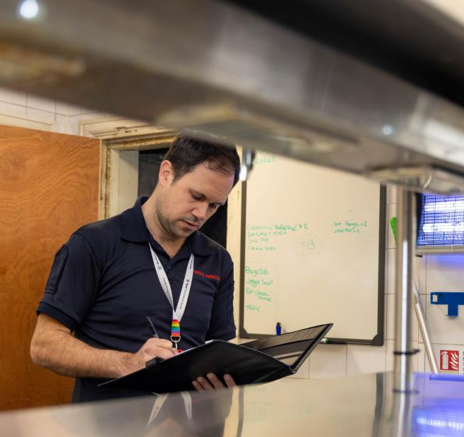
Building Safety
As we enter the second year of our 2025 - 2028 Risk-Based Intervention Programme (RBIP), audit outcomes are demonstrating a clear positive impact of our interventions on the safety of the built environment.
We are developing our RBIP further to include people, places, and spaces, creating a direct link to our CRMP. This aligns the approaches of Operations, Building and Customer Safety, and our wider engagement strategy. We are one of the first Fire and Rescue Services to adopt this integrated approach.
We work closely with Essex FRS using a reciprocal peer review approach to share learning, challenge practice and support continuous improvement across both services.

Slide 18

Building Safety
Work is continuing with Ministry of Housing, Communities and Local Government (MHCLG) and local authorities to address the premises within Kent and Medway requiring remediation.
Following summarising our approach to remediation, MHCLG approved £110k of New Burdens funding for this fiscal year to create a dedicated temporary post to lead this workstream for KFRS.
We are continuing to support the Building Safety Regulator (BSR) - two temporary funded colleagues in post until January 2027.

Slide 19
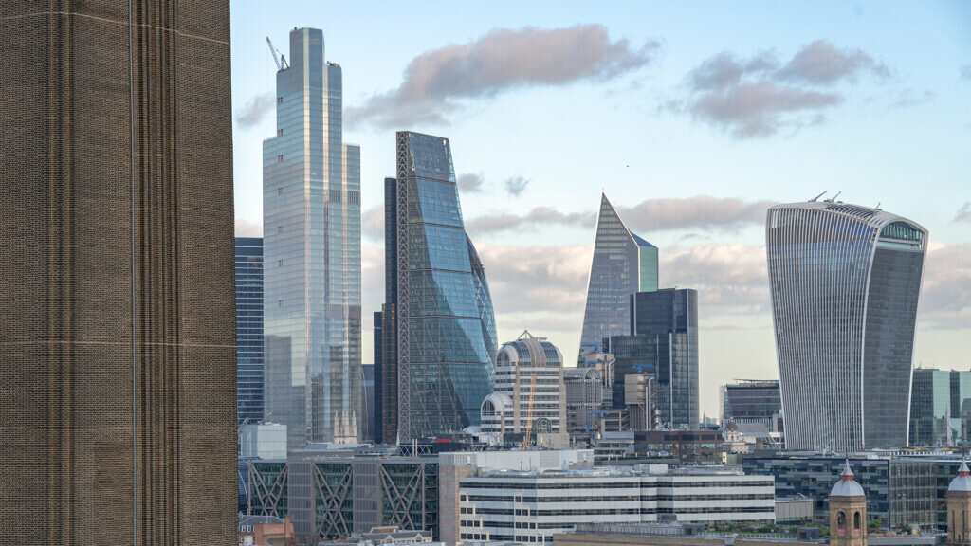
Building Safety – New Regulations
Building Safety delivered the Fire Safety (Residential Evacuation Plans) (England) Regulations 2025 rollout and training following the launch on 6 April 2026 across the organisation, which included:
Responsible Person webinars
Operational Crew seminars
On-Call seminars
FRCC training sessions
Officer and Inspector CPD training sessions
Exercise scheduled at a vacant 7-storey HRRB incorporating practical training on the new regulations

Slide 20
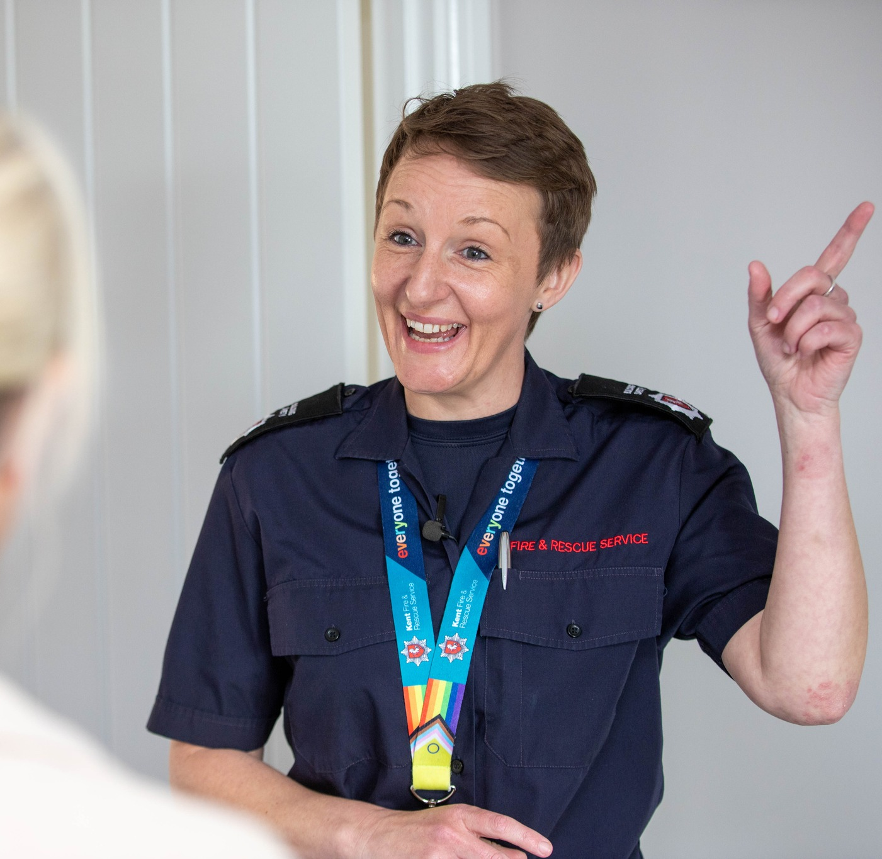
Building Safety
We are continuing to deliver the Skills For Justice Level 2 Award in Fire Safety to operational colleagues.
All Building Safety colleagues have either completed or are currently undertaking the Fire Safety Level 4 Diploma, with all training needs continuing to be funded through the Protection Uplift Grant.
We are also undertaking specialist training, including the Level 5 Diploma in Fire Engineering. This demonstrates full alignment with the competency framework for fire safety regulators.

Slide 21


Enforcement
Prohibition Notices (PN) (79):
This is our most significant category. Almost two-thirds of all actions were for immediate risk to life or safety. To address the risk, the responsible person was required to stop using all or part of the building for that activity straight away.
Enforcement Notices (EN) (22):
These represent cases where a breach of regulations was identified. Formal improvements or remedies have been legally mandated within a set timeframe.

Slide 22
Enforcement
Current Enforcement Activity:
Alterations Notices (AN) (17 / 14%):
These notify duty holders that any planned changes to their premises, processes, or high-risk areas must be reported to the authority beforehand, indicating ongoing close monitoring of these sites.
Other investigations (3):
There are 3 specific properties operating outside standard Alteration (AN), Enforcement (EN), or Prohibition (PN) notices. These require separate administrative or investigative oversight:
Mill House
Conqueror House
Luton Road

Slide 23
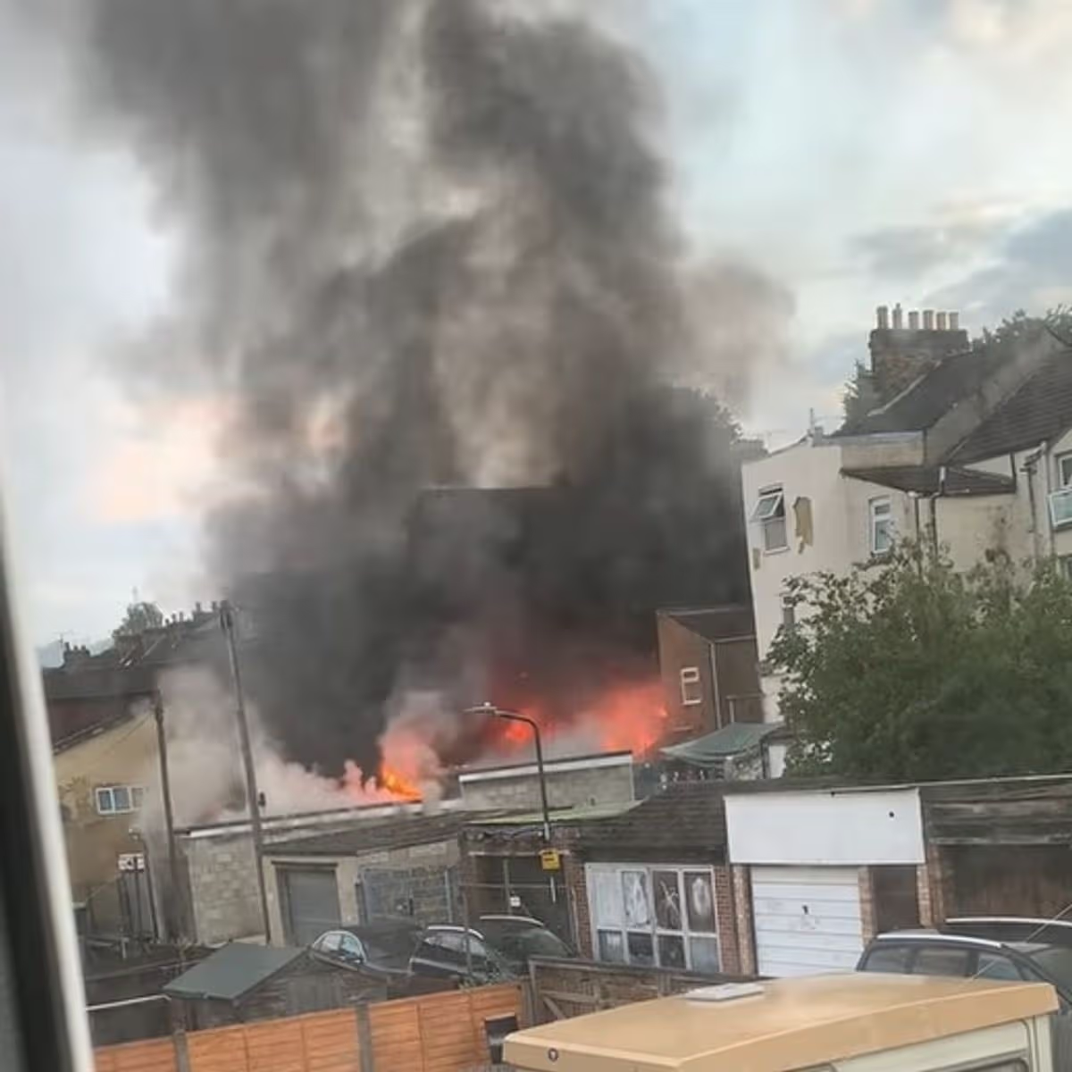
Enforcement
Other investigations (3):
Luton Road
The Luton Road fire in Chatham, Kent, occurred on the morning of July 20, 2023. It was a significant emergency response incident involving both commercial and residential property.
The fire broke out shortly before 6:00 AM near the junction of Luton Road and Bank Street.

Slide 24
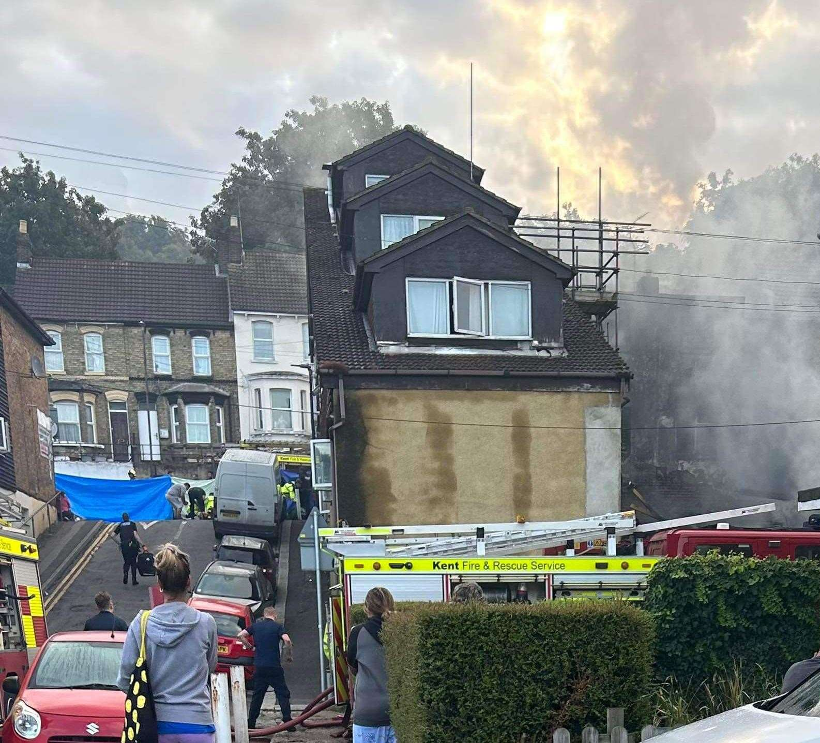
Enforcement
Other investigations (3):
Luton Road
The blaze initially started at the rear of a commercial premises and rapidly spread into the adjoining building and neighbouring residential flats. Firefighters wearing breathing apparatus successfully rescued a woman and two children from one of the affected properties. Where life saving emergency first aid was administered.
The responsible person following a investigation was issued a with a simple caution by KFRS, this is a successful prosecution, and forms a Criminal Record. It is a formal admission of criminal liability and is recorded on the Police National Computer (PNC) system.

Slide 25
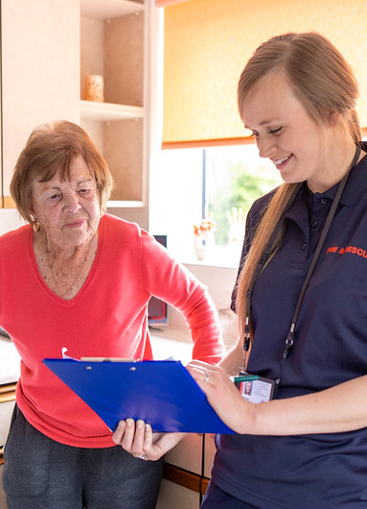
Customer Safety
KFRS has recently completed an evaluation of Home Fire Safety Visits. The evaluation assessed the top three safety behaviours by measuring how well residents remembered advice and whether they changed their actions following a visit.
Customer safety teams are providing additional training to operational colleagues to ensure all visits meet the required competencies for person-centred care.
We are currently trialling the delivery of Home Fire Safety Visits with on-call stations to expand our reach and community engagement.
We are introduced an improved quality assurance (QA) programme to measure Home Fire Safety Visits carried out by station based colleagues. KFRS are part of a National Fire Chiefs Council group developing a national QA framework and guidance.

Slide 26
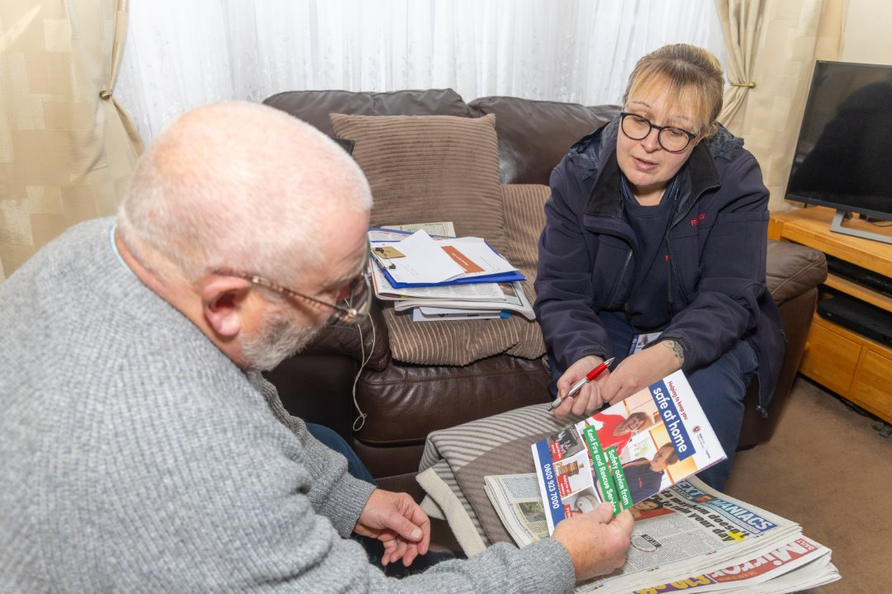
Safeguarding
KFRS worked with the Kent and Medway Safeguarding Adults Board (KMSAB) to review its protection and support for adults at risk.
The self-assessment framework included peer reviews with partner agencies to ensure lessons from Safeguarding Adult Reviews are embedded into training and procedures.
The review highlighted KFRS's business continuity processes for safeguarding as a particularly effective area of work.

Slide 27

Community Intelligence
and Partnerships
KFRS FRS is the National Fire Chiefs Council lead for derelict buildings and is coordinating a multi-agency group, in line with the national framework, to standardise interventions for arson and anti-social behaviour. The work is being delivered in collaboration with organisations including Historic England.
We are trialling a new standardised data collection form across several fire stations to improve the quality and consistency of information gathered on high-risk groups. This will provide stronger insights, enabling better informed decision making and risk planning.

Slide 28
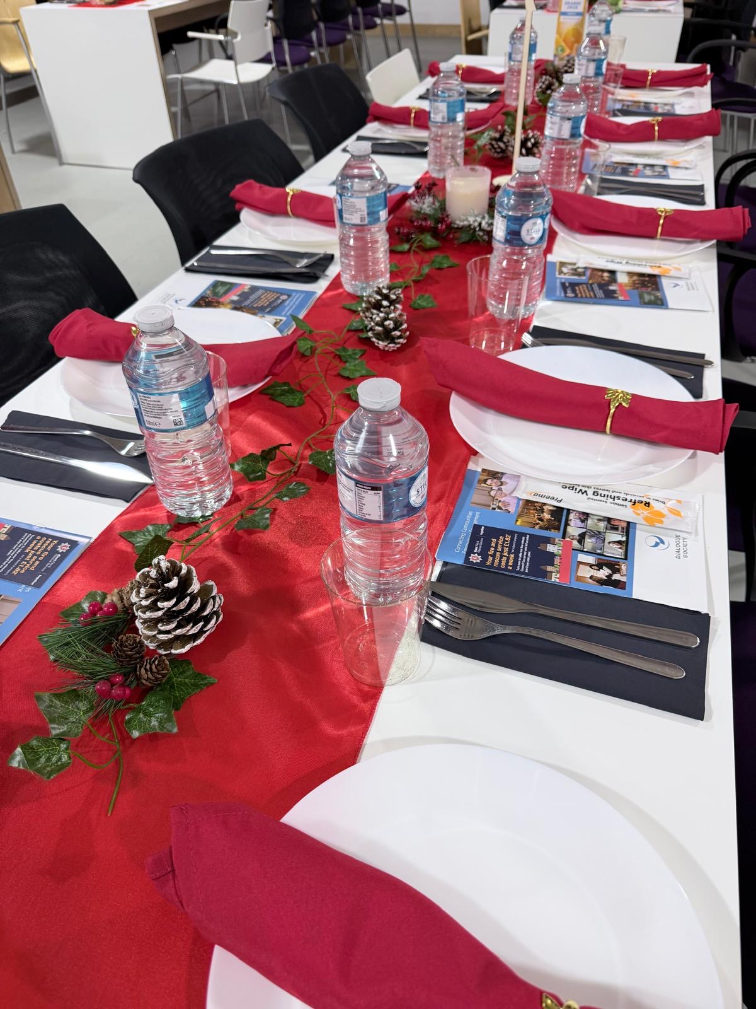
Community Intelligence
and Partnerships
We are working with rural communities and landowners to map wildfire risks and promote ETHANE messaging. This provides a structured framework for sharing critical incident data—covering Exact location, Type of incident, Hazards, Access, Number of casualties, and Emergency services required to ensure a fast and coordinated response.
Reviews of our open day and water safety events are complete; we are now evaluating our education programme and have conducted 14 community visits regarding the rural plan.
Working alongside multi-agency partners, we completed a joint evaluation of the Napier Barracks closure. This collaborative model will now be shared nationally as an example of best practice.

Slide 29
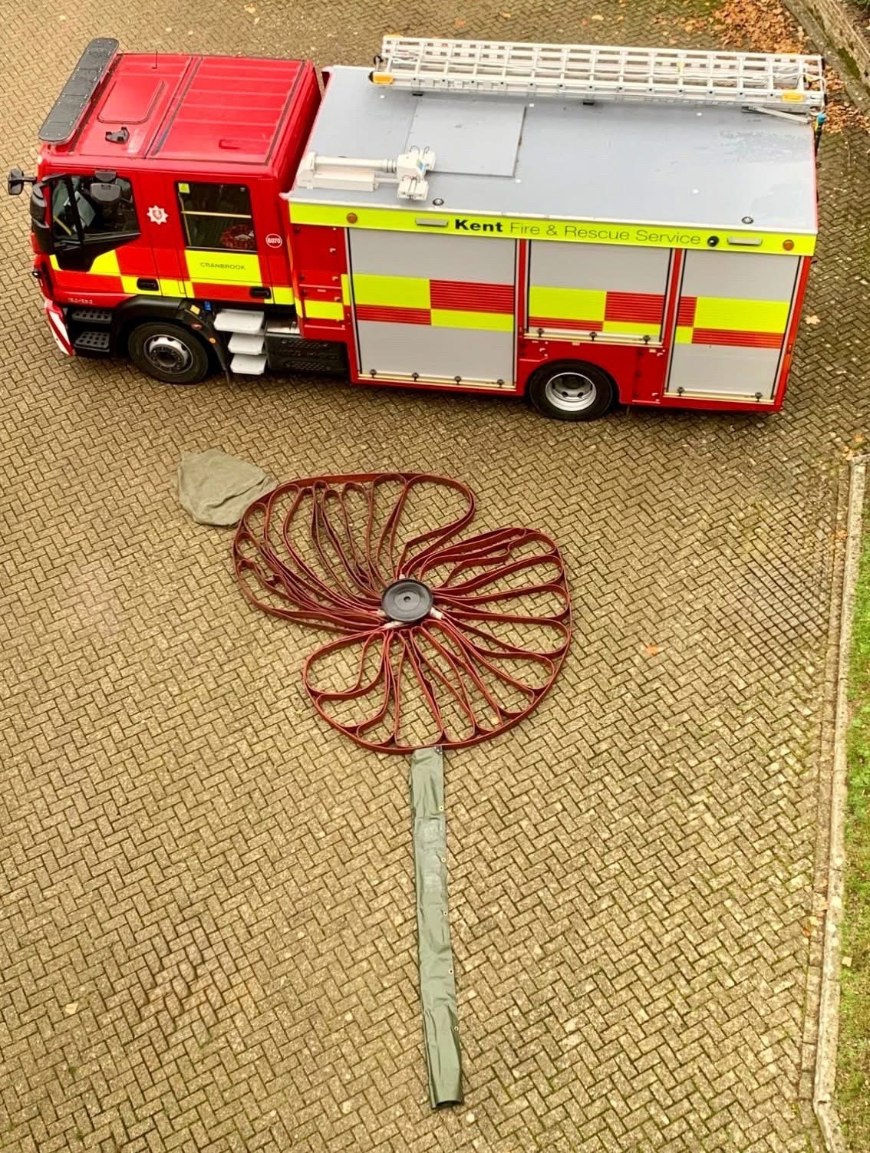
Communications and Marketing
COMPLETED
We've relaunched our water safety campaign, Make the Right Call, to educate the public to call 999 for the fire service for inland water rescues. A wildfire prevention campaign will go live in June, focusing on responsible disposal of smoking materials, and taking care with disposable barbecues and bonfires.
We're leading on the development of a county-wide partnership campaign with local authorities, about safe disposal of rechargeable lithium-ion batteries to reduce fires.
We've added a new, streamlined translation tool to the public website which is more compliant with accessibility regulations, providing a better user experience.

Slide 30
Communications and Marketing
We've published spring and summer editions of 'Response' magazine for operational colleagues – showcasing learning from incidents and internal innovation.
Improvements are being made to all internal communication and engagement channels to ensure effective communications to colleagues, including a new intranet.
KFRS social media channel continues to grow at pace, with significant engagement on video content across TikTok and Instagram in recent months.
The team continues to work to protect the reputation of the service, media train operational colleagues, and secure media coverage for incidents, case studies, and good news stories.
COMPLETED

Slide 31
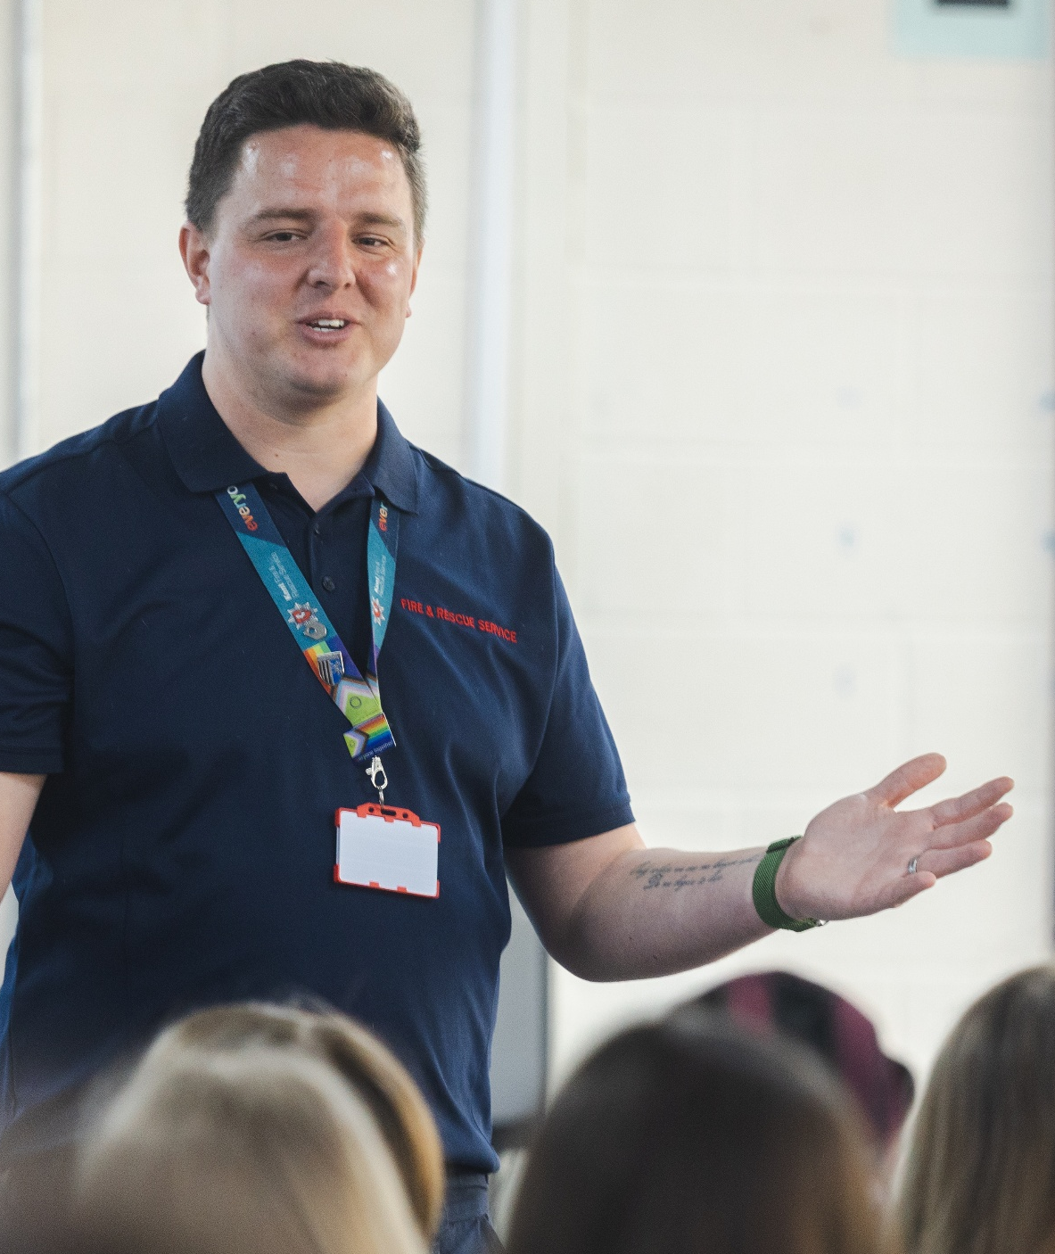
Education
From September 2025 – April 2026 the Education Team have delivered key fire safety education to 326 schools, 200 fire safety interventions to young people, 75 fire safety talks to community groups and supported the delivery of education at events.
A new Fire Cadet cohort was launched at Sheerness Fire Station in March 2026 welcoming 12 young people from the local area to join the 40 week Level 1 programme. This initiative was funded by the National Fire Chiefs Council by the Uniformed Services Grant and sees Fire Cadets running from an increased total of three locations in the county (Ramsgate, Rochester and Sheerness).

Slide 32

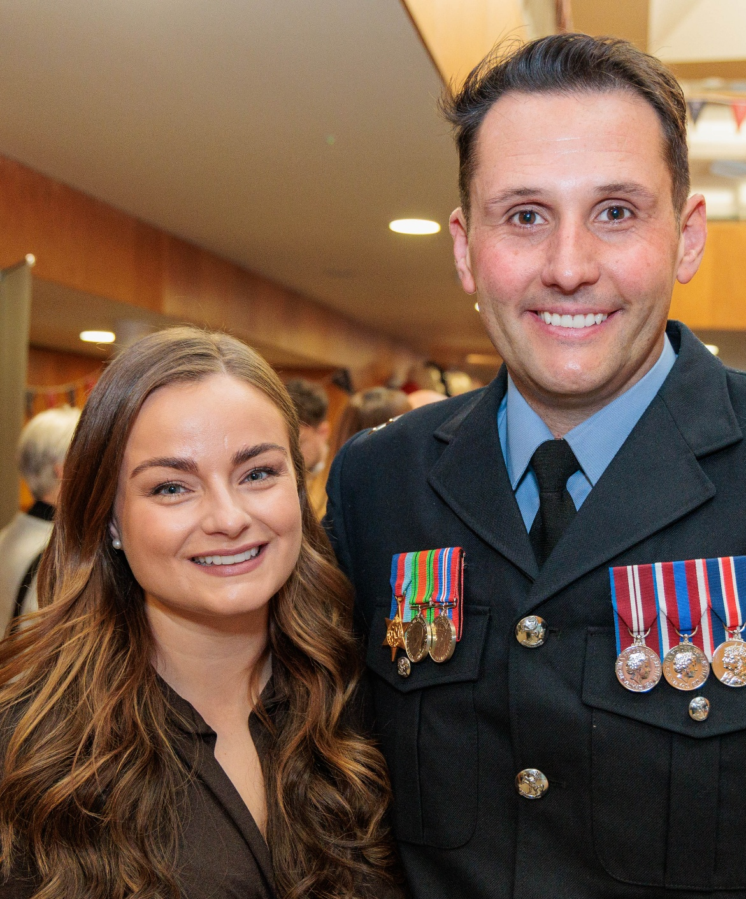
Events
Station based Fire Safety Family events will take place in Sevenoaks on the 28th and 29th July 2026. Aimed at children aged 3 – 7 years and their families. The event will be a fun, interactive and engaging way of promoting safer behaviours
Attendance at water safety events in key areas of the county are being prioritised in line with risk and will support the delivery of the Make the Right Call campaign
An online learning experience to support people who can’t make our physical events will launch in May 2026.
Looking ahead, the events team are focused on developing a winter roadshow – a series of community-based events – focusing on fire safety in the home for those living in rural communities

Slide 33
E. Customer Feedback Annual Update
June 2026
For further information please contact:
Amy Checksfield, CMB Support Officer

Slide 34
Compliments received in 2025/26
Year | Number of compliments received
2022-23 | 129
2023-24 | 129
2024-25 | 118
2025-26 | 103
Customers are actively encouraged, via surveys, to provide feedback on the services they have received from the Authority.
The number of compliments received has reduced by 15 this last financial year. However, it is important to note that the Authority continues to receive far more compliments than complaints (103 versus 55 respectively).
Operational incidents continue to make up most compliments (63 in total) with Safe and Well Visits, open days, and general thanks to KFRS also attracting compliments.
It is pleasing to note the comments received of colleagues going above and beyond to meet or exceed customers’ needs and expectations.

Slide 35
Complaints received in 2025/6
Year | Number of complaints received
2022-23 | 44 | 23 founded | 21 unfounded
2023-24 | 59 | 38 founded | 21 unfounded
2024-25 | 52 | 27 founded | 25 unfounded
2025-26 | 55 | 14 founded * 8 partially founded | 31unfounded * 2 withdrawn
The number of complaints slightly increased in 2024/25. The number of founded complaints continues to remain very low for an Authority of this size.
As with previous years, the most frequent reason for a founded complaint continues to be driving and there are no other trends that can be identified from the low number of complaints.
Whilst all complainants are still encouraged to submit complaints in writing this is no longer a requirement to ensure the process is fully accessible to everyone.
We are also further reviewing the customer website to ensure that it is as easy as possible for customers to submit their feedback.
No complaints went to appeal stage in 2025/26 this is a reduction from 3 in 2024/25.
Annual letter for 2025/26 from Local Government and Social Care Ombudsman confirmed no complaints received by them about KFRS.

Slide 36
Other customer feedback
Home Fire Safety Visits
Customers receiving a Safe and Well or Home Fire Safety visit are asked for feedback on the services they received.
This feedback is discussed regularly with the Team Leaders within the Safe and Well Team to support continuous improvement.
Any areas for learning and improvement are reviewed and shared with members of the Prevention team and firefighters.

Slide 37
Home Fire Safety Visits
The information within Tables 3, 4 and 5 shows an incredibly high levels of satisfaction.
Overall satisfaction | Very happy | Happy | Other
2025/26 | 815 (96%) | 28 (3%) | 2 (0%)
2024/25 | 1,170 (92%) | 77 (6%) | 20 (2%)
2023/24 | 961 (96%) | 36 (4%) | 5 (0%)
NPS | Detractors | Passives | Promoters | Average NPS
2025/26 | 5 | 15 | 825 | 97
2024/25 | 24 | 64 | 1167 | 91
2023/24 | 9 | 27 | 966 | 96
Feeling safer | Yes | No or unsure
2025/26 | 831 (98%) | 14 (10%)
2024/25 | 1226 (95%) | 59 (5%)
2023/24 | 971 (97%) | 31 (3%)

Slide 38
Following an incident
Customers involved in an incident that Kent Fire and Rescue Service has attended are asked for feedback on the service they have received.
The information received is discussed regularly with the Professional Standards team as well as operational response colleagues and is used to support continuous improvement.
A summary of the main findings is included in Tables 6, 7, 8 and 9 on the next slide which shows a high level of satisfaction. The figures are low, and we have developed a marketing and outreach plan to increase meaningful feedback.

Slide 39

Overall satisfaction | Very happy | Happy | Very unhappy | Other
2025/26 | 8 (100%) | 0 (0%) | 0 (0%) | 0 (0%)
2024/25 | 21 (81%) | 3 (11.5%) | 1 (3.8%) | 1 (3.8%)
Effects of incident | Yes | No | Unhappy | Don’t know
2025/26 | 7 (100%) | 0 (0%) | 0 (0%) | 0 (0%)
2024/25 | 14 (77.8%) | 0 (0%) | 4 (22.2%) | 0 (0%)
 | Quicker than I expected | As quickly as I expected | I had no expectations | Slower than expected | I don’t know how quickly they arrived
2025/26 | 4 (57.14%) | 2 (28.57%) | 0 (0%) | 1 (14.29%) | 0 (0%)
2024/25 | 13 (68.4%) | 2 (10.5%) | 3 (15.8%) | 1 (5.3%) | 0 (0%)
NPS | Detractors | Passives | Promoters | NPS score
2025/26 | 0 (0%) | 0 (0%) | 7 (100%) | 0 (0%)
2024/25 | 1 (4%) | 0 (0%) | 23 (96%) | 92

Slide 40
F. Ministry of Housing, Communities & Local Government Productivity and Efficiency Plan for Fire and Rescue Authorities
June 2026
For further information please contact:
Barrie Fullbrook, Director of Finance

Slide 41
Sections 4.6 and 5.3 of the Fire and Rescue National Framework for England require that fire and rescue authorities publish an annual efficiency plan (now called a ‘Productivity and Efficiency Plan’).
In 2026, responsibility for coordinating these annual plans moved from the Home Office to the Ministry of Housing, Communities & Local Government (MHCLG), who issued updated guidance about how they are to be prepared.
KFRS has prepared the Productivity and Efficiency Plan April 2026 in accordance with the new guidance and submitted it to MHCLG in line with their deadline of 30 April 2026.
Link to location on KFRS website:
Productivity and Efficiency Return - April 2026

Slide 42
G. Carbon Reduction Update (Fleet)
Update on progress
June 2026
For further information please contact:
Matt Deadman, Director – Response and Resilience

Slide 43
Carbon Produced by Vehicle Fuel

Slide 44
2025/26 Actions to Reduce Fuel Carbon Emissions
Replacement of ten 2012 plate pool cars, diesel Vauxhall Astra, Euro emissions standard 5 with hybrid Toyota Corolla, emissions standard 6. This will save approximately 18 tonnes of CO² per annum
Replacement of two 21-year-old Driver Training vehicles, Scania CP31 Euro emissions standard 3, with Scania CP28 Euro 6 emissions standard. This will save approximately 25 tonnes CO² per annum
Issue of tyre pressure gauges to all pool cars to ensure tyres are kept at the correct pressures to minimise poor fuel consumption

Slide 45
2026/27Plan to Reduce Carbon Emissions
Replacement of nine 2012 plate pool cars, diesel Vauxhall Astra, Euro emissions standard 5 with hybrid Toyota Corolla, emissions standard 6. This will save approximately 16 tonnes of CO² per annum
Trial of HVO in SHQ fuel tank for Response Vehicles. Estimated CO² saving of 31 tonnes per annum
Contract signed for new appliances (up to 41 over next five years) that will be Euro 6/7 compliant saving approximately 400 tonnes of CO² per annum when fully delivered

Slide 46
H. Freedom of information request update
May 2026
For further information please contact:
Kirsty Driver, Information Officer

Slide 47
Freedom of Information update 2026/27
*Q1 currently only covers the period from 01/04/2026 to 16/06/2026 as this is the only data available at the time of completing the report.
**Although this is not a requirement in the Cabinet Office Code of Practice for Freedom of Information Requests 2018, it is reported to Members as part of our commitment to transparency and good governance.
.
Total information requests to year to date = 295 (including FOI, SAR, EIR, partner agencies, incident reports and general information) | 2026/27
 | Q1 | Q2 | Q3 | Q4 | Total
The number of FOI requests received during the period | 56 |  |  |  | 25
The number of the received requests that have not yet been processed | 23 |  |  |  | 10
The number of the received requests that were processed in full | 33 |  |  |  | 15
The number of requests where the information was granted in full | 14 |  |  |  | 8
The number of requests where the information was refused in full | 6 |  |  |  | 2
The number of requests where the information was granted in part and refused in part | 7 |  |  |  | 3
The number of requests received that have been referred for internal review | 2 |  |  |  | 0
Number of data subject access requests** | 4 |  |  |  | 0

Slide 48
Freedom of Information end of year update 2025/26
**Although this is not a requirement in the Cabinet Office Code of Practice for Freedom of Information Requests 2018, it is reported to Members as part of our commitment to transparency and good governance.
Total information requests 2025/26 = 1042 (including FOI, SAR, EIR, partner agencies, incident reports and general information) | 2025/26
 | Q1 | Q2 | Q3 | Q4 | Total
The number of requests received during the period | 44 | 50 | 38 | 52 | 184
The number of the received requests that have not yet been processed | 0 | 0 | 0 | 0 | 0
The number of the received requests that were processed in full | 44 | 50 | 38 | 52 | 184
The number of requests where the information was granted in full | 21 | 27 | 19 | 24 | 91
The number of requests where the information was refused in full | 8 | 5 | 6 | 3 | 22
The number of requests where the information was granted in part and refused in part | 15 | 16 | 9 | 15 | 55
The number of requests received that have been referred for internal review | 0 | 0 | 0 | 2 | 2
Number of data subject access requests** | 1 | 7 | 8 | 12 | 28

Slide 49
I. Pensions and Pension Board meeting update
June 2026
For further information please contact:
Matt Deadman, Director – Response and Resilience

Slide 50
In accordance with Public Service Pensions Act 2013, the Authority established a Pension Board for Firefighters’ Pension Schemes.
Board comprises representatives of both the employer and employees.
To ensure Members are kept informed, and provide assurance of compliance with the Act, minutes of the Pension Board meetings are routinely reported to the Authority.
The agendas and minutes for all Pension Board meetings are published on the Authority’s website.
The latest agreed minutes of the Pension Board meeting held on 10/12/2025 can be viewed here https://www.kent.fire-uk.org/pension-board
Next Pension Board meeting will be 29th June.
We are reviewing the Pension Board Terms of Reference and Pensions Policy. These will be presented to the Authority for Approval in October.

Slide 51
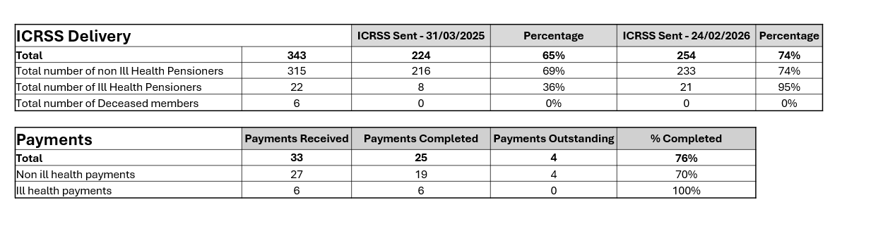
Current McCloud RSS Position
LPPA have advised that letters have been issued to all those who have yet to receive an RSS or IC-RSS to confirm the reasons for the delay and the next steps.

Slide 52
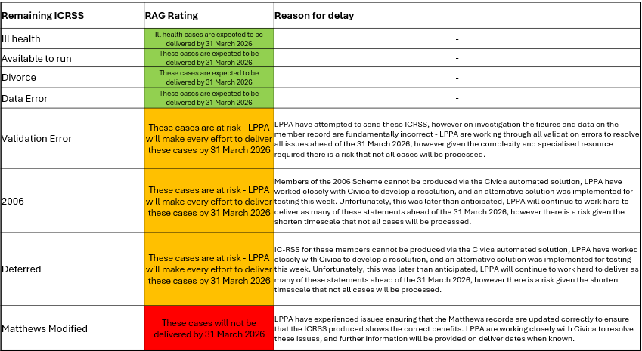
LPPA have advised that letters have been issued to all those who have yet to receive an RSS or IC-RSS to confirm the reasons for the delay and the next steps.

Slide 53
Current McCloud Position
Bereavement cases that require an IC-RSS are scheduled for production by the end of June 2026.
Prioritising any remedy cases that require an immediate payment,.
Data and Feedback suggests that LPPA remains ahead of the national position regarding remedy implementation.
LPPA remain positive that all outstanding IC-RSS ill health cases will be produced for impacted members by the 31 March 2026. IC-RSS production for some non-ill health members continues to be constrained by a combination of factors, including:
Legacy data quality issues and the effort required to amend or correct member records to allow calculations to be run.
Delayed guidance which has affected several member cohorts.
Manual cases where the complexity has made software solution impractical.
Civica software defects and the late delivery of software.
As a result, some outstanding IC-RSS are now at risk of not being delivered by 31 March 2026.
LPPA reassures clients they remain focused on producing as many outstanding IC-RSS as possible, ahead of the 31 March 2026.
Further system testing will enable LPPA to provide a further update on progress mid-March 2026, at which time LPPA will also contact at-risk members (those who will not receive an ICRSS by the end of March) to apologise and inform them of the further delay.
Payroll and Pensions Team have sat down with LPPA to discuss next steps if the risk becomes a reality, we are clear on our reporting to TPR requirements and confident this will be communicated to members effectively by LPPA.

Slide 54
Matthews Progress
225 pensioners are now on the pensioners payroll and receiving their pension. 35 pensioners have not yet been processed are either waiting for member retirement forms to be sent back to LPPA, LPPA requiring clarification on how process (interactions with McCloud / conversions / deaths since election)
Processed 627 of 631 EOIs. Remaining 4 referred to GAD. Processed 476 of 476 positive elections forms
All active and deferred records for Matthews have been set up on the LPPA portal on our side, all statements and election forms have been processed and uploaded.
LPPA are currently prioritising pensioners and active members who are turning 60 and wish to retire, once these priority cases are complete, they will be working on updating PensionPoint to allow the pension to be viewable by active and deferred members.

Slide 55
Q3 - Client Report from LPPA
Overall Operational Casework Performance was 99.1%, this is still above 95% target but as it is usually 100% we have questioned this. They explained it was due to higher levels of unexpected long-term sickness. Steps have been put in place to remedy the issues, and they expect to be back to 100% by Q4.
Contact Centre performance average call wait time was 3 minutes and 04 Seconds.
6 complaints received (3 carried over from last quarter), 2 upheld and 3 not upheld and 1 carried forward,
1 ongoing IDRP with LPPA.

Slide 56
Pension Dashboard Update
Advised in previous Pension Board that we report a delay to The Pensions Regulator (TPR) regarding a delay in connecting to Pensions Dashboards.
17th December – LPPA confirmed the retest had been successful and the schemes were now confirmed as actively connected to the Pensions Dashboard.
18th December – Emailed TPR to confirm we were now connected.
23rd December – TPR confirmed that they have checked their records, and the status was confirmed as ‘Connected’. Case closed with TPR.
Work is ongoing with Pensions Dashboards at LPPA to ensure data is cleansed for public launch. Expected late 2026/early 2027.

Slide 57
Contribution Structure Changes
Wef 1 April 2026 there are changes to FPS 2015 Contribution Structure main changes include:
An increase from 4 to 5 bandings
Changes to the earnings thresholds for each banding
A change from assessing Wholetime equivalent earnings to actual earnings.
Changes to the employee contribution percentage rates

Slide 58
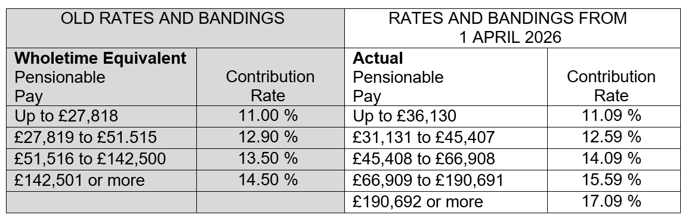
Contribution Structure Changes

Slide 59
Contribution Structure Changes
As contribution bandings will be based on actual pensionable pay from 1 April 2026, all on-call colleagues will be placed in the lowest banding from this date (11.09%).
An earnings assessment will be undertaken annually on 1 April which will determine the contribution rate for the year.
A contribution banding will be adjusted in year if a permanent material change is identified in your pensionable pay (e.g. Promotion, Demotion, Loss of Allowance or pay award).
Earnings (pensionable pay) thresholds will increase with CPI on 1 April each subsequent year using the CPI from September of the previous year.

