Slide 1
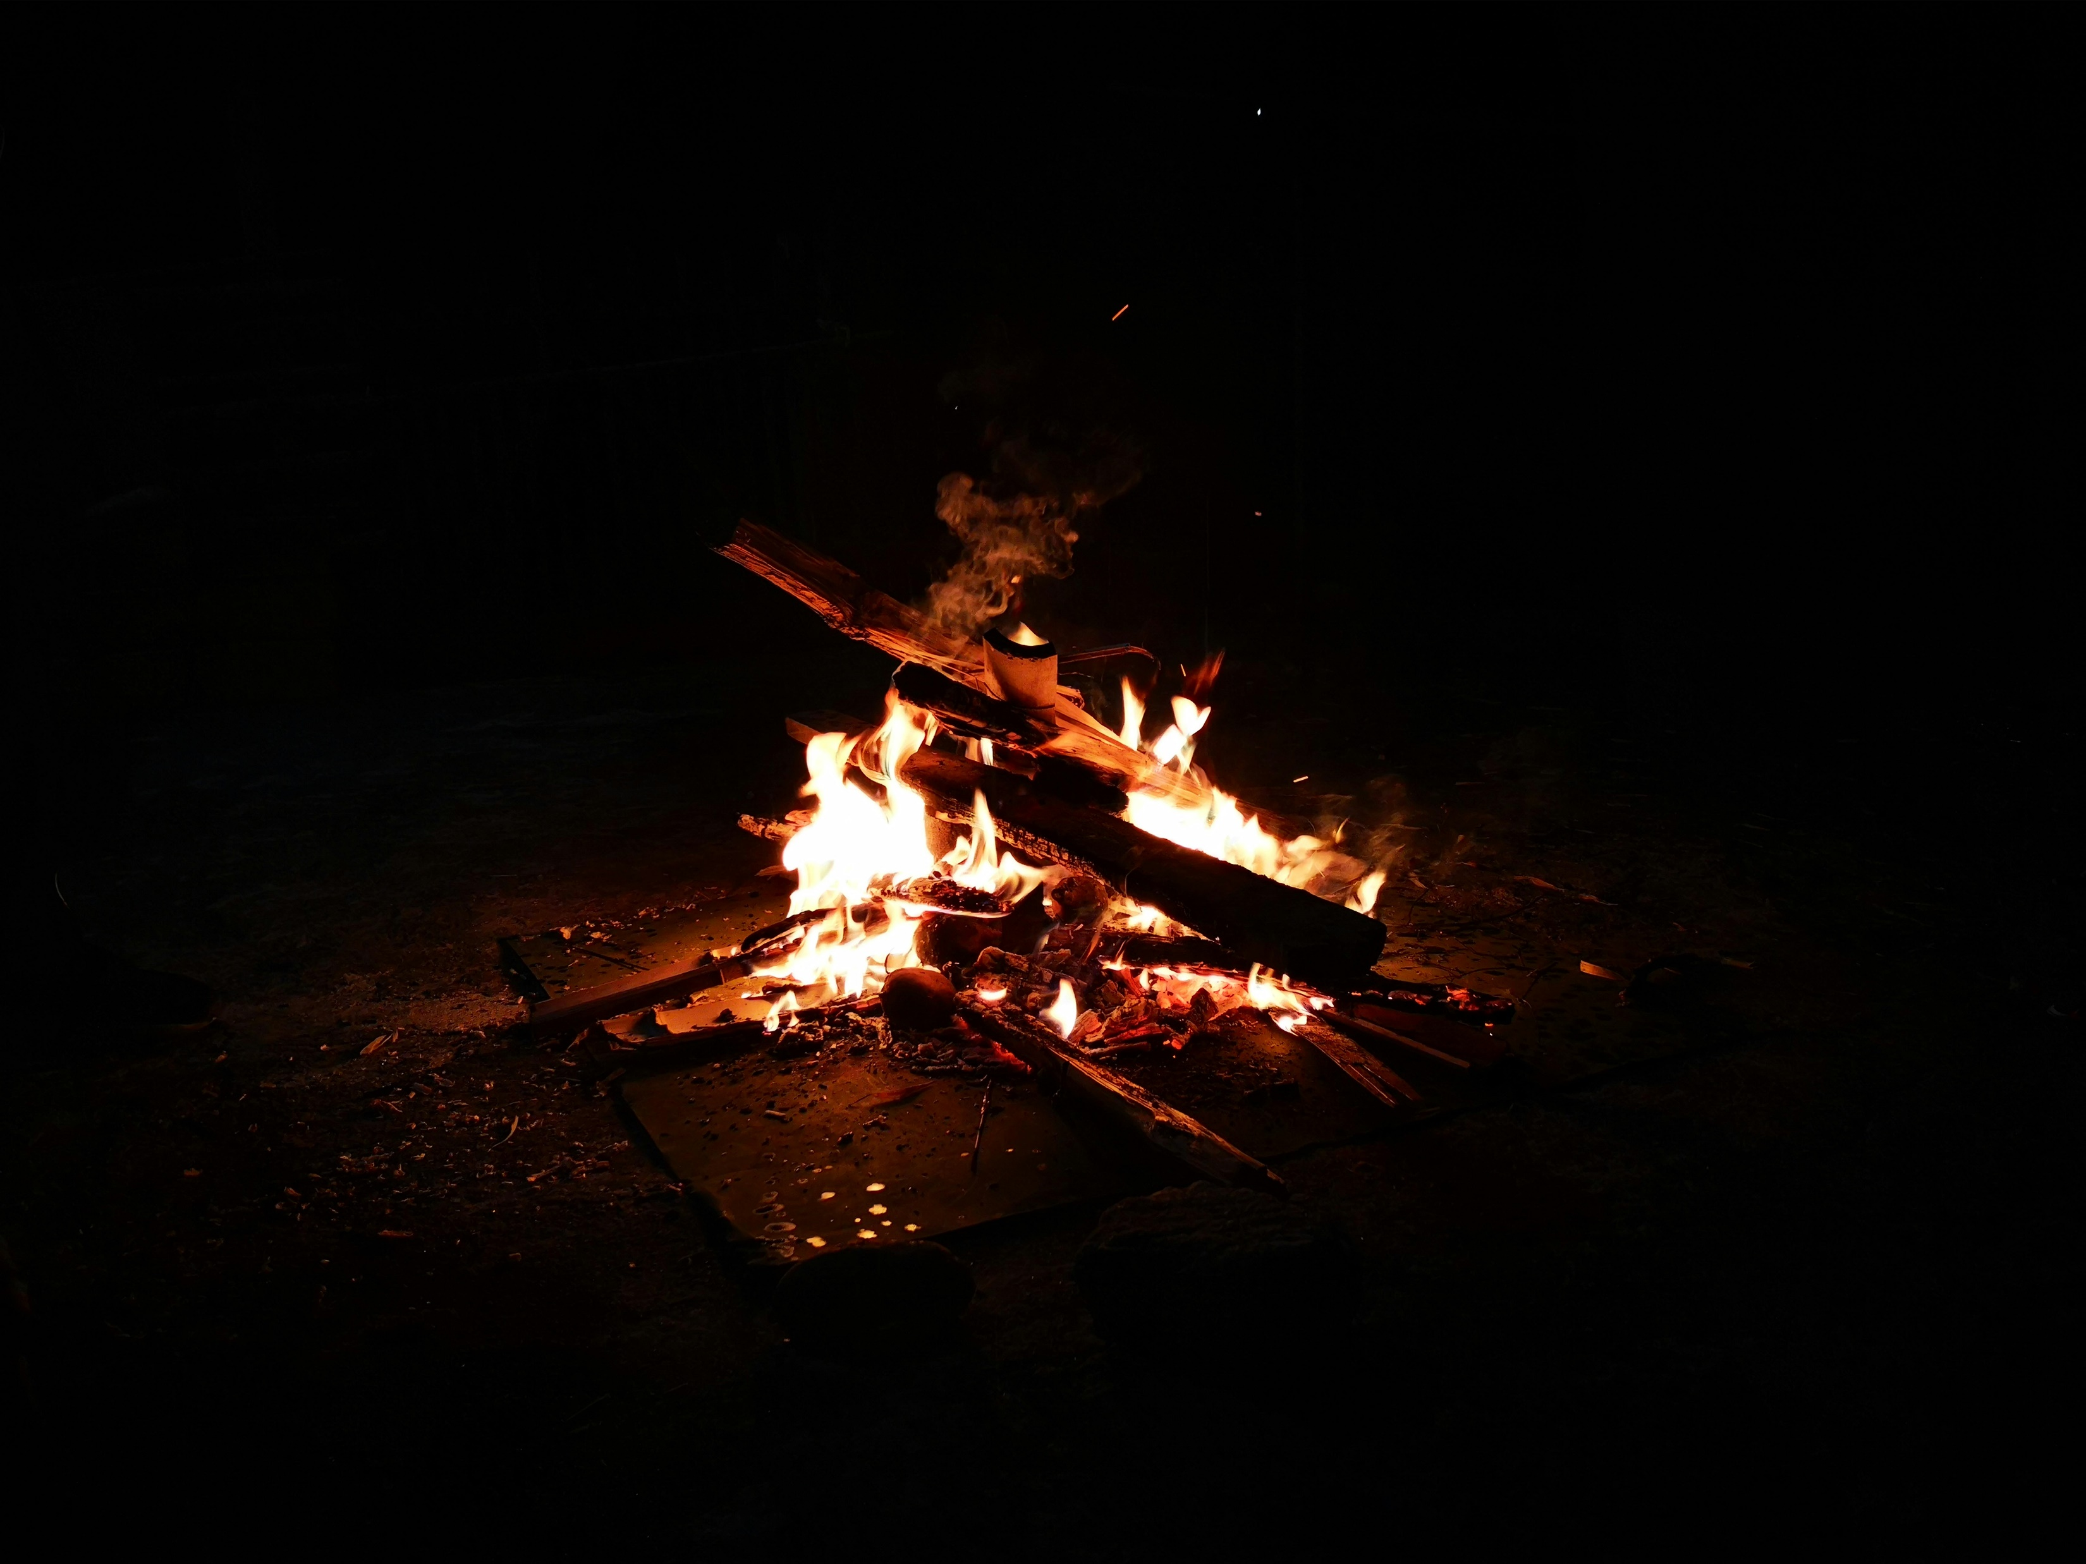


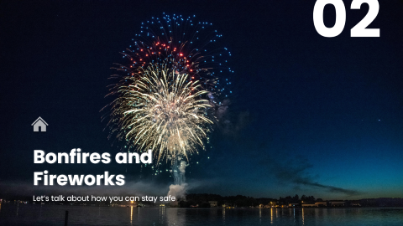
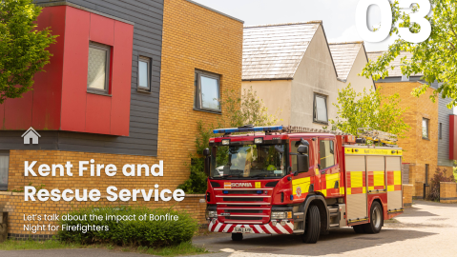
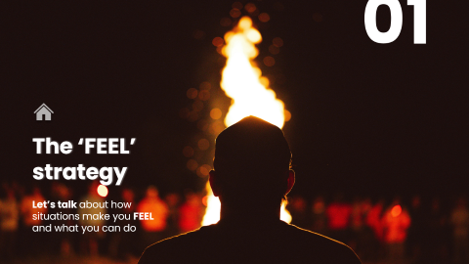
Secondary school
Bonfire and Firework Safety
Find out how you can keep yourself and others safe during bonfire and firework season
PREV
NEXT

Slide 2

Secondary school
Bonfire and Firework Safety
Find out how you can keep yourself and others safe during bonfire and firework season
PREV
NEXT

Slide 3
Secondary school
Bonfire and Firework Safety
Find out how you can keep yourself and others safe during bonfire and firework season
PREV
NEXT

Slide 4
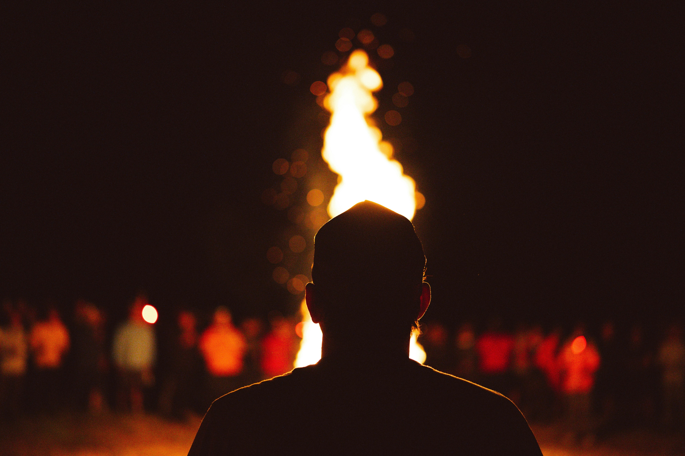

01
The ‘FEEL’ strategy
Let’s talk about how situations make you FEEL and what you can do

Slide 5
We want you to come away from today’s session…
Knowing what a risk is and identifying risky situations
Understanding how consequences affect you and others
Understanding the ‘FEEL’ strategy to keep yourself and other safe

Slide 6



Think of a risky situation. What makes it risky?
What is a risk?
Noun
A situation involving exposure to danger
“standing close to the bonfire was too much of a risk”

Slide 7

about risky situations…
LET’S TALK
It’s important to be aware of the choices you make and how they might affect you.
Reveal each situation below discuss the risks and how you can keep yourself safe.
You’re asked to light a firework
Your friends are encouraging you to buy fireworks
1
A bonfire has been lit too close to the neighbour's fence
3
2
Every risk you take will have a consequence

Slide 8
What is a consequence?
What is a consequence?
Noun
A result or effect, typically one that is unwelcome or unpleasant
“the choice they made can have a serious consequence”
Discuss what a consequence is and think of an example
LET’S TALK
How can you prevent yourself and others being hurt or injured in a risky situation?

Slide 9
Focus on yourself and put yourself first
Each decision you make will have an effect
Have an excuse prepared
Make sure to leave the situation
F
E
E
L
!
If a situation is making you uncomfortable remember our strategy
How does it make you FEEL?
THE FEEL STRATEGY

Slide 10
Focus on yourself and put yourself first
Each decision you make will have an effect
Have an excuse prepared
Make sure to leave the situation
F
E
E
L
THE FEEL STRATEGY

Slide 11




Focus
Effect
Excuse
Leave
CASE STUDY
How would that make you FEEL?
You are invited to the park by your friend. When you get there, you realise you don’t know anyone. Some of the group are being loud and annoying.
How would that make you FEEL?
One of the group explains that they have a firework and holds up a bag. They say it would be ok to set it off as there's no one around.
How would that make you FEEL?
The group are unsure - your friend asks whether you want to light it.
!
Let’s break down FEEL more on the next slide

Slide 12

Here’s an example of how we’ve used FEEL
Focus
Effect
Excuse
Leave
CASE STUDY
Is it safe?
What is the consequence of staying?
What can you say to prevent a consequence?
Can you use your excuse to leave?
Is it safe to be there?
Will it cause harm or put you in danger?
Can you say or do something that allows you to leave?
Have you got the confidence to keep yourself safe and leave the situation?
!
You've focused on yourself and decided it's not safe.
There could be serious consequences if someone lights that firework.
You make an excuse and say you need to go to dance/football practice.
You ask your friend if they want to join and you leave the group.
Here’s an example of how we’ve used FEEL

Slide 13

Focus
Effect
Excuse
Leave
CASE STUDY
You are invited to the park by your friend. When you get there, you realise you don’t know anyone. Some of the group are being loud and annoying.
You tell your friend it’s too risky.
You get your phone out and pretend someone has messaged you.
You tell your friend that you need to leave and encourage them to join you.
One of the group explains that they have a firework and holds up a bag. They say it would be ok to set it off as there's no one around.
The group are unsure - your friend asks whether you want to light it.
How would that make you FEEL?

Slide 14
What is the positive effect of leaving the situation?
LET’S TALK
What excuse could you make to leave the situation?

Slide 15
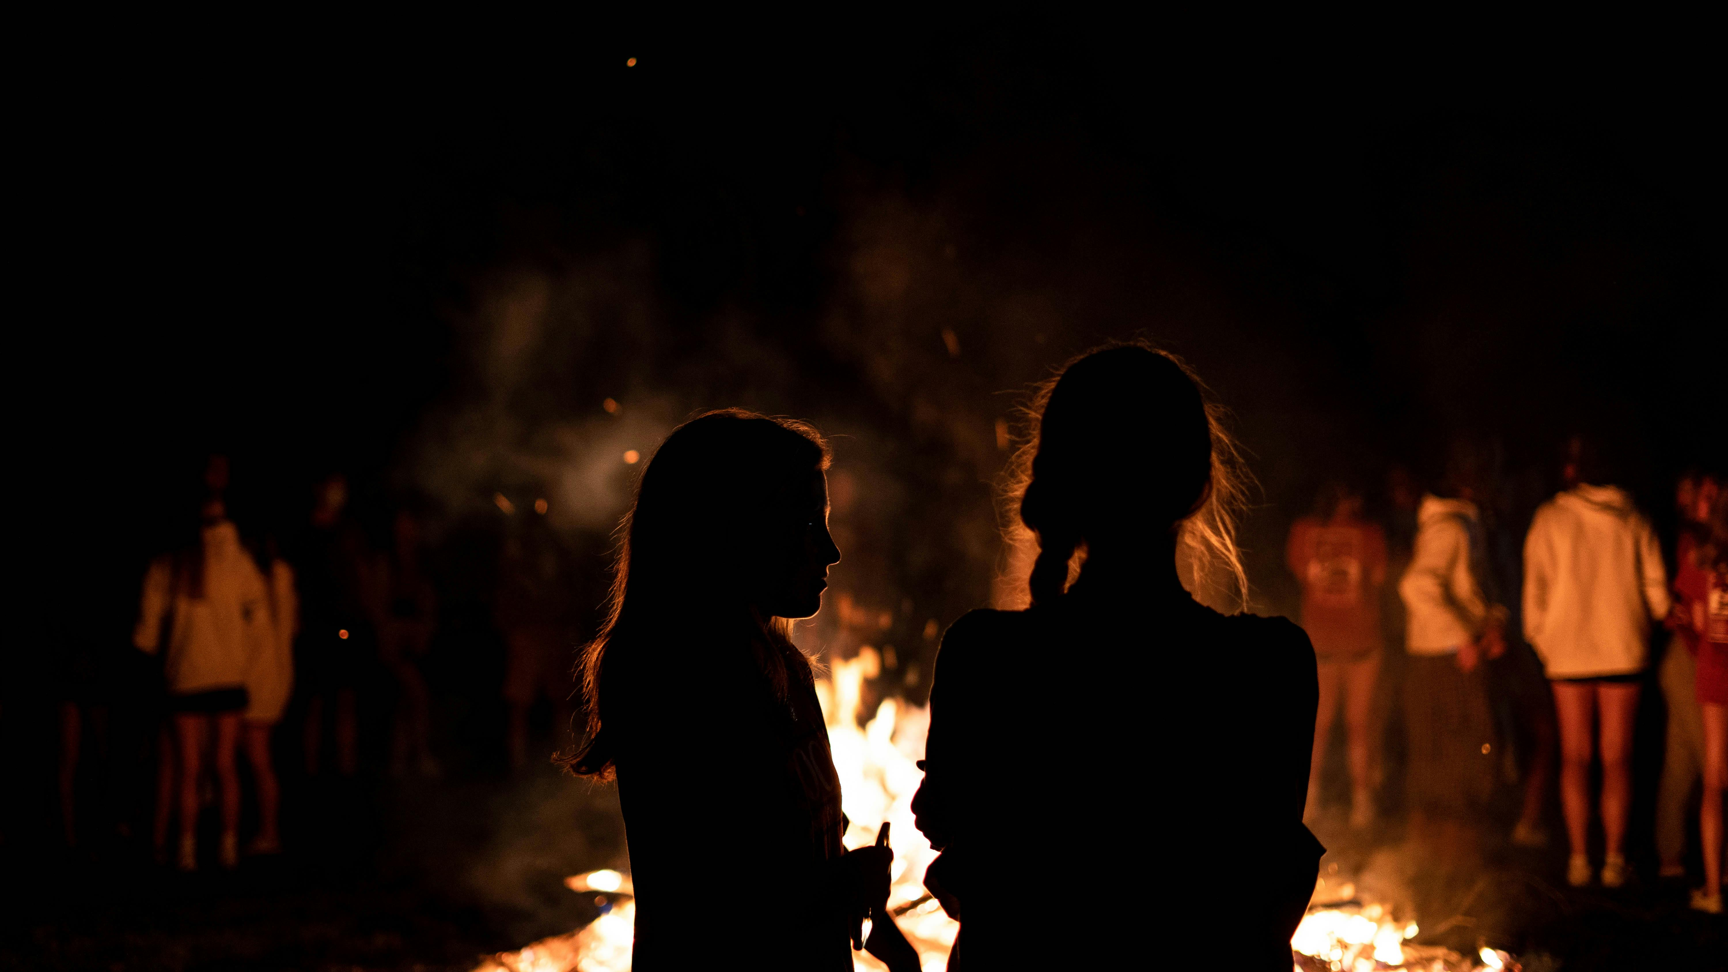

RE-CAP

Slide 16
What does FEEL stand for?

Slide 17
What does FEEL stand for?
Give an example of a risky situation and how you would stay safe

Slide 18
What does FEEL stand for?
Give an example of a risky situation and how you would stay safe
Name a consequence of risky behaviour

Slide 19
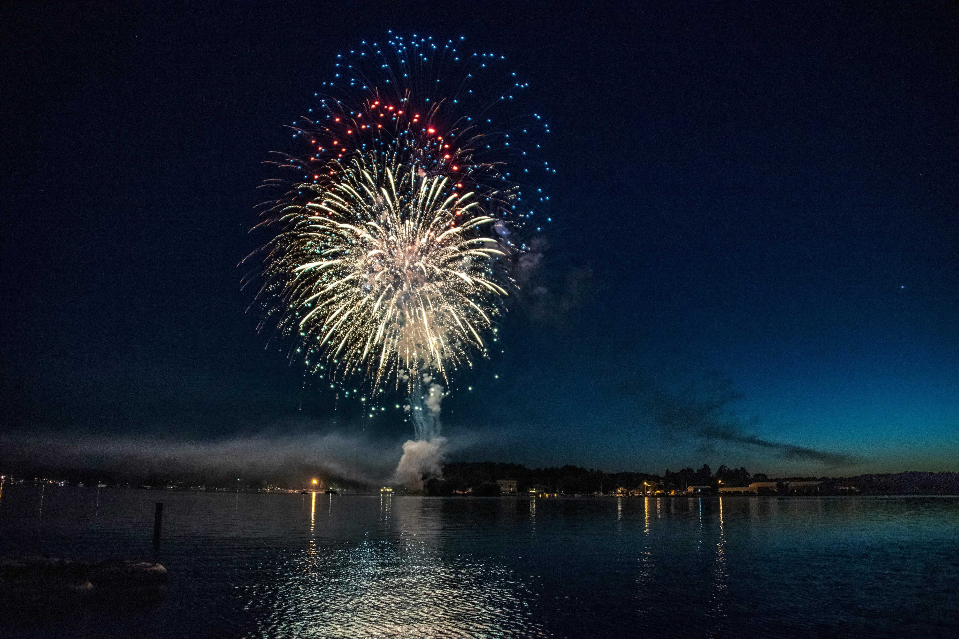
02
Bonfires and Fireworks
Let’s talk about how you can stay safe

Slide 20
We want you to come away from today’s session…
Identifying safe practises around fireworks and bonfires
Understanding the firework code and sharing this with others
Understanding the law around fireworks

Slide 21

Bonfires
At Kent Fire and Rescue, we always advise that you attend an organised bonfire/firework display
Lighting bonfires too close to surroundings such as foliage, fences, sheds or wheelie bins can cause fire to spread rapidly.
Who and what could this impact?
LET’S TALK

Slide 22
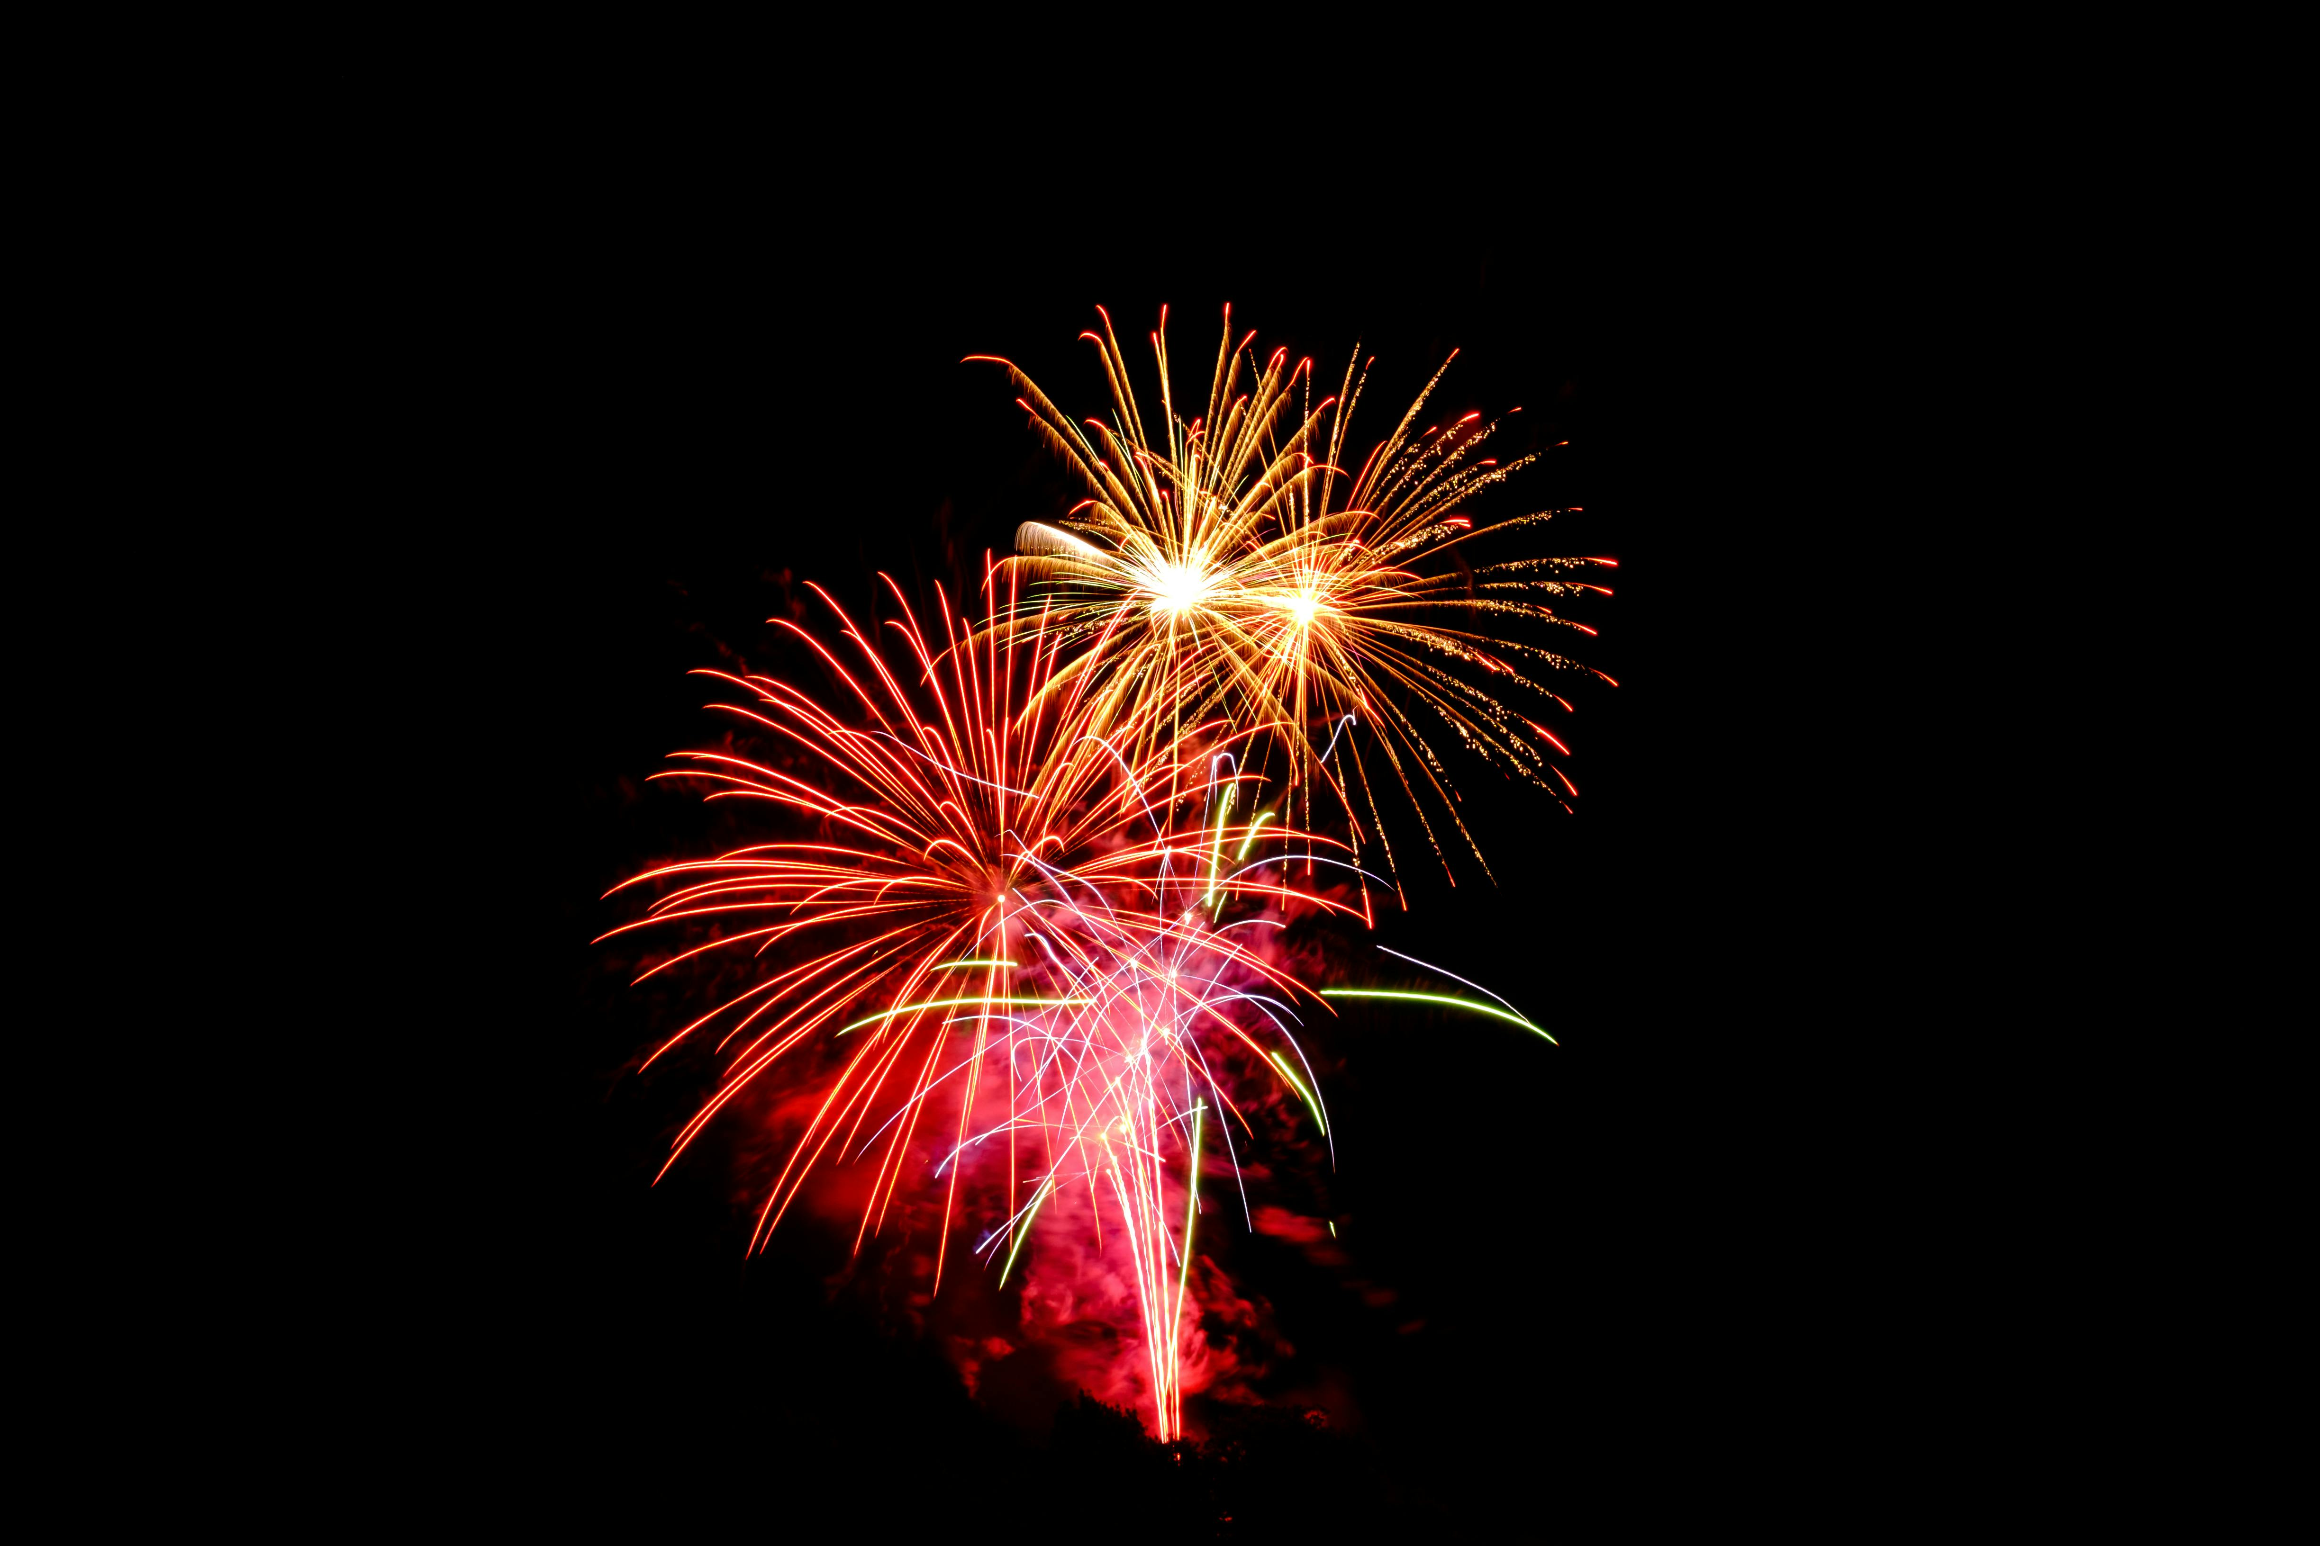
Fireworks
Firework displays are something that can be enjoyed by everyone, but should be done safely, carefully and lawfully.
It’s important to always follow the firework code!
LET’S TALK
Why do we have firework displays?
To find your nearest display visit –
https://familiesonline.co.uk/kent/whats-on-kent-firework-displays-2025/

Slide 23











The Firework Code
You MUST be to buy or use fireworks. Knowing the key parts of the Firework Code can help you keep yourself and others safe!
If it doesn’t feel safe, have the confidence to speak up and say something to prevent serious consequences
Keep fireworks in a closed box
Keep pets safe indoors
Follow the instructions on EACH firework
Never give sparklers to a child under 5
Only buy fireworks that are CE marked
Light sparklers one at a time and always wear gloves
Never put fireworks in your pocket
Be considerate of others

Slide 24
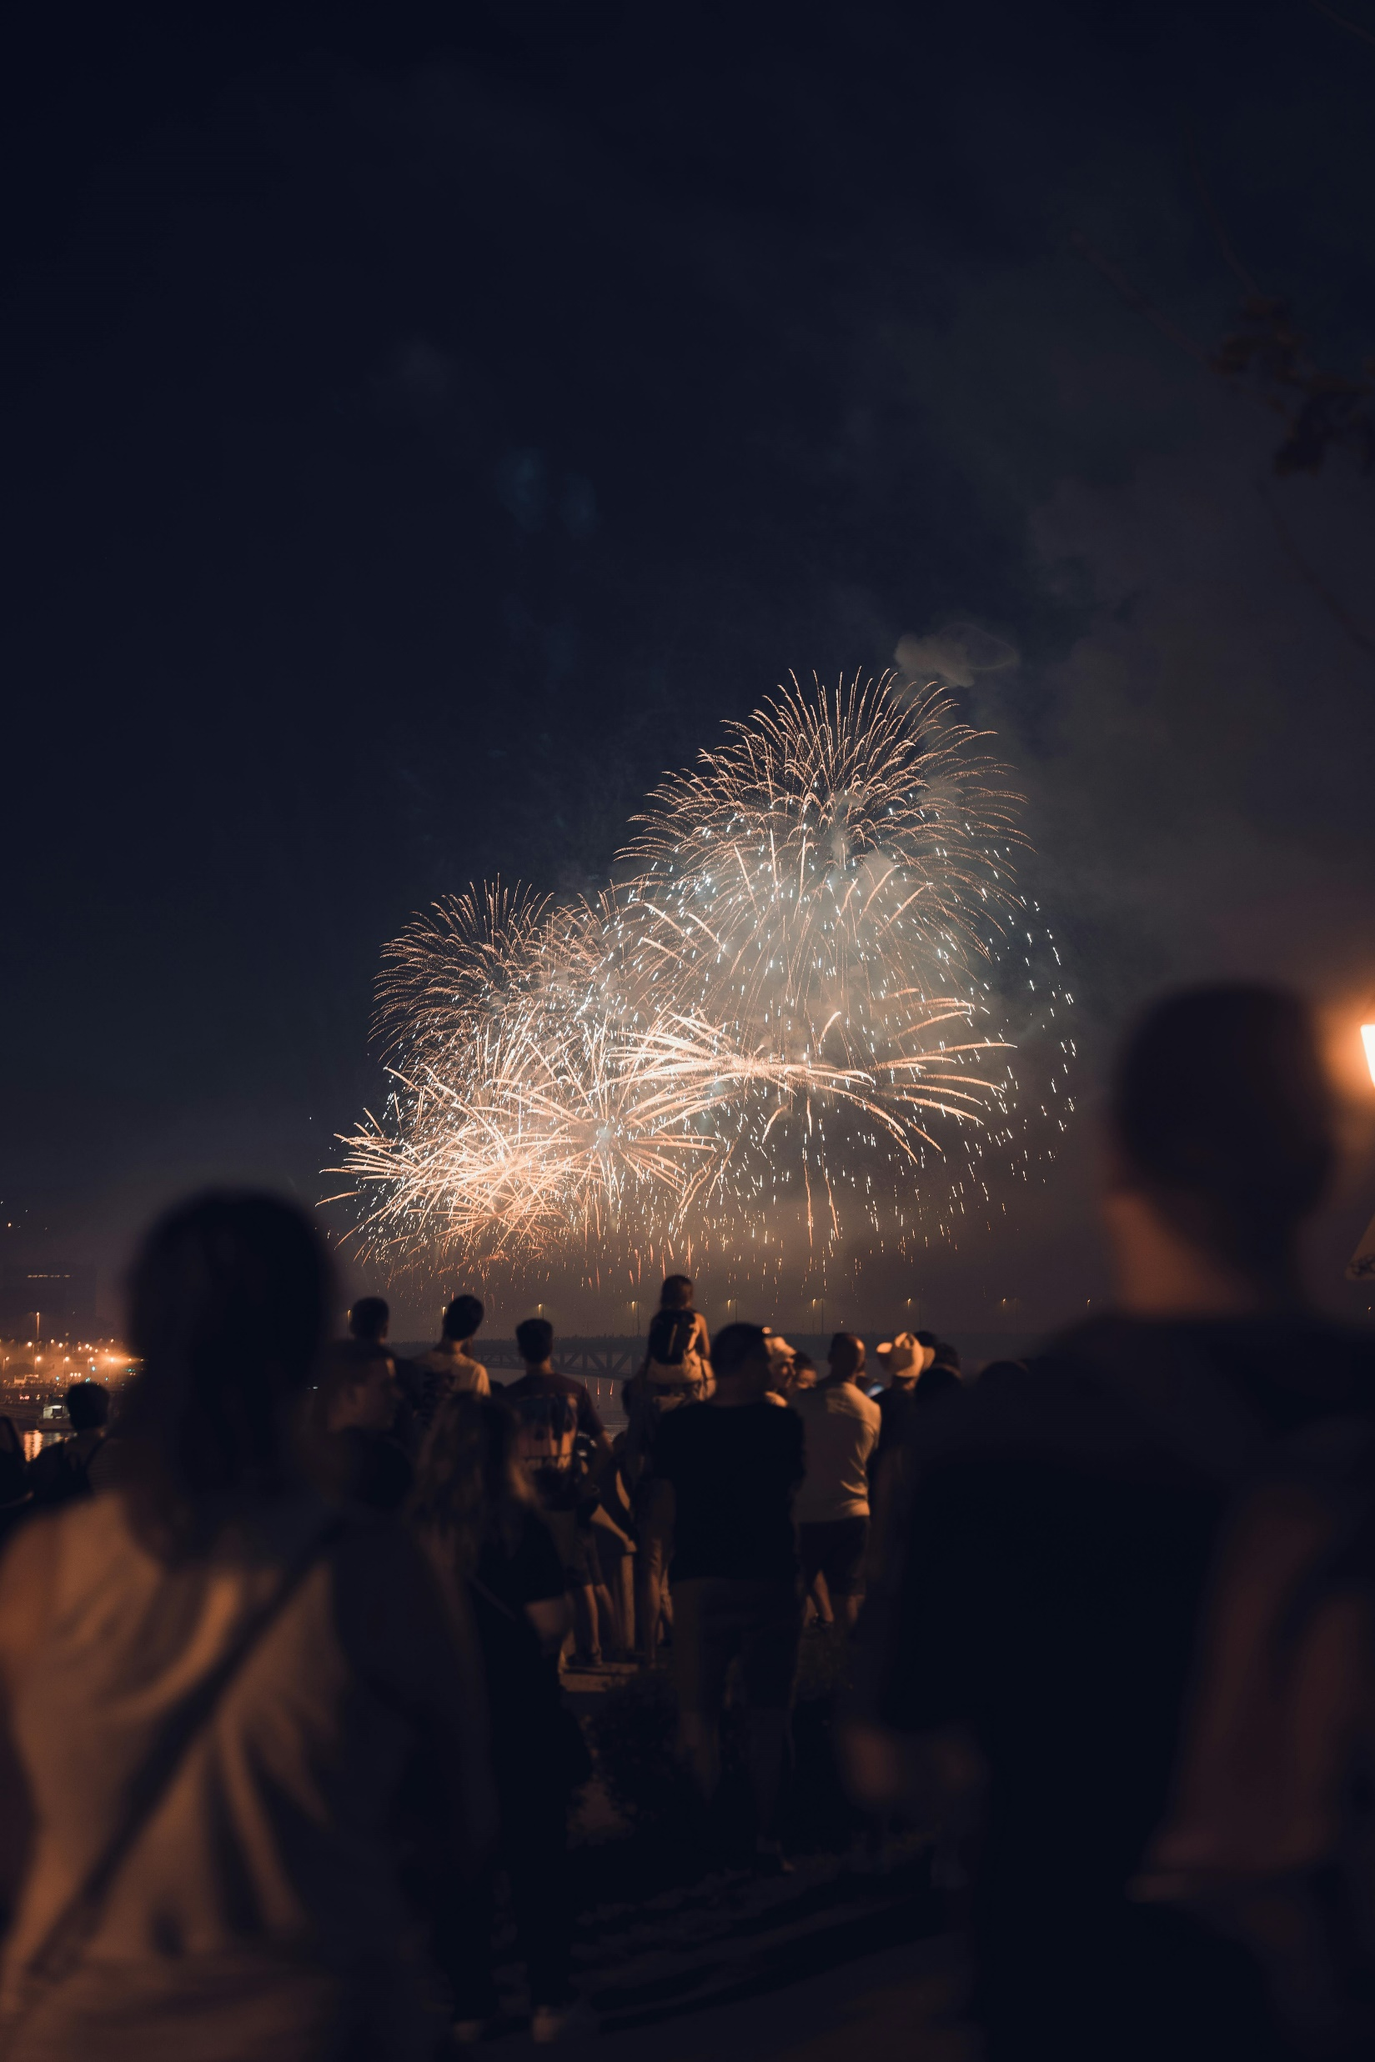




The Law
It is illegal to give fireworks to anyone under the age of 18
It is illegal to buy fireworks under the age of 18
It is illegal to set off fireworks before 6pm and after 11pm (except for the 5th November where this extends to midnight.)
You can be fined £5000 if you are caught throwing a firework.
LET’S TALK
What would you do if someone tries to give you fireworks?

Slide 25
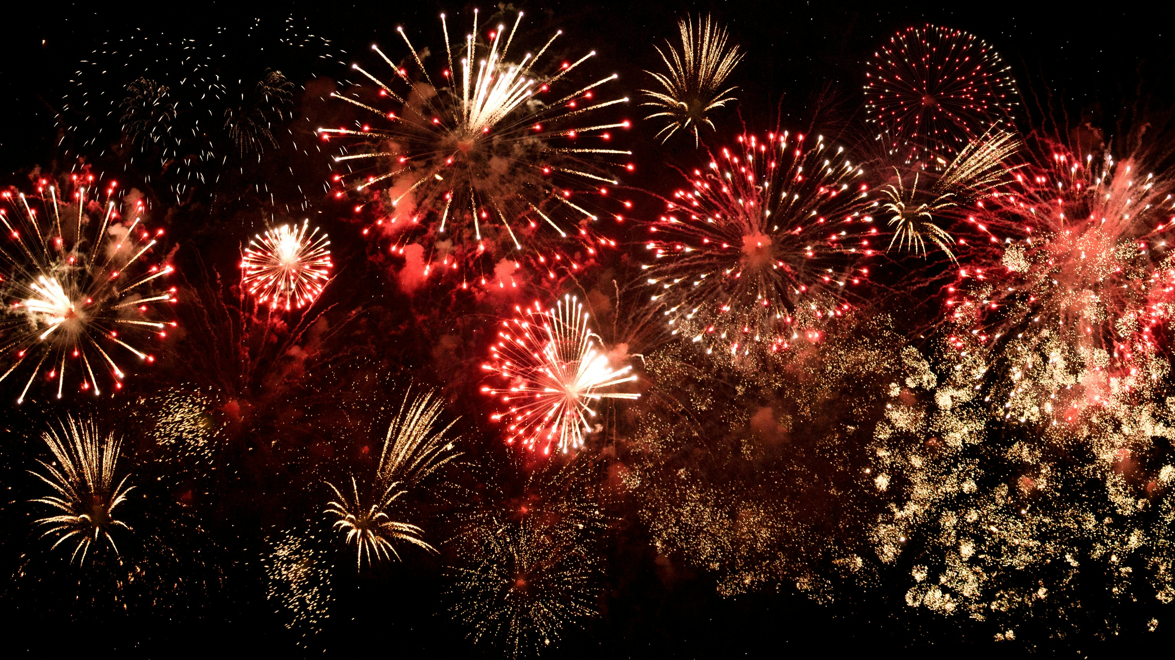
RE-CAP

Slide 26
Give an example of an occasion that has firework displays

Slide 27
Give an example of an occasion that has firework displays
Name a part of the firework code

Slide 28
Give an example of an occasion that has firework displays
Name a part of the firework code
Can you give an example of a consequence for not following the law around fireworks?

Slide 29
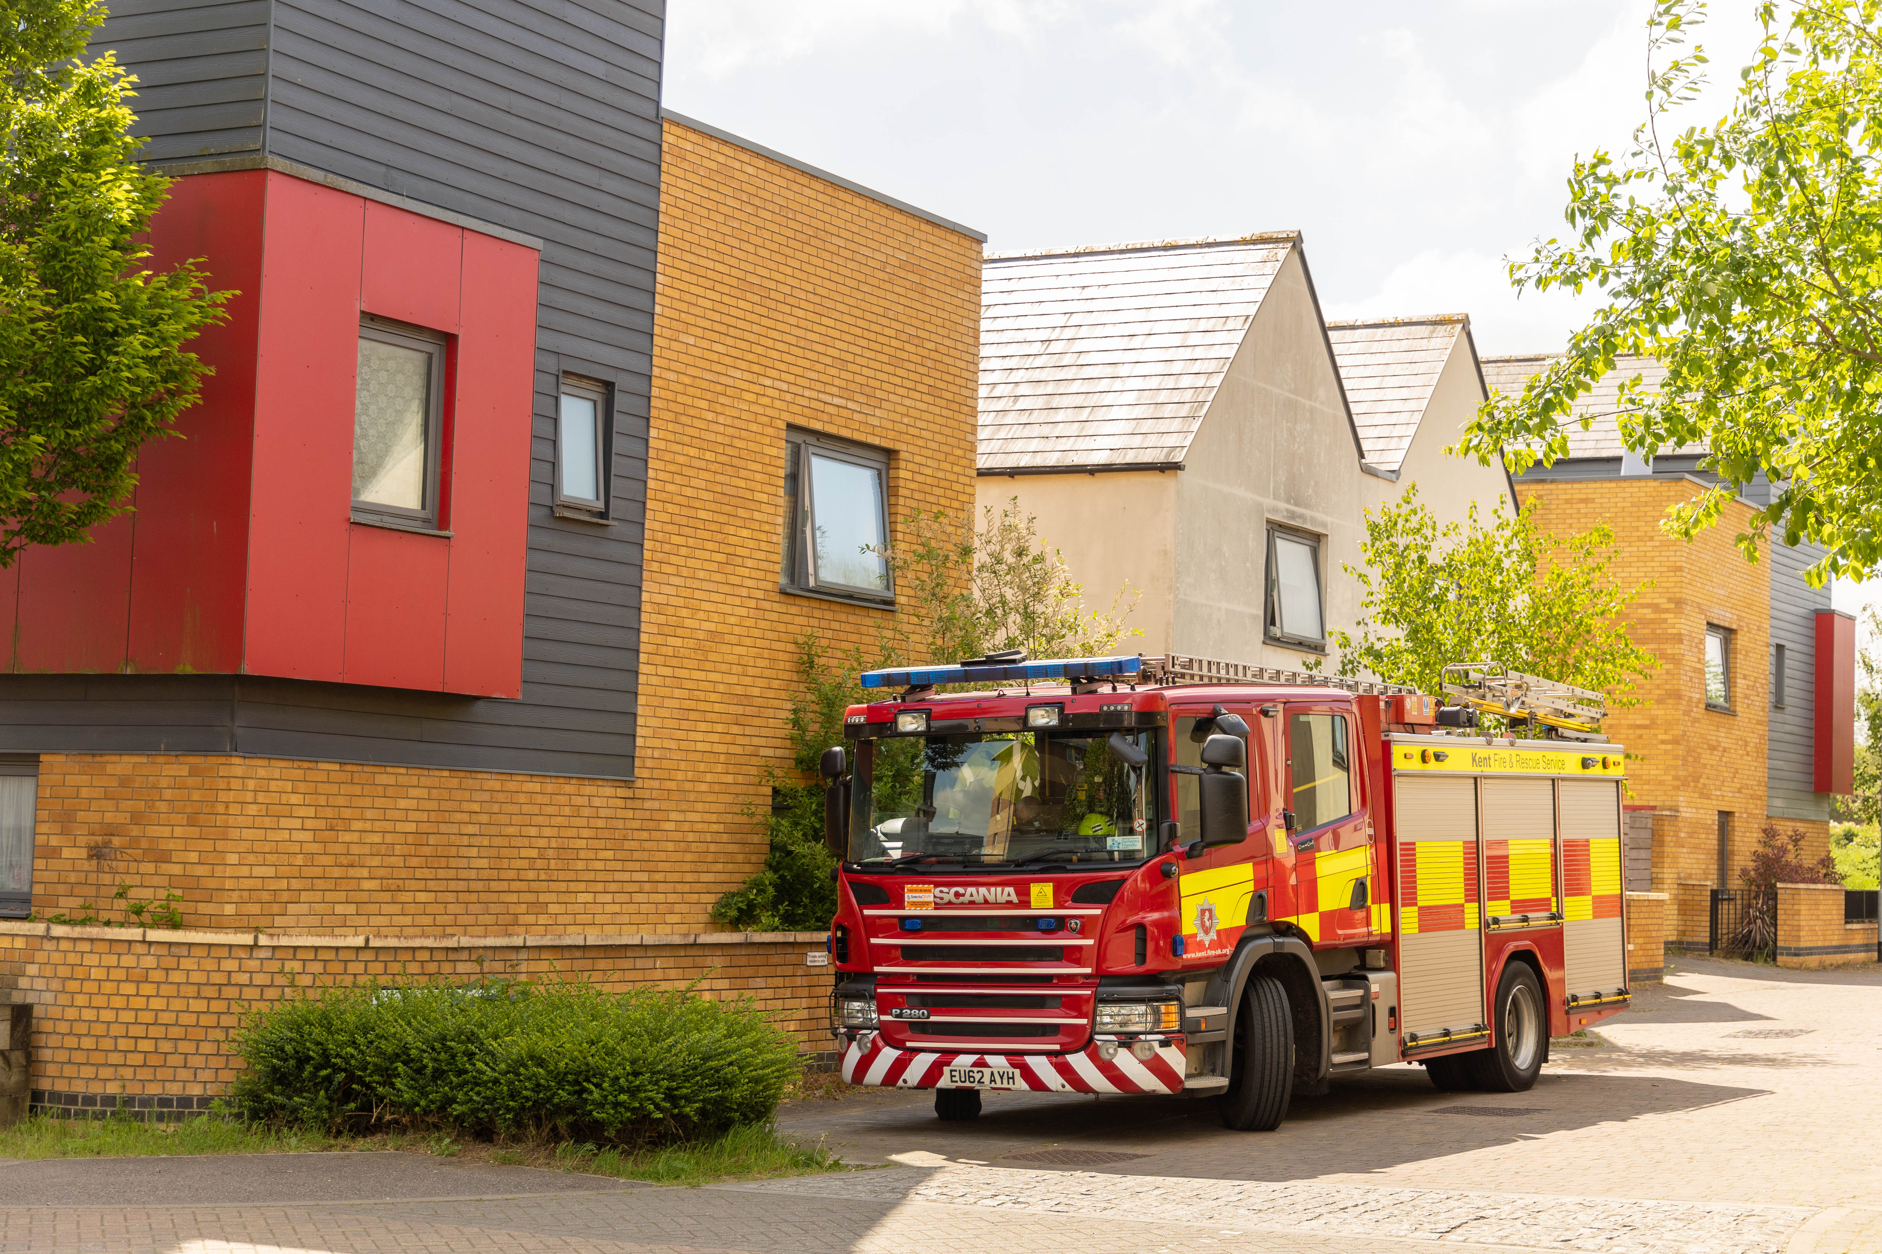
03
Kent Fire and Rescue Service
Let’s talk about the impact of Bonfire Night for Firefighters

Slide 30
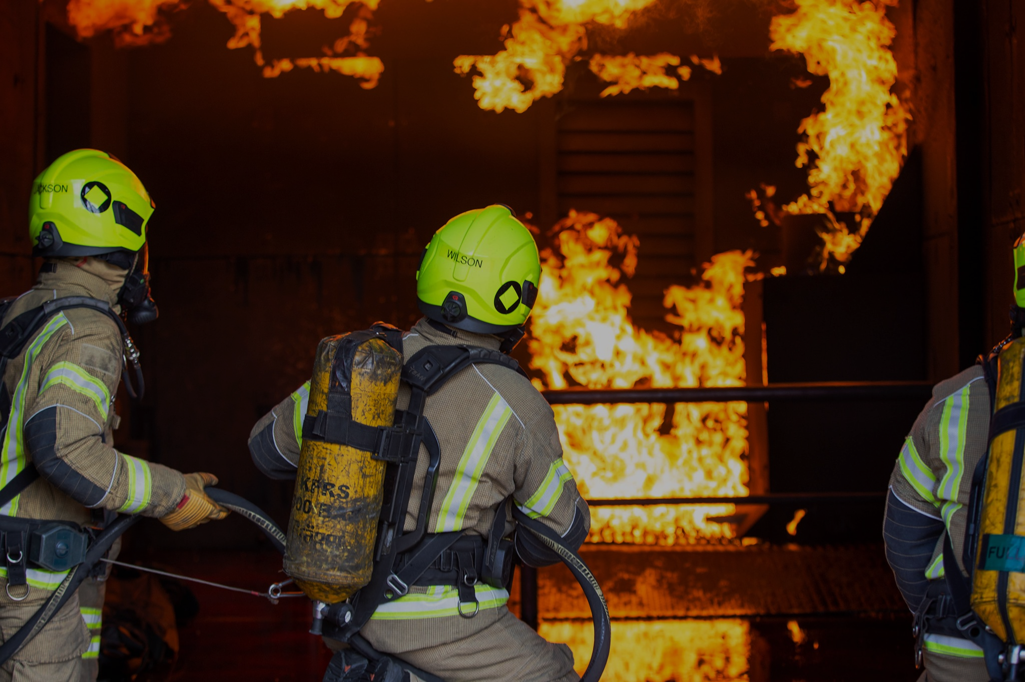
We want you to come away from today’s session…
Understanding what the Fire Service does
Understanding the effect risky decisions have on firefighters
Understanding your roles and responsibilities in keeping firefighters safe

Slide 31


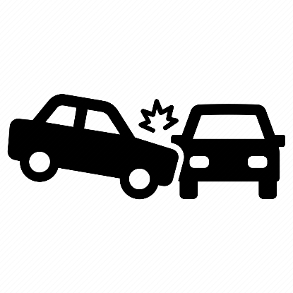



What we do
Respond to 999 calls
Fight fires and provide post incident support
Attend road traffic collisions
Attend and support medical emergencies
Provide fire safety education in schools
Provide home fire safety visits
Firefighters are trained to attend and help at lots of different emergencies across Kent
LET’S TALK
Think of an emergency the Fire Service might attend?

Slide 32

On Bonfire Night…
nothing changes
Discuss the impact this has on firefighters
What could you do to keep yourself and others (including firefighters) safe?

Slide 33
Focus on how the situation impacts the Fire Service
What effect can risky decisions have on firefighters?
Is it an emergency? Do you need to call 999?
Leave the situation before it gets too risky
F
E
E
L
Firefighters can’t follow the FEEL strategy as sometimes their role is the consequence of someone else's risk
!
You can adapt the FEEL strategy to keep Firefighters as safe as possible

Slide 34
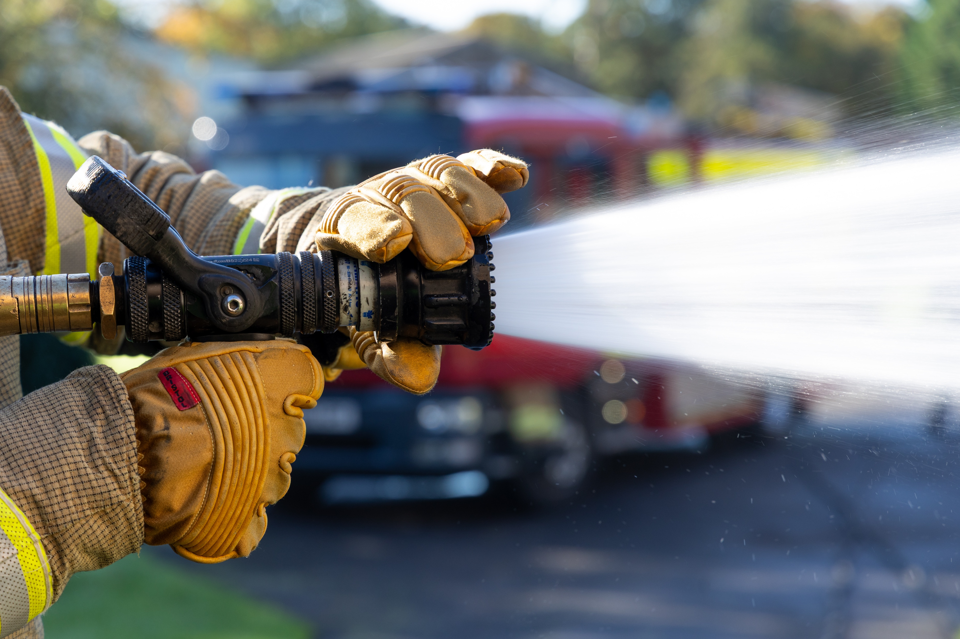
RE-CAP

Slide 35
Name a responsibility of the Fire Service

Slide 36
Name a responsibility of the Fire Service
What are some of the main risks that a firefighter can face in their role?

Slide 37
Name a responsibility of the Fire Service
What are some of the main risks that a firefighter can face in their role?
How does Bonfire Night affect the Fire Service and the community?

Slide 38
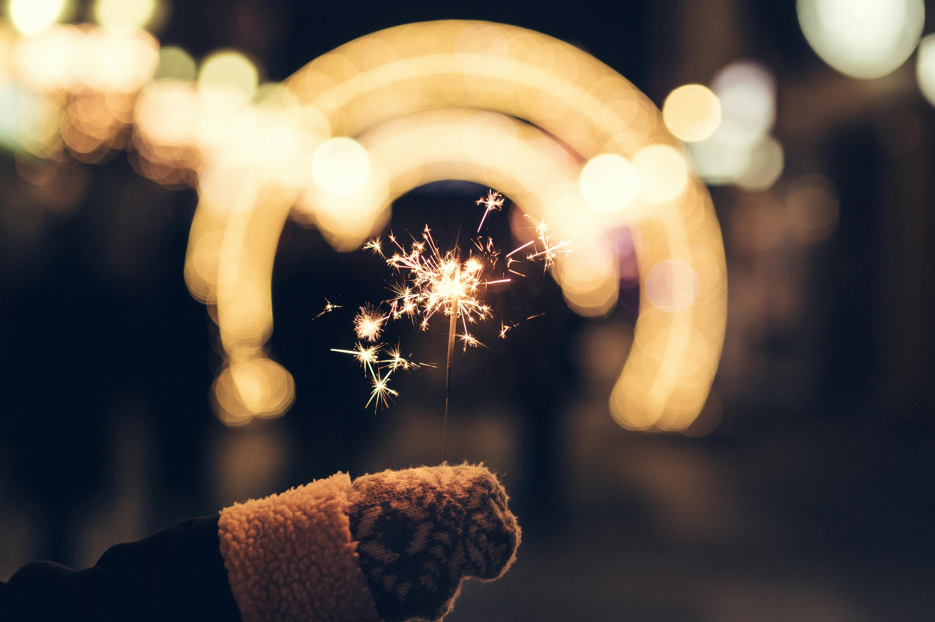
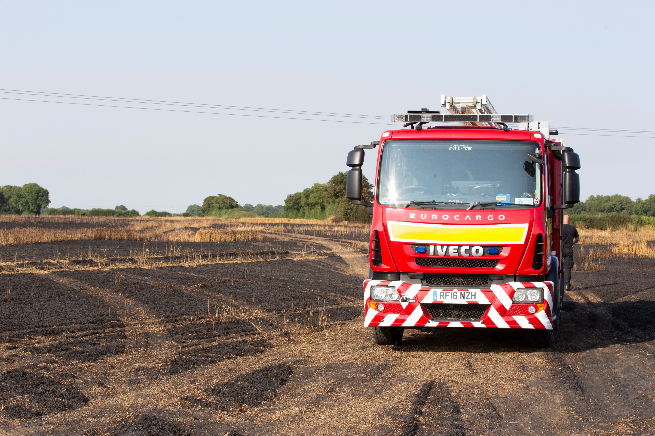

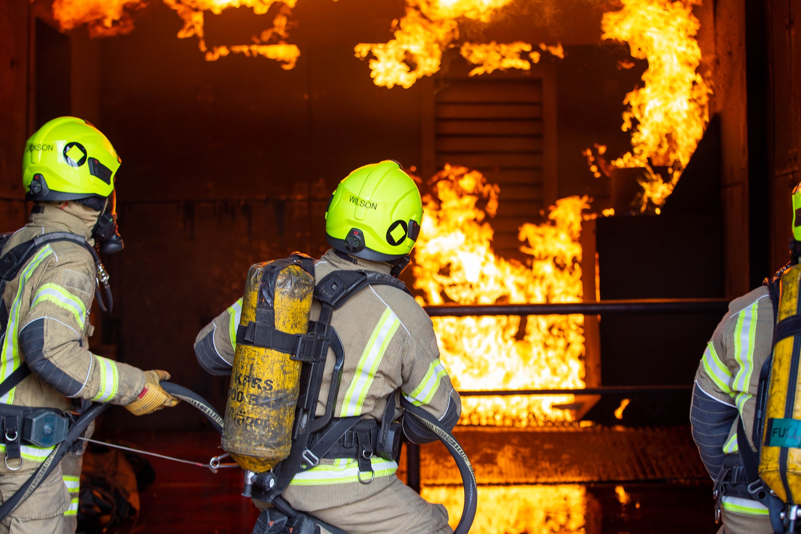
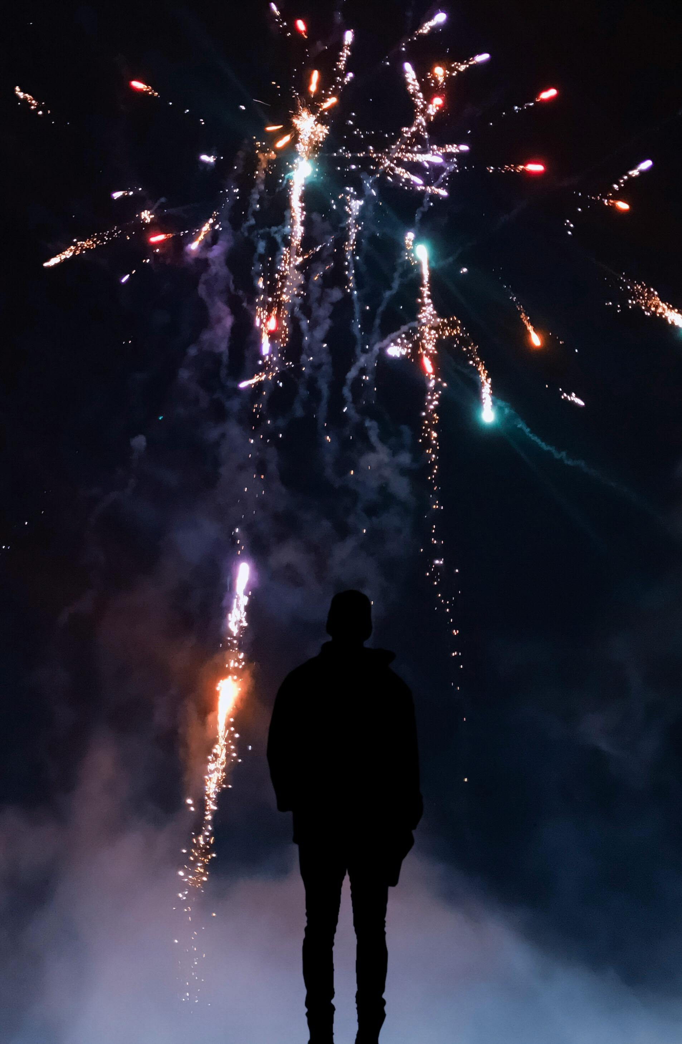

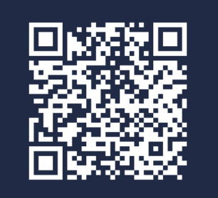

Stay safe and enjoy the fireworks!
Scan the code to learn more about our current Fire Cadet cohorts
For more information visit www.kent.fire-uk.org

