Slide 1

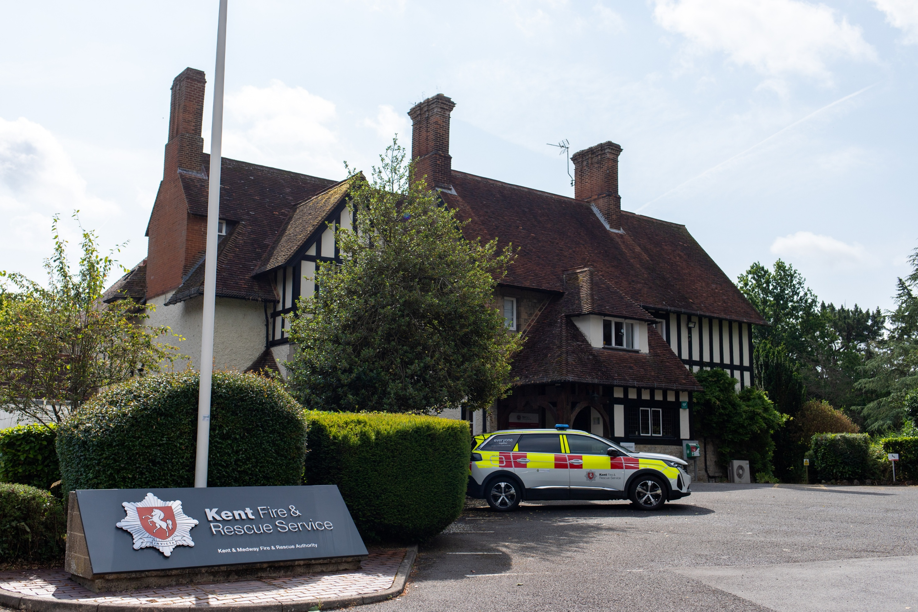

Explore what
we do
Kent Fire
at
click to get started
Rescue
and

Slide 2

Aims and objectives
Understand the different roles and responsibilities at Kent Fire and Rescue Service.
Understand and identify “super strengths” and how they bring value to a role within the Fire Service.
Understand how the Fire Service works to keep communities safe, including responding to emergencies.

Slide 3



What are super strengths?
‘Super strengths are the personal qualities, skills and characteristics that you bring to a job role.’
Kent Fire and Rescue values individuals who can identify their super strengths.
This encourages feelings of self-worth,, confidence, and develops strengths.
By identifying your super strengths this can help guide you with career moves.

Slide 4
So, let’s think of some examples
Innovative
Curious
Aspirational
Emotional Intelligence
Activity - Can you identify each others’ super strengths?

Slide 5
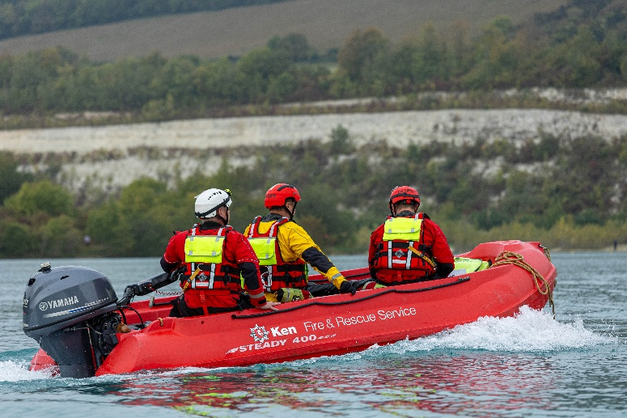
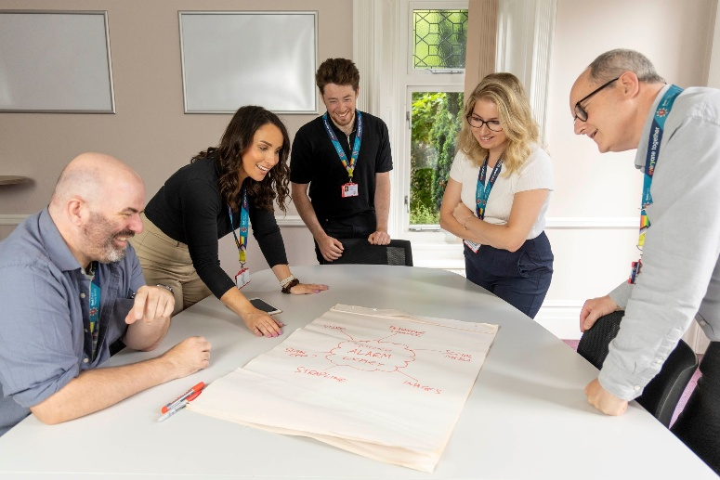
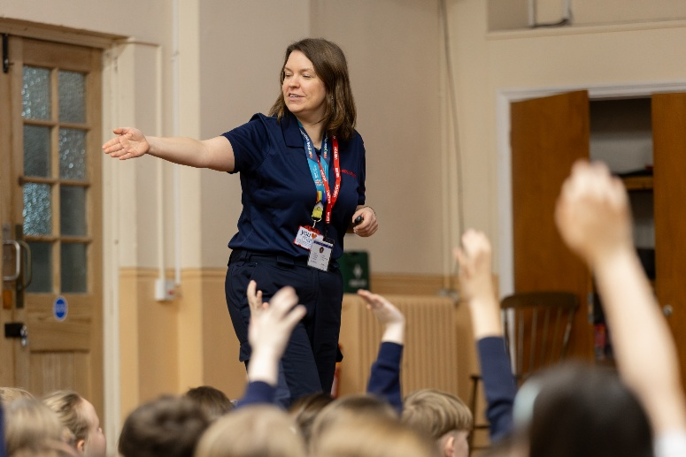
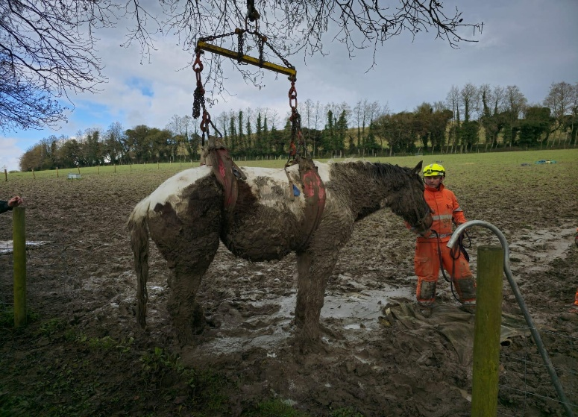
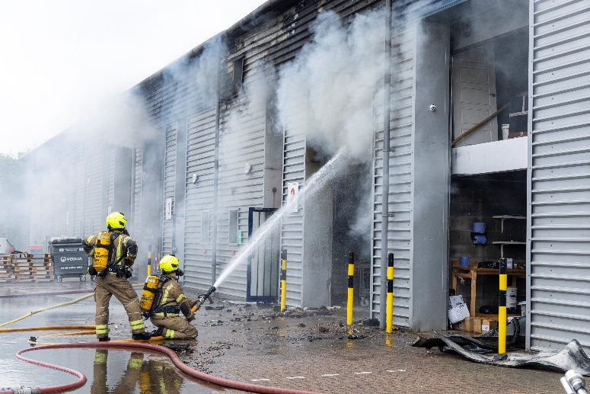
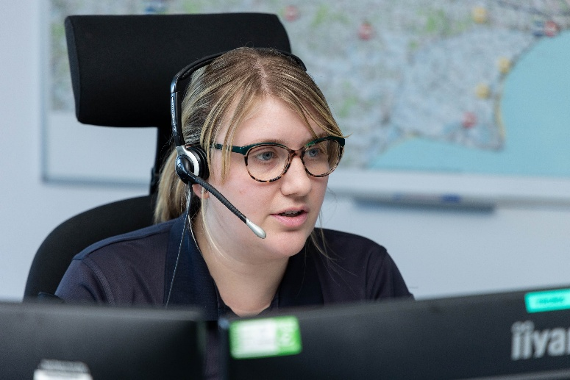
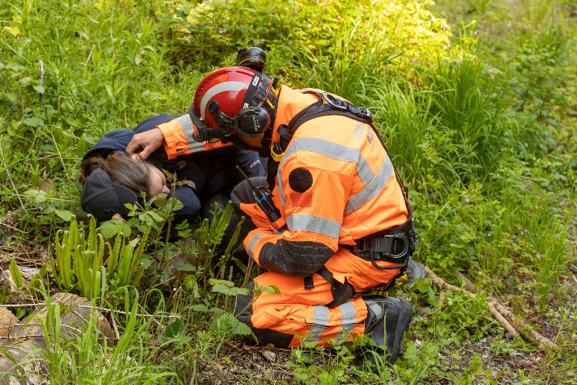
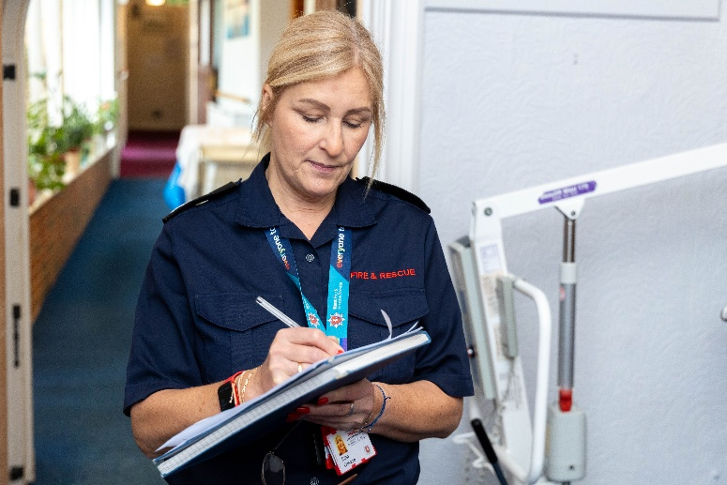
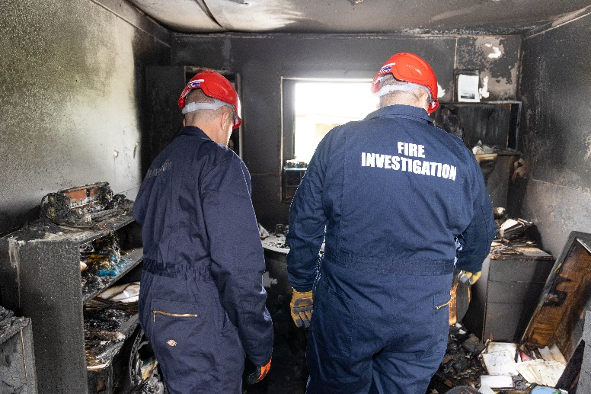
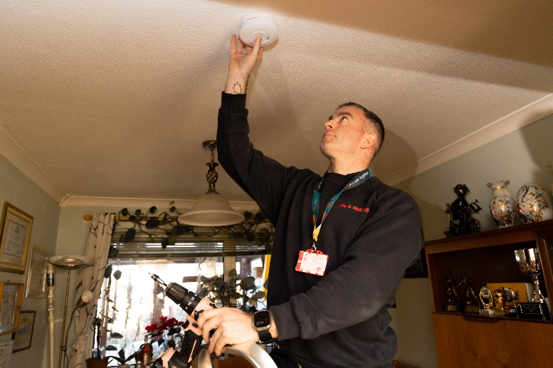
What roles are there in the Fire Service?
Discuss in pairs or small groups

Slide 6

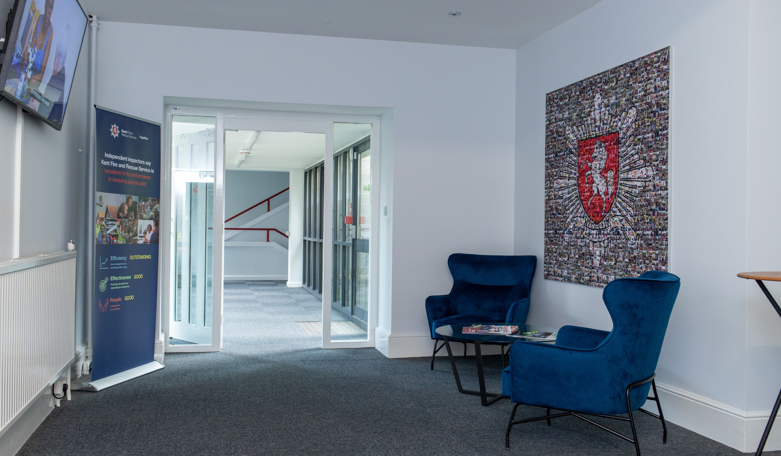

























00
What
we do
Let’s talk
Let’s talk
Firefighters
Fire Cadets

Slide 7
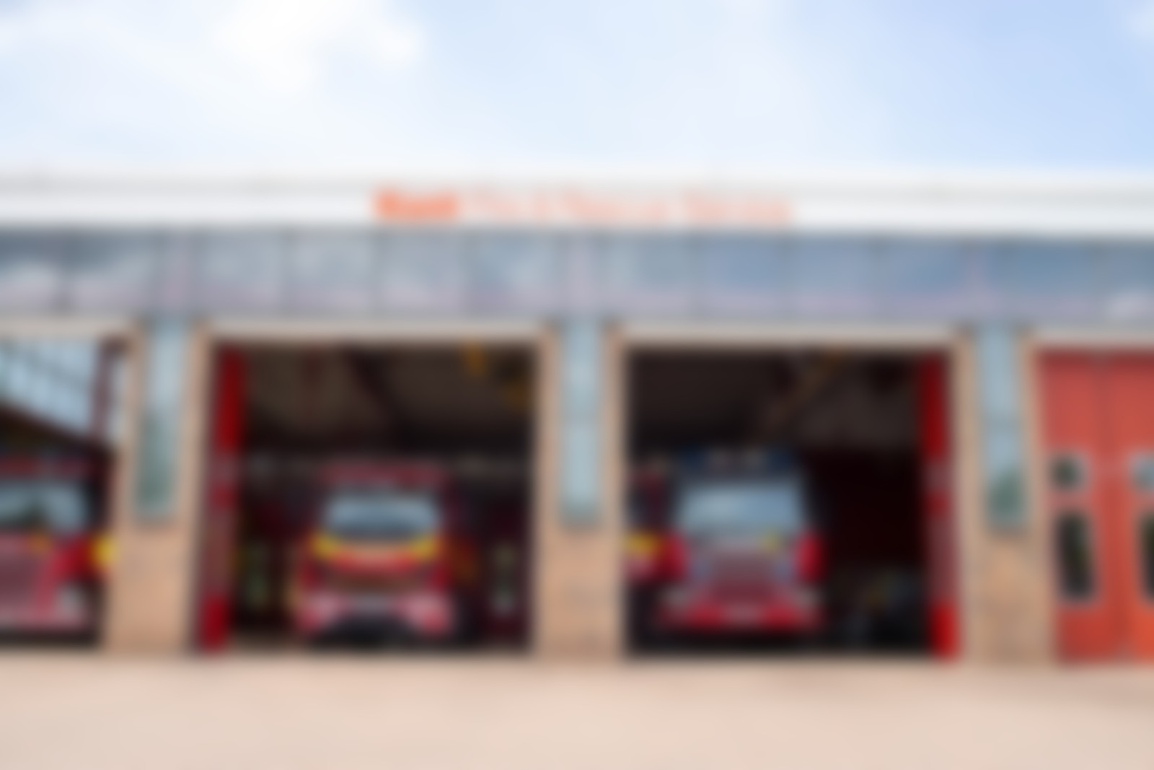
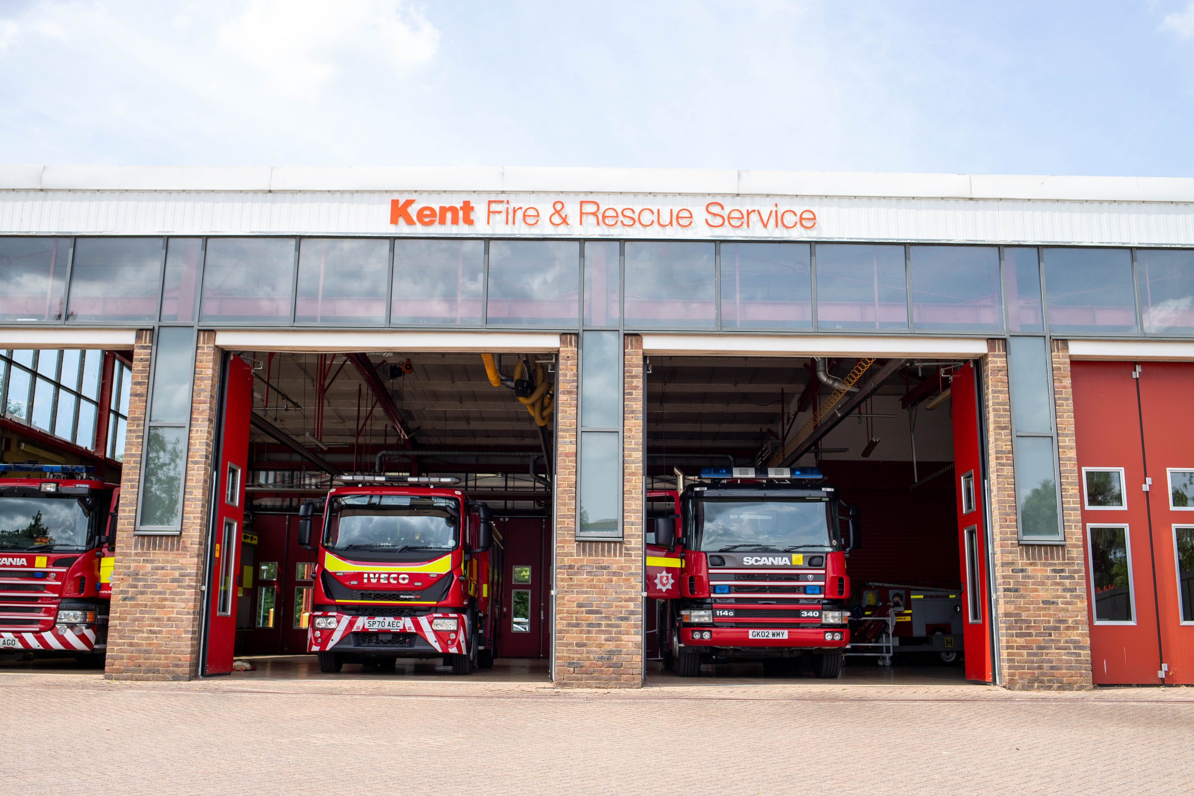


Slide 8

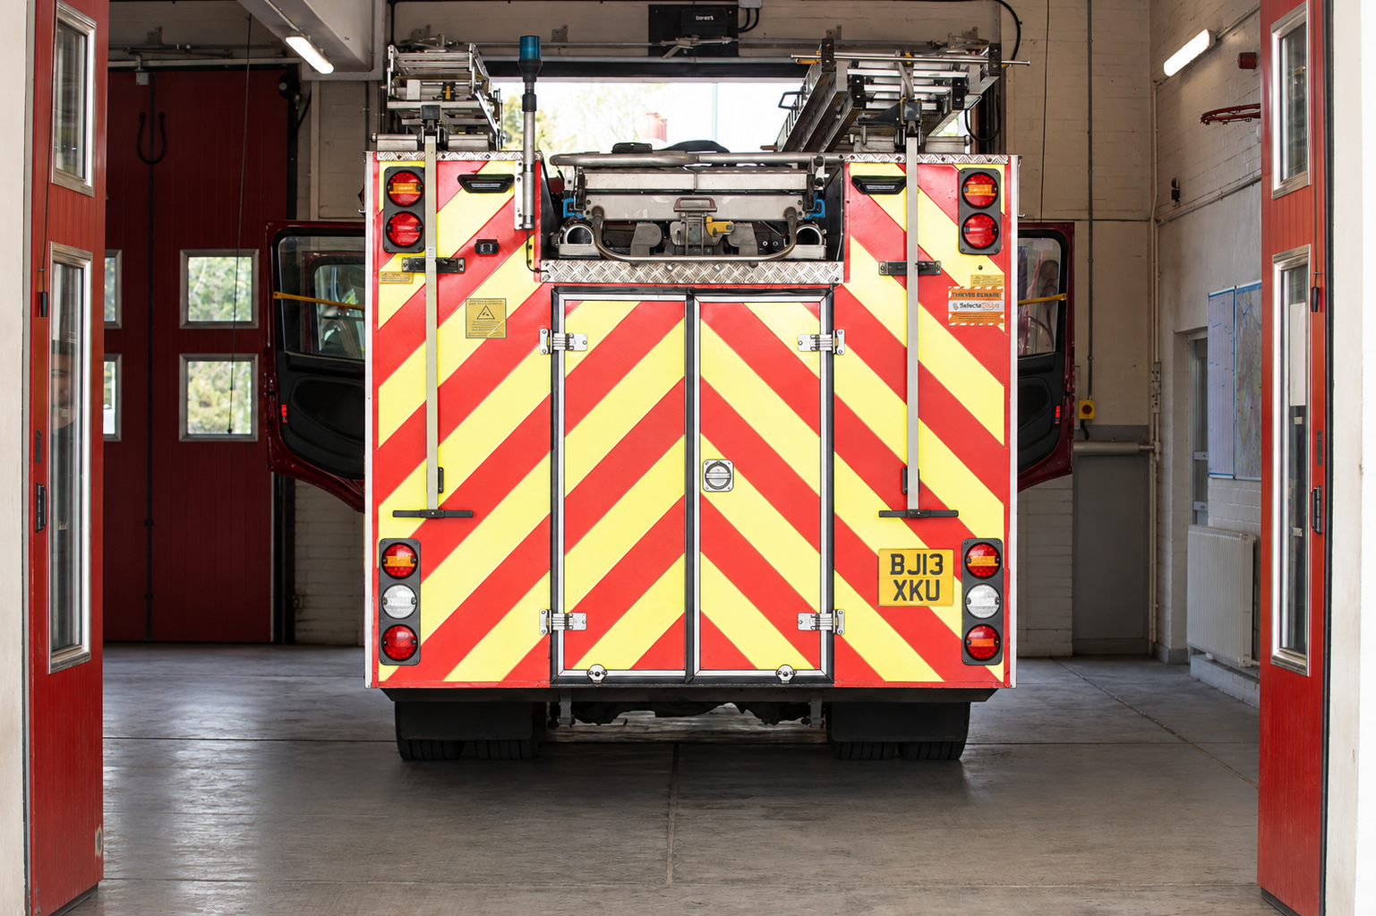








Specialist Teams (extra training required)

Slide 9
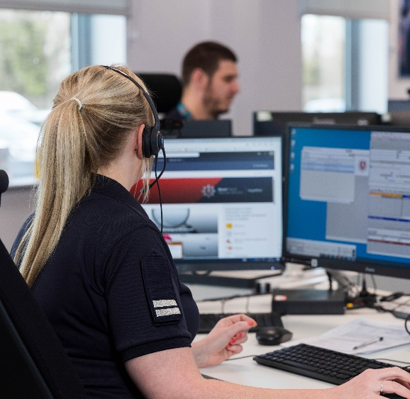

Firefighters
About this job
Taking calls from the public, crews, other emergency services and partner agencies
Mobilise and support emergency fire and rescue service resource
Salaries start from £28,000 per annum
As a Fire Control Operator, you play a vital role in helping people during emergencies such as fires, road traffic collisions, and water rescues. Working in a fast-paced control room, you answer 999 calls, keep callers calm, provide life-saving safety advice, and make sure the right emergency crews are sent quickly. The job involves working closely with firefighters, police, and ambulance services, using technology and communication skills to share important information and coordinate responses.
What super strengths would this role require?
THINK!
This job requires communication -
collaboration – decision making

Slide 10
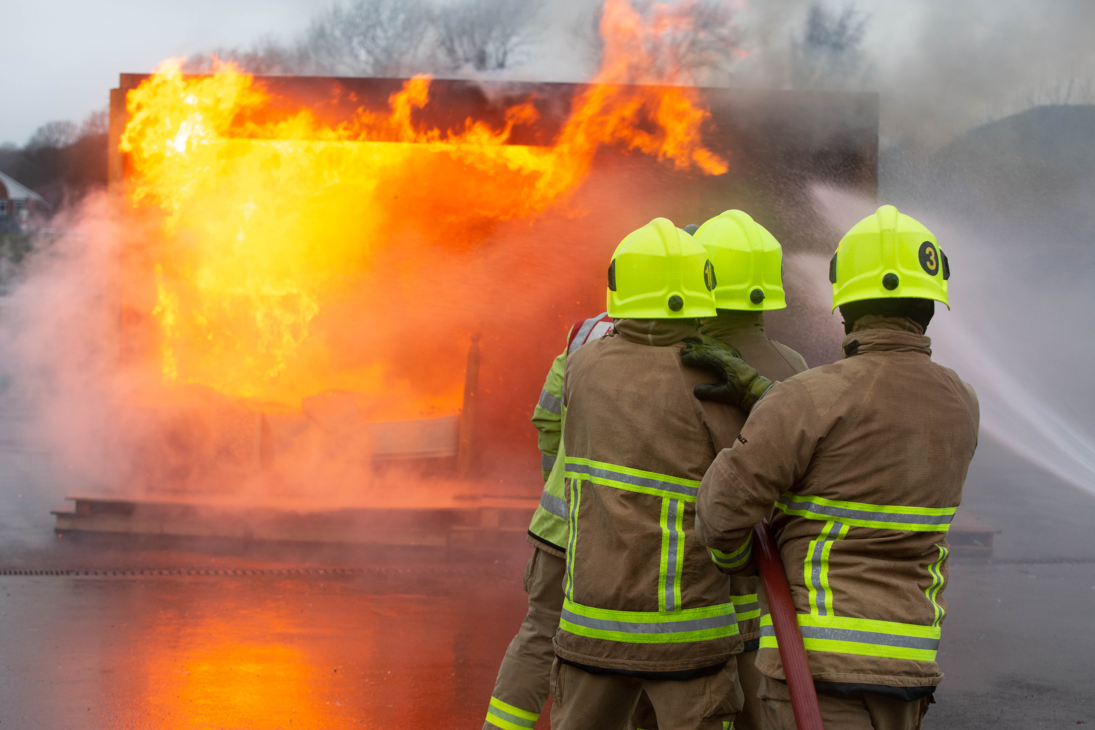

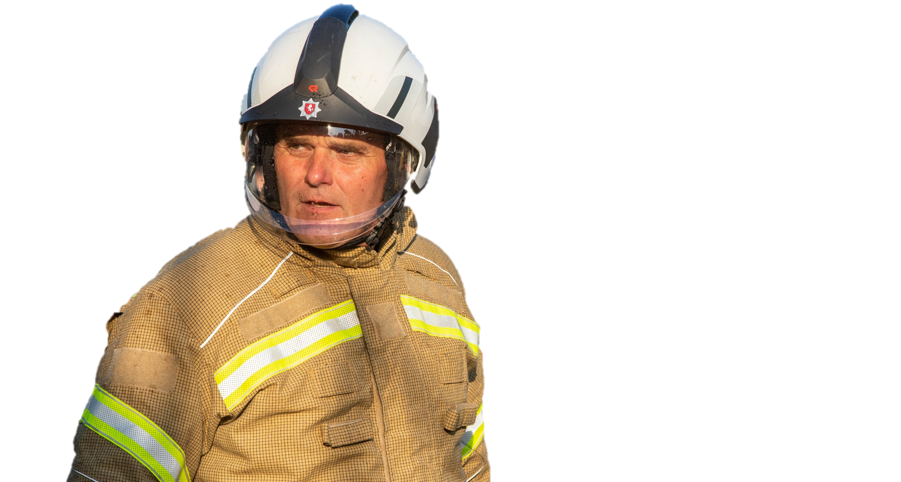

Firefighters
Engaging with people across the county to support their understanding about fire safety and reducing their risk.
Attending emergency calls and requests for assistance including fires, road accidents, flooding, spillages of dangerous substances and rail or air crashes.
To become a Firefighter, you need to be aged 18 or over, meet the required health and physical standards and work well in a team
Our on-call firefighters respond to emergencies in their area. They need to live/work within 5 minutes of the fire station. They work a full-time job alongside being on-call.
What super strengths would this role require?
This job requires compassion, kindness, enthusiasm and commitment

Slide 11
Water
Rescue
About this job
Taking calls from the public, crews, other emergency services and partner agencies
Mobilise and support emergency fire and rescue service resource
Salaries start from £28,000 per annum
As a Fire Control Operator, you play a vital role in helping people during emergencies such as fires, road traffic collisions, and water rescues. Working in a fast-paced control room, you answer 999 calls, keep callers calm, provide life-saving safety advice, and make sure the right emergency crews are sent quickly. The job involves working closely with firefighters, police, and ambulance services, using technology and communication skills to share important information and coordinate responses.
What super strengths would this role require?
THINK!
This job requires communication -
collaboration – decision making

Slide 12
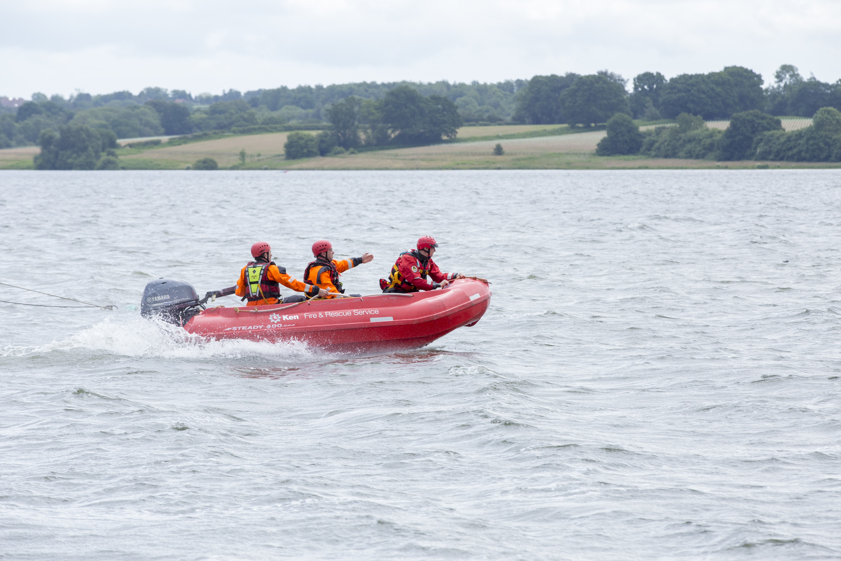
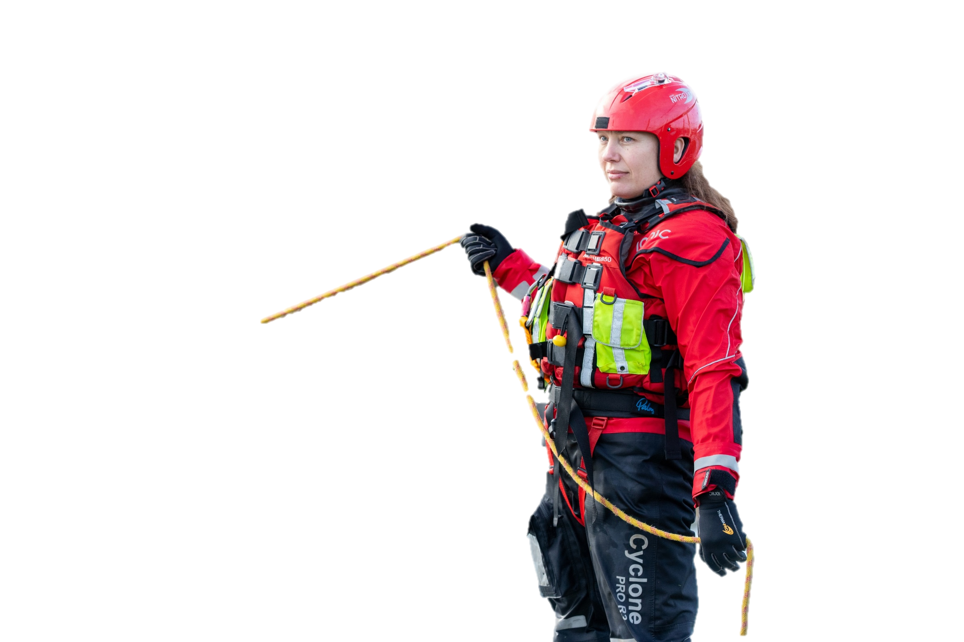
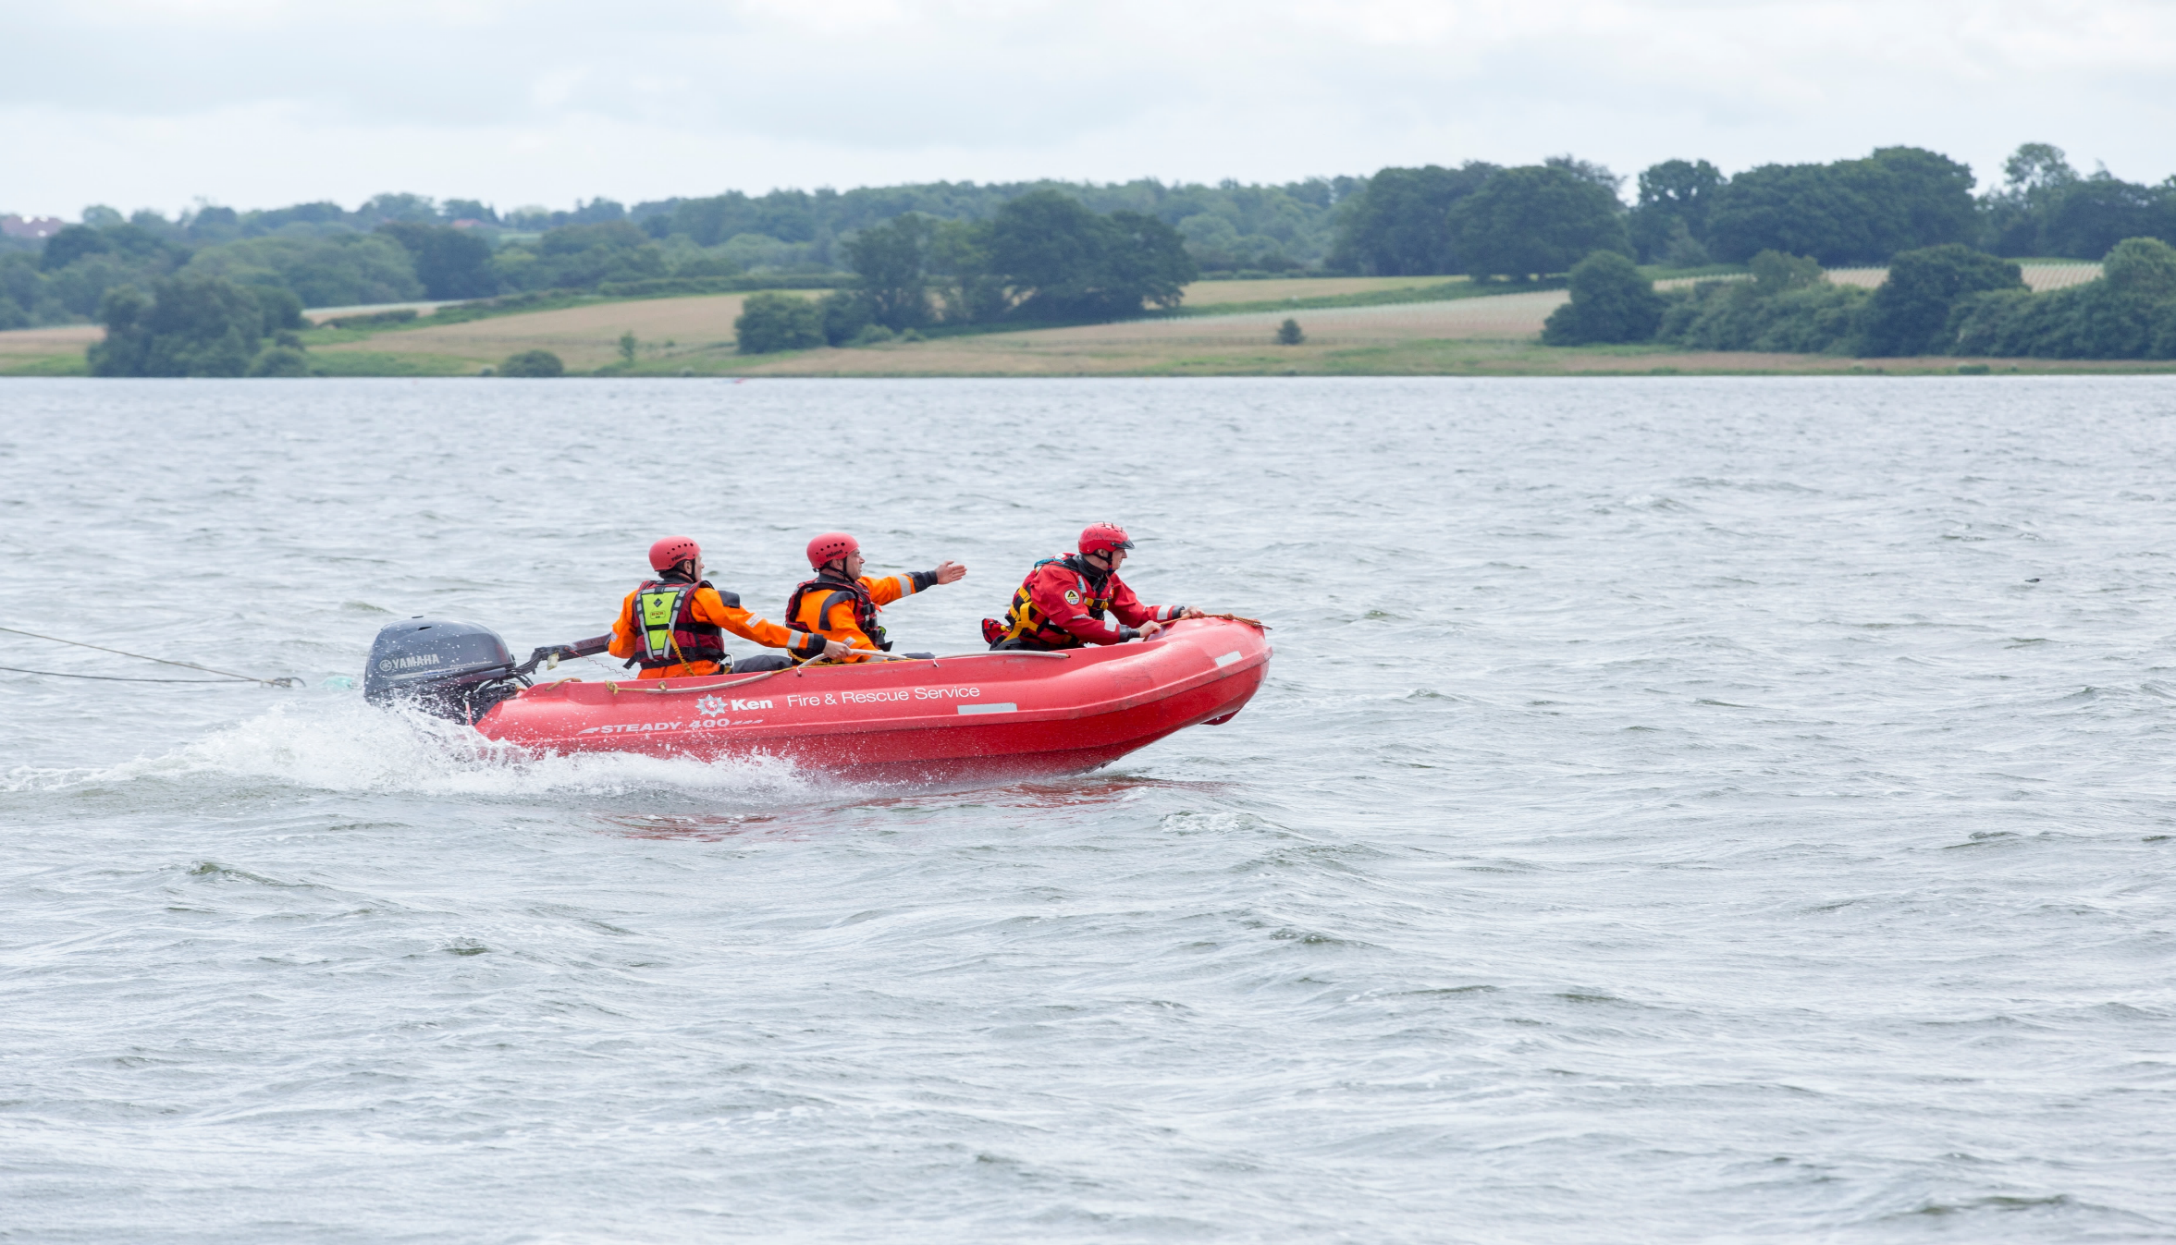
Firefighters
Water Rescue
Responding to emergency calls involving individuals in trouble in the water. This can be in rivers, lakes, canals and ponds.
Specialist PPE and equipment such as dry suits, floatation devices, inflatable boats and throw lines.
Located at Whitstable, Folkestone, Larkfield, Rochester and Tonbridge fire stations.

Slide 13
Animal
Rescue
About this job
Taking calls from the public, crews, other emergency services and partner agencies
Mobilise and support emergency fire and rescue service resource
Salaries start from £28,000 per annum
As a Fire Control Operator, you play a vital role in helping people during emergencies such as fires, road traffic collisions, and water rescues. Working in a fast-paced control room, you answer 999 calls, keep callers calm, provide life-saving safety advice, and make sure the right emergency crews are sent quickly. The job involves working closely with firefighters, police, and ambulance services, using technology and communication skills to share important information and coordinate responses.
What super strengths would this role require?
THINK!
This job requires communication -
collaboration – decision making

Slide 14

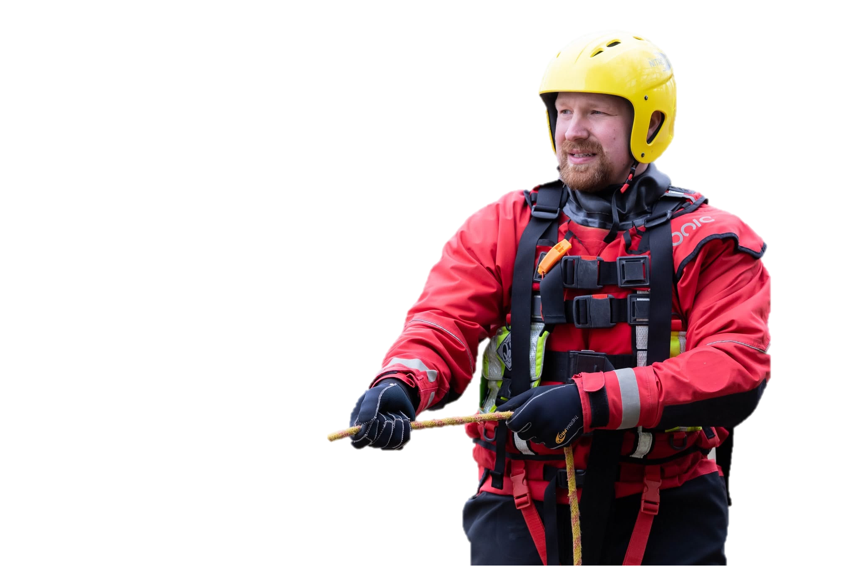

Firefighters
Water Rescue
Animal Rescue
Responding to emergency calls involving animals. This can include rescuing a range of animals like dogs, birds, cattle, horses and even elephants!
Specialist PPE and equipment including an All-Terrian Rescue Unit (ARU) vehicle with a crane, winches and harnesses for animal rescues.
Located at Faversham fire station.

Slide 15
Technical
Rescue
About this job
Taking calls from the public, crews, other emergency services and partner agencies
Mobilise and support emergency fire and rescue service resource
Salaries start from £28,000 per annum
As a Fire Control Operator, you play a vital role in helping people during emergencies such as fires, road traffic collisions, and water rescues. Working in a fast-paced control room, you answer 999 calls, keep callers calm, provide life-saving safety advice, and make sure the right emergency crews are sent quickly. The job involves working closely with firefighters, police, and ambulance services, using technology and communication skills to share important information and coordinate responses.
What super strengths would this role require?
THINK!
This job requires communication -
collaboration – decision making

Slide 16
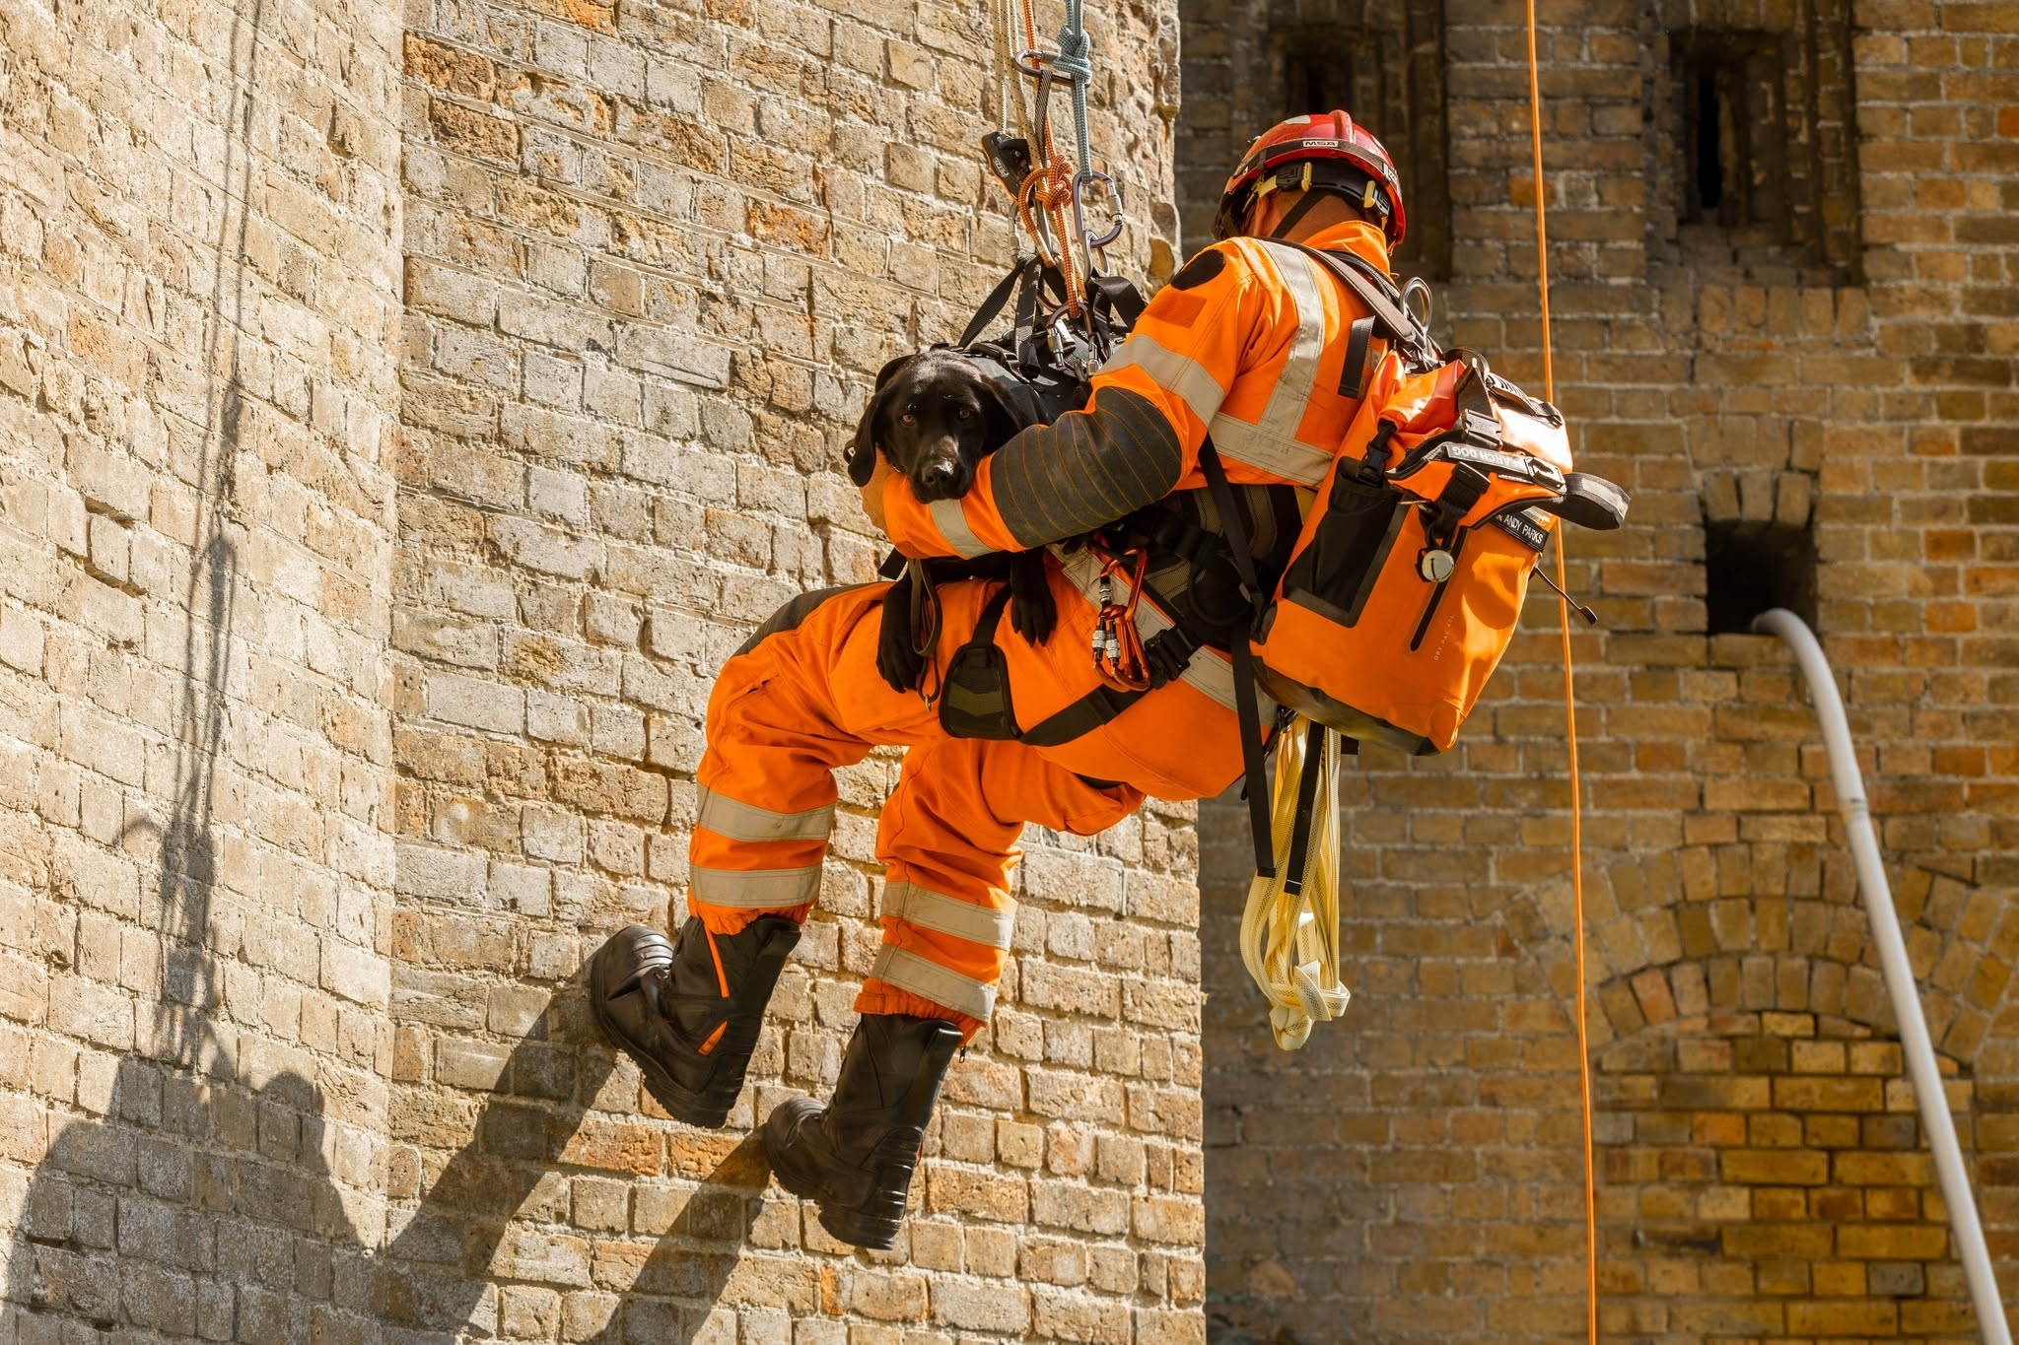
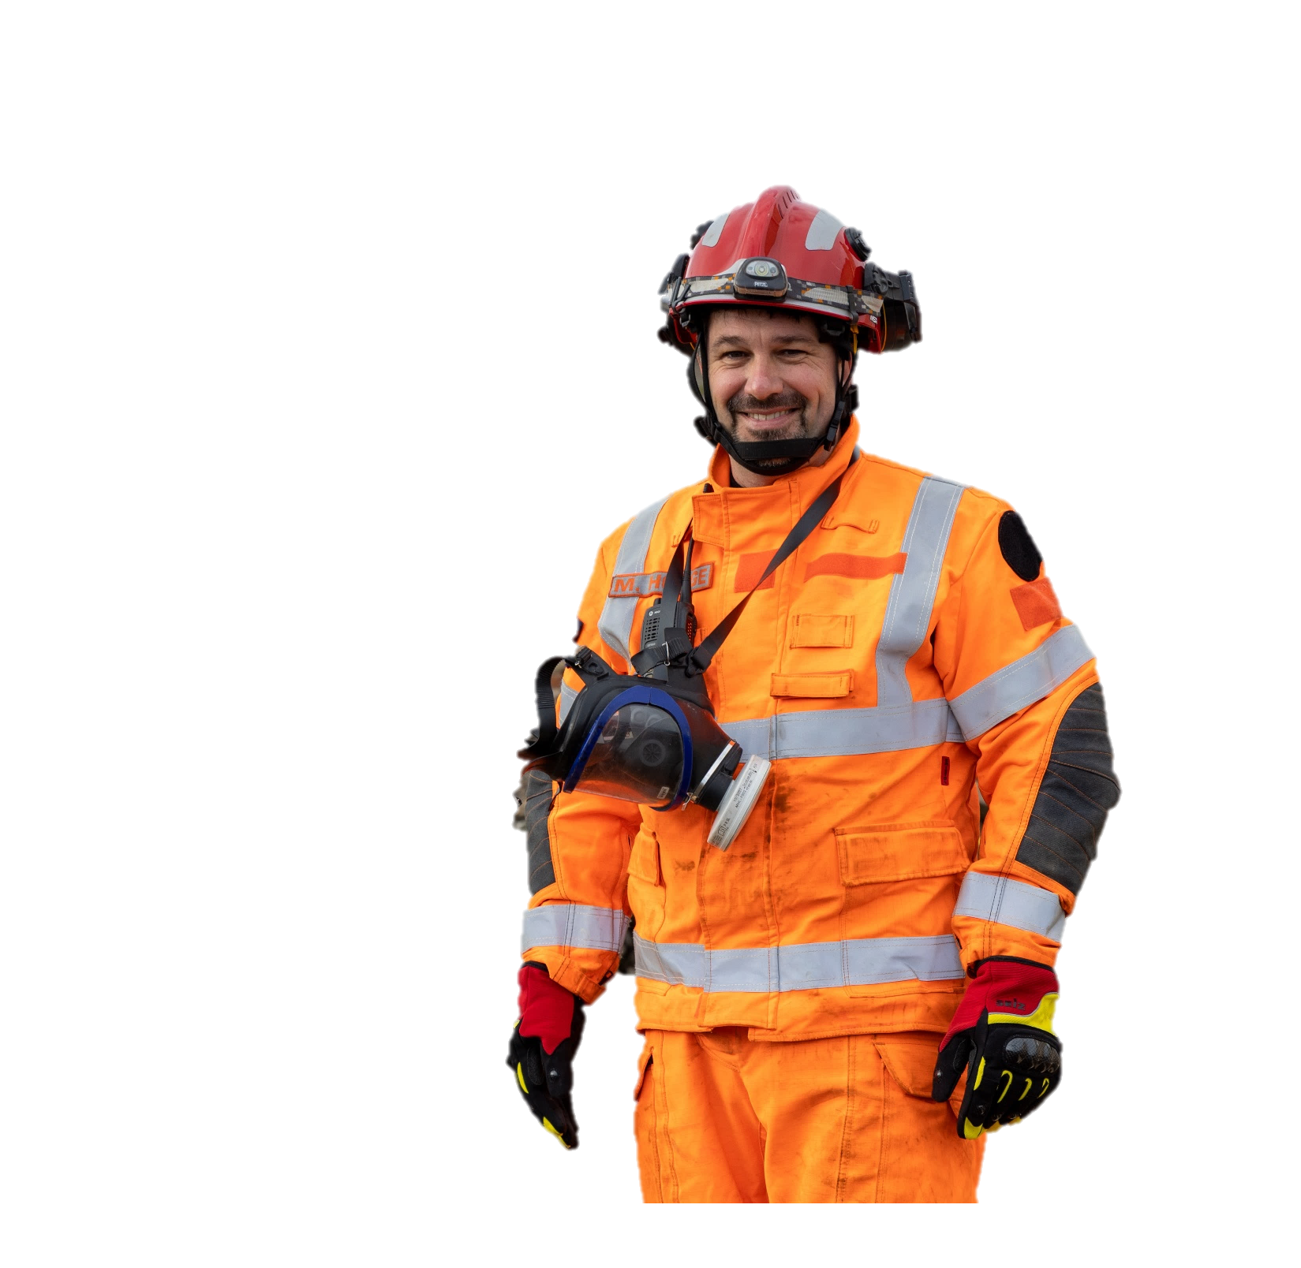

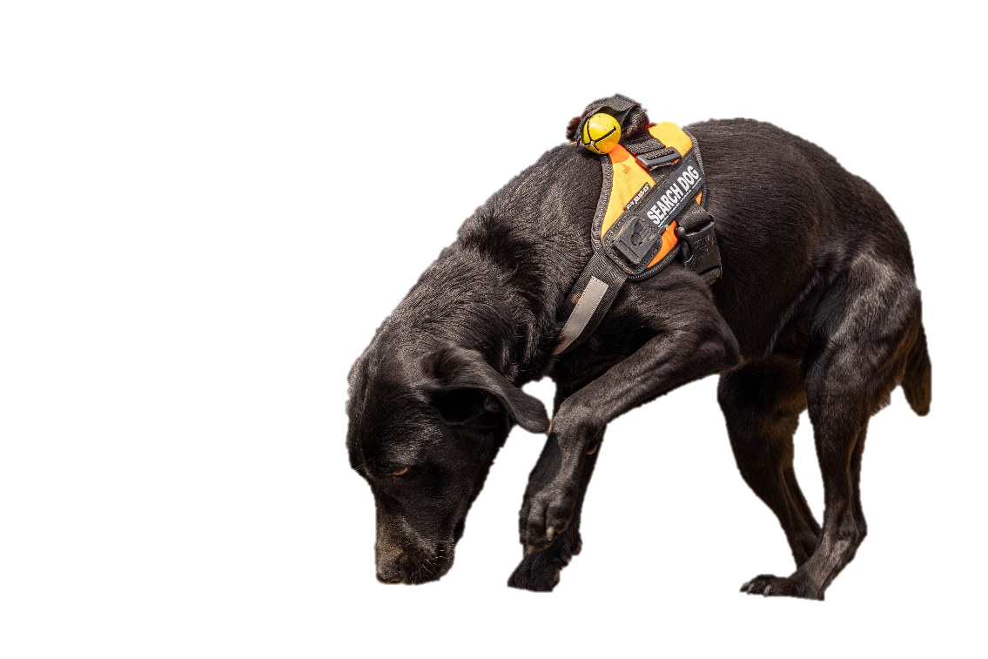
Tech Rescue
Technical Rescue
Responding to emergency calls for complex rescues. This can include missing people, someone who is trapped or catastrophic incidents such as earthquakes.
Specialist PPE and equipment including technical search equipment and a search and rescue dog unit.
Located at Tonbridge fire station.

Slide 17
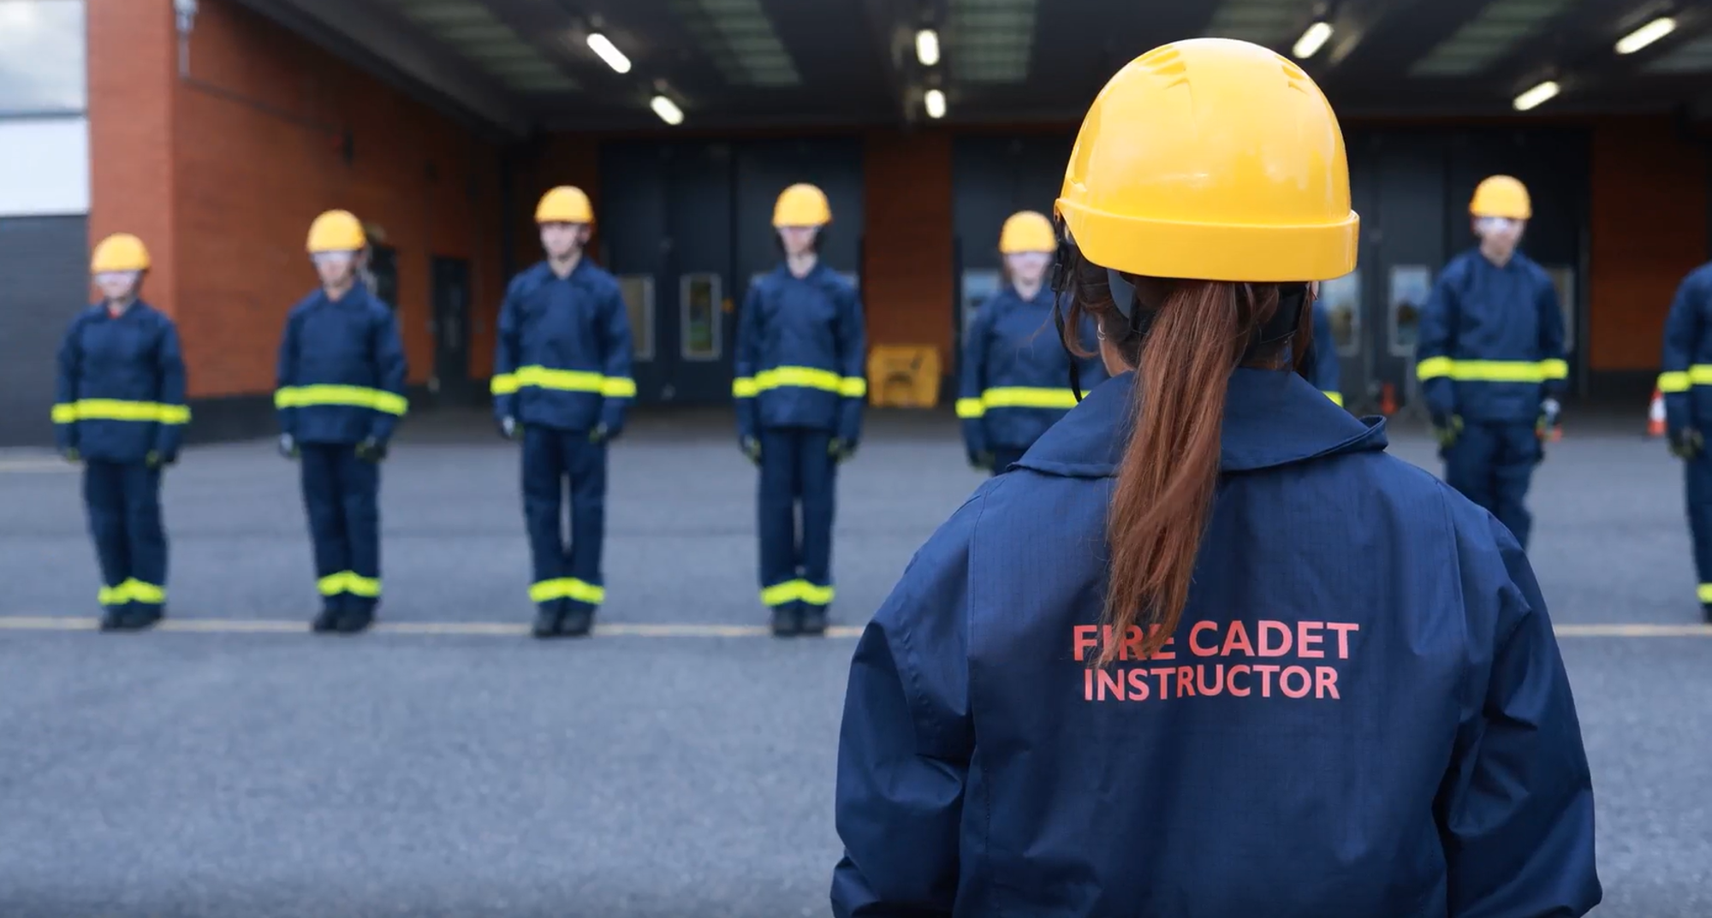


Slide 18
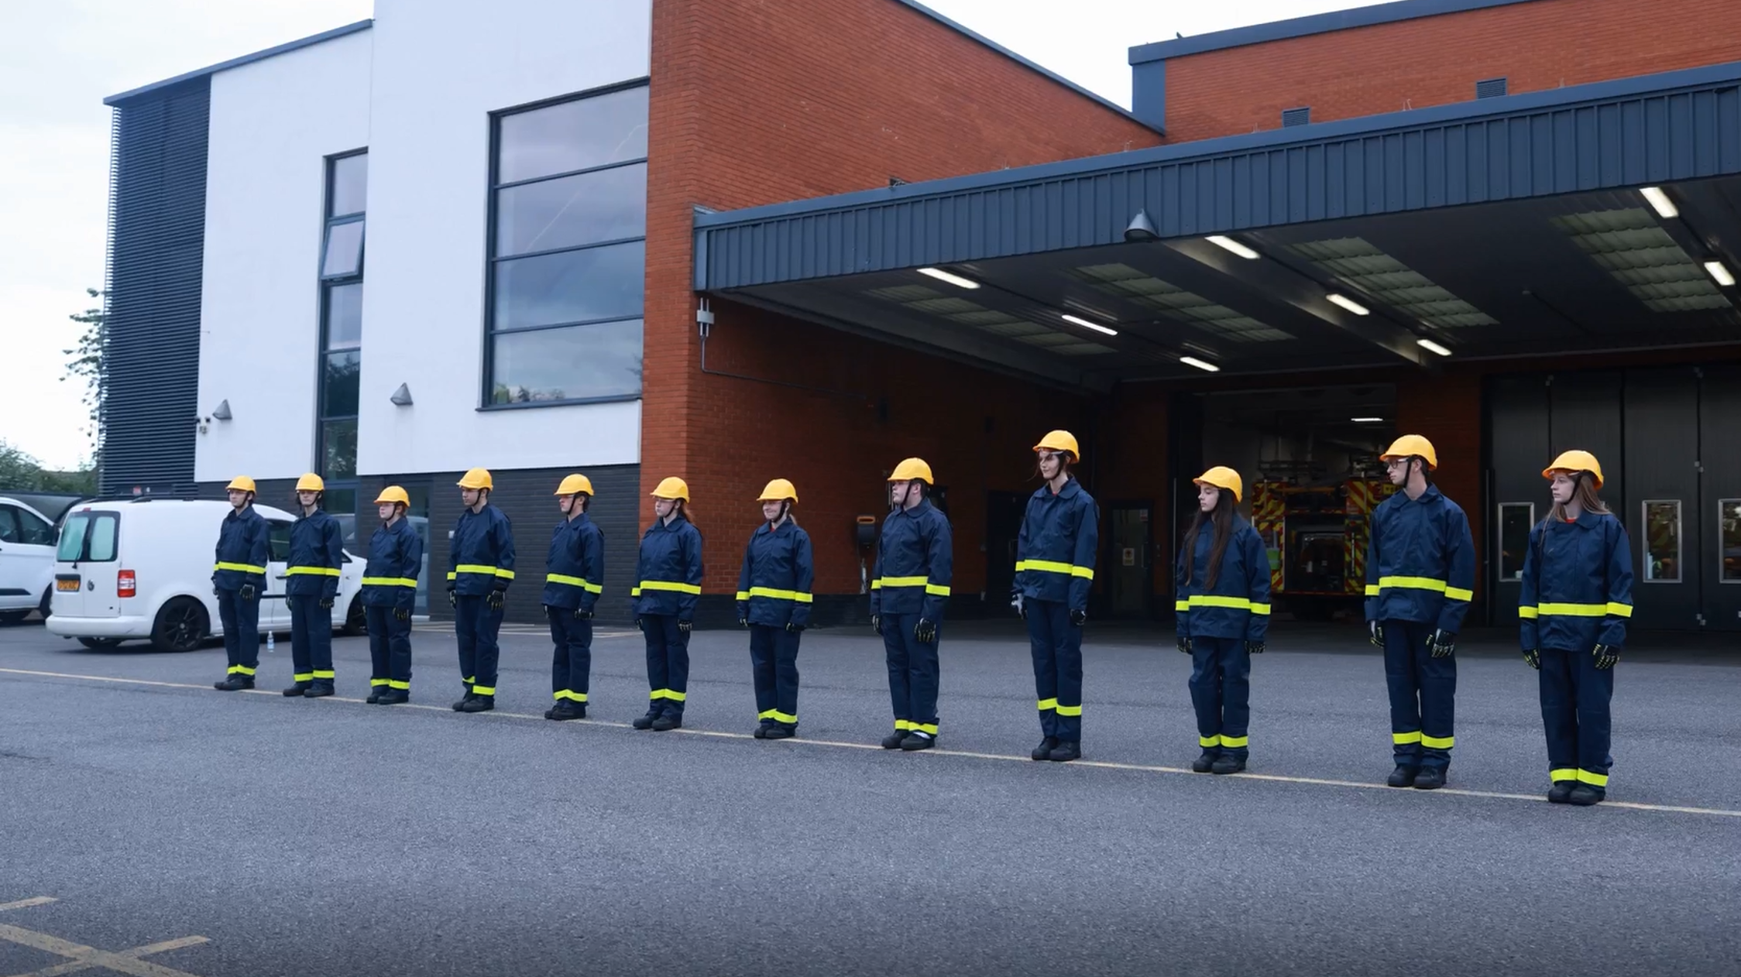
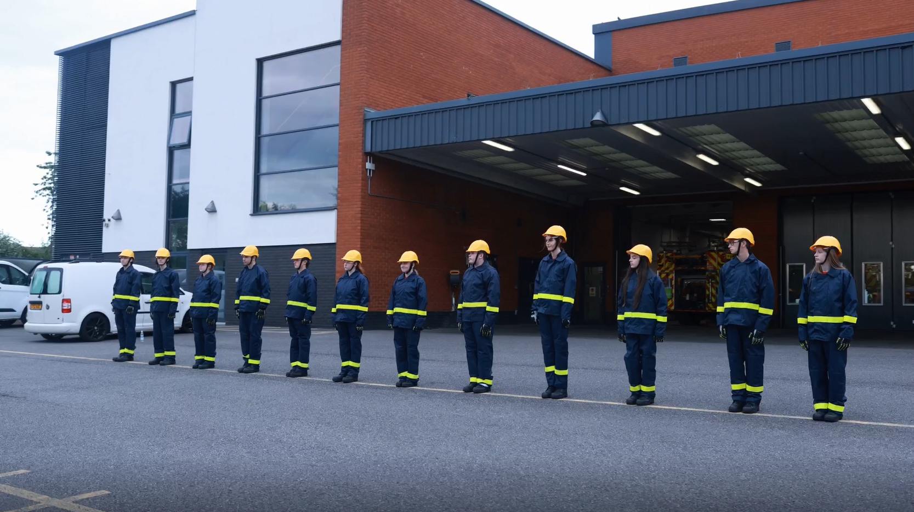
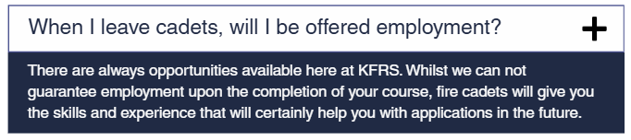
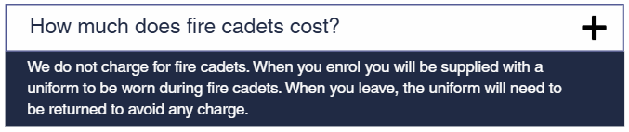
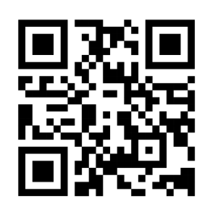
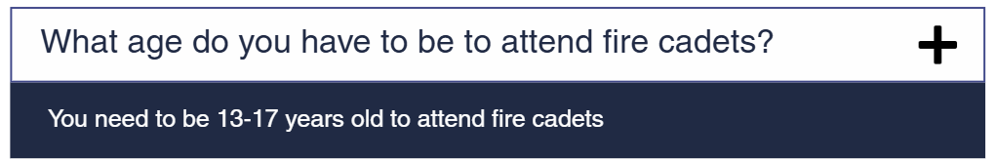
Why do we offer
Fire Cadets?
Fire cadets offers young people a unique opportunity to improve their life skills and personal development. Cadets face challenges that help build communication, leadership, and collaboration skills that are valuable not only within the fire service but in everyday life. Working in a team cadets learn how to support one another, resolve conflicts, and achieve common goals - skills that are essential in any professional or personal setting and inspires the next generation to help create a safer future for Kent and Medway.
Frequently asked questions
If you’re interested in fire cadets find out more here

Slide 19

Fire Control
Operator
About this job
Taking calls from the public, crews, other emergency services and partner agencies.
Mobilise and support emergency fire and rescue service resource.
What super strengths would this role require?
This job requires communication,
collaboration and decision making
As a Fire Control Operator, you play a vital role in helping people during emergencies such as fires, road traffic collisions, and water rescues. Working in a fast-paced control room, you answer 999 calls, keep callers calm, provide life-saving safety advice, and make sure the right emergency crews are sent quickly. The job involves working closely with firefighters, police, and ambulance services, using technology and communication skills to share important information and coordinate responses.

Slide 20
Operator
Fire Control
About this job
Receiving calls from the public, crews, other emergency services and partner agencies.
Mobilise and support emergency fire and rescue service resource.
What super strengths would this role require?
As a Fire Control Operator, you play a vital role in helping people during emergencies such as fires, road traffic collisions, and water rescues. Working in a fast-paced control room, you answer 999 calls, keep callers calm, provide life-saving safety advice, and make sure the right emergency crews are sent quickly. The job involves working closely with firefighters, police, and ambulance services, using technology and communication skills to share important information and coordinate responses.
This job requires communication,
collaboration and decision making

Slide 21
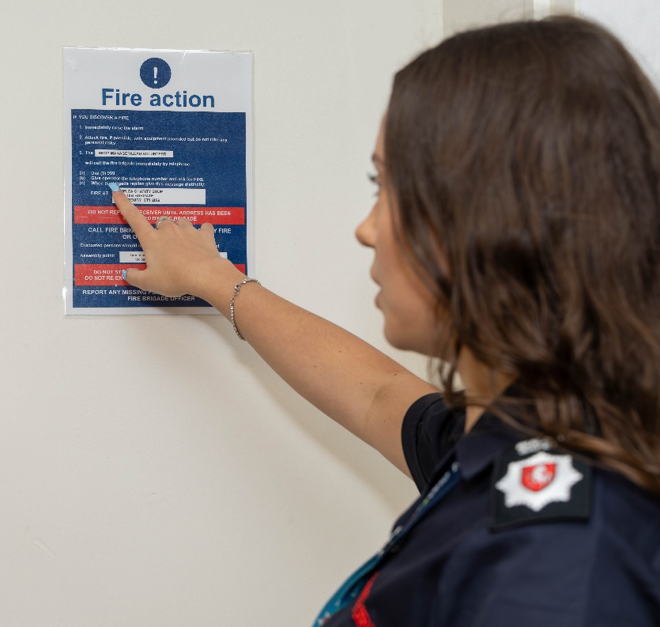
Building Fire
Safety Operator
About this job
Carrying out fire safety inspections/re-inspections and audits.
Audit premises and provide advice and guidance to responsible persons and take enforcement action where necessary.
This job requires communication,
problem solving and attention to detail
What super strengths would this role require?
I help make sure buildings such as care homes, flats and hospitals are safe and follow fire safety laws. I enjoy working with people in the community, carrying out inspections and helping organisations improve safety. No two days are the same – I might spend part of the day visiting buildings, speaking with managers, reviewing safety measures, and then recording my findings back at the fire station.

Slide 22
Building Fire
Safety Operator
About this job
Completing fire safety inspections/re-inspections and audits.
Audit premises and provide advice and guidance to responsible persons and take enforcement action where necessary.
This job requires communication,
problem solving and attention to detail
I help make sure buildings such as care homes, flats and hospitals are safe and follow fire safety laws. I enjoy working with people in the community, carrying out inspections and helping organisations improve safety. No two days are the same – I might spend part of the day visiting buildings, speaking with managers, reviewing safety measures, and then recording my findings back at the fire station.
What super strengths would this role require?

Slide 23
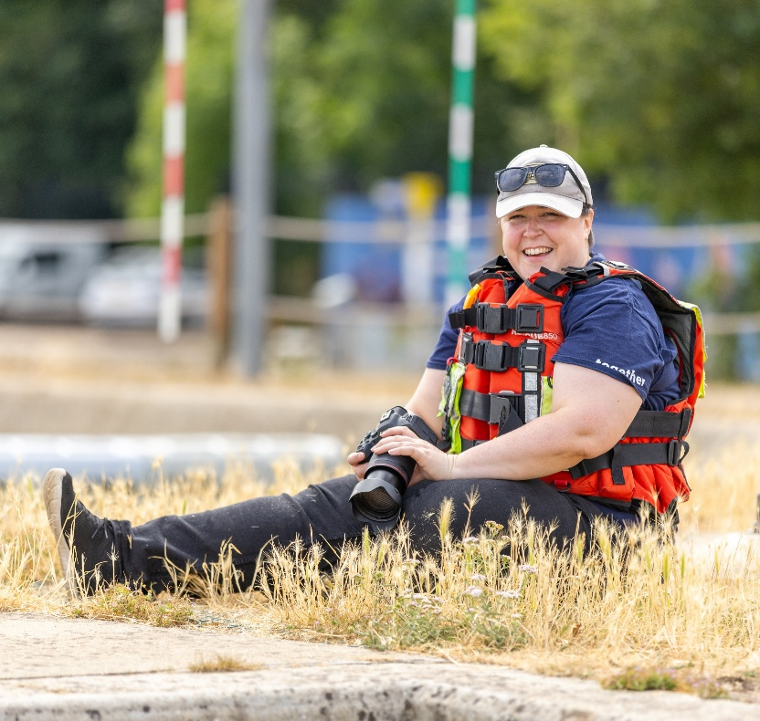
Content
Designer
About this job
Create, edit and improve content for use across the service.
Design clear, accessible and high-quality content that supports the safety and wellbeing of our communities.
This job requires creativity, collaboration and innovation
What super strengths would this role require?
I work in a creative role where no two days are the same. I create engaging content such as training videos for firefighters and virtual reality (VR) experiences that help educate and inspire the public. A typical week might include meetings, filming at different locations, and editing projects ready for delivery. The job combines creativity with problem-solving, as I often turn complex information into content that is easy to understand and interesting to watch. Being curious, enjoying learning new things, and always looking to improve are important skills.

Slide 24
Content
Designer
About this job
Create, edit and improve content for use across the service.
Design clear, accessible and high-quality content that supports the safety and wellbeing of our communities.
This job requires creativity, collaboration and innovation
I work in a creative role where no two days are the same. I create engaging content such as training videos for firefighters and virtual reality (VR) experiences that help educate and inspire the public. A typical week might include meetings, filming at different locations, and editing projects ready for delivery. The job combines creativity with problem-solving, as I often turn complex information into content that is easy to understand and interesting to watch. Being curious, enjoying learning new things, and always looking to improve are important skills.
What super strengths would this role require?

Slide 25

Safe and Well
Officer
About this job
Visit customers in their homes providing fire safety advice and assessing the risk of fire.
Offer and fit free fire prevention equipment such as smoke alarms.
What super strengths would this role require?
This job requires compassion, time management and decision making
This role is all about helping people stay safe in their homes and supporting members of the community who may need extra help. No two days are the same – you might fit smoke alarms, give fire safety advice, work with other organisations, or simply spend time chatting with someone who hasn't seen many people recently. The job involves planning visits, travelling to different homes, completing safety checks, and writing reports.

Slide 26
Safe and Well
Officer
About this job
Visit customers in their homes providing fire safety advice and assessing the risk of fire.
Offer and install free fire prevention equipment such as smoke alarms.
What super strengths would this role require?
This role is all about helping people stay safe in their homes and supporting members of the community who may need extra help. No two days are the same – you might fit smoke alarms, give fire safety advice, work with other organisations, or simply spend time chatting with someone who hasn't seen many people recently. The job involves planning visits, travelling to different homes, completing safety checks, and writing reports.
This job requires compassion, time management and decision making

Slide 27
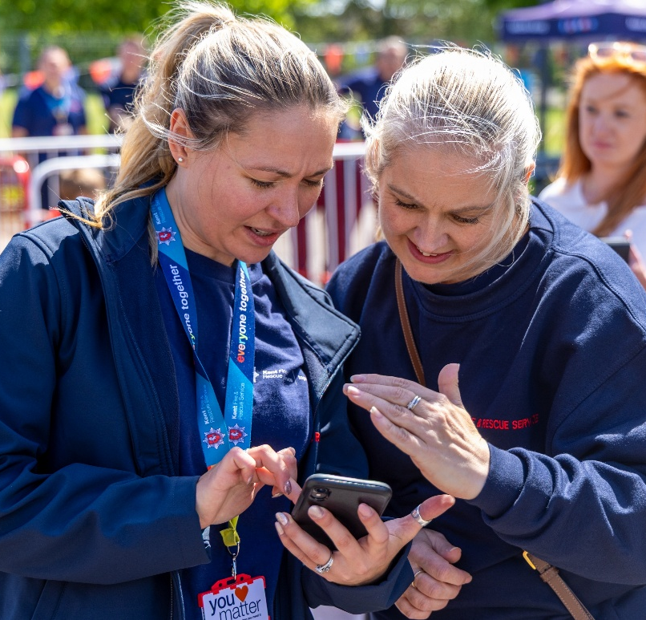
Social Media
Officer
About this job
Run Kent Fire and Rescue’s social media channels day-to-day, and during emergency incidents.
Produce detailed content plans for all Kent Fire and Rescue’s social media channels.
This job requires work independently, working well under pressure and attention to detail
What super strengths would this role require?
I work in communications, creating content that helps inform and engage the public. What I enjoy most is the variety of the role—no two days are the same. I travel to different fire stations, work with firefighters and colleagues, create videos and social media content, and help plan campaigns with my team. It’s rewarding to know that the content we create can have a real impact on the community.

Slide 28
Officer
Social Media
About this job
Operate Kent Fire and Rescue’s social media channels day-to-day, and during emergency incidents.
Produce detailed content plans for all Kent Fire and Rescue’s social media channels.
This job requires work independently, working well under pressure and attention to detail
I work in communications, creating content that helps inform and engage the public. What I enjoy most is the variety of the role—no two days are the same. I travel to different fire stations, work with firefighters and colleagues, create videos and social media content, and help plan campaigns with my team. It’s rewarding to know that the content we create can have a real impact on the community.
What super strengths would this role require?

Slide 29
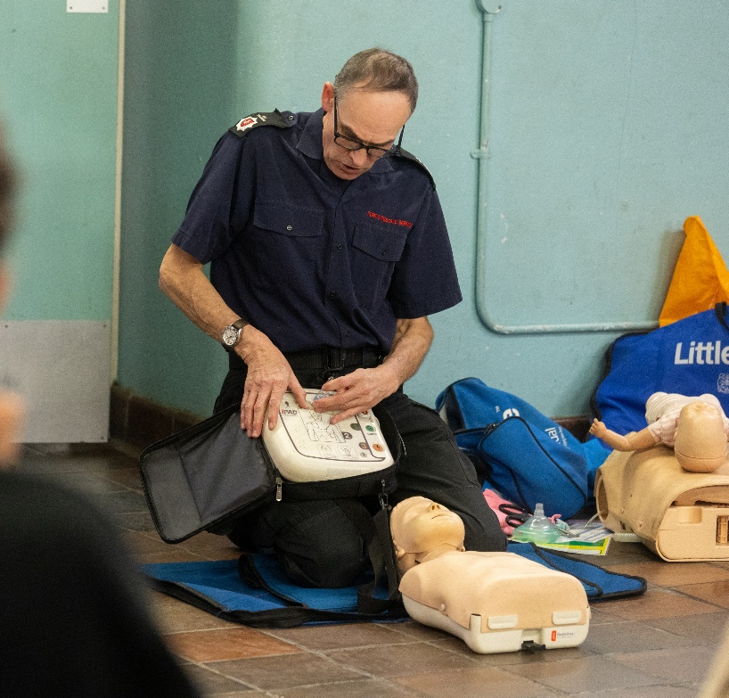
Immediate
Emergency
Care Trainer
About this job
Deliver immediate emergency care and patient moving and handling training to operational colleagues.
Deliver first aid training to non-operational colleagues.
As an Immediate Emergency Care Trainer, I have the privilege of meeting people from all backgrounds, including teachers, parents, carers, students, business professionals, and community groups. Watching them develop the confidence to perform CPR and respond effectively in an emergency is incredibly inspiring. Knowing that a few hours of training today could mean someone gets a second chance tomorrow is what makes this role so rewarding. Empowering people to act when it matters most is not just a job—it’s a chance to make a lasting difference in our communities.
This job requires networking, communication and nurturing
What super strengths would this role require?

Slide 30
Immediate
Emergency
Care Trainer
About this job
Deliver immediate emergency care and patient moving and handling training to operational colleagues.
Deliver first aid training to non-operational colleagues.
This job requires networking, communication and nurturing
As an Immediate Emergency Care Trainer, I have the privilege of meeting people from all backgrounds, including teachers, parents, carers, students, business professionals, and community groups. Watching them develop the confidence to perform CPR and respond effectively in an emergency is incredibly inspiring. Knowing that a few hours of training today could mean someone gets a second chance tomorrow is what makes this role so rewarding. Empowering people to act when it matters most is not just a job—it’s a chance to make a lasting difference in our communities.
What super strengths would this role require?

Slide 31
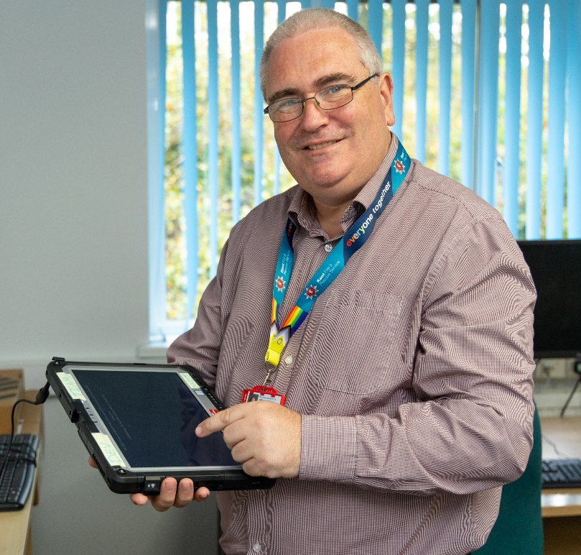
IT First Line
Engineer
About this job
Provide IT support to internal staff helping with simple queries and resolving straightforward incidents.
Diagnose and resolve basic issues with laptops, desktops, mobile phones, radios and printers.
This job requires problem-solving, time management and active listening
Behind every resolved issue is a person who can get back to doing their job, supporting others, or delivering vital services because technology is working as it should. This role is about much more than fixing technical problems—it’s about listening, communicating, and building trust while applying technical expertise to find solutions quickly and effectively. The most rewarding part is knowing that through a combination of people skills and technology, we help keep essential services running and empower others to succeed every day.
What super strengths would this role require?

Slide 32
IT First Line
Engineer
About this job
Provide IT support to internal staff helping with simple queries and resolving straightforward incidents.
Diagnose and resolve basic issues with laptops, desktops, mobile phones, radios and printers.
This job requires problem-solving, time management and active listening
Behind every resolved issue is a person who can get back to doing their job, supporting others, or delivering vital services because technology is working as it should. This role is about much more than fixing technical problems—it’s about listening, communicating, and building trust while applying technical expertise to find solutions quickly and effectively. The most rewarding part is knowing that through a combination of people skills and technology, we help keep essential services running and empower others to succeed every day.
What super strengths would this role require?

Slide 33
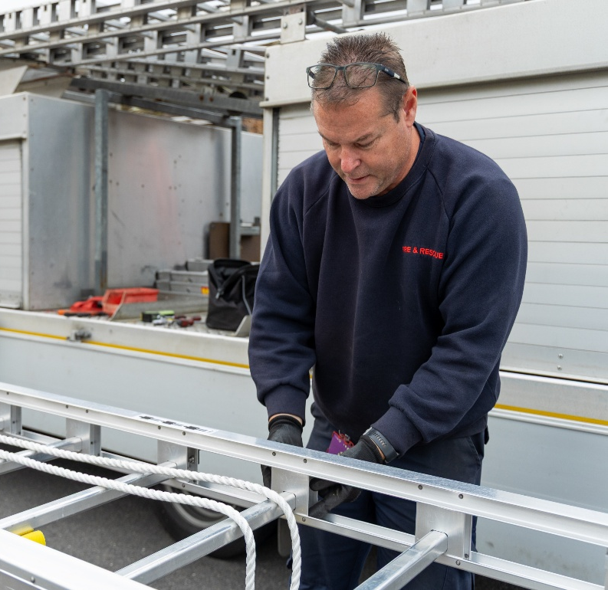
Mobile
Technician
About this job
Maintain, service and repair our fleet of fire engines, specialist vehicles, light vehicles and equipment.
Ensure that vehicles meet legal requirements.
This job requires patience, problem solving and curiosity
What super strengths would this role require?
I take great pride in knowing that the work I do helps keep the fire service ready to respond when it matters most. Every inspection, repair, and service plays a vital role in ensuring our vehicles remain reliable, safe, and operational, allowing crews to reach emergencies quickly and without delay. Whether I’m diagnosing a fault, carrying out preventative maintenance, or resolving unexpected issues, I know that my work directly supports the people who protect our communities.

Slide 34
Technician
Mobile
About this job
Maintain, service and repair our fleet of fire engines, specialist vehicles, light vehicles and equipment.
Ensure that vehicles meet legal requirements.
This job requires patience, problem solving and curiosity
I take great pride in knowing that the work I do helps keep the fire service ready to respond when it matters most. Every inspection, repair, and service plays a vital role in ensuring our vehicles remain reliable, safe, and operational, allowing crews to reach emergencies quickly and without delay. Whether I’m diagnosing a fault, carrying out preventative maintenance, or resolving unexpected issues, I know that my work directly supports the people who protect our communities.
What super strengths would this role require?

Slide 35
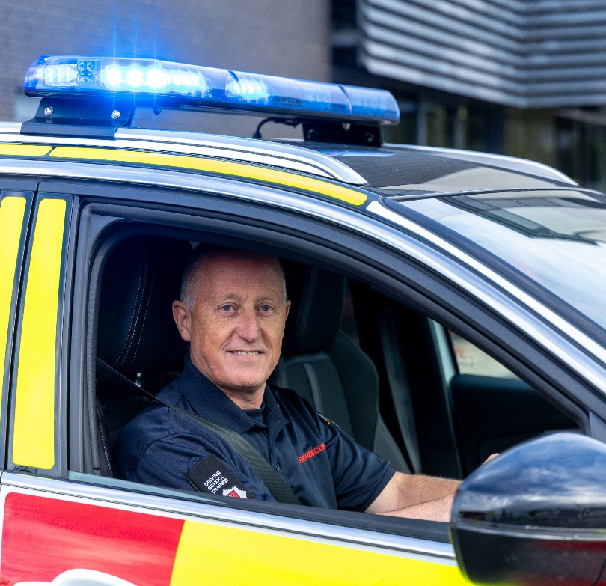
Driving
Instructor
About this job
Train/assess driving standards with licence acquisition and emergency response driver skills.
Provide appropriate feedback to develop driver skills.
This job requires observant, attention to detail and communication
What super strengths would this role require?
As a blue light vehicle driving instructor, I support colleagues in developing the skills, confidence and judgement required to blue light vehicles safely and effectively. I focus on developing strong decision-making and observation skills, helping learners assess risks, anticipate hazards and make safe, timely decisions in demanding situations. I also value the relationships built with colleagues throughout the learning process, creating an environment based on trust, communication and teamwork, which are essential when working together in an emergency response role.

Slide 36
Instructor
Driving
About this job
Train and assess driving standards with licence acquisition and emergency response driver skills.
Provide appropriate feedback to develop driver skills.
This job requires observant, attention to detail and communication
As a blue light vehicle driving instructor, I support colleagues in developing the skills, confidence and judgement required to blue light vehicles safely and effectively. I focus on developing strong decision-making and observation skills, helping learners assess risks, anticipate hazards and make safe, timely decisions in demanding situations. I also value the relationships built with colleagues throughout the learning process, creating an environment based on trust, communication and teamwork, which are essential when working together in an emergency response role.
What super strengths would this role require?

Slide 37

Education
Intervention Officer
About this job
Delivering fire safety talks to schools and communities educating young people on how to stay safe in their homes..
Providing fire safety interventions to young people to help them understand the dangers
This job requires patience, enthusiasm and passion
I am passionate about educating children and young people about the importance of fire safety and helping them understand how simple actions can keep themselves, their families, and others safe. I am committed to promoting a strong culture of safety and take pride in helping children develop the knowledge and confidence they need to recognise fire risks and know what to do in an emergency. My passion for keeping people safe is at the heart of everything I do, and I find it incredibly rewarding to know that the education I provide can help protect lives and prevent fires.
What super strengths would this role require?

Slide 38
Education
Intervention Officer
About this job
Deliver fire safety talks to schools and communities, educating young people on how to stay safe in their homes and communities.
Providing fire safety interventions to young people to help them understand the dangers.
This job requires patience, enthusiasm and passion
I am passionate about educating children and young people about the importance of fire safety and helping them understand how simple actions can keep themselves, their families, and others safe. I am committed to promoting a strong culture of safety and take pride in helping children develop the knowledge and confidence they need to recognise fire risks and know what to do in an emergency. My passion for keeping people safe is at the heart of everything I do, and I find it incredibly rewarding to know that the education I provide can help protect lives and prevent fires.
What super strengths would this role require?

Slide 39
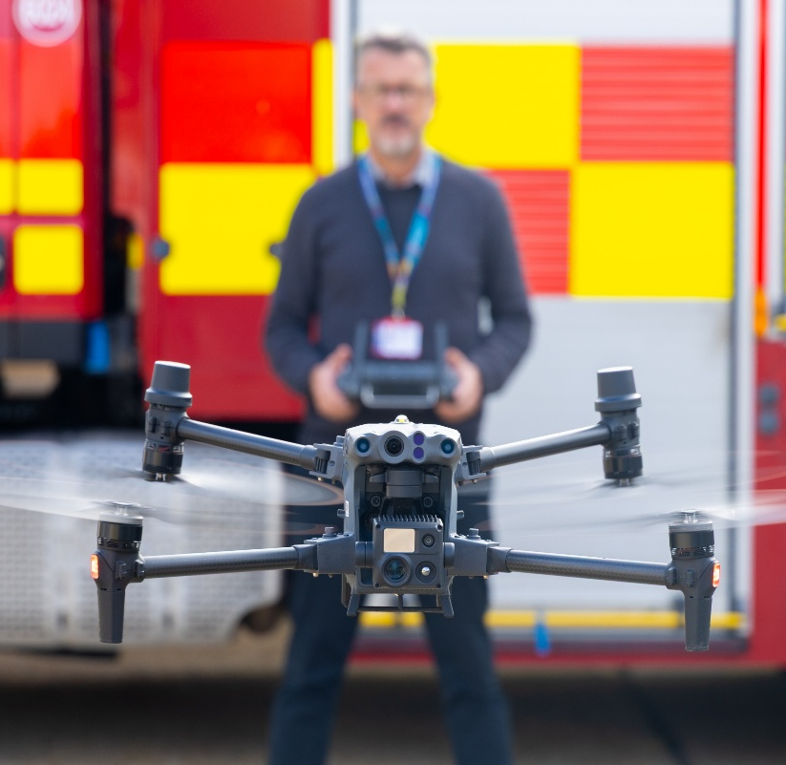
Drone
Capabilities
Manager
About this job
Oversee the required maintenance of the drone assets. This includes firmware, application support and hardware.
Research, evaluate and develop policy, procedures and equipment in respect of drones.
This job requires communication, problem solving and leadership
My role is to ensure our drone capability is safe, effective and ready to support operational colleagues when needed. I am responsible for the day-to-day maintenance, checks and readiness of our drones, as well as ensuring that the service operates within the relevant legislation, regulations and procedures required for safe drone operations.
My role also involves supporting operational teams by providing an aerial perspective at incidents. Drone footage and information can give colleagues a clearer understanding of what is happening on the ground, helping them make informed decisions and respond more effectively.
What super strengths would this role require?

Slide 40
Drone
Capabilities
Manager
About this job
Oversee the required maintenance of the drone assets. This includes firmware, application support and hardware.
Research, evaluate and develop policy, procedures and equipment in respect of drones.
My role is to ensure our drone capability is safe, effective and ready to support operational colleagues when needed. I am responsible for the day-to-day maintenance, checks and readiness of our drones, as well as ensuring that the service operates within the relevant legislation, regulations and procedures required for safe drone operations.
My role also involves supporting operational teams by providing an aerial perspective at incidents. Drone footage and information can give colleagues a clearer understanding of what is happening on the ground, helping them make informed decisions and respond more effectively.
This job requires communication, problem solving and leadership
What super strengths would this role require?

Slide 41
Summary

Slide 42
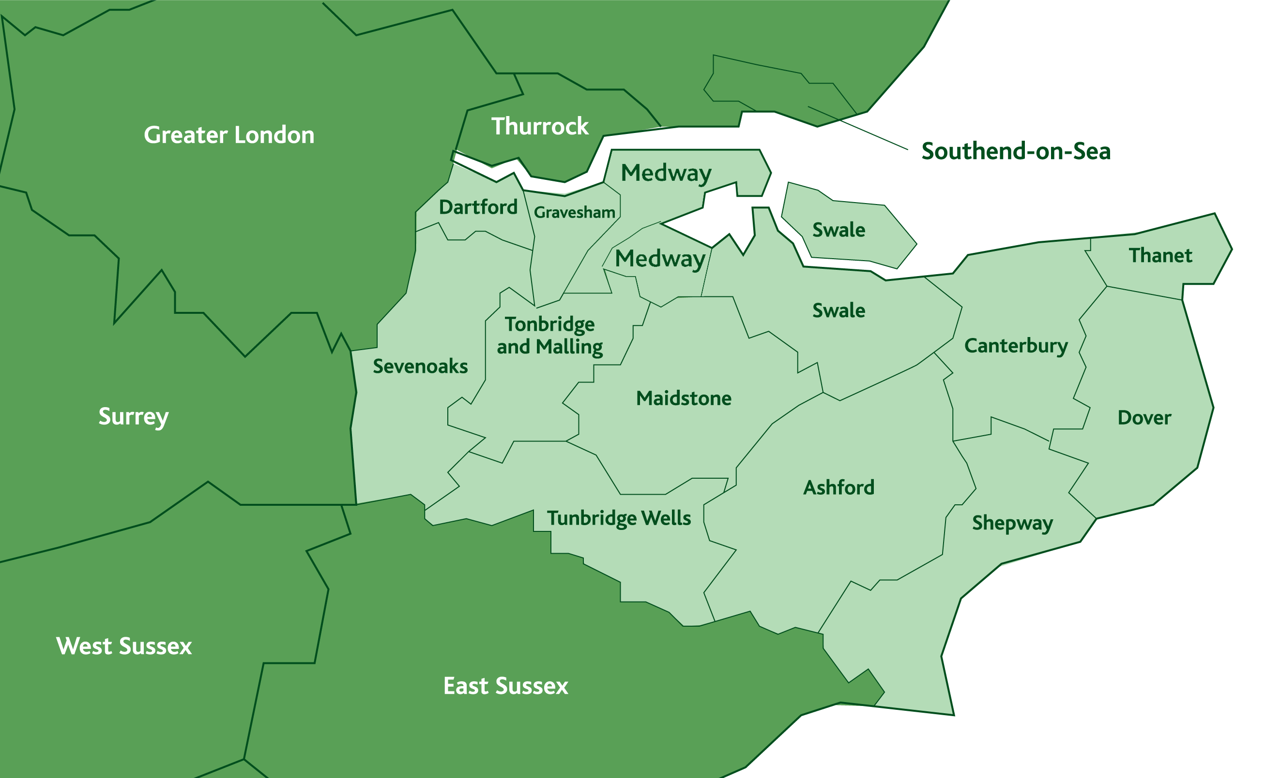


Every role across the service contributes to protecting the people of Kent
Keeping communities across Kent safe every day
Here are the fire stations across Kent and Medway
Learning check
Map of
Name a role within the fire service and its purpose
Name a super strength you have and how it could bring value to the fire service
Name a specialist team and the type of rescue they train for
Kent

