Slide 1


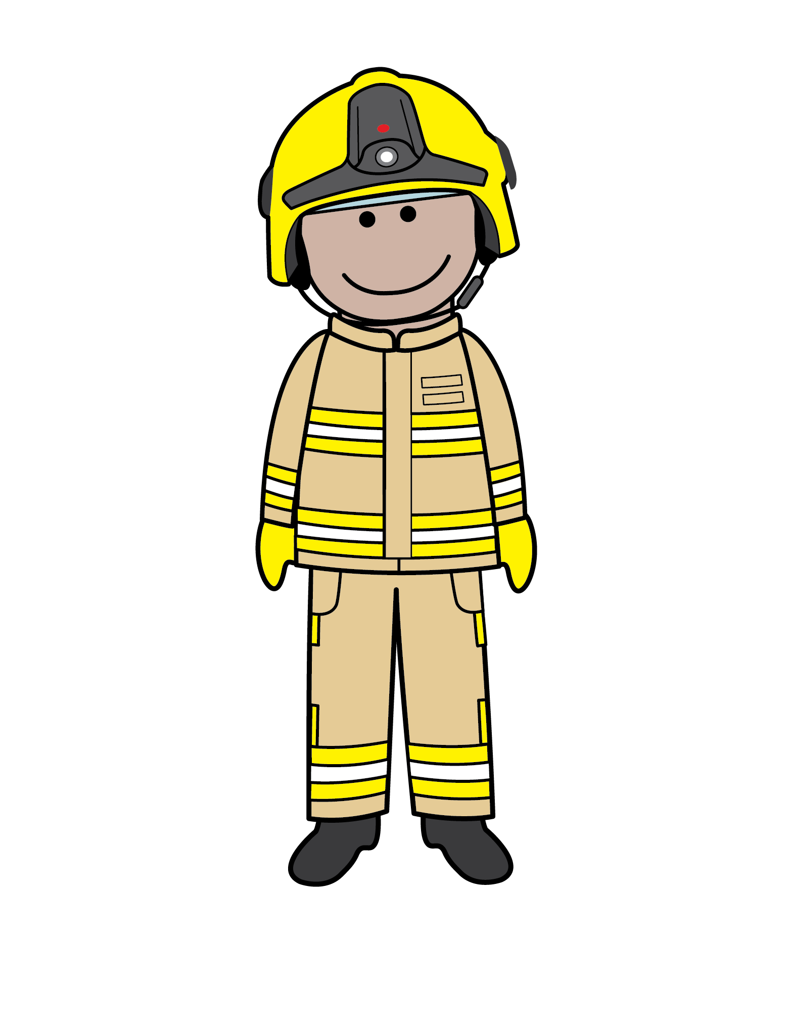



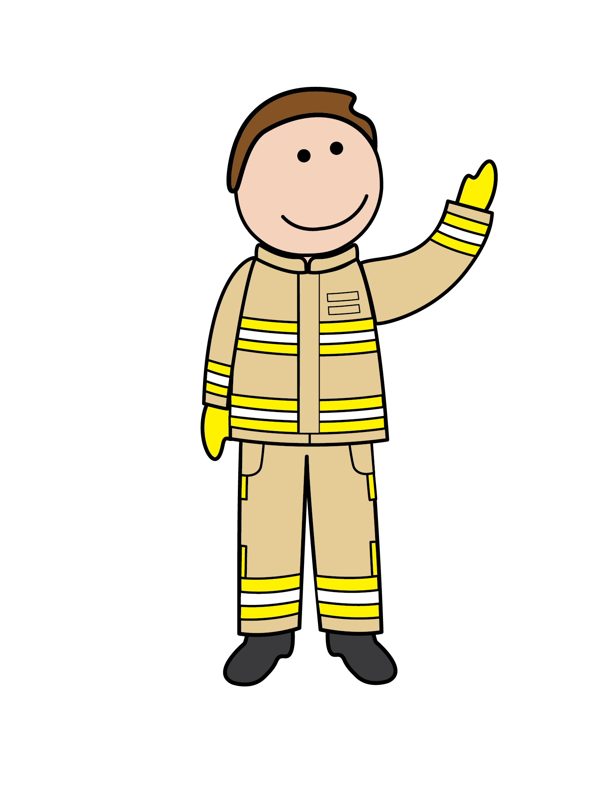
GUESS
WHO?
Bonfire and firework safety

Slide 2


Today you will learn…
The hazards you may see at bonfire and firework celebrations
How to stay safe around bonfires and fireworks

Slide 3


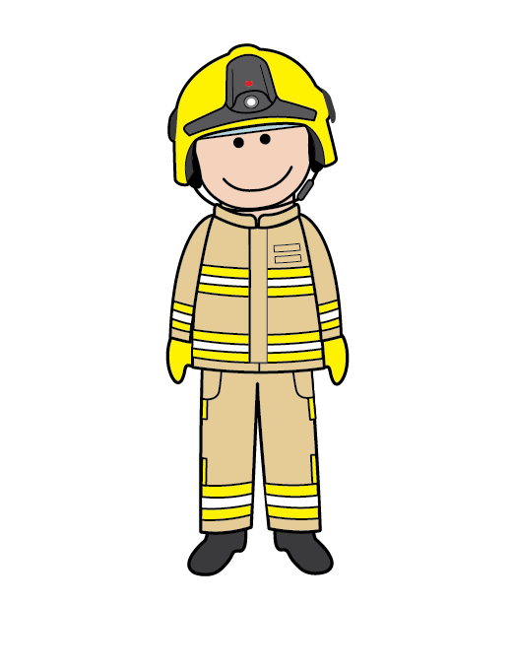
Guess the picture
It’s a bonfire!
Remember to keep a safe distance from the bonfire and always have an adult with you.

Slide 4

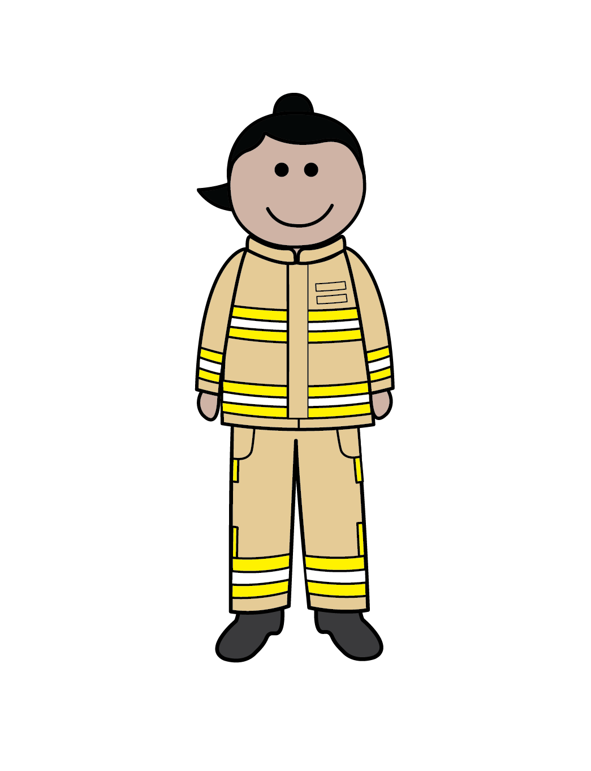
It’s fireworks!
Guess the picture
Remember, never touch fireworks. Keep a safe distance away and always have an adult with you.

Slide 5


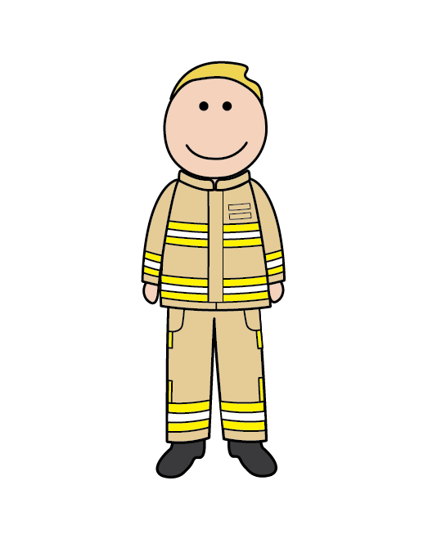
It’s sparklers!
Guess the picture
Remember, only adults can light one sparkler at a time and when you hold them make sure you are wearing gloves.

Slide 6

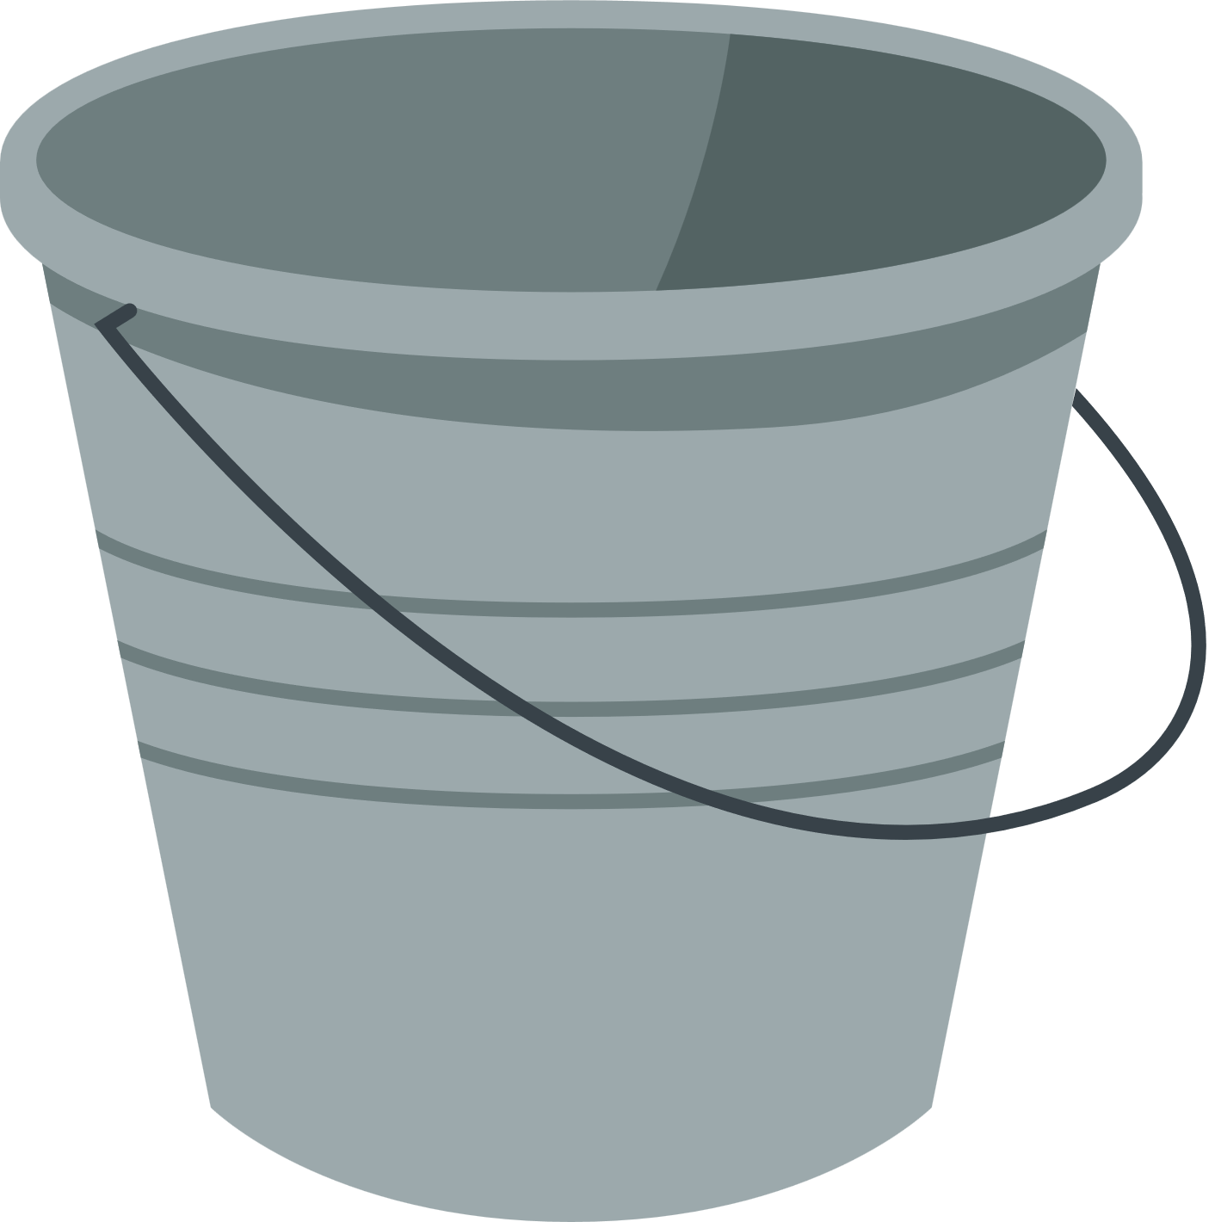
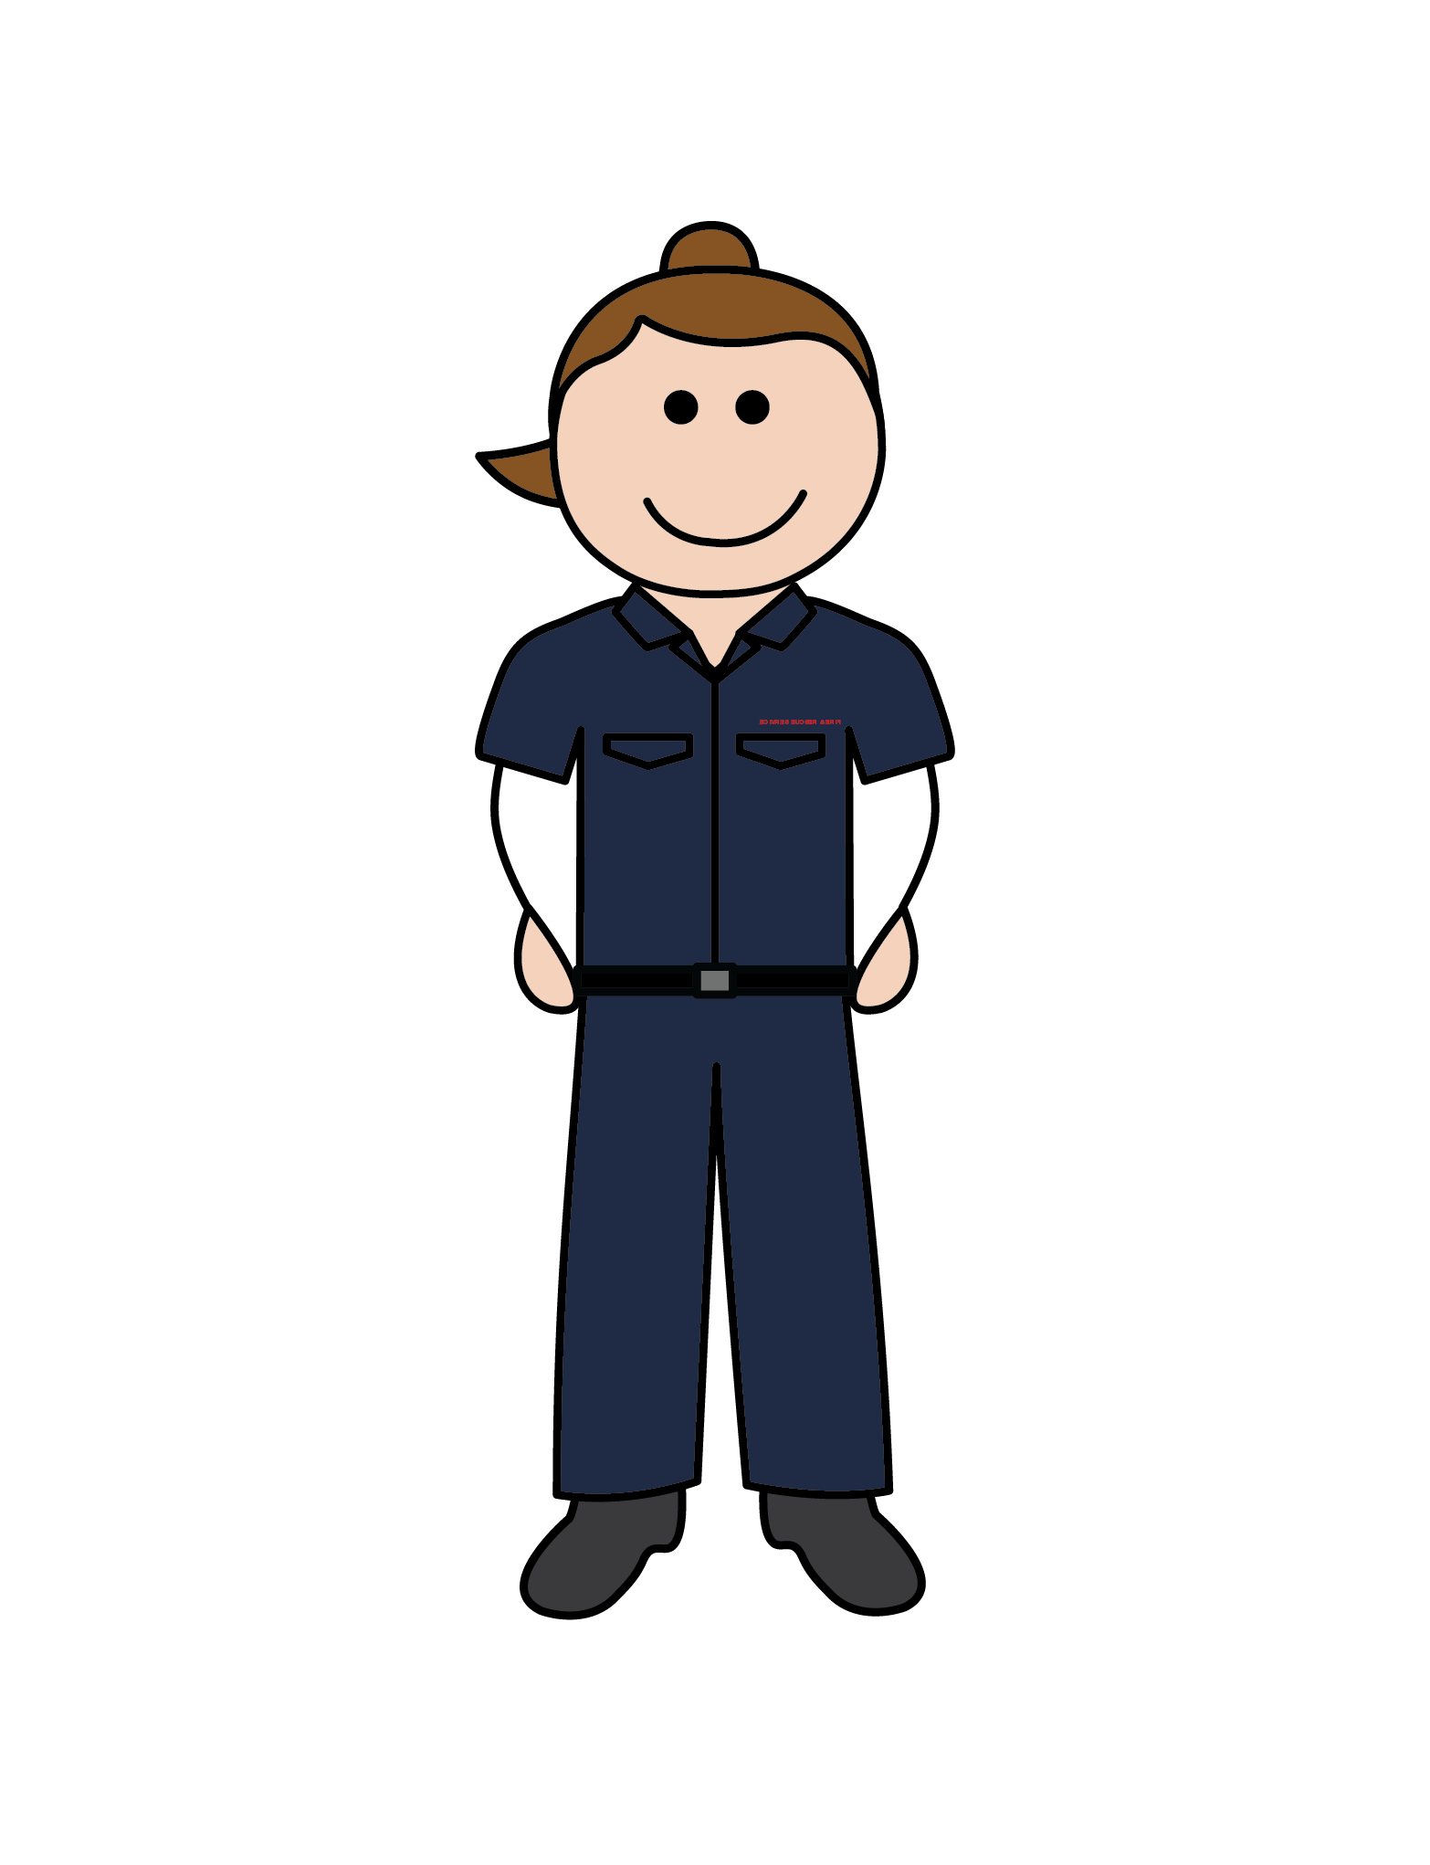
It’s a bucket of water!
Guess the picture
Remember, to have a bucket of water (or sand) to cool your sparkler down. An adult will help you do this.

Slide 7
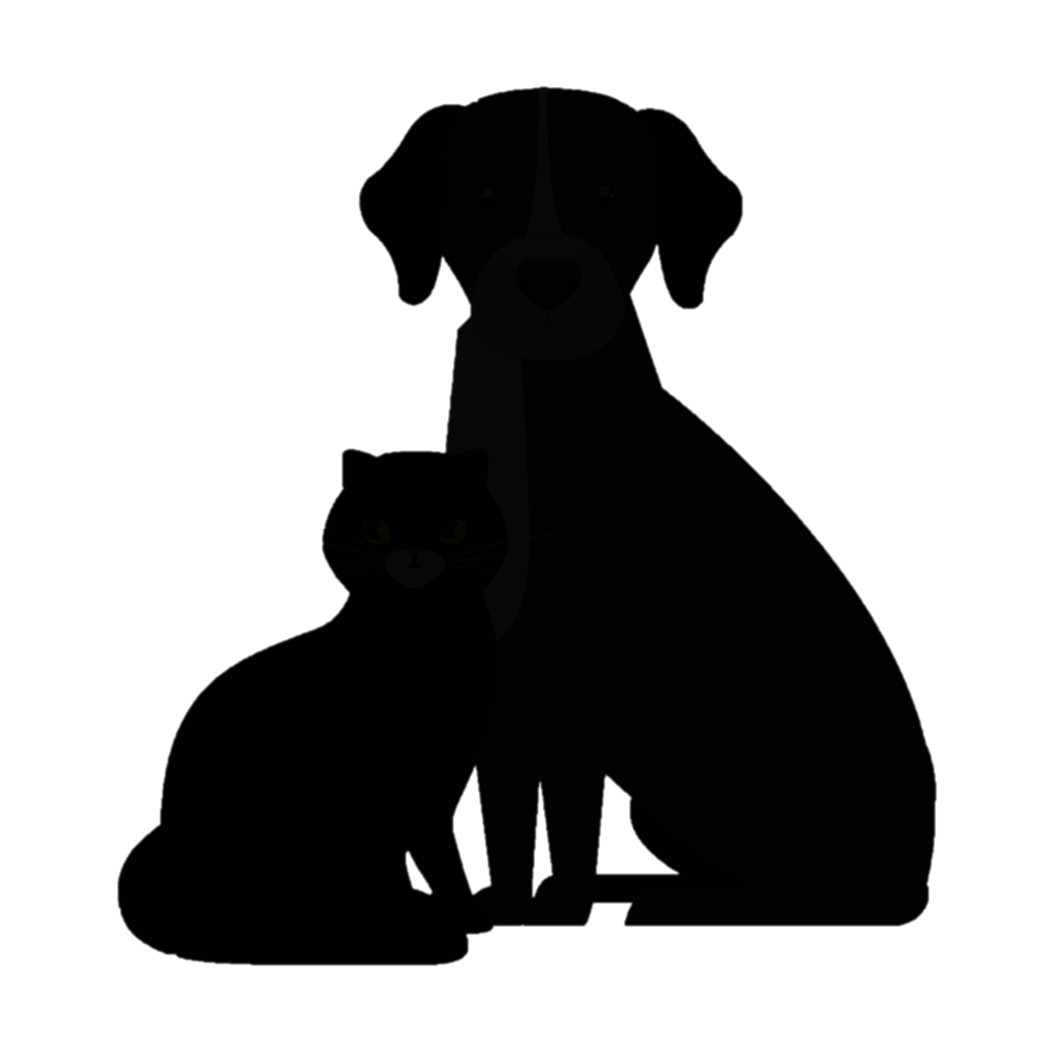
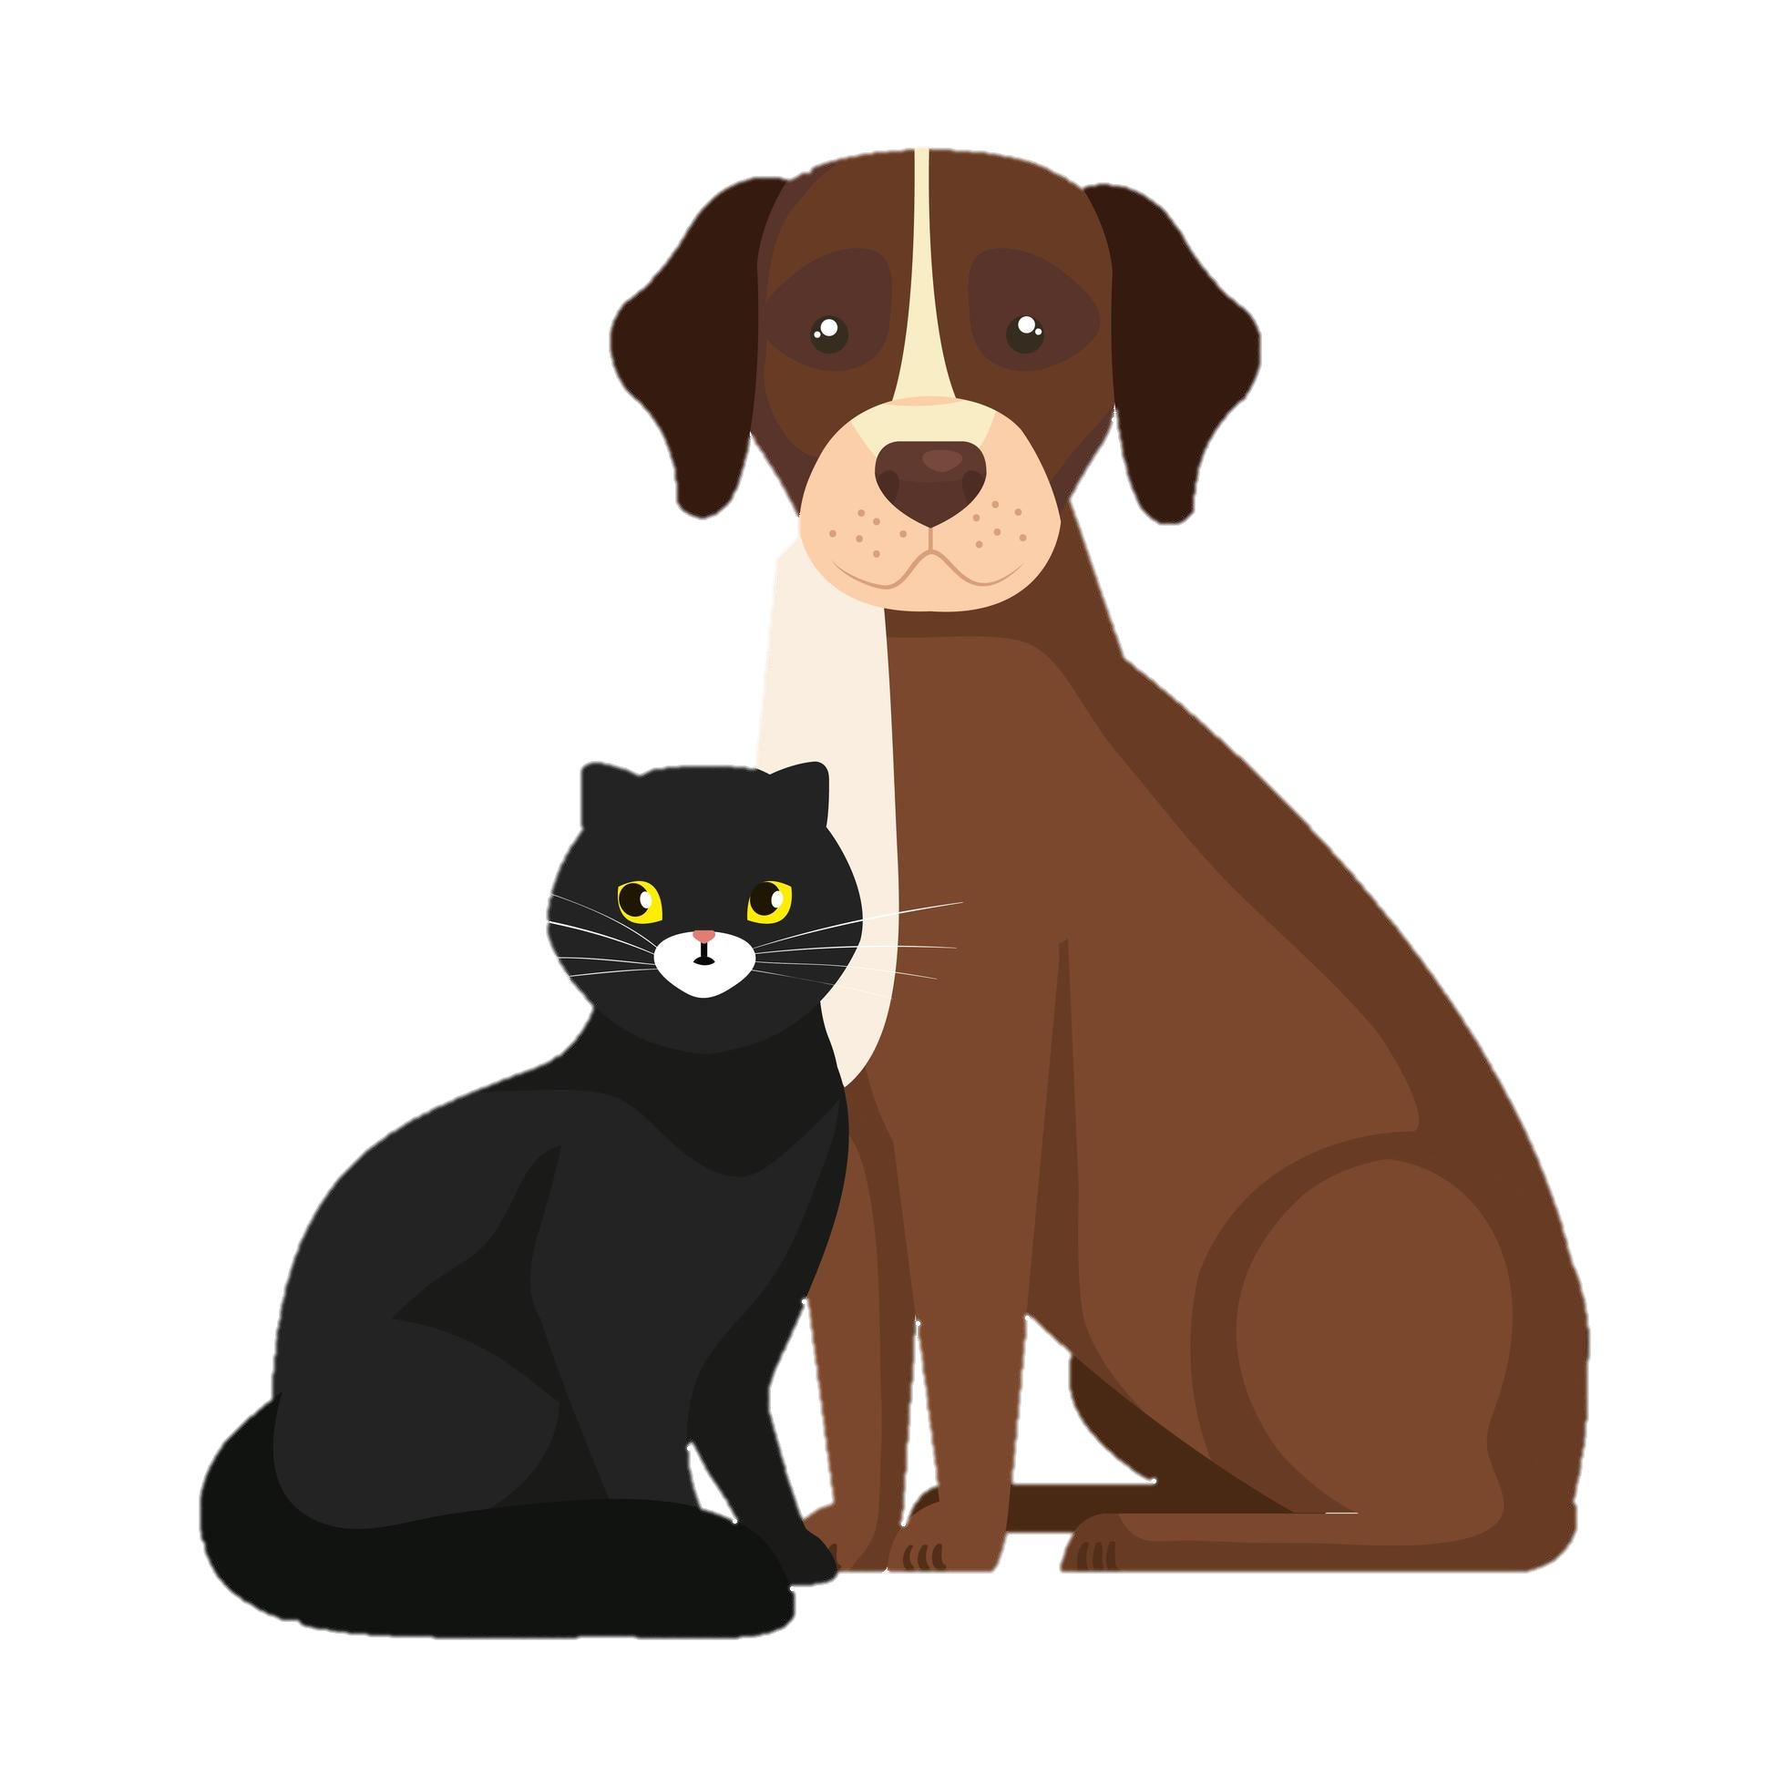
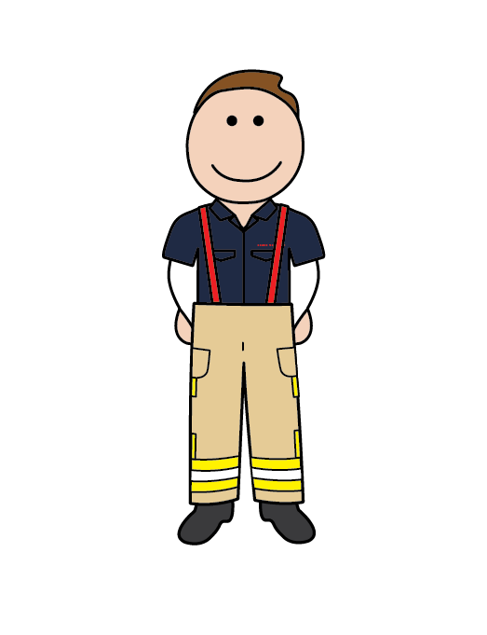
Guess the picture
It’s a pet!
Remember, if you have pets, make sure they are kept inside the home, so they are safe.

Slide 8
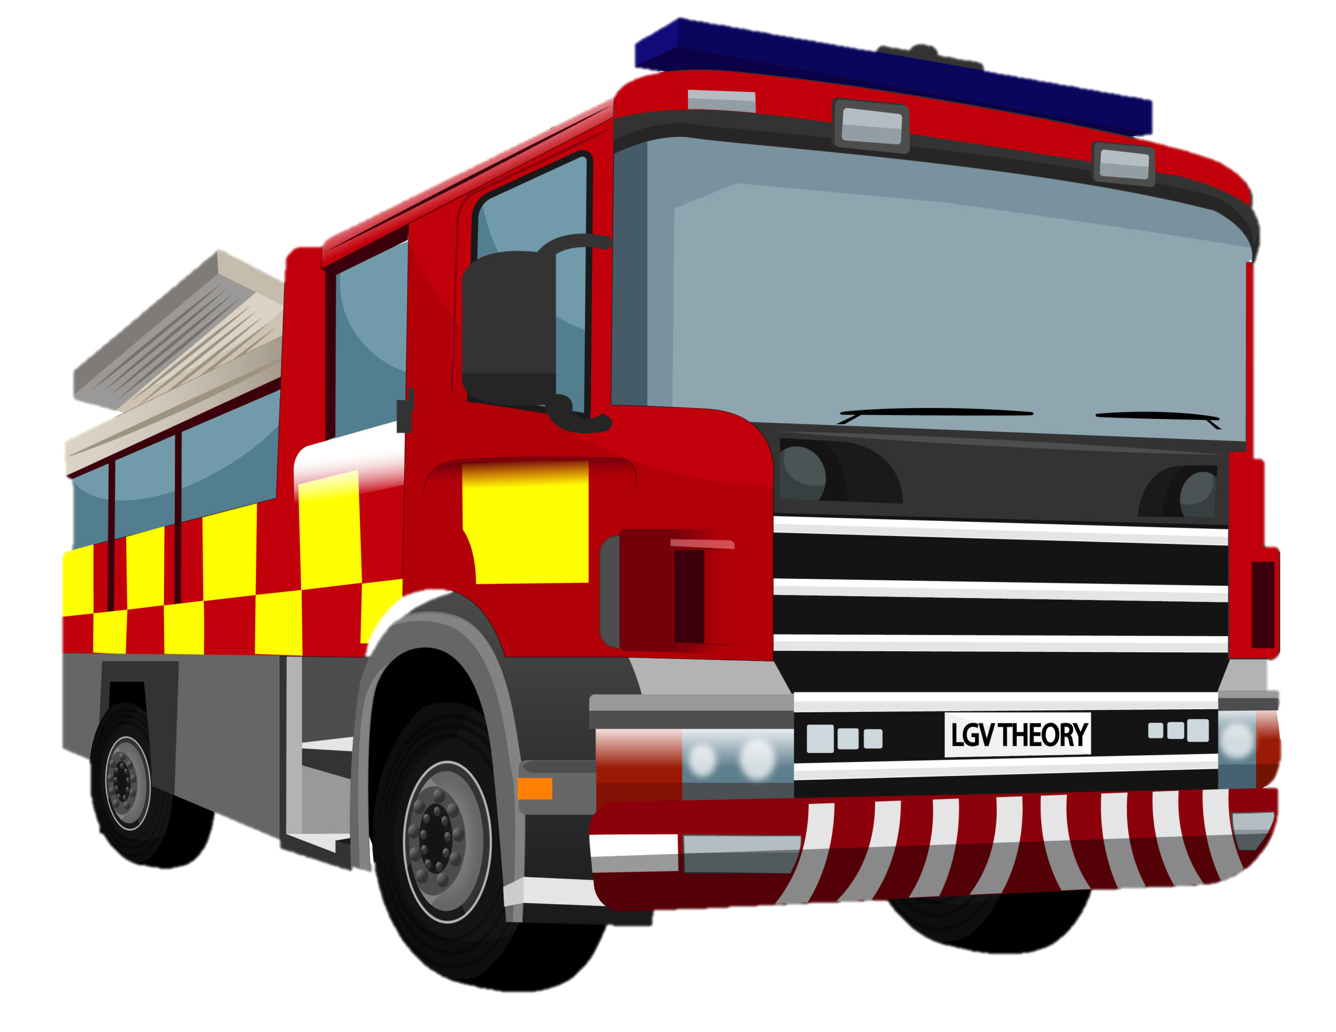
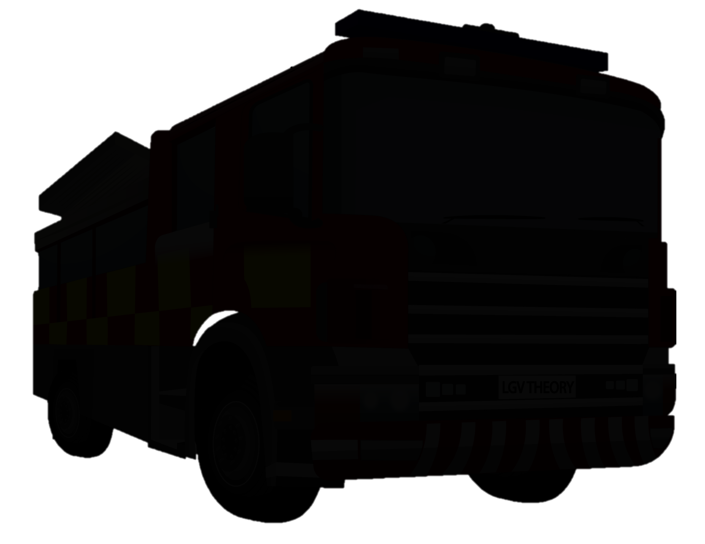
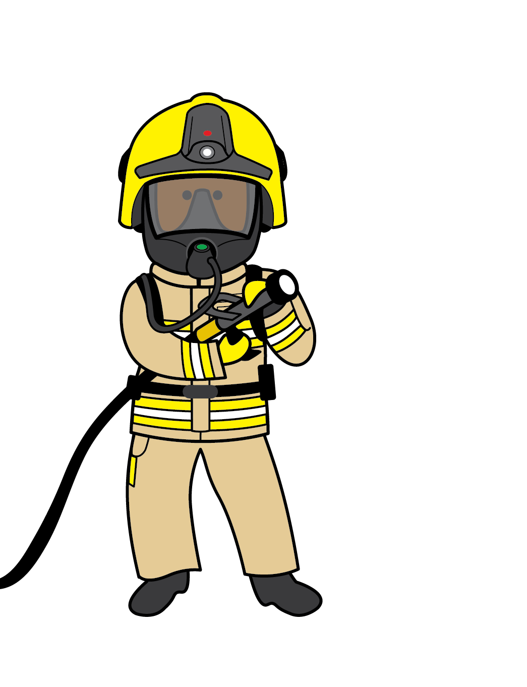
Guess the picture
It’s a fire engine!
Remember, if there is an emergency you need to call 999.

Slide 9


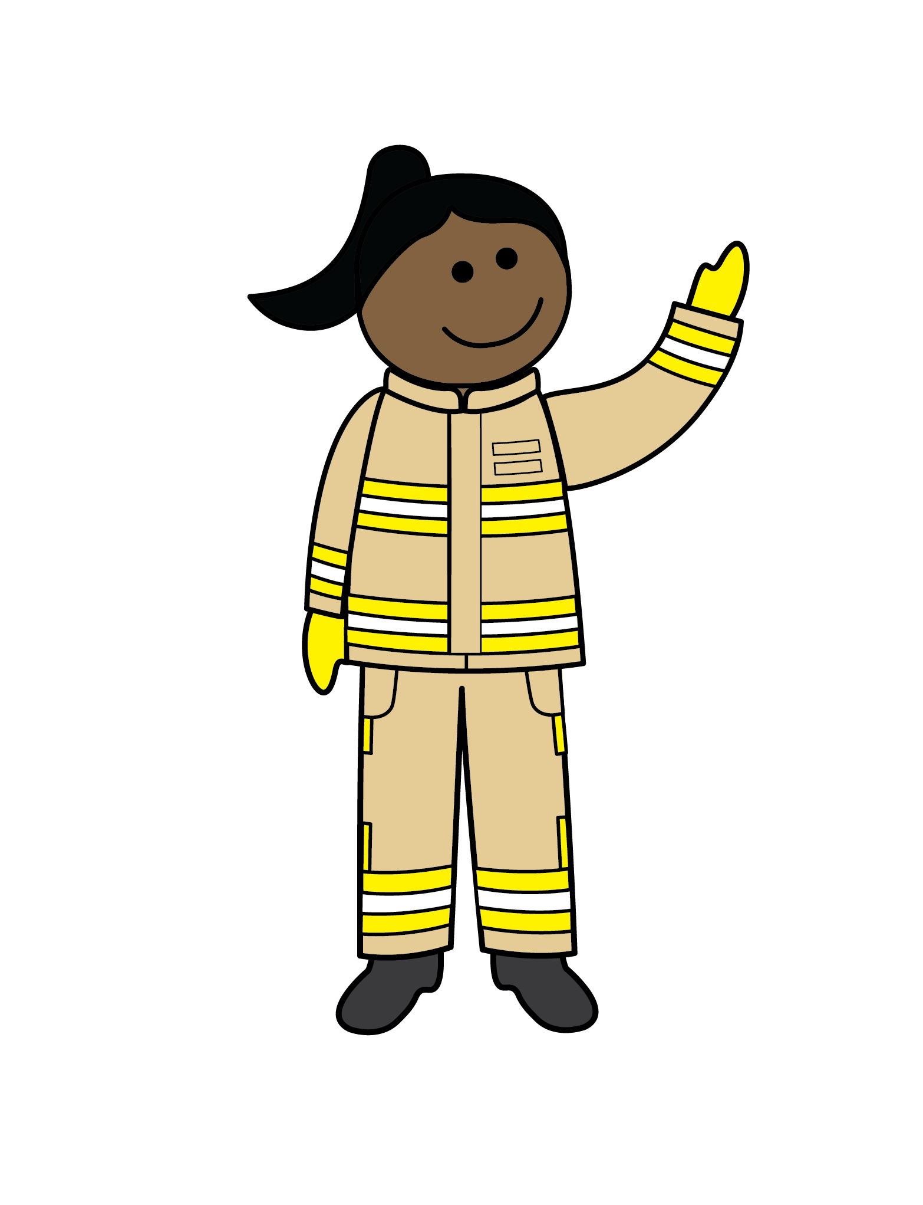



Finish the sentence…
safe
Remember, keep a distance from bonfires and fireworks.
one
gloves.
Remember, only light sparkler at a time and always wear
water
Remember to have a bucket of to cool your sparkler down.
pets
Remember, keep all inside the home.
999
If there’s an emergency, call

Slide 10

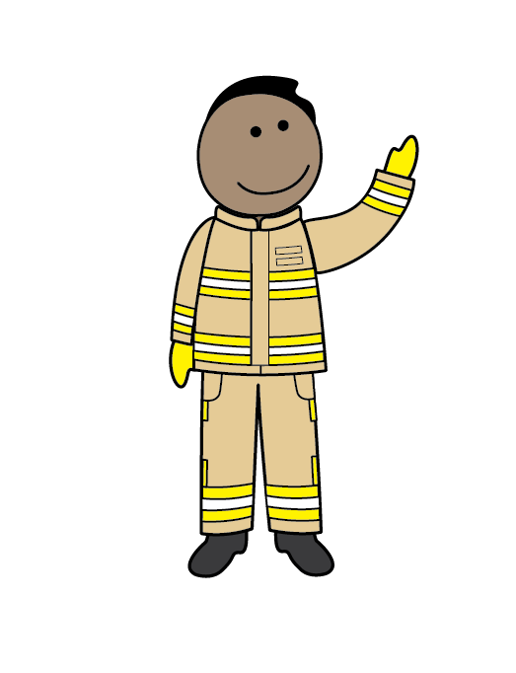
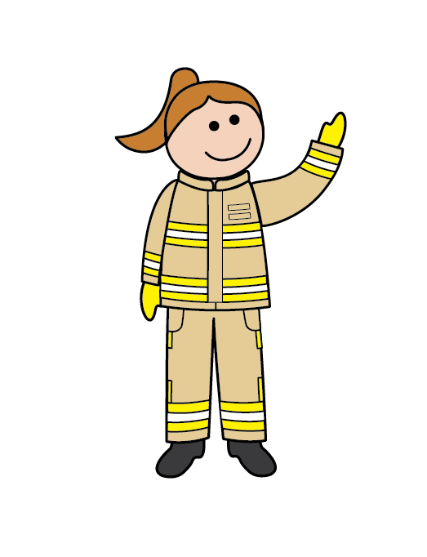
Stay safe and enjoy the fireworks!
Remember, always stay with an adult!
It’s their job to keep you safe!

