Slide 1
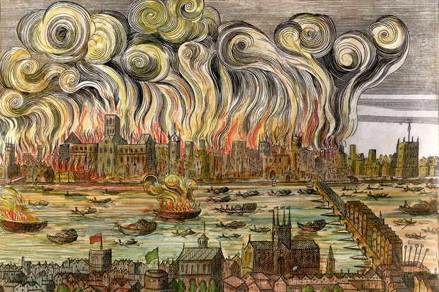
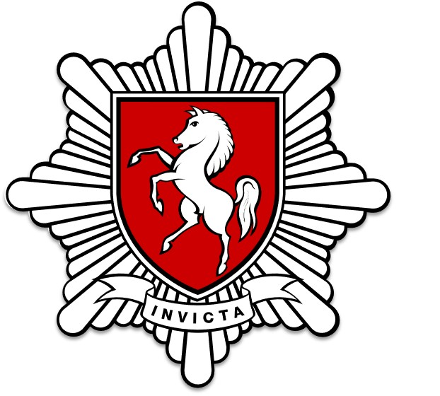

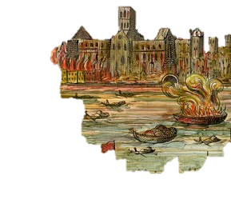
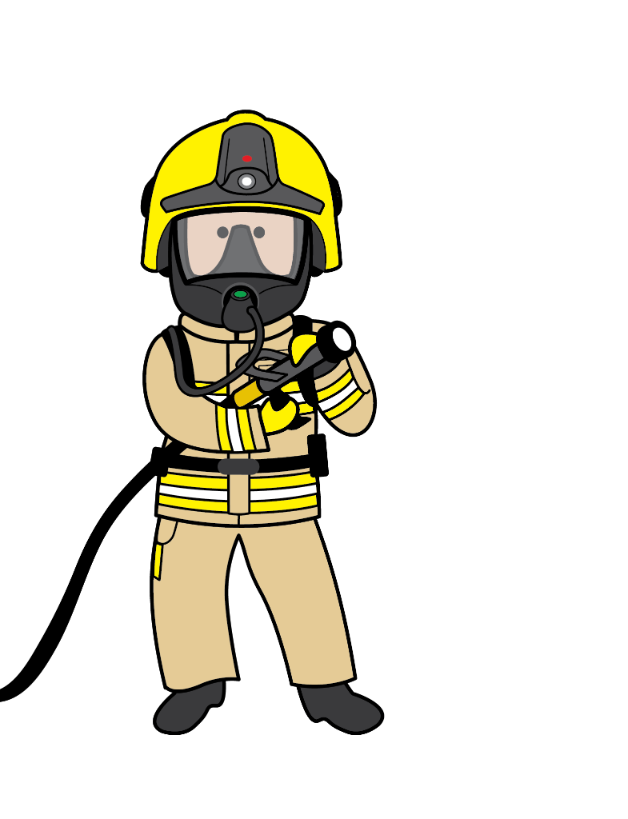
THE GREAT FIRE OF LONDON
KEY STAGE 1
Firefighting: Then and Now

Slide 2

Today, you will learn…
How the fires were tackled during the Great Fire of London
The differences between firefighting now and during the Great Fire of London
How the Fire and Rescue Service help people now

Slide 3
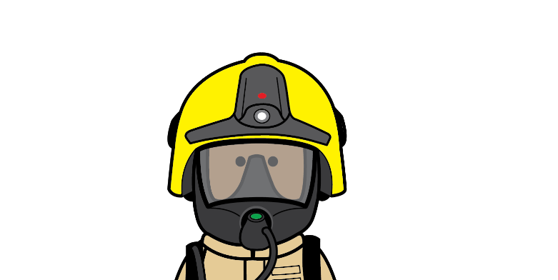




Let’s set the scene…
It’s the year 1666
Imagine what you will see
Imagine what you will smell
A huge fire has started on Pudding Lane inside a bakery. It has spread to the streets of London and lots of buildings are on fire.
Close your eyes…
Imagine what you would feel
Imagine what you would hear

Slide 4

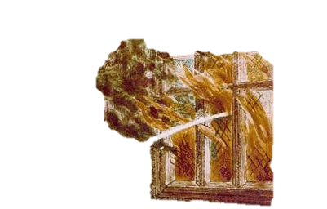
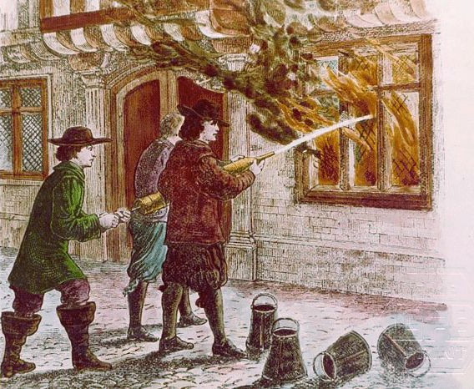
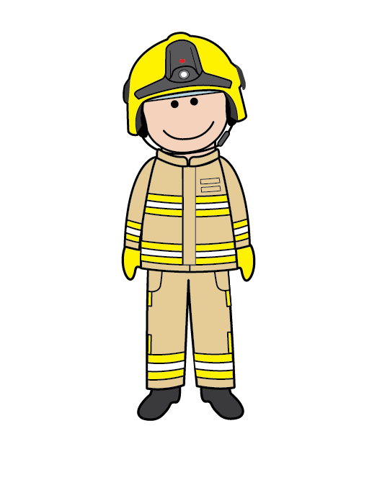
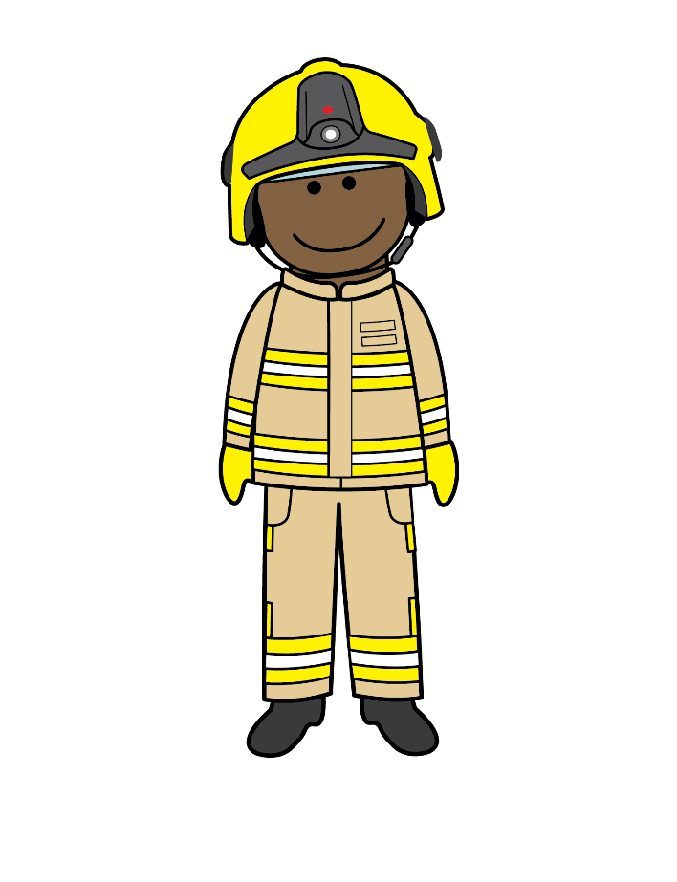
Firefighting in 1666
In 1666, a huge fire made its way through the city of London.
They’re using a water squirter!
There was no fire service to call like there is today

Slide 5
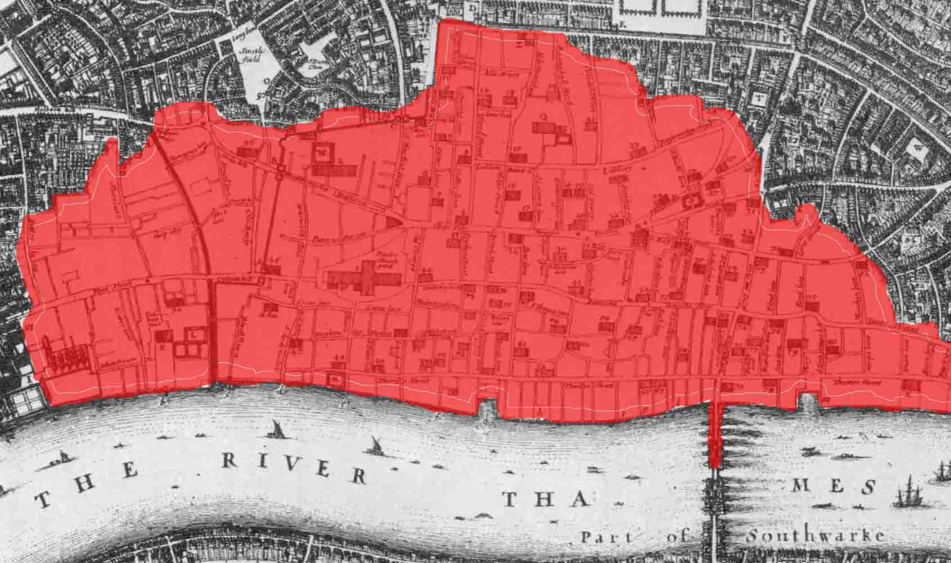
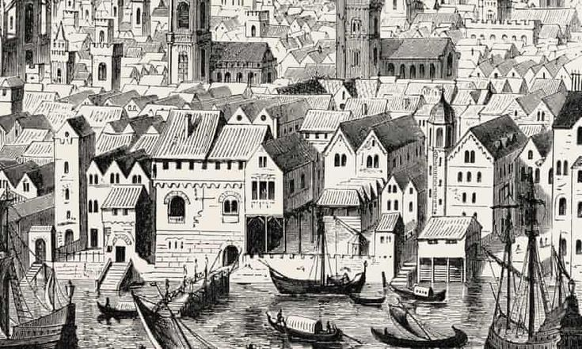

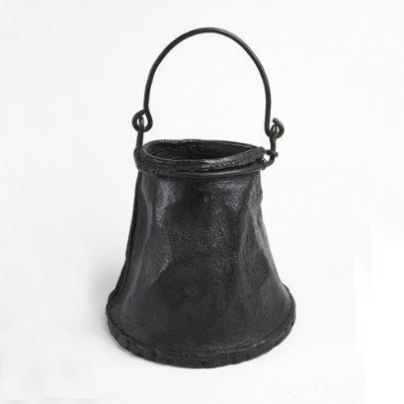
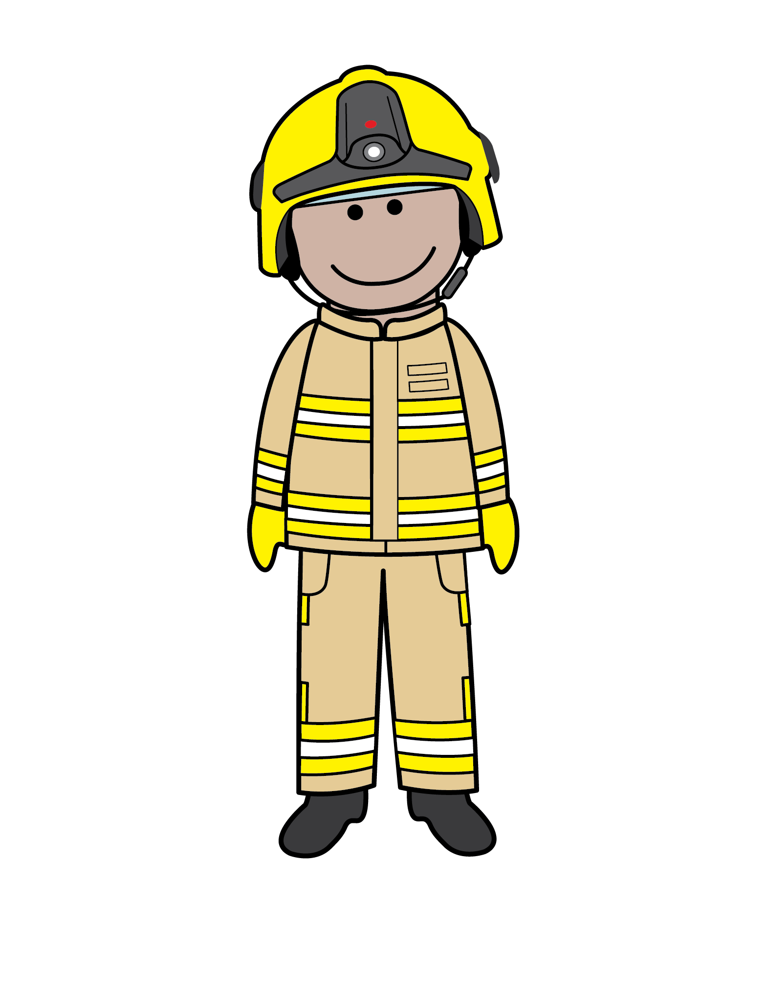
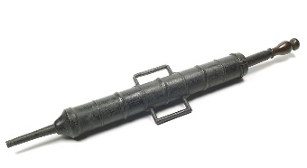
Firefighting Tools in 1666
Fire Hook
Water squirters worked by pumping water from a bucket!
Leather buckets were filled up in the River Thames and passed along
Fire hooks were used to pull burning buildings down!
What tools do you think they used to put the fires out?
Houses were built very close together and caught fire quickly
Bucket
Water Squirter

Slide 6
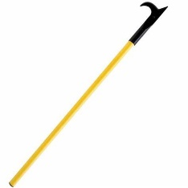
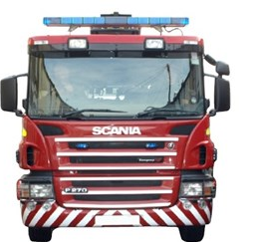
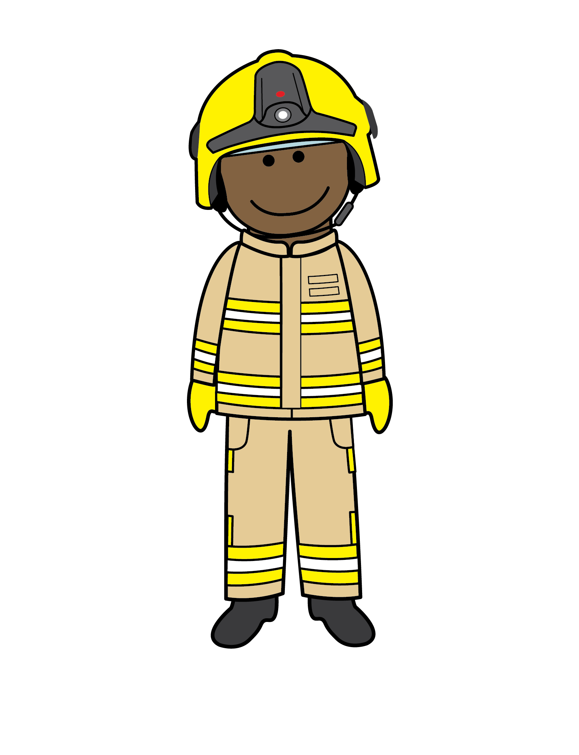
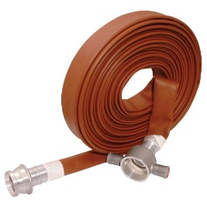
Firefighting Tools
What we use today
FIRE HOOK
We still use fire hooks but not to pull down buildings!
We don’t need to use buckets when we have fire engines to carry water!
Hoses are more powerful than water squirters and can reach a lot further!
Today, we use different tools to fight fires.
FIRE ENGINE
WATER HOSE

Slide 7
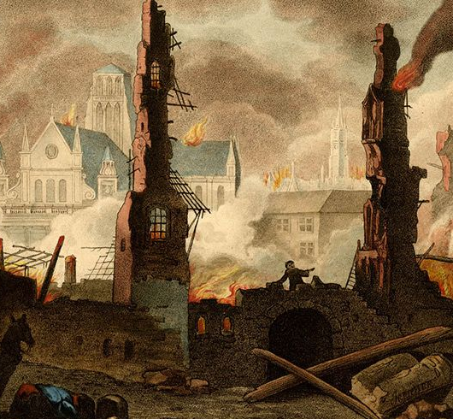

What did the fire do to London?
The fire destroyed lots of buildings. London had to be rebuilt safely.
You can watch how London was rebuilt here - How did they rebuild London? (youtube.com)
That’s right, call 999 and ask for the Fire Service!
Today we have 44 Fire Services in England! In Kent we have 55 fire stations!
If you see a fire, what number should you call?
IT TOOK 3 YEARS TO REBUILD EVERYTHING THAT BURNT DOWN

Slide 8
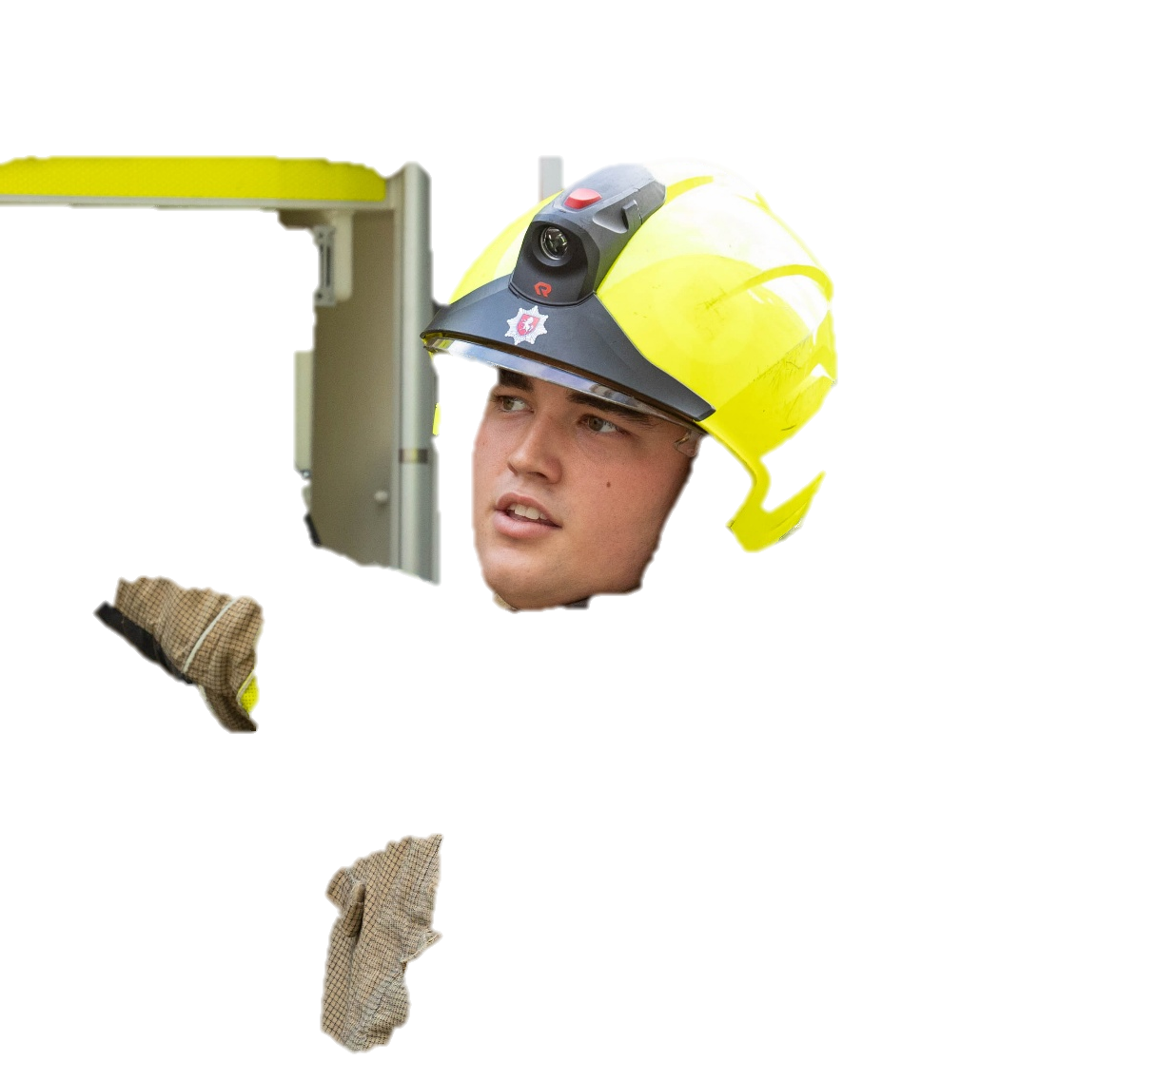
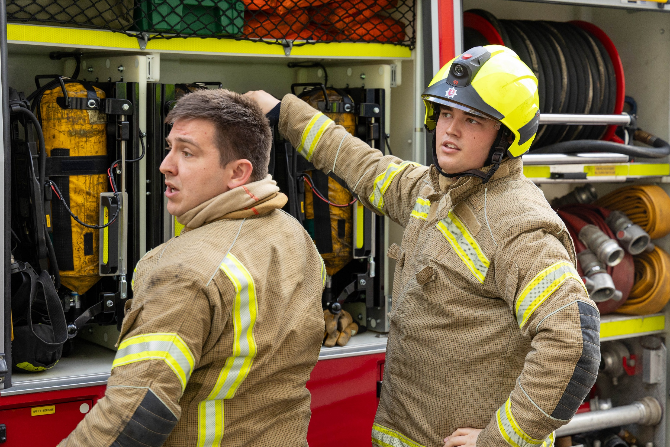
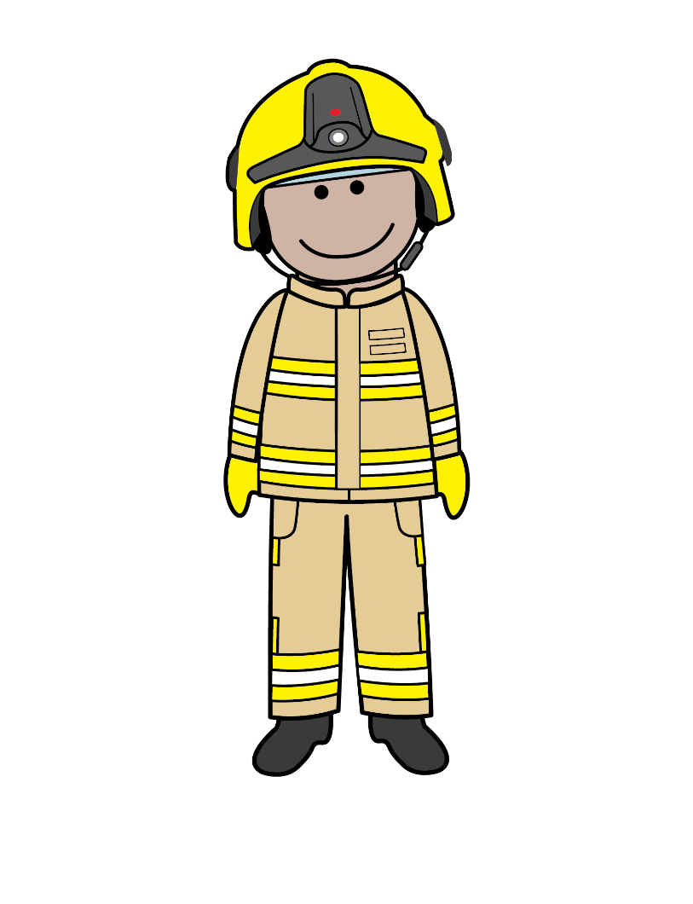
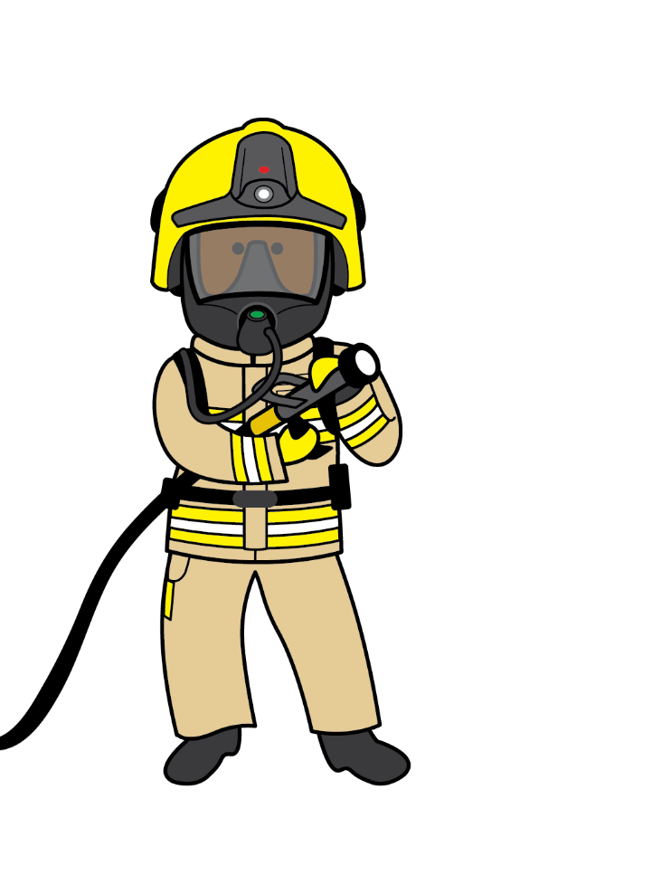
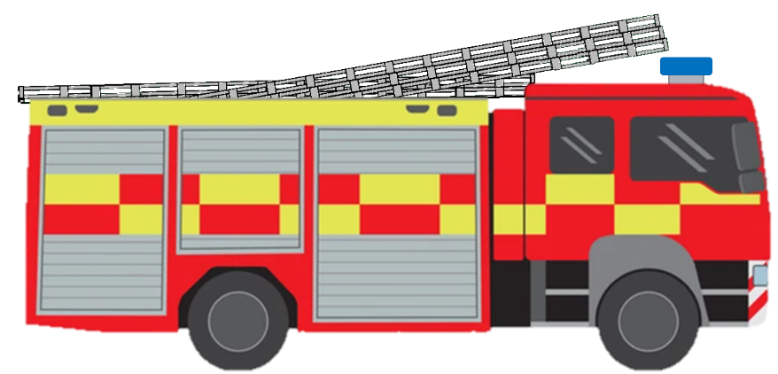
Firefighting Today
Today, we have lots of special tools to put out fires and rescue people.
Fire engines help us get to emergencies quickly and carry lots of tools like hoses, a big water tank, breathing apparatus sets and ladders.
The Firefighters are getting their breathing apparatus (BA) sets out. The BA sets are like a mask that allow the firefighters to breathe in smoky areas.

Slide 9
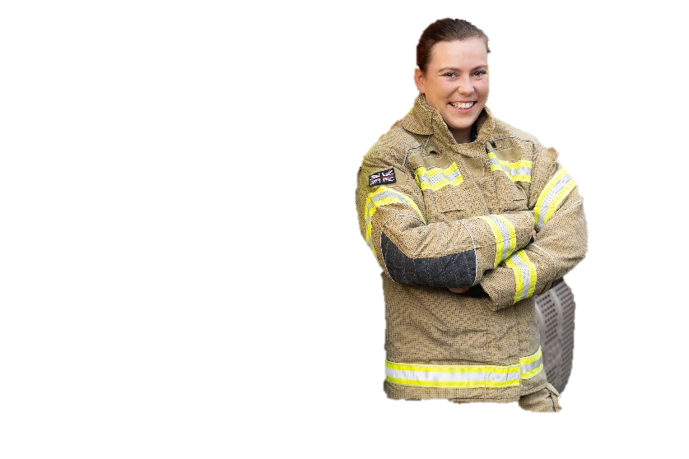
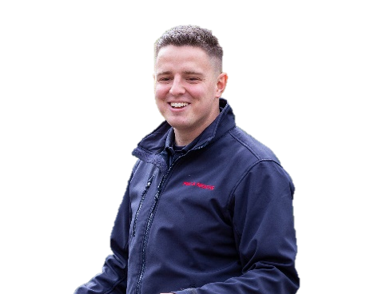

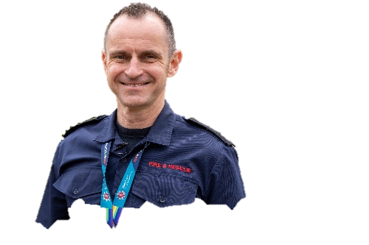
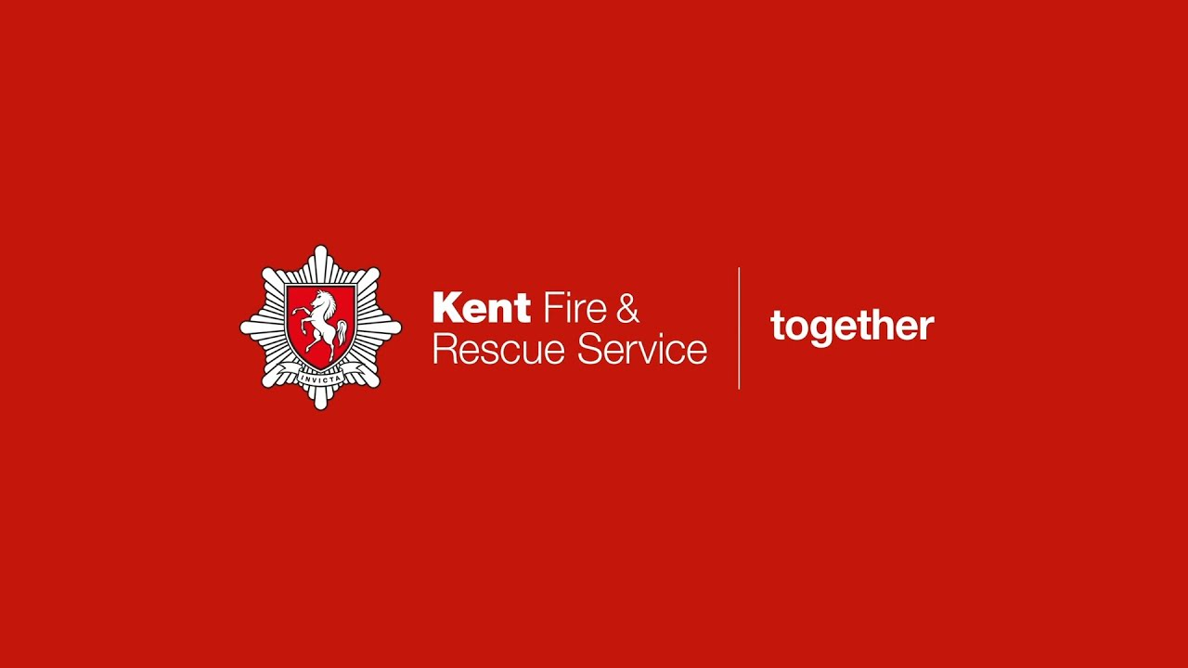
Kent Fire and Rescue Service
The Fire Service today, is very different from the past.
Today, the Fire Service do more than just put out fires.
Click the link to see how we help people across Kent!

Slide 10


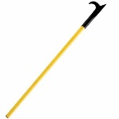
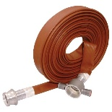

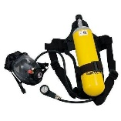
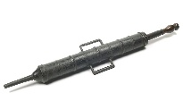

1666
Sorting Game
Can you sort the firefighting tools into the correct box?
Today

