Slide 1
KS1
Water Safety
June 2025-June 2026
Working alongside

Slide 2
Today, you will learn…
To know the emergency services for water rescue
To be aware of common hazards in the water
To understand the water safety code

Slide 3
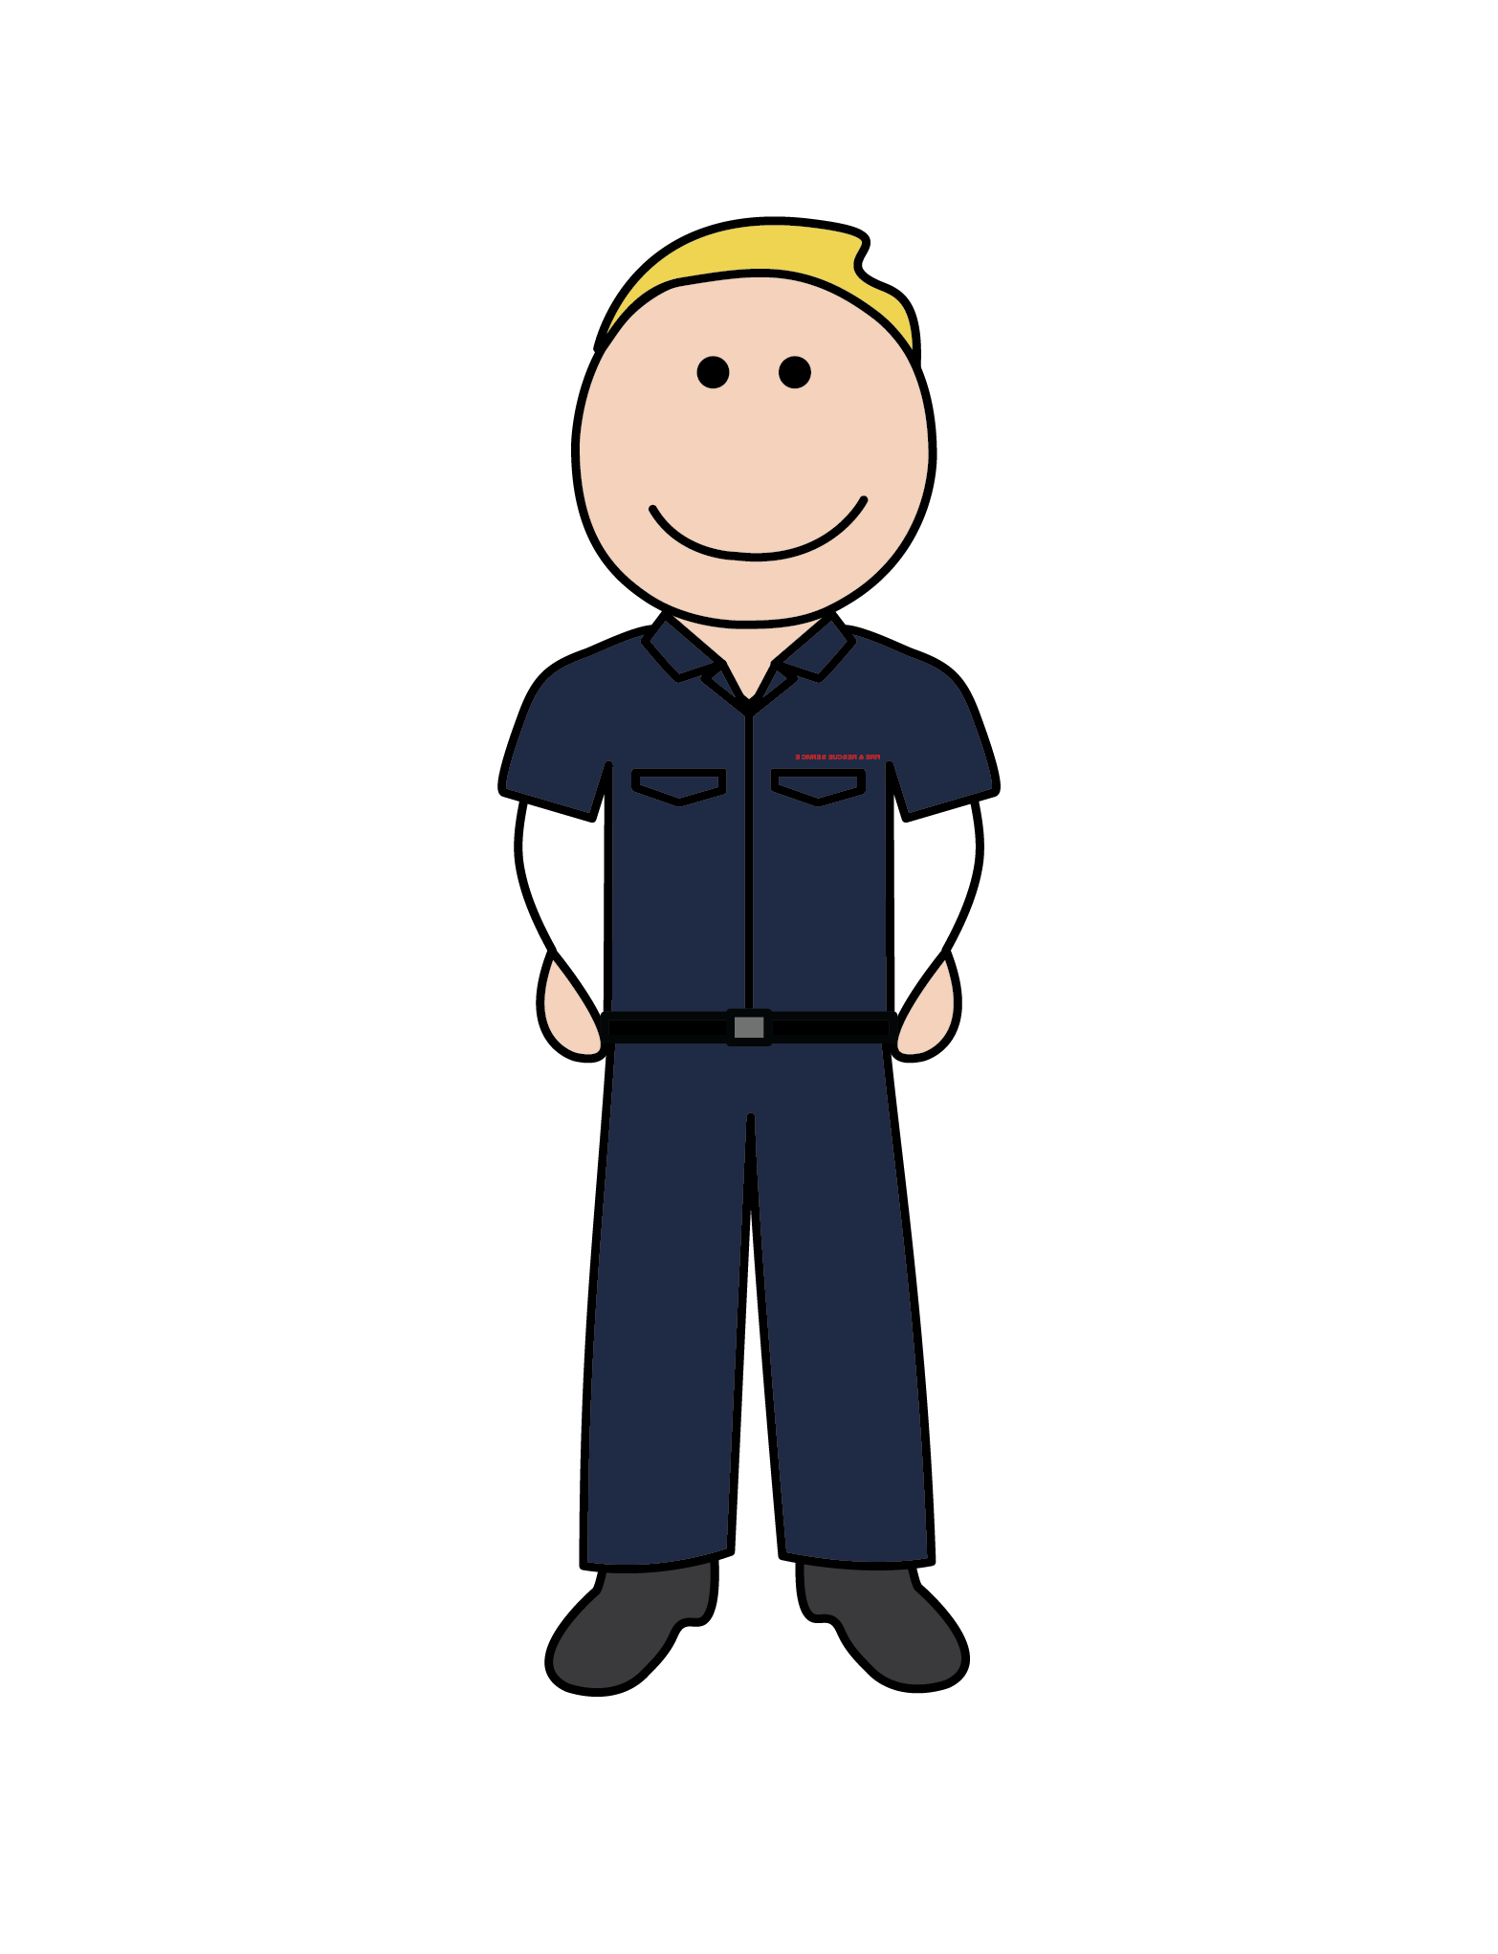
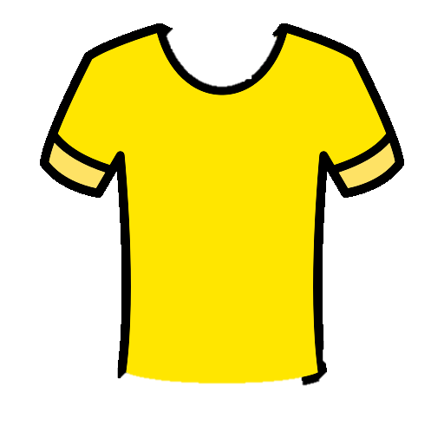
The Beach
You should call 999 and ask for who?
A trip to the beach can be fun and exciting!
You can make lots of sandcastles
Find lots of different seashells
And even have a swim in the sea
BUT if someone is in trouble in the water…

Slide 4
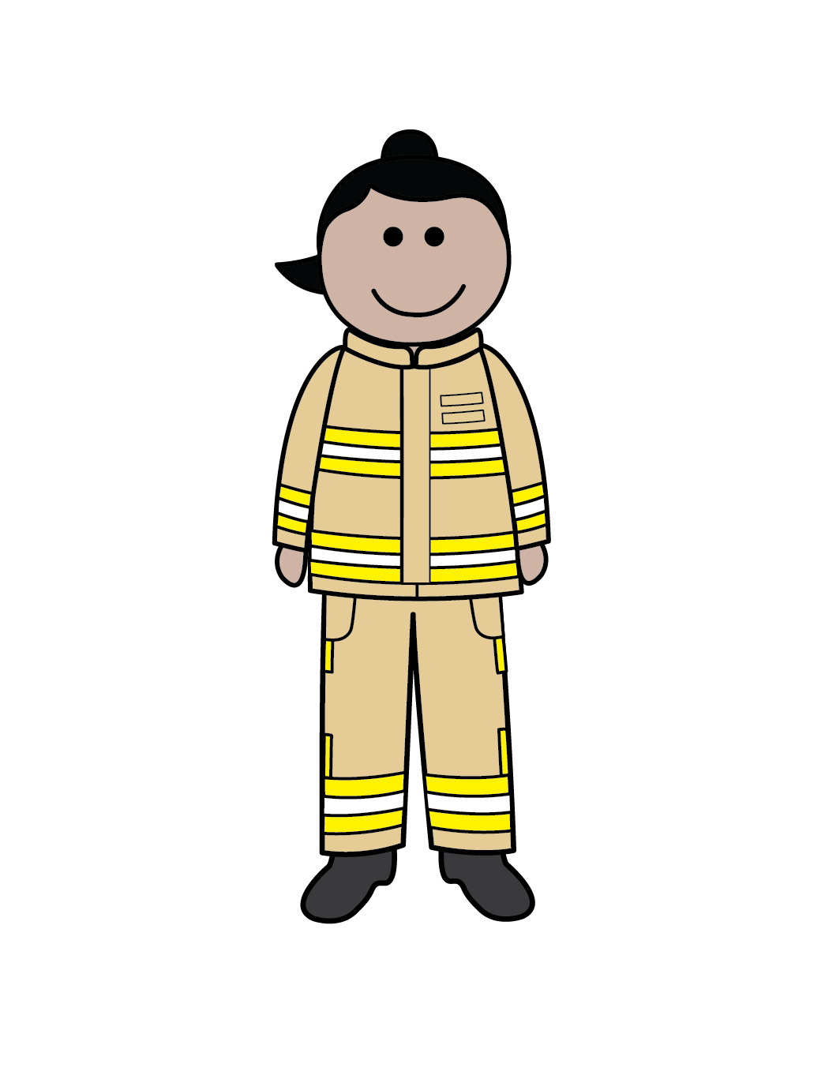
The Coastguard!
Remember coastguards help you at sea
That’s right! The Coastguard rescue people who have got into trouble in the sea and coastline.
They have special boats to help reach people in need
They wear important life jackets to keep them safe when they rescue people
WHO can help you with inland water emergencies?

Slide 5
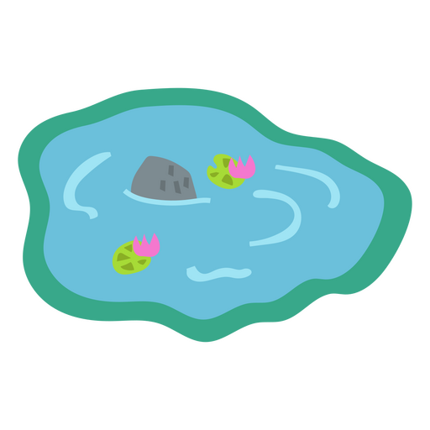
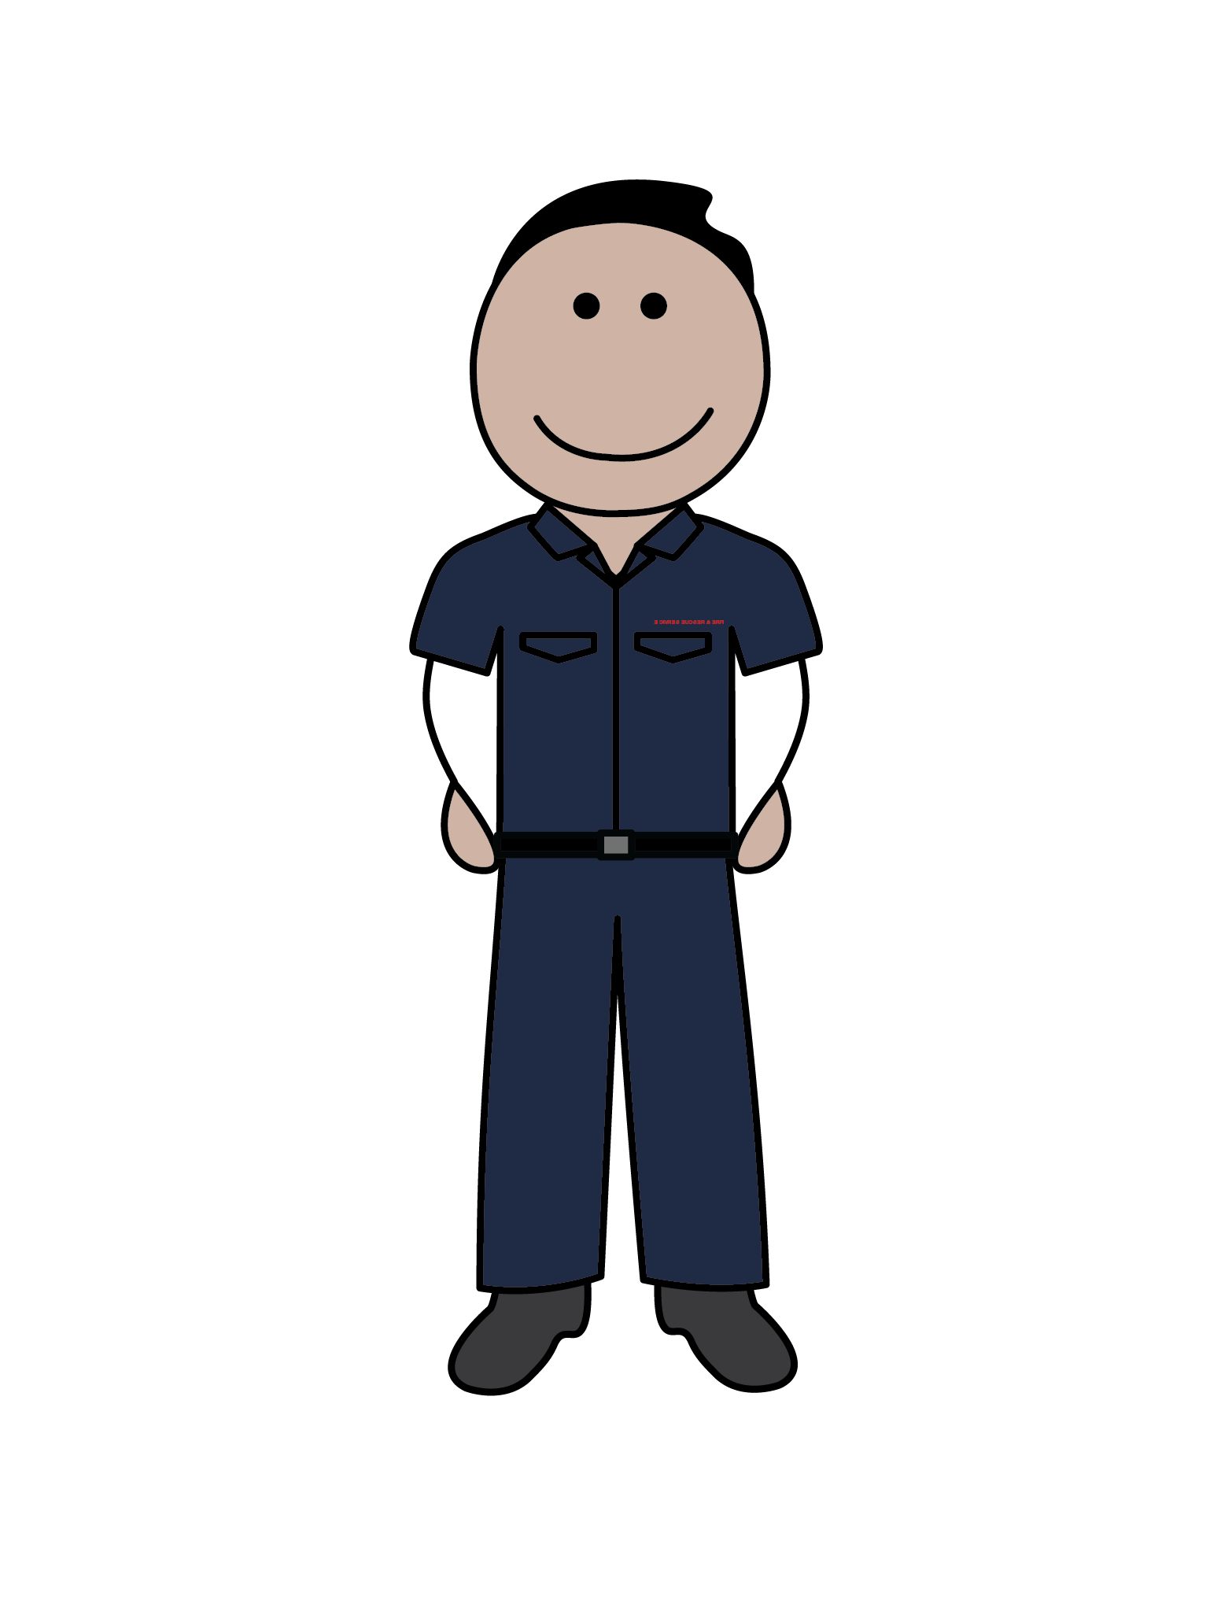
But first, it’s important to…
Know what inland water is

Slide 6
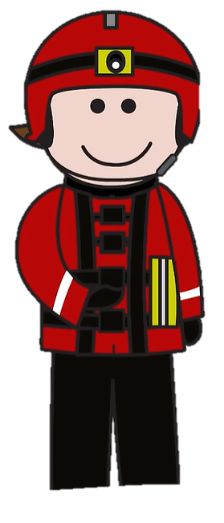
Inland water
Fire Service!
Here’s how we can help
Any large areas of water you see that are away from the coastline are known as inland water. This includes rivers, ponds, creeks, canals and lakes.
If someone is in trouble in inland water, you should call 999 and ask for the…
At the fire service we have a specialist water rescue team who have the correct tools and clothing to rescue anyone in trouble in inland water.

Slide 7
How we can help
Let’s start with what we wear to keep us safe

Slide 8
How we can help
Our water safety vehicle holds special tools. These include…
An inflatable boat to access the area safely
Our personal floatation device (buoyancy aid) allows us to access the water safely
Using our water pole helps us check how deep the water is – remember this can change quickly

Slide 9
How we can help
Our water safety vehicle holds special tools. These include…
An inflatable boat to access the area safely
Our personal floatation device (buoyancy aid) allows us to access the water safely
Using our water pole helps us check how deep the water is – remember this can change quickly
If someone is in trouble our throw line is used to bring them back to safety
Here’s how they work…

Slide 10
To the
RESCUE!
Who should you call?

Slide 11
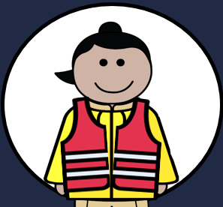
It’s important to
Quick! Someone is in trouble in the lake
Who should you call?
Call 999 and ask for the fire service!

Slide 12
It’s important to
Quick! Someone is in trouble in the sea
Who should you call?
Call 999 and ask for the coastguard

Slide 13
It’s important to
Quick! Someone is in trouble in the river
Who should you call?
Call 999 and ask for the fire service!

Slide 14
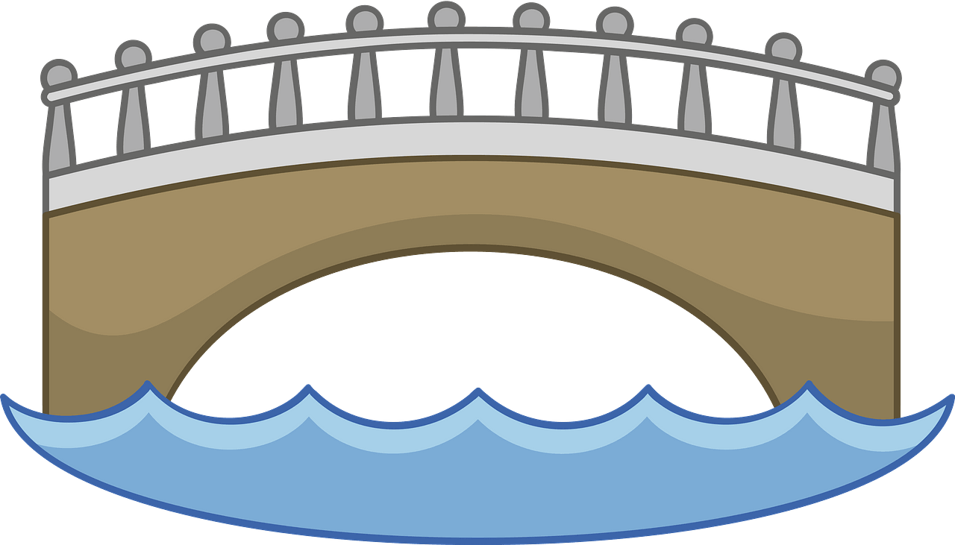
It’s important to
Quick! Someone is in trouble in the canal
Who should you call?
Call 999 and ask for the fire service!

Slide 15
Well done, you know how to
It’s important to always stay away from the waters’ edge because of hidden hazards in the water
D
D
D
D
So, we all need to be aware of the hazards around open water
Here are some signs you may see near open water that will warn you of the hazards
Good Question!
A hazard is something that is dangerous and likely to cause damage
But what is a hazard?

Slide 16
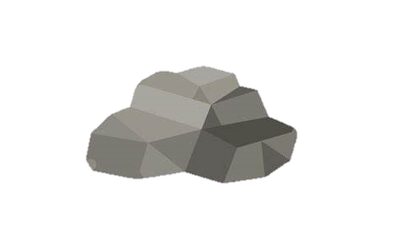
Common hazards in the water
There are lots of hidden hazards under the water, that you can’t see.
Litter
Reeds and branches
Sewage

Slide 17
How can you be safe around water?
Follow the Water Safety Code!
Stop and Think
Stay together
Call 999
Float
Learn more about the Water Safety Code here - https://youtu.be/zwzB7So7jSM?si=hnciusDwxR2RMCRl

Slide 18
Float to Live
If the water is cold, it can make you panic, which makes you move more and makes you tired
D
But why should you float?
Lying on your back and gently swishing your arms and feet around in circles uses less energy
Keeping you head above the water allows you to breathe
Floating gives you more time to think, call for help and await rescue

Slide 19
How to float
1
Tilt your head back, submerging your ears
2
Relax and try to control your breathing
3
Move your hands to help you stay afloat
4
Your legs might sink but that’s OK – everyone floats differently
5
Spread your arms and legs to improve stability

Slide 20
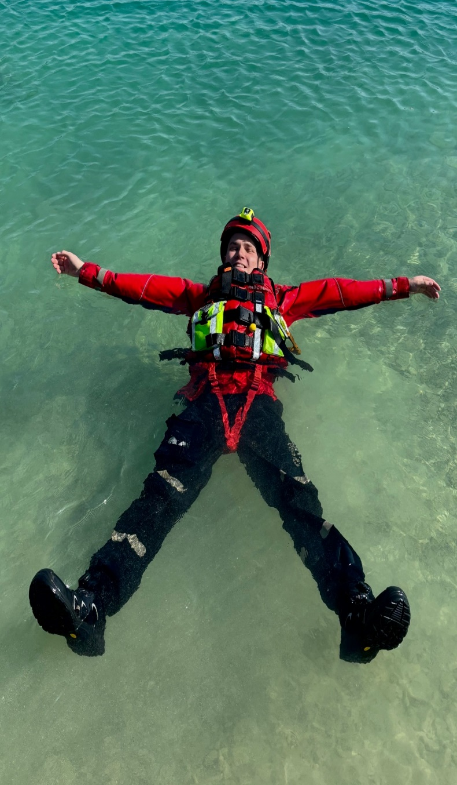
How to float
1
Tilt your head back, submerging your ears
2
Relax and try to control your breathing
3
Move your hands to help you stay afloat
4
Your legs might sink but that’s OK – everyone floats differently
5
Spread your arms and legs to improve stability

Slide 22
Who should you call if someone is in trouble in the sea?
OR
The Fire Service?
The Coastguard?

Slide 23
Who should you call if someone is in trouble in inland water?
OR
The Coastguard?
The Fire Service?

Slide 24
Name the parts of the Water Safety Code
Stop and Think
Stay together
Call 999
Float

Slide 25
What do these signs mean?

Slide 26
What hazards could be underwater?

Slide 27
If you fall in the water, what should you do?
A
B
Relax and lay on your back
Tilt you head back and control your breathing
ALL OF THEM!
C
D
Move your hands and legs gently to stay afloat
Spread your arms and legs for stability

Slide 28
Working alongside
Remember to stay safe around water
Try our water safety resources

