Slide 1
KS2
Water Safety
June 2025-June 2026
Working alongside

Slide 2
Today, you will learn…
To identify the emergency services for water rescue
To be aware of common hazards in the water
To understand the water safety code

Slide 3
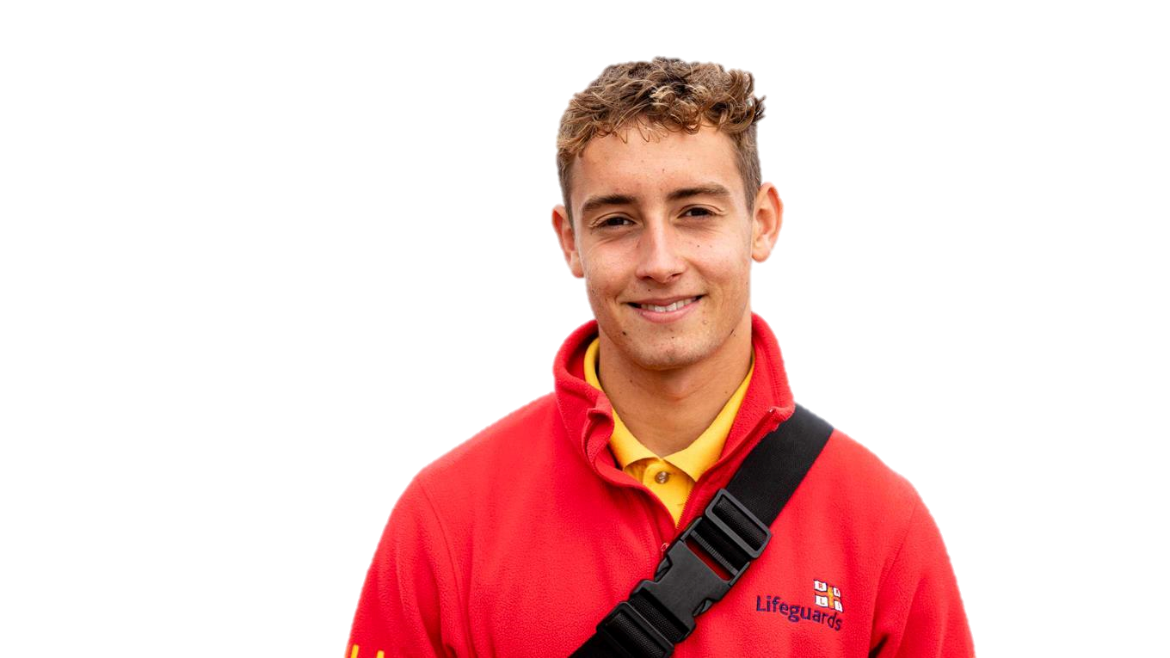
The Beach
A trip to the beach can be fun and exciting!
You should call 999 and ask for who?
You can make lots of sandcastles
Find lots of different seashells
And even have a swim in the sea
BUT if someone is in trouble in the water…

Slide 4
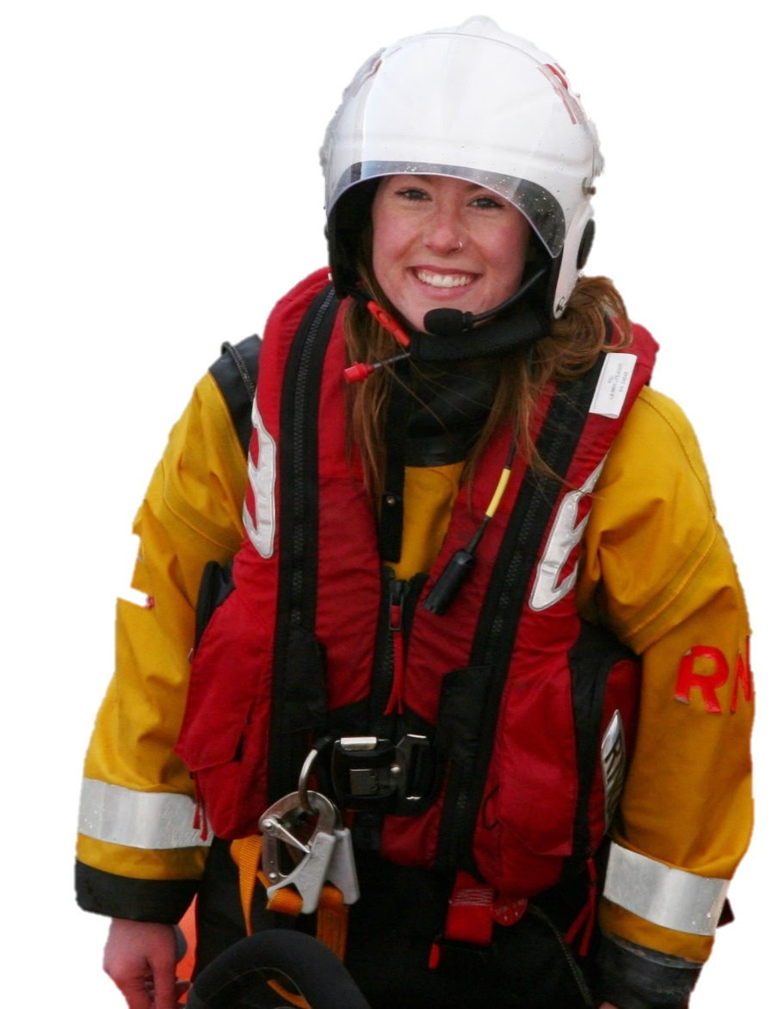
The Coastguard!
Remember coastguards help you at sea
That’s right! The Coastguard rescue people who have got into trouble in the sea and coastline.
They have special boats to help reach people in need
They wear important life jackets to keep them safe when they rescue people
WHO can help you with inland water emergencies?

Slide 5
But first, it’s important to know…
What is inland water?

Slide 6
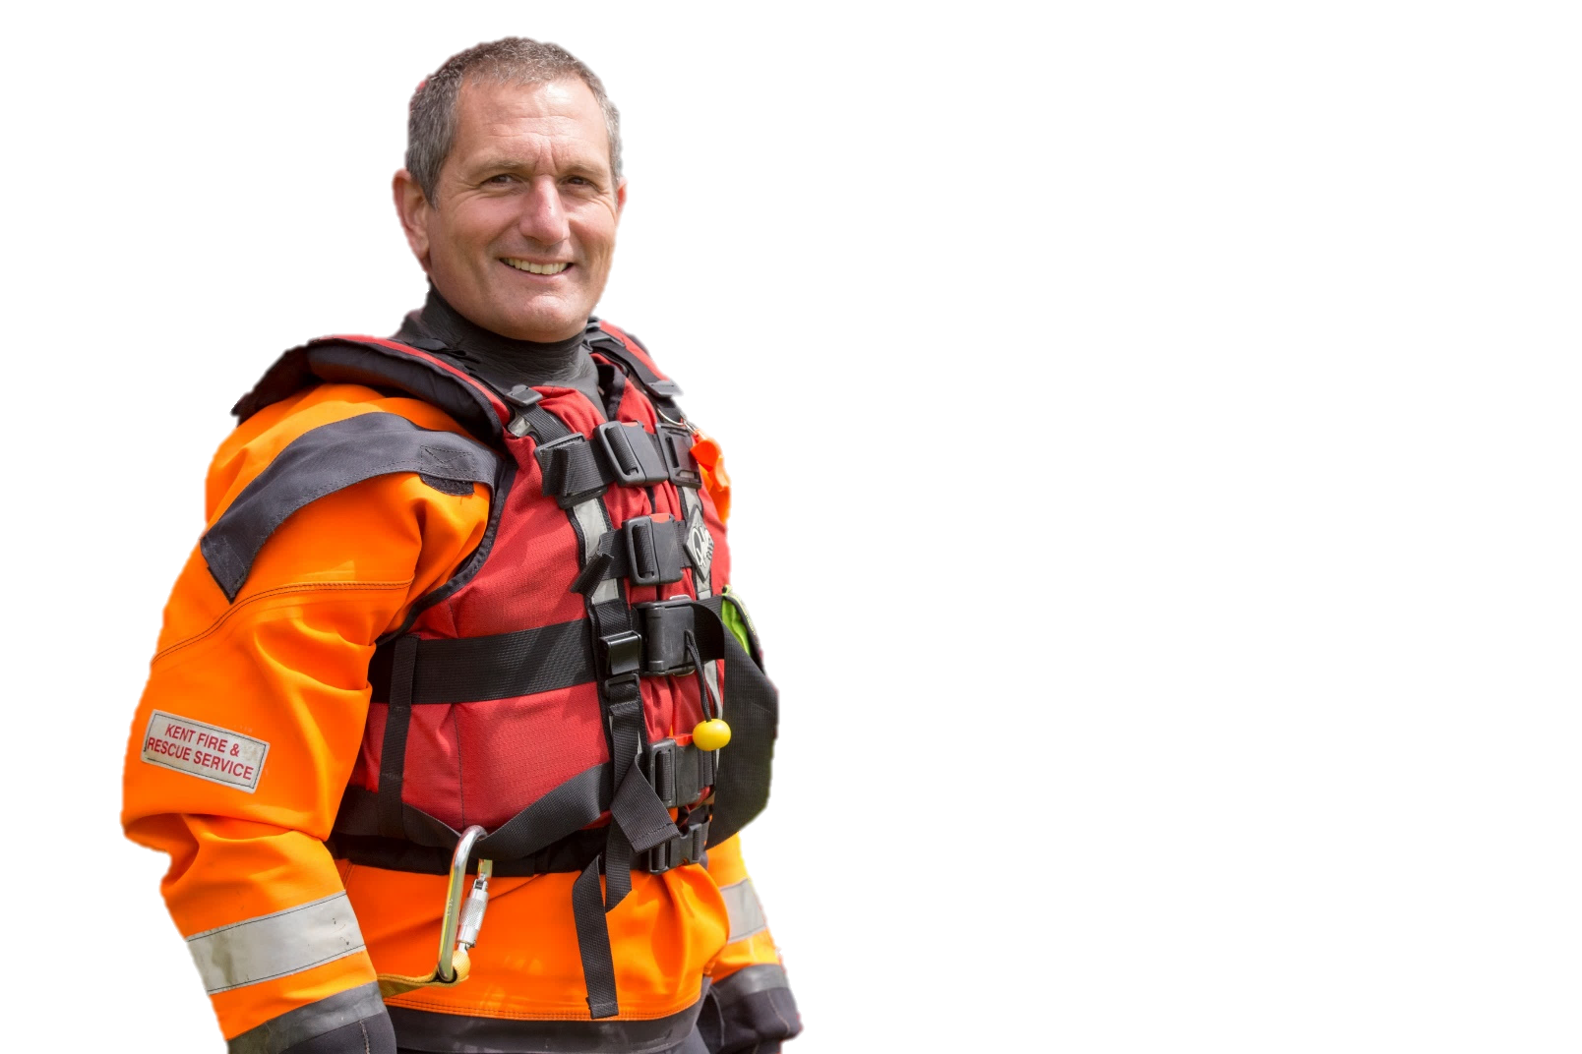
Inland water
Fire Service!
Here’s how we can help
Any large areas of water you see that are away from the coastline are known as inland water. This includes rivers, ponds, creeks, canals and lakes.
If someone is in trouble in inland water, you should call 999 and ask for the…
At the fire service we have a specialist water rescue team who have the correct tools and clothing to rescue anyone in trouble in inland water.

Slide 7
How we can help
Let’s start with what we wear to keep us safe
We wear dry suits to avoid getting wet and cold in the water
We wear a floatation device to help us to float in the water
We wear a helmet to protect us from any dangers

Slide 8
How we can help
Our water safety vehicle holds special tools. These include…
An inflatable boat to access the area safely
Our personal floatation device (buoyancy aid) allows us to access the water safely
Using our water pole helps us check how deep the water is – remember this can change quickly

Slide 9
How we can help
Our water safety vehicle holds special tools. These include…
An inflatable boat to access the area safely
Our personal floatation device (buoyancy aid) allows us to access the water safely
Using our water pole helps us check how deep the water is – remember this can change quickly
If someone is in trouble our throw line is used to bring them back to safety
Here’s how they work…

Slide 10
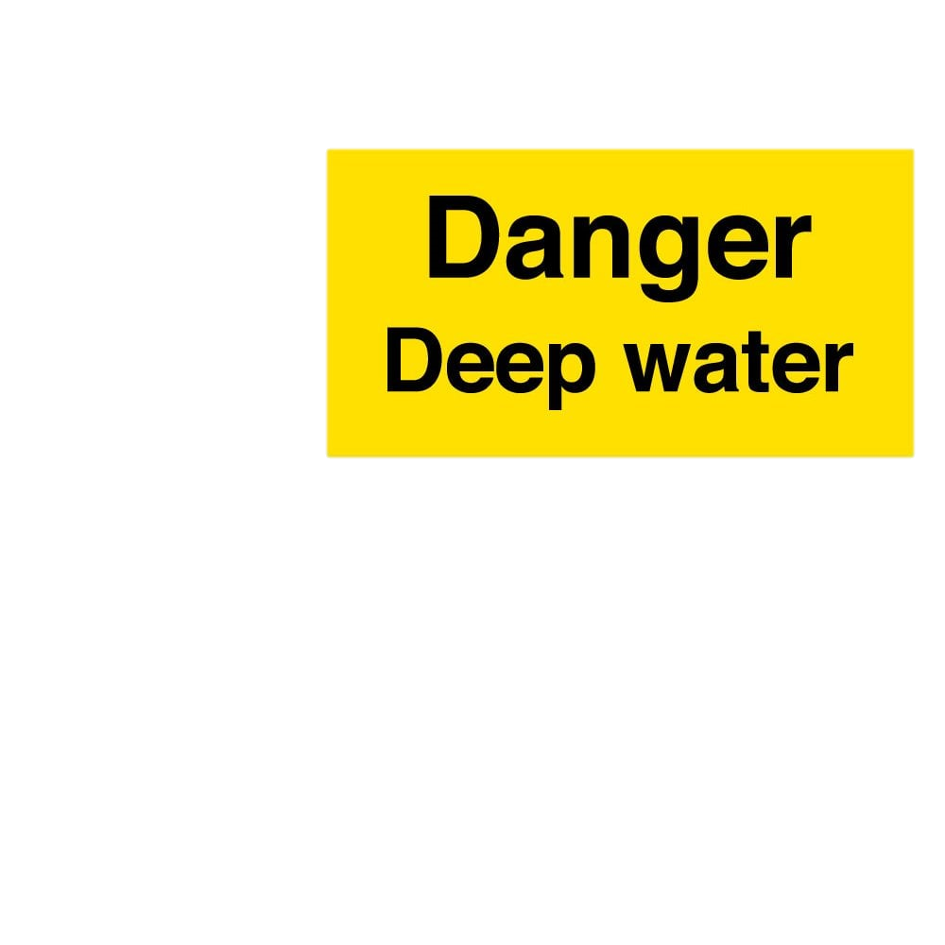
It’s important to be aware of the dangers of open water
You may recognise these signs
Remember to
It’s important to always stay away from the waters’ edge because of hidden hazards in the water
What is a hazard?
A hazard is something that is dangerous and likely to cause damage

Slide 11
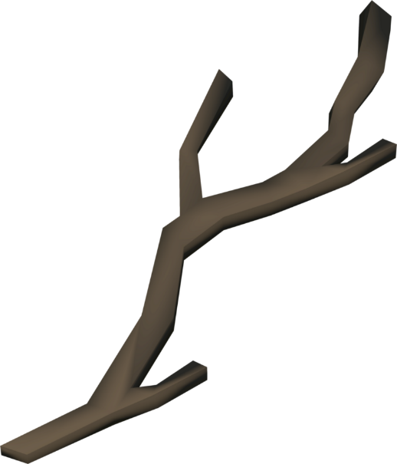
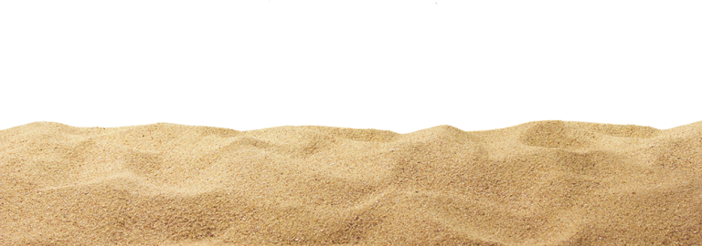
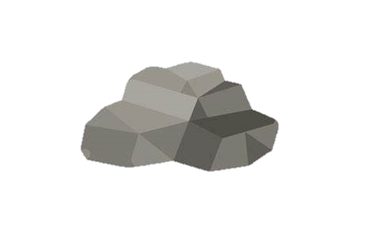
Common hazards in the water
There are lots of hidden hazards under the water, that you can’t see.
Litter
Reeds and branches
Sewage

Slide 12
You know how to
Now it’s time to
Your task:
There will be a series of water safety scenarios for you to think about. You need to discuss and decide the safest option for each one.

Slide 13
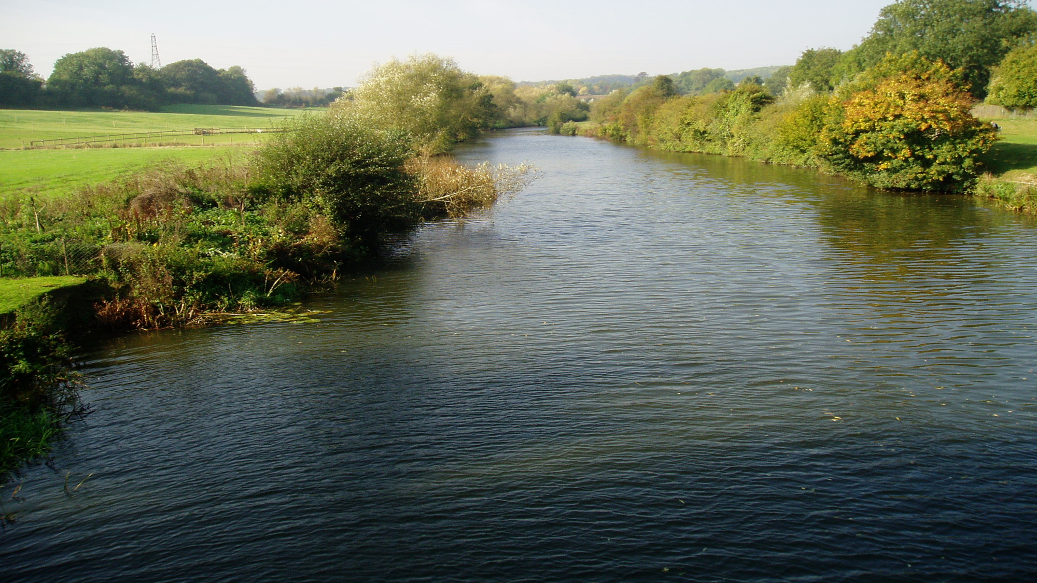
Your friends want to play football at the local park. Your friend kicks the ball hard and it falls into the nearby river. Your friend tries to retrieve it.
Do you…
A
B
C
Leave the ball. It’s too risky and you could put yourself and others in danger
Watch your friend try and retrieve it. The water doesn’t look too deep.
Stand on the edge of the lake and use something to drag the ball in.

Slide 14
Always let someone know where you are going and when you expect to be back
Be wary of all edges around open water. The soft, wet ground can give way underneath you
Slips and falls can happen in all locations

Slide 15
You are walking along a canal pathway when you see someone in the water. They have fallen in and are struggling to stay afloat.
What should you do?
A
B
C
Run to the nearest rescue equipment point to bring back a floatation aid
Jump in and help them. You are a good swimmer and are certain you can save them
Call the emergency services and stay with the person to try and calm them

Slide 16
Reeds and plant life can cause you to get tangled in the water
The water can be deceiving, it may be deeper than you think
Diseases can be found in canal water which can make you very sick

Slide 17
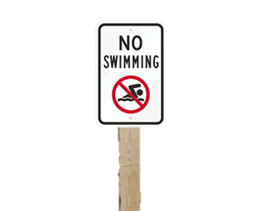
You and your friends find a lake. The water looks calm. Your friends decide to jump in the lake for a swim. They don’t see the ‘No Swimming’ sign.
Do you…
A
B
C
Follow them into the river. The water looks calm, so it won’t be a risk
Tell them to come back as it’s not safe to swim. If they don’t listen find and tell an adult
Sit on the edge of the lake with your feet in the water

Slide 18
Even on a warm day, the water can be freezing cold - this can cause cold water shock
Even though the water may look calm – underneath can be strong currents
You should NEVER enter the water where it is unsafe

Slide 19
Cold Water Shock
A body of water below 15 degrees is referred to as cold water.
The average UK temperature for open water is 12 degrees – even in the summer!
Cold Water
Shock causes:
Your blood pressure to increase from restricted blood flow
Your heart rate to increase
Your breathing to increase uncontrollably
Your body to panic
Learn more about Cold Water Shock https://www.youtube.com/watch?v=dVNEOZjPzYg

Slide 20
How can you be safe around water?
Follow the Water Safety Code!
Stop and Think
Stay together
Call 999
Float
Learn more about the Water Safety Code here - https://youtu.be/zwzB7So7jSM?si=hnciusDwxR2RMCRl

Slide 21
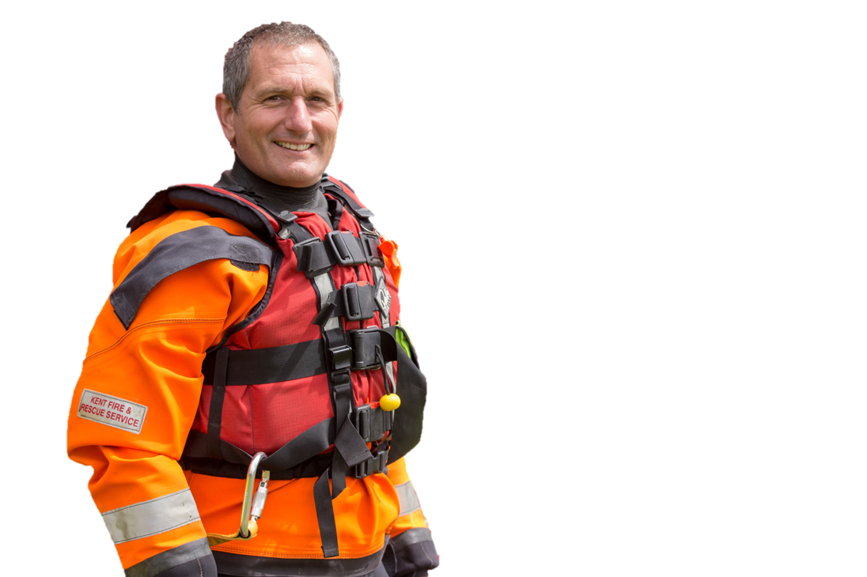
Float to Live
If the water is cold, it can make you panic, which makes you move more and you can become tired
D
But why should you float?
Lying on your back and gently swishing your arms and feet around in circles uses less energy
Keeping your head above the water allows you to breathe
Floating gives you more time to think, call for help and await rescue

Slide 22
How to float
1
Tilt your head back, submerging your ears
2
Relax and try to control your breathing
3
Move your hands to help you stay afloat
4
Your legs might sink but that’s OK – everyone floats differently
5
Spread your arms and legs to improve stability

Slide 23
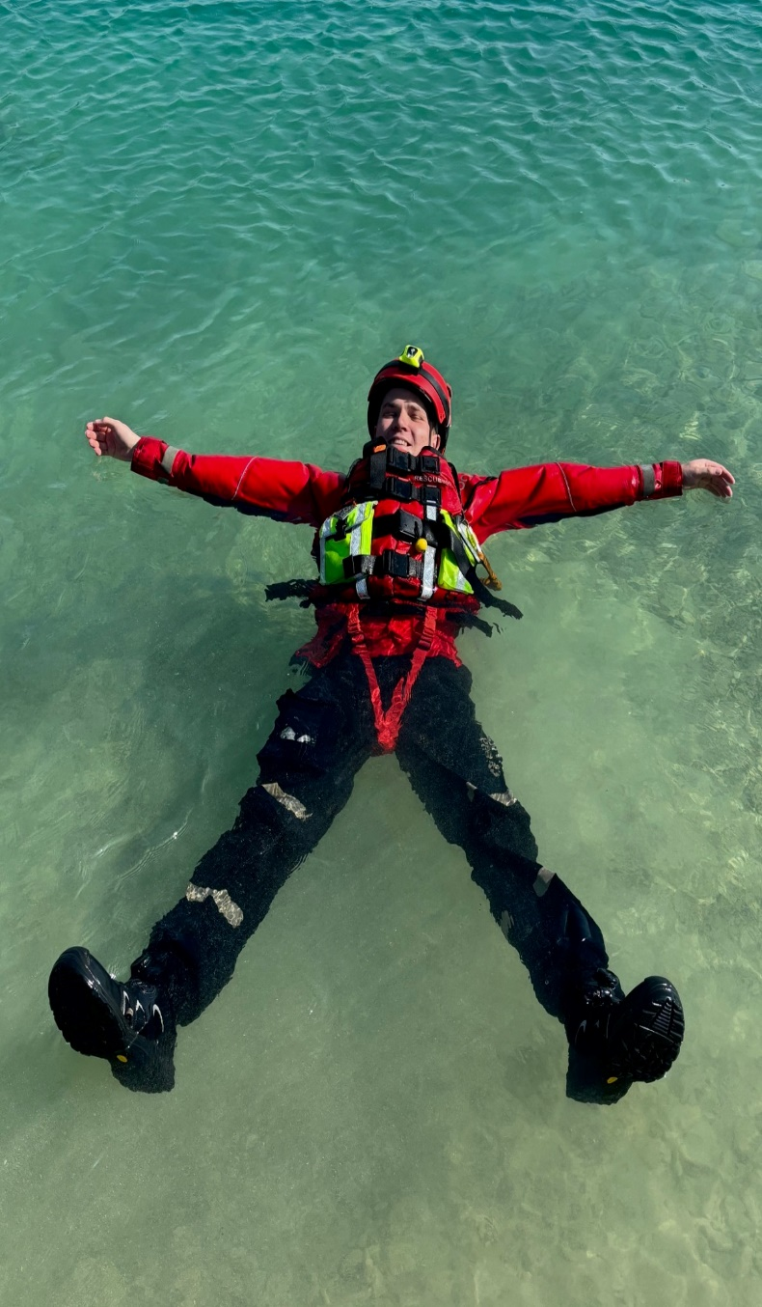
How to float
1
Tilt your head back, submerging your ears
2
Relax and try to control your breathing
3
Move your hands to help you stay afloat
4
Your legs might sink but that’s OK – everyone floats differently
5
Spread your arms and legs to improve stability

Slide 25
Who should you call if someone is in trouble in the sea?
OR
The Fire Service?
The Coastguard?

Slide 26
Who should you call if someone is in trouble in inland water?
OR
The Coastguard?
The Fire Service?

Slide 27
Name the parts of the Water Safety Code
Stop and Think
Stay together
Call 999
Float

Slide 28
What do these signs mean?

Slide 29
What hazards could be underwater?

Slide 30
If you fall in the water, what should you do?
A
B
Relax and lay on your back
Tilt you head back and control your breathing
ALL OF THEM!
C
D
Move your hands and legs gently to stay afloat
Spread your arms and legs for stability

Slide 31
Working alongside
Remember to stay safe around water
Try our water safety resources

