Slide 1
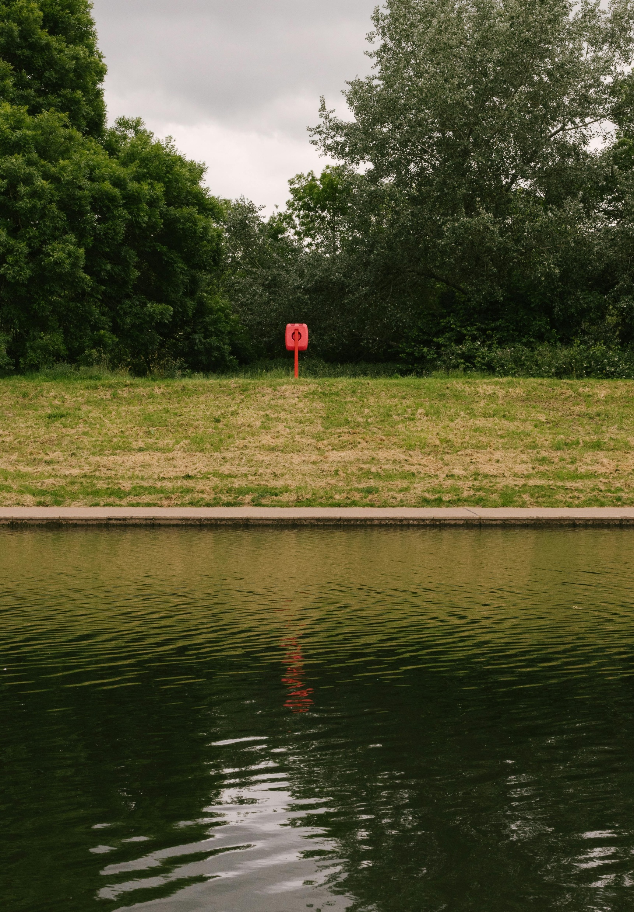

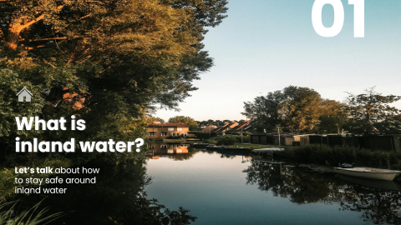
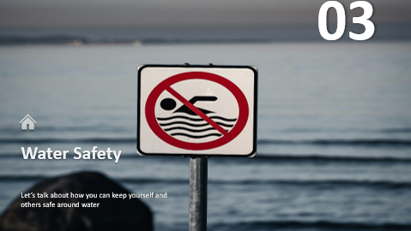


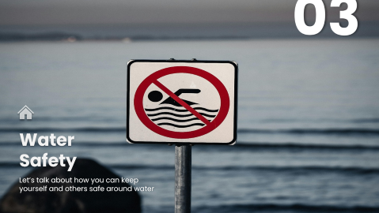
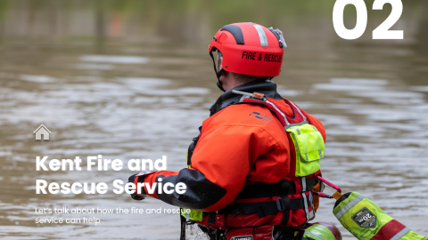
Secondary school
Water
Safety
Find out how you can keep yourself and others safe around inland water
PREV
NEXT

Slide 2


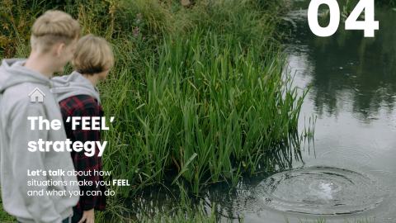

Secondary school
Water
Safety
Find out how you can keep yourself and others safe around inland water
PREV
NEXT

Slide 3
Secondary school
Water
Safety
Find out how you can keep yourself and others safe around inland water
NEXT
PREV
NEXT

Slide 4
Secondary school
Water
Safety
Find out how you can keep yourself and others safe around inland water
PREV
NEXT

Slide 5
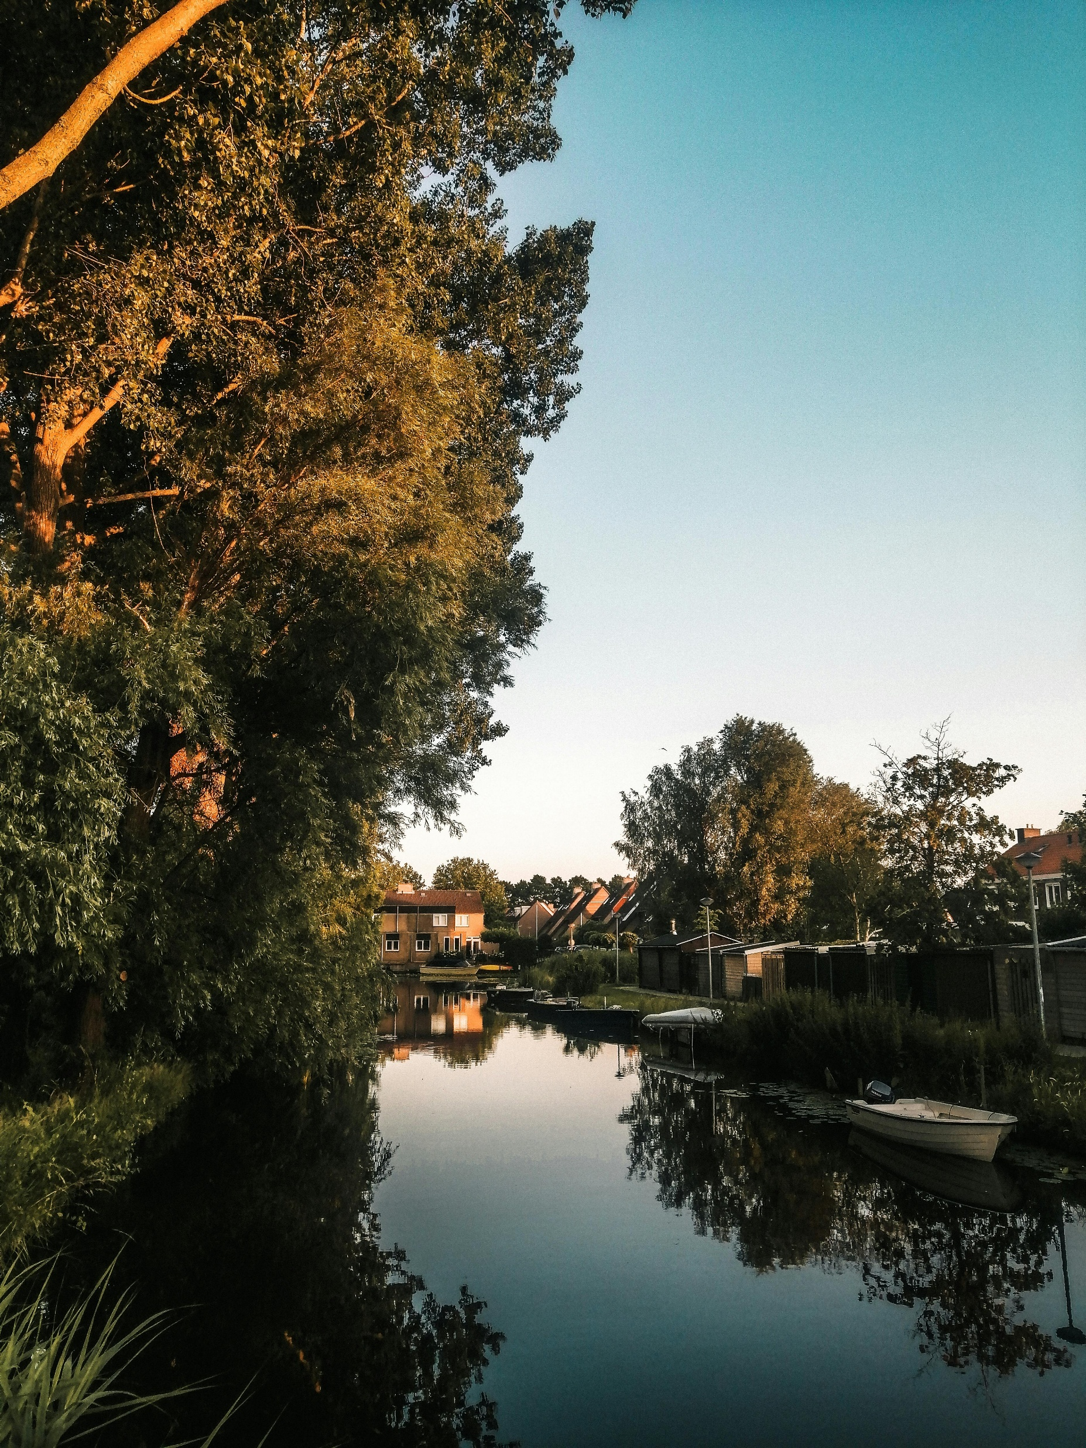
01
What is inland water?
Let’s talk about how to stay safe around inland water

Slide 6
We want you to come away from today’s session…
To understand what inland water is
Identifying the different types of inland water
Understanding the dangers of inland water

Slide 7
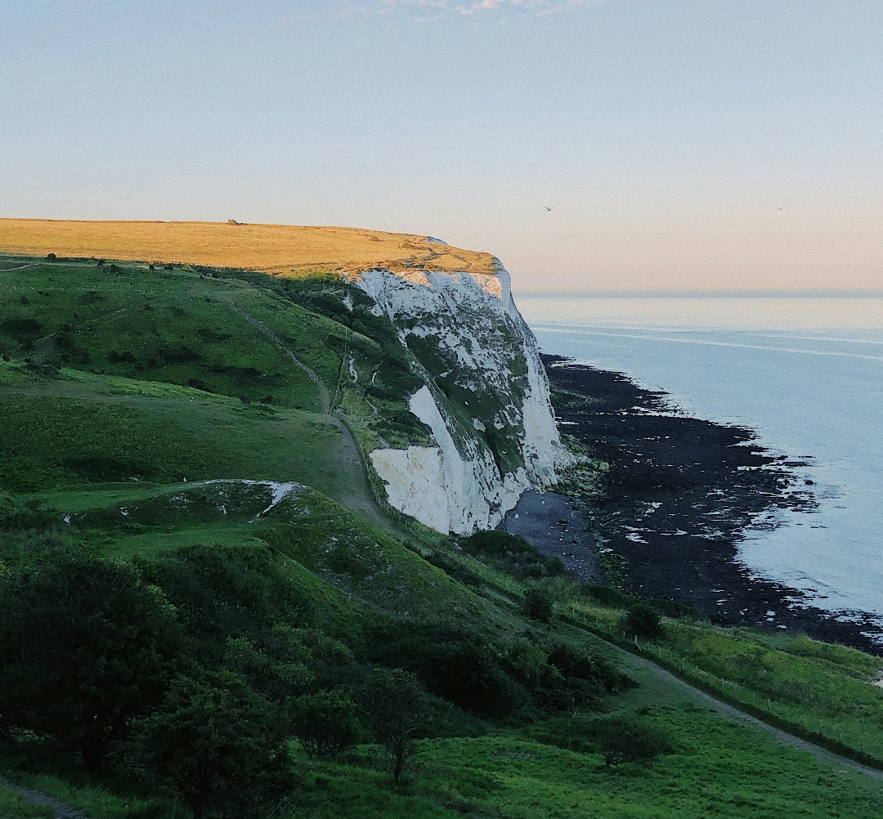
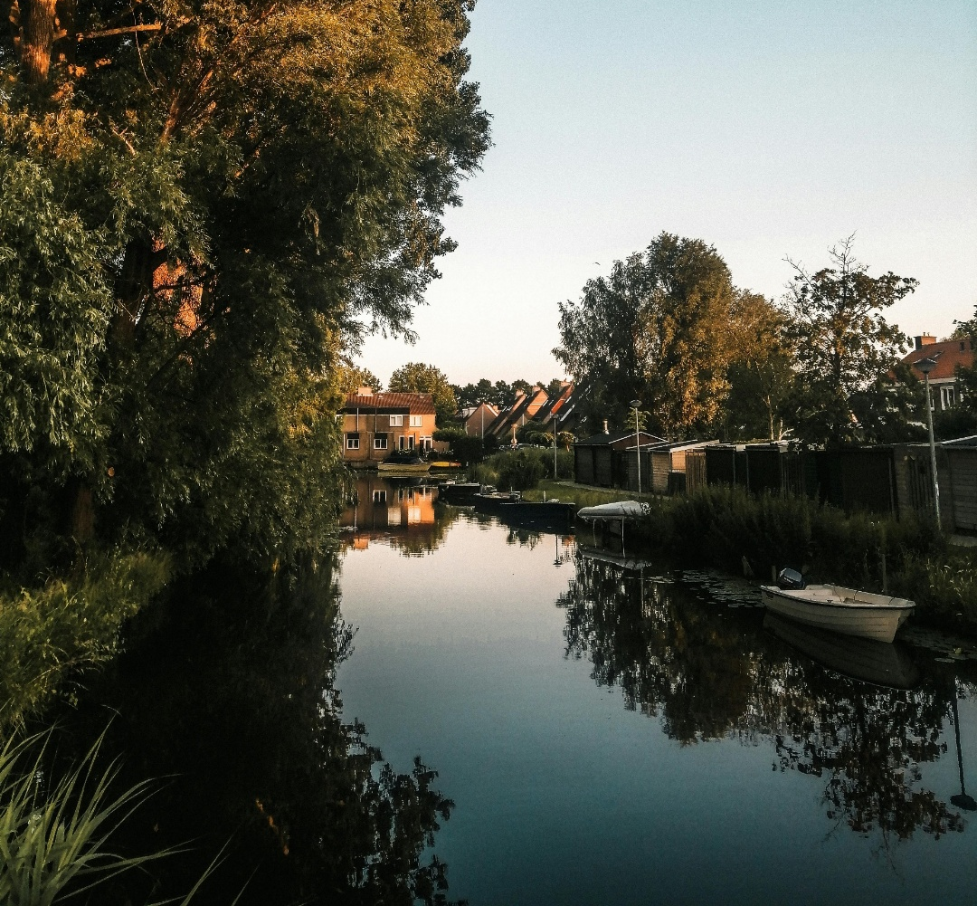

In Kent there are two types of open water…
Coastal
The RNLI patrols 13 of Kent’s beaches, keeping people safe
Kent’s coastline stretches 350 miles!

Slide 8

In Kent there are two types of open water…
Inland
But… what is inland water?

Slide 9
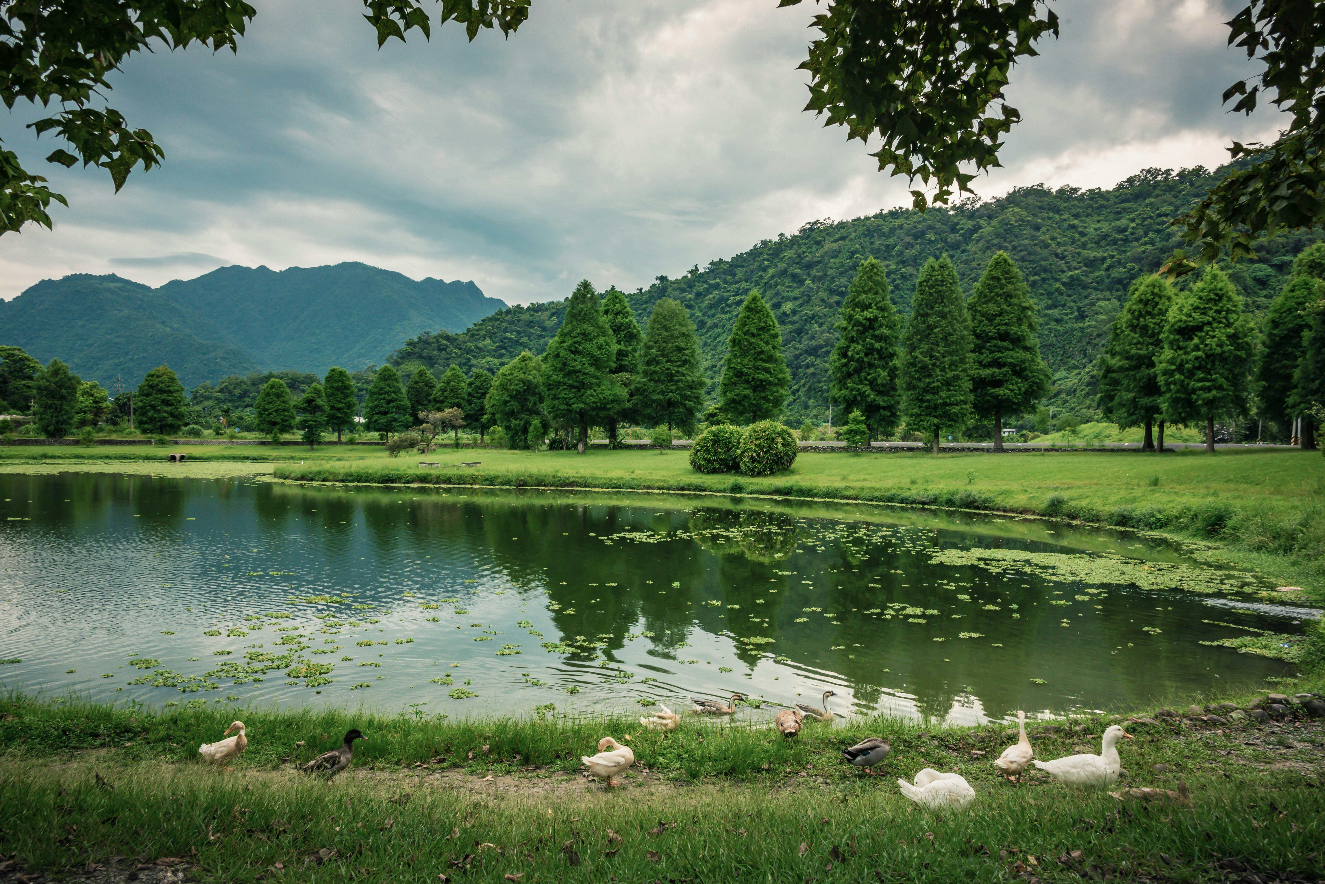
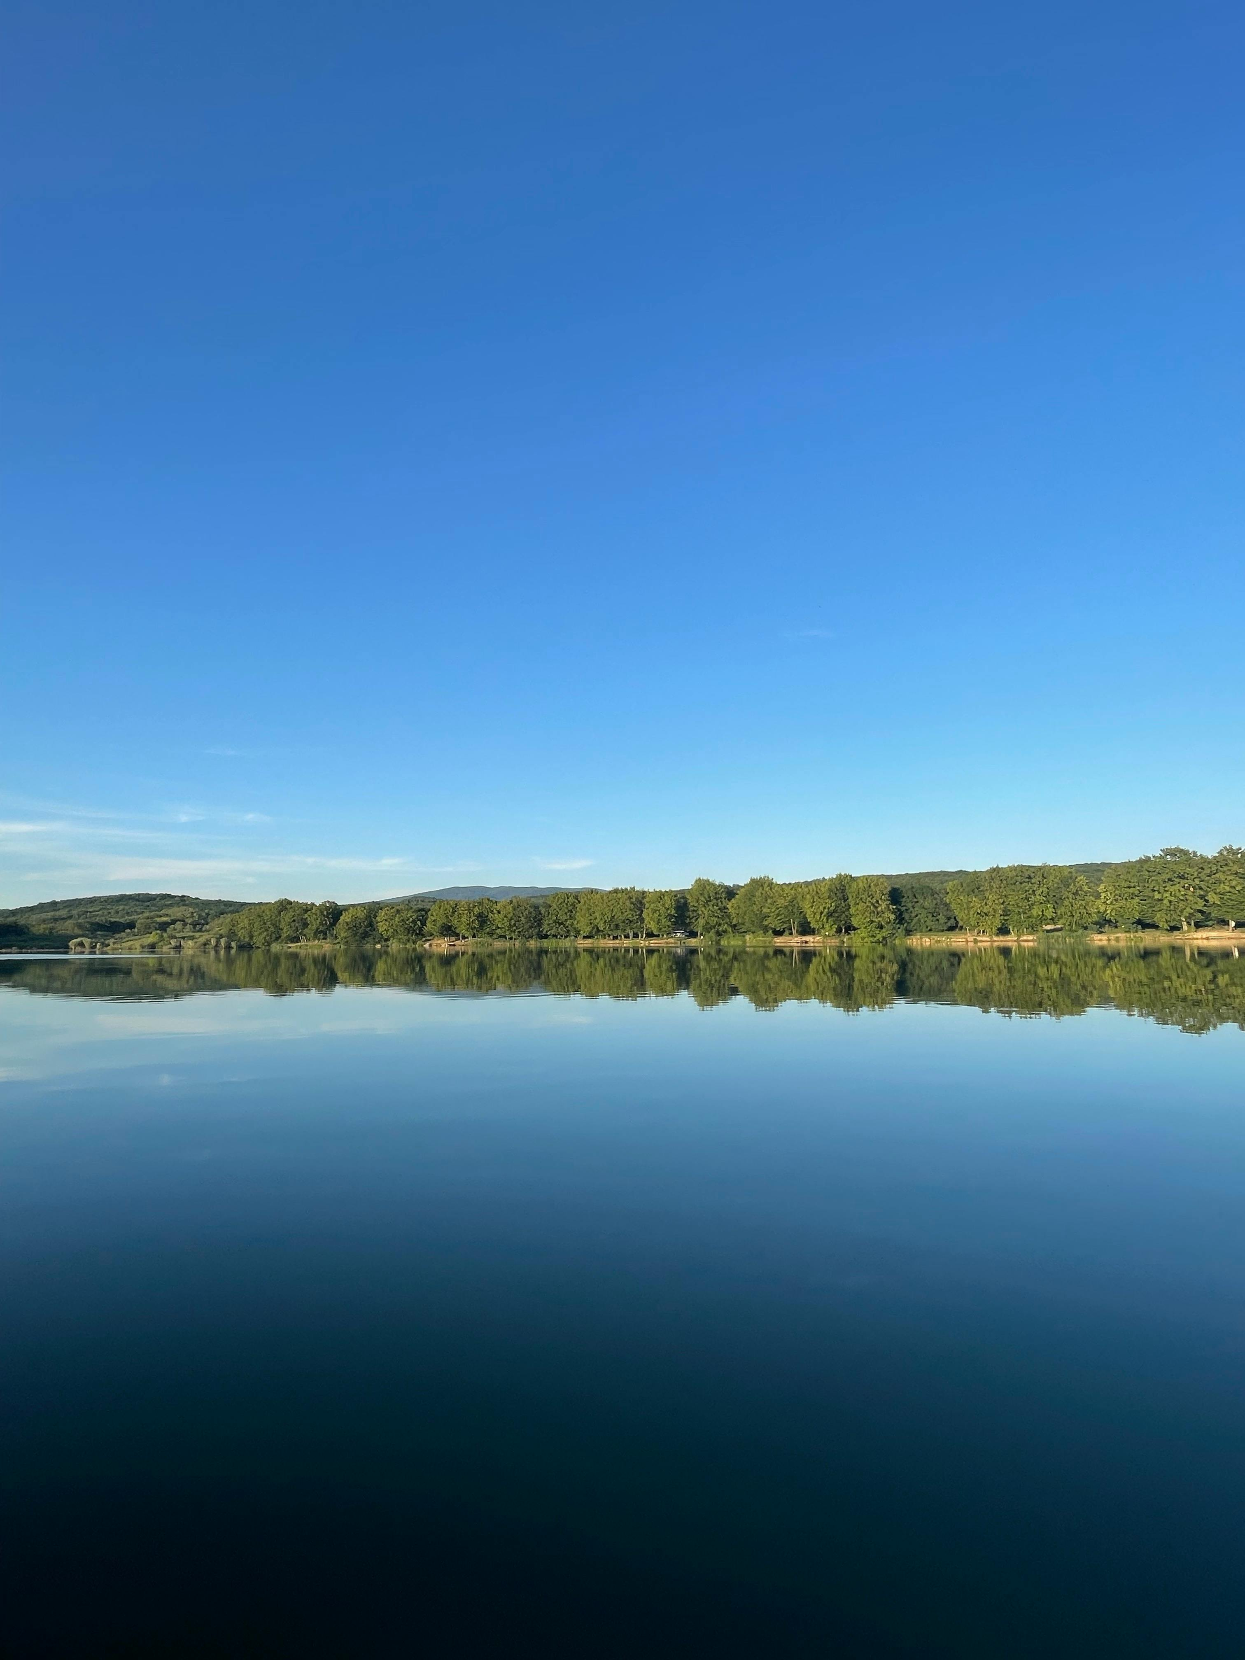
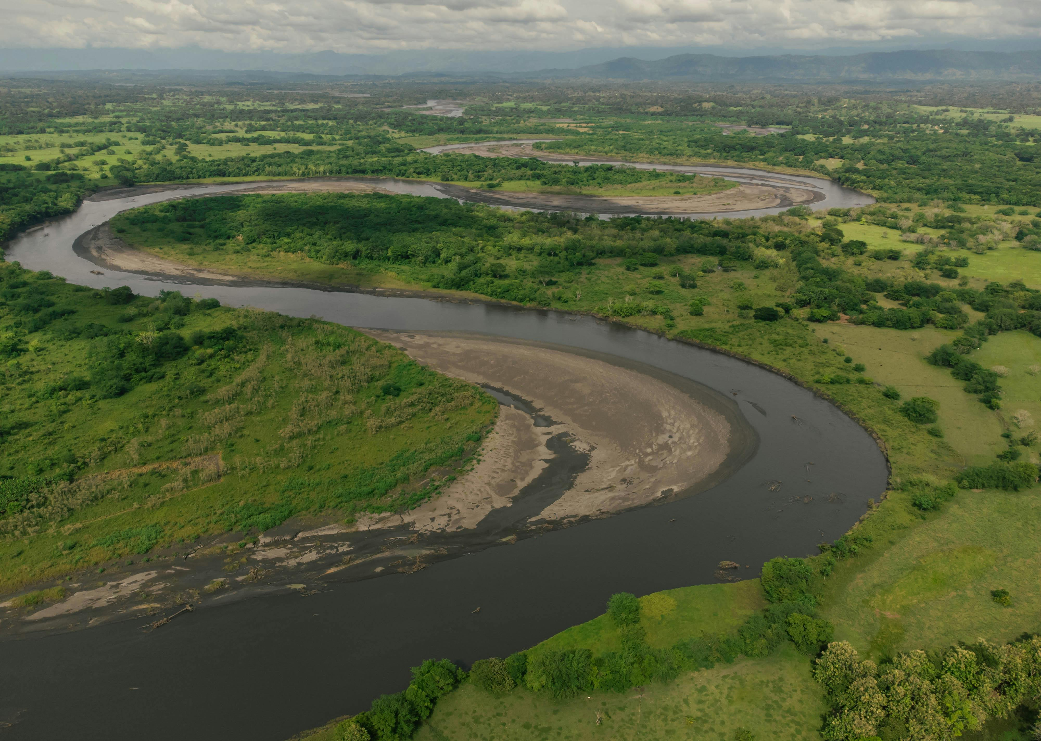
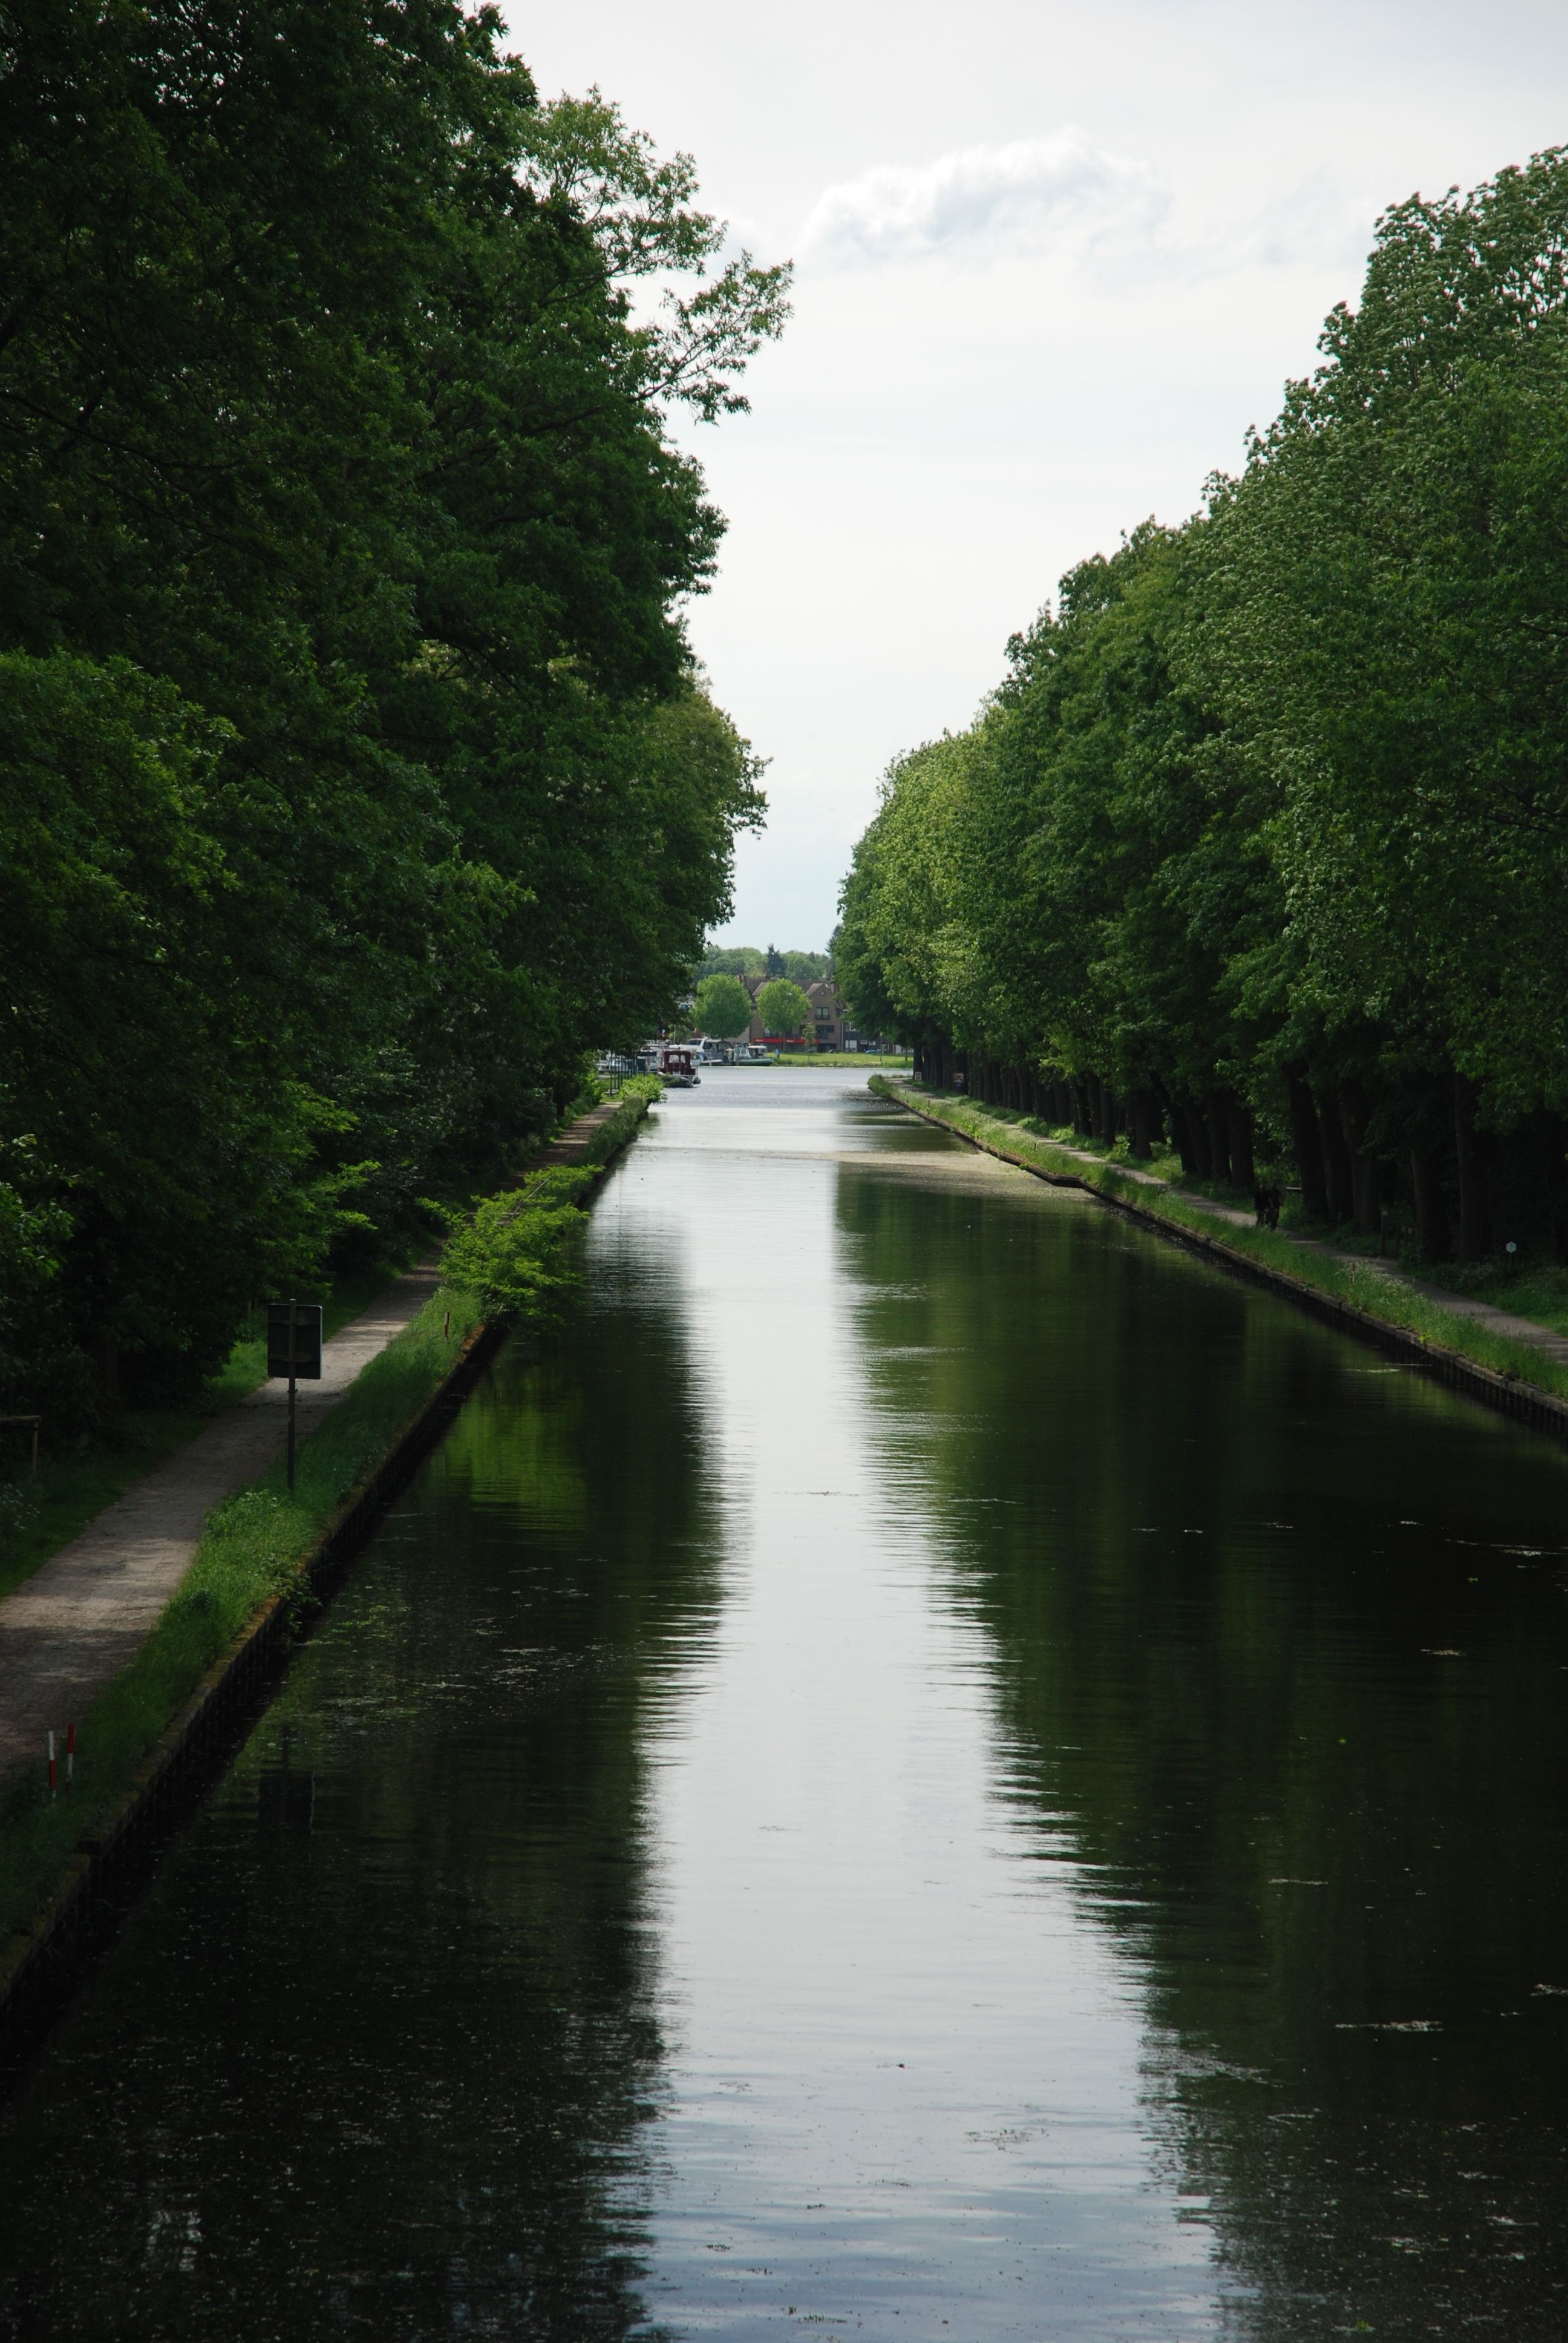
Can you think of any examples of inland water?
Inland water are large areas of water you see that are away from the coastline.
Canals
Rivers
Lakes
Ponds
THINK – Kent is full of inland water. Are there any local areas of water close to you?

Slide 10
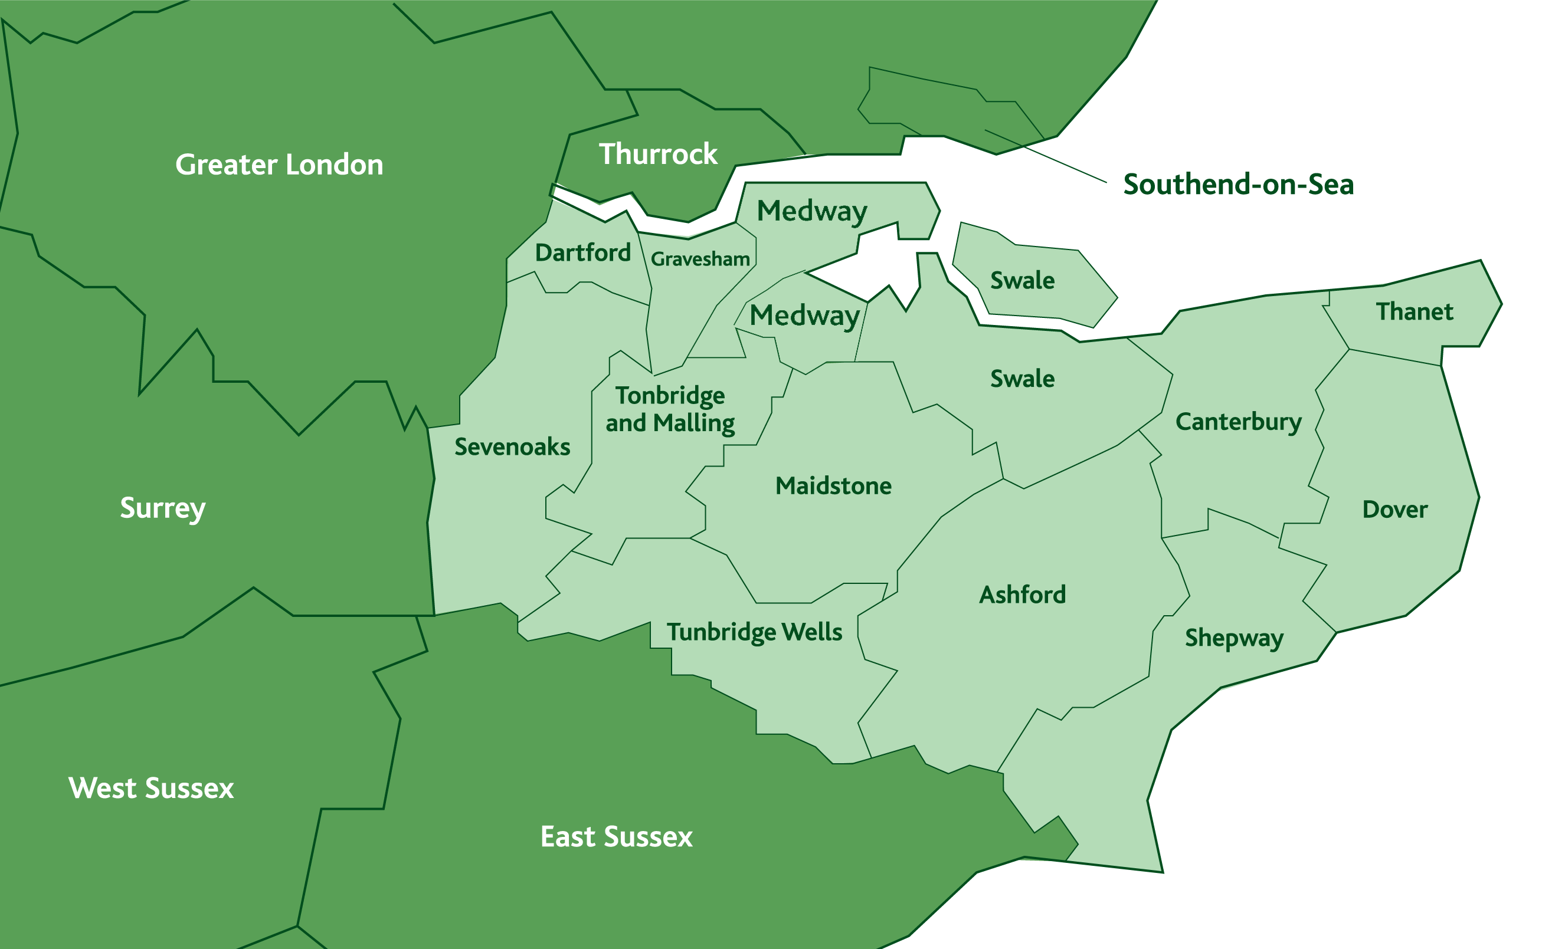


Here we’ve highlighted the main hotspots in Kent
These are areas in which emergency services have been called when someone needs help.
These are often busy areas with dog walkers, runners and families.
KEY
Lakes
Rivers
Why do people think it’s safe to enter the water in these areas?
Water Emergencies
LET’S TALK

Slide 11
So, what makes inland water dangerous?
Here are some things you need to consider…

Slide 12
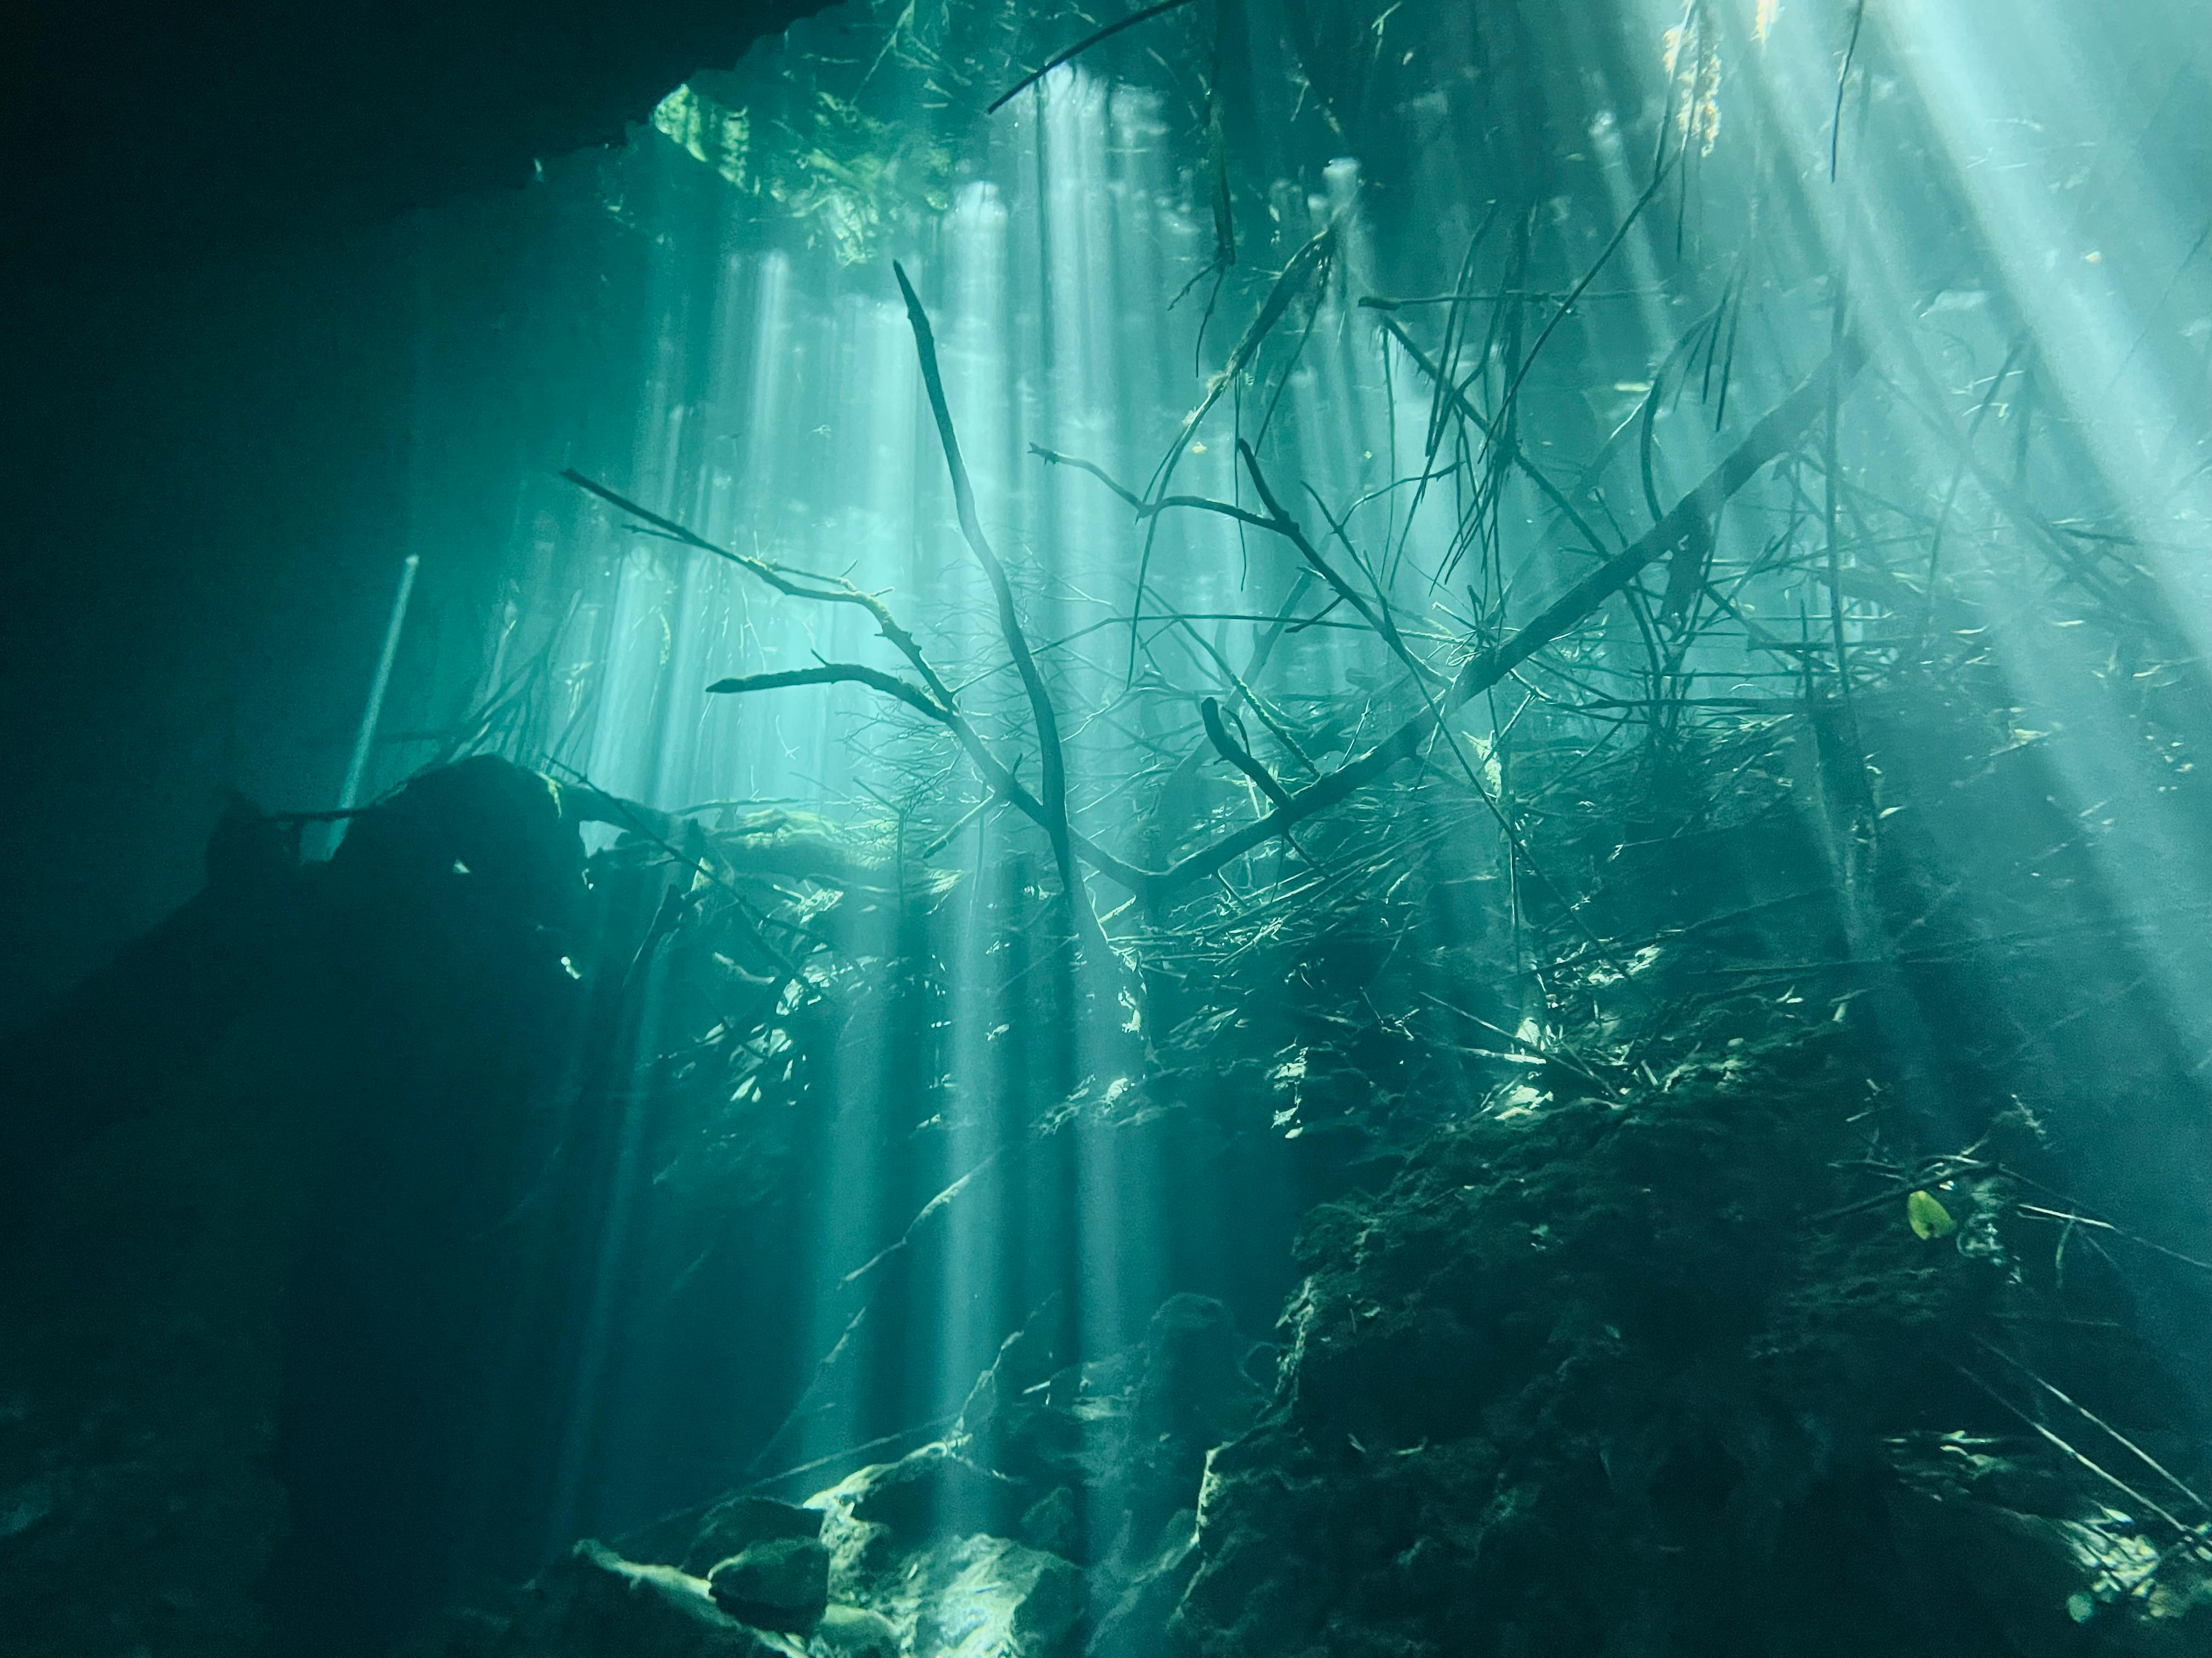

There are numerous hazards under the water that you can’t see. These include…
Below the surface
Litter – broken bottles and sharp objects could be in the water
Reeds – Even the strongest of swimmers can get caught
Contaminants – Water can contain deadly diseases
Riverbed – Even if you can walk along the riverbed, this can suddenly give way
MAKE SURE YOU TEST THEM ONCE A WEEK
VACCUM THEM TWICE A YEAR
CHANGE THE BATTERY EVERY YEAR (UNLESS FITTED WITH A 10 YEAR BATTERY)
IF THE ALARM GOES OFF – GET OUT, STAY OUT AND CALL 999

Slide 13
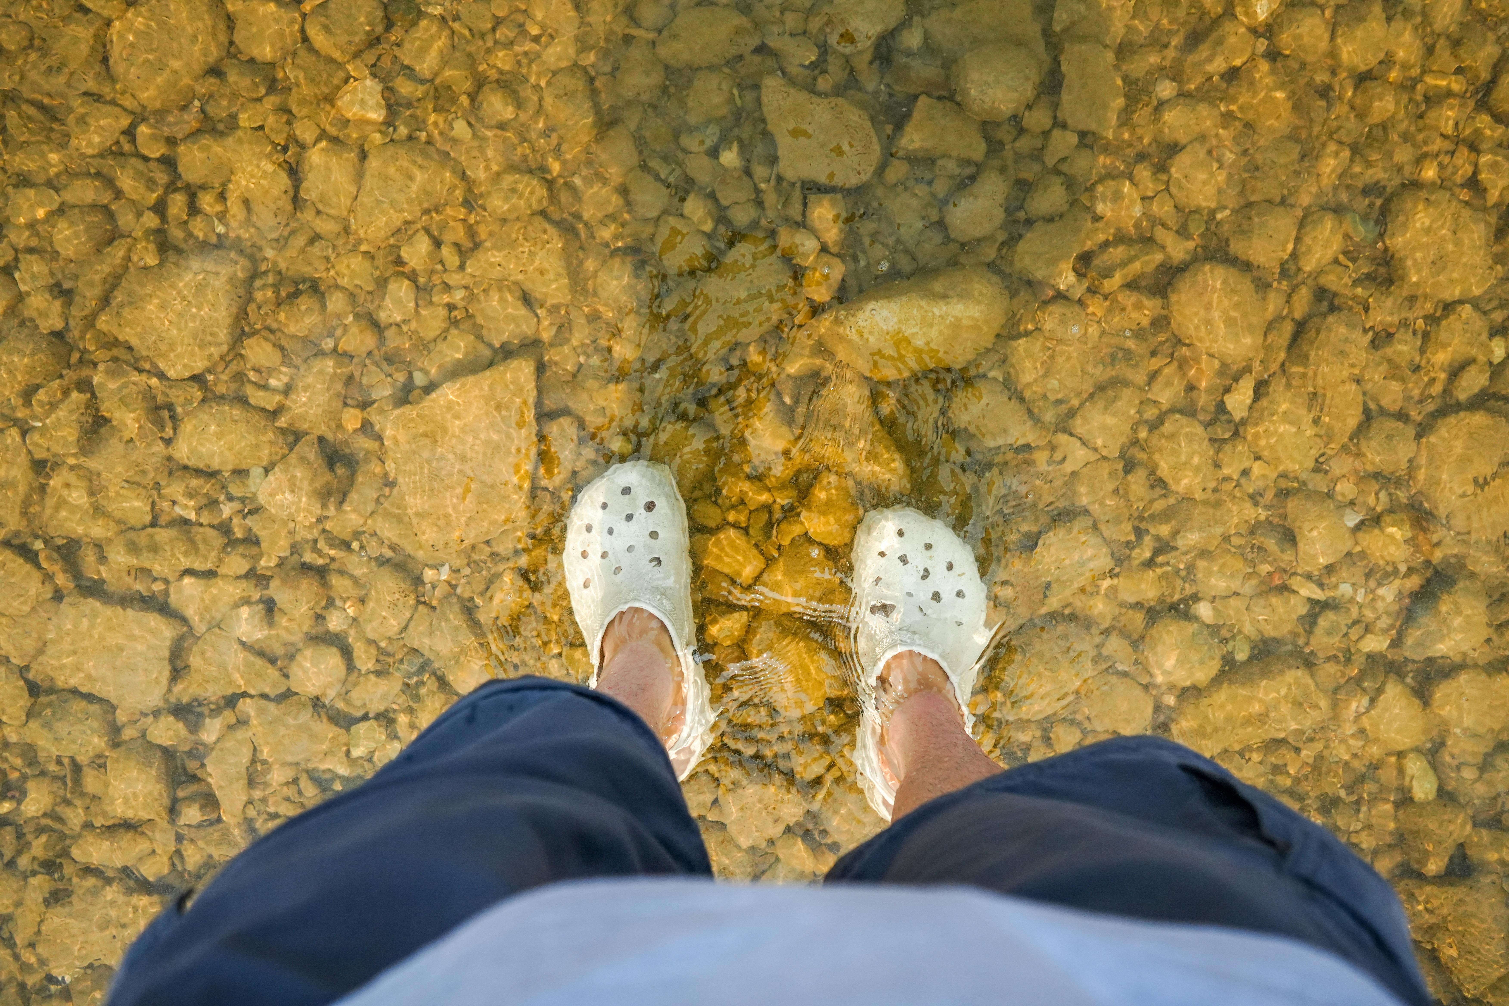
Temperature
A body of water under 15 degrees is considered cold water.
The average temperature of open waters in the UK is 12 degrees – even in the summer!
Entering open waters can cause cold water shock, meaning the cold temperature of the water could affect your body in a way that could lead to serious consequences.
MAKE SURE YOU TEST THEM ONCE A WEEK
VACCUM THEM TWICE A YEAR
CHANGE THE BATTERY EVERY YEAR (UNLESS FITTED WITH A 10 YEAR BATTERY)
IF THE ALARM GOES OFF – GET OUT, STAY OUT AND CALL 999

Slide 14
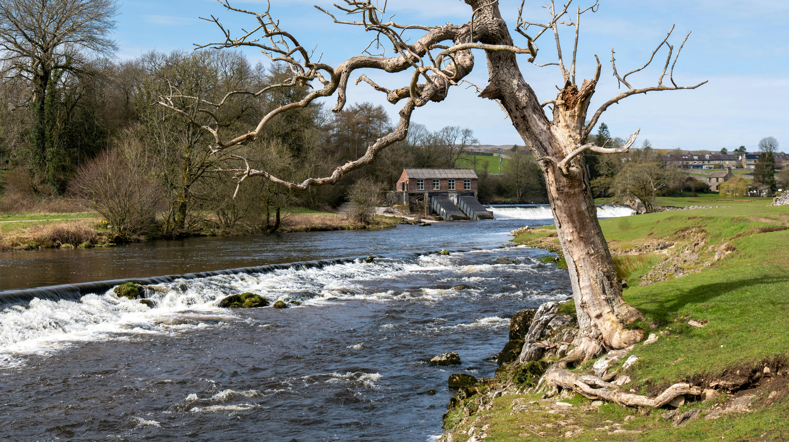

Currents
Similar to coastal water, inland water also has different currents.
These channels of water pose serious risk and can pull swimmers into deeper water at high speeds.
Some currents are hidden beneath the surface known as undercurrents. They are unpredictable and can cause swimmers to be pulled underwater.
Inland water is often seen as calm because the current is less visible to the coast. For example, waves crashing against the shoreline.
MAKE SURE YOU TEST THEM ONCE A WEEK
VACCUM THEM TWICE A YEAR
CHANGE THE BATTERY EVERY YEAR (UNLESS FITTED WITH A 10 YEAR BATTERY)
IF THE ALARM GOES OFF – GET OUT, STAY OUT AND CALL 999

Slide 15
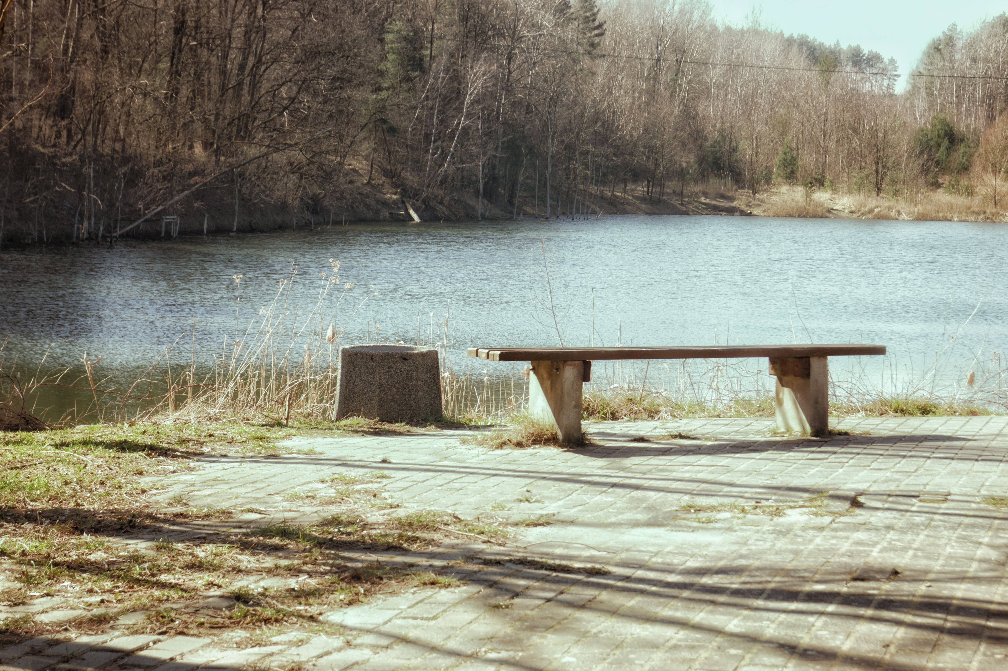

Unsupervised areas
Areas of inland water are unlikely to be monitored by lifeguards.
Swimming in areas without a lifeguard can increase risk.
If you were to get in trouble, you are putting yourself and others (fire service) in danger.
Call 999 and ask for the fire service
Who do you call for inland water emergencies?
MAKE SURE YOU TEST THEM ONCE A WEEK
VACCUM THEM TWICE A YEAR
CHANGE THE BATTERY EVERY YEAR (UNLESS FITTED WITH A 10 YEAR BATTERY)
IF THE ALARM GOES OFF – GET OUT, STAY OUT AND CALL 999

Slide 16

Re-cap
What is inland water?
Name a type of inland water
What are the dangers of inland water?

Slide 17
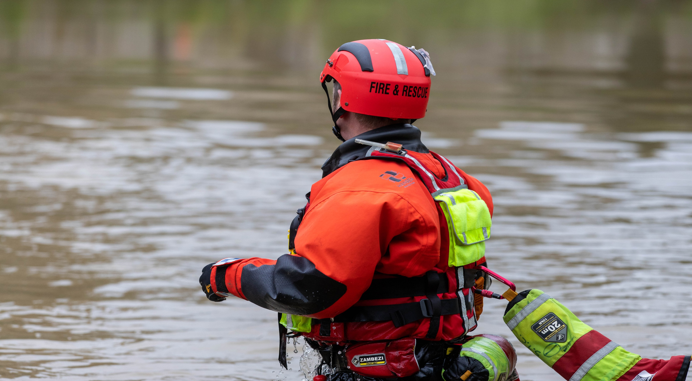
02
Kent Fire and Rescue Service
Let’s talk about how the fire and rescue service can help

Slide 18
We want you to come away from today’s session…
Understand what the fire service does for the community
Understanding how the fire service responds to water emergencies
Understanding the importance of making the right call

Slide 19
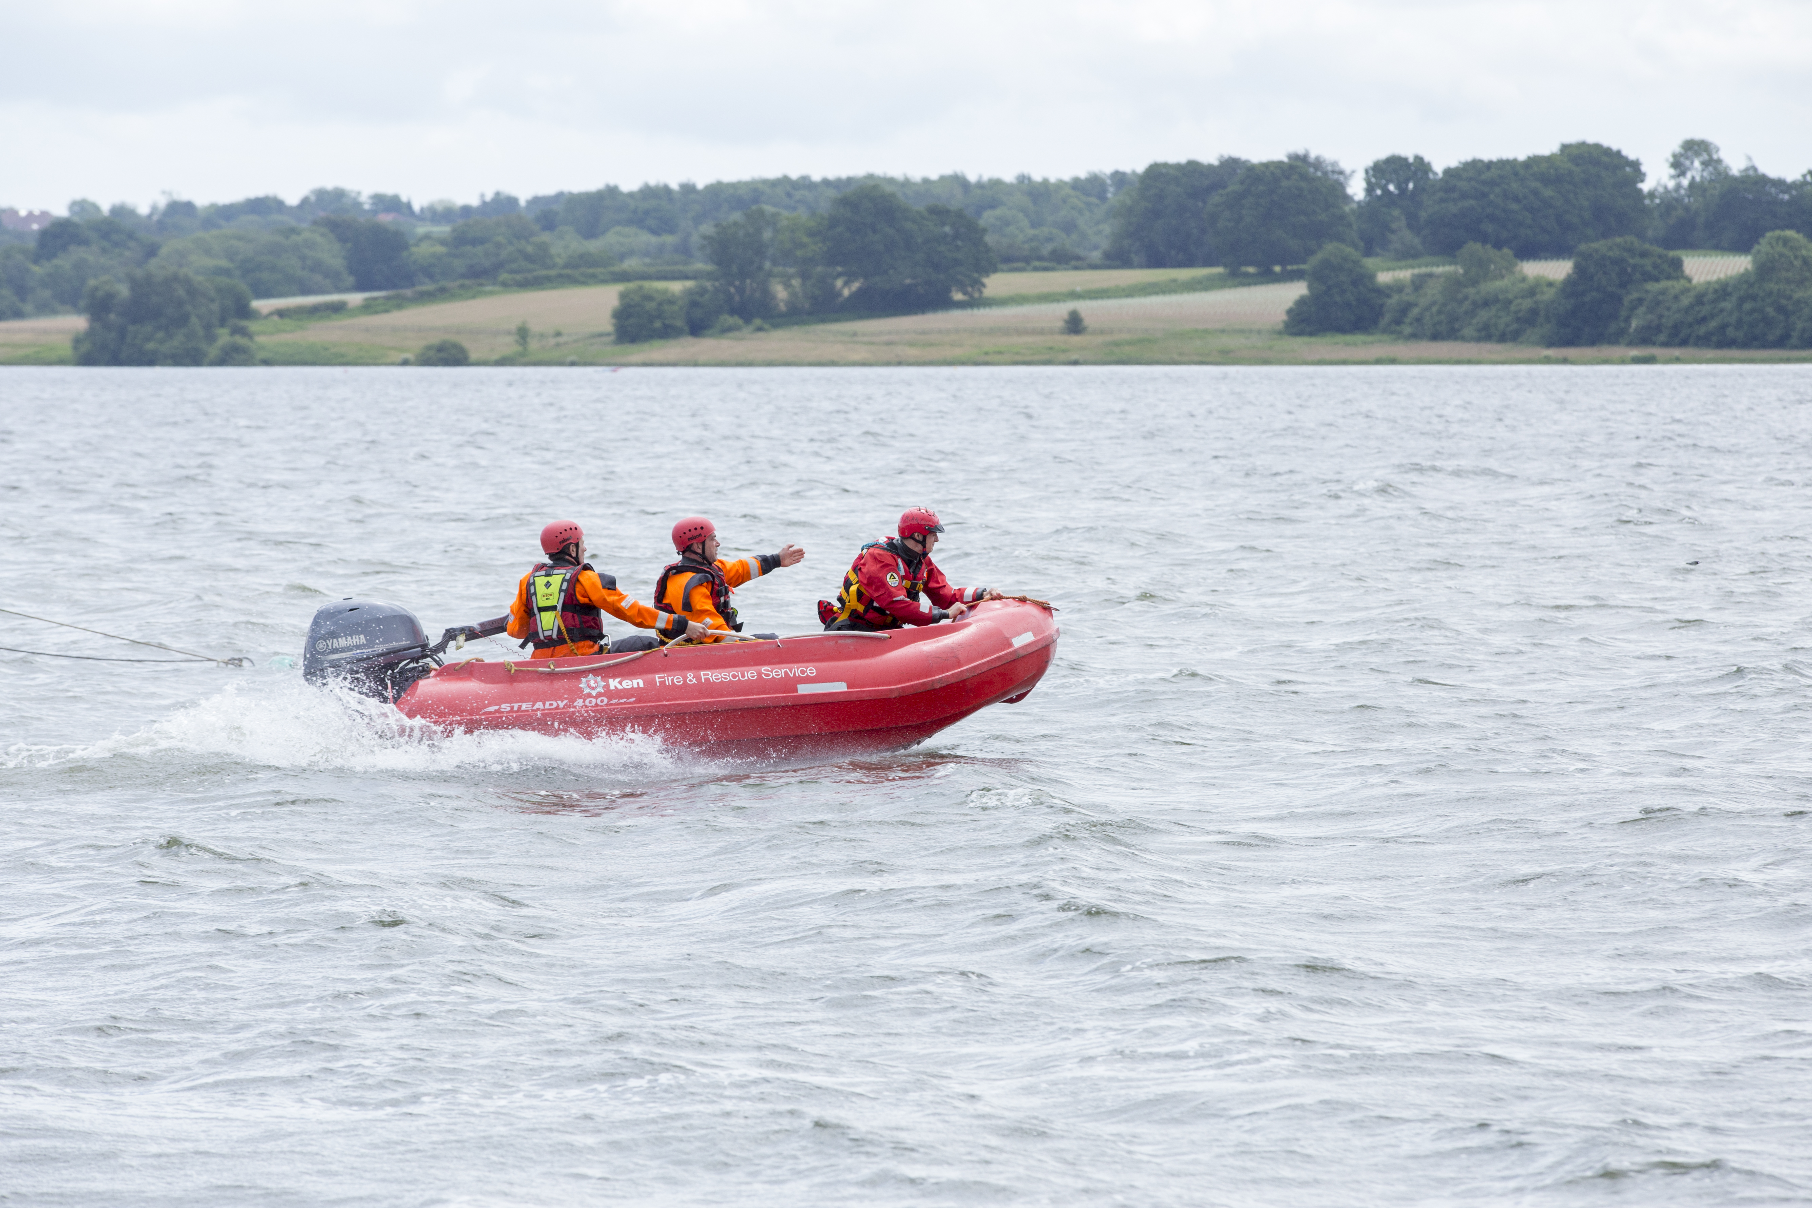
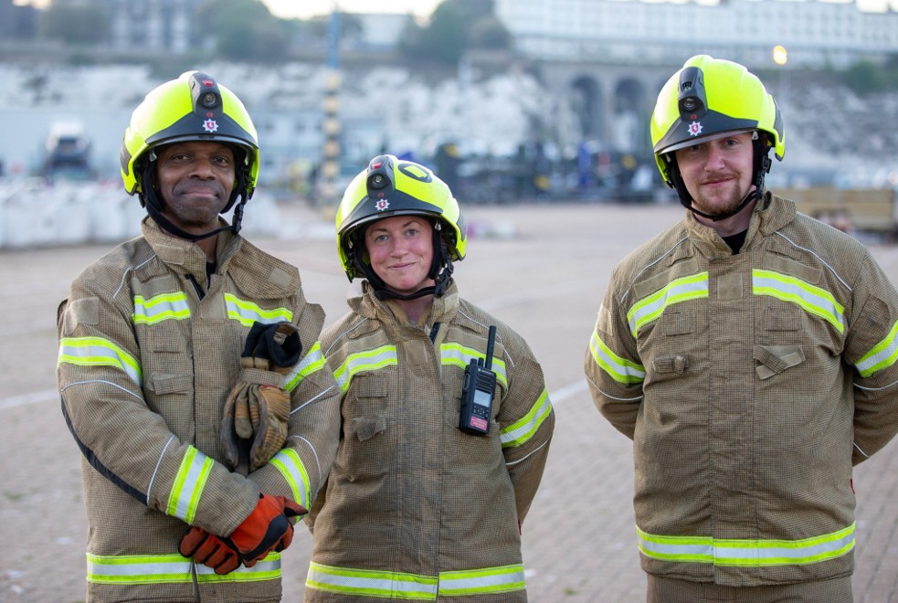
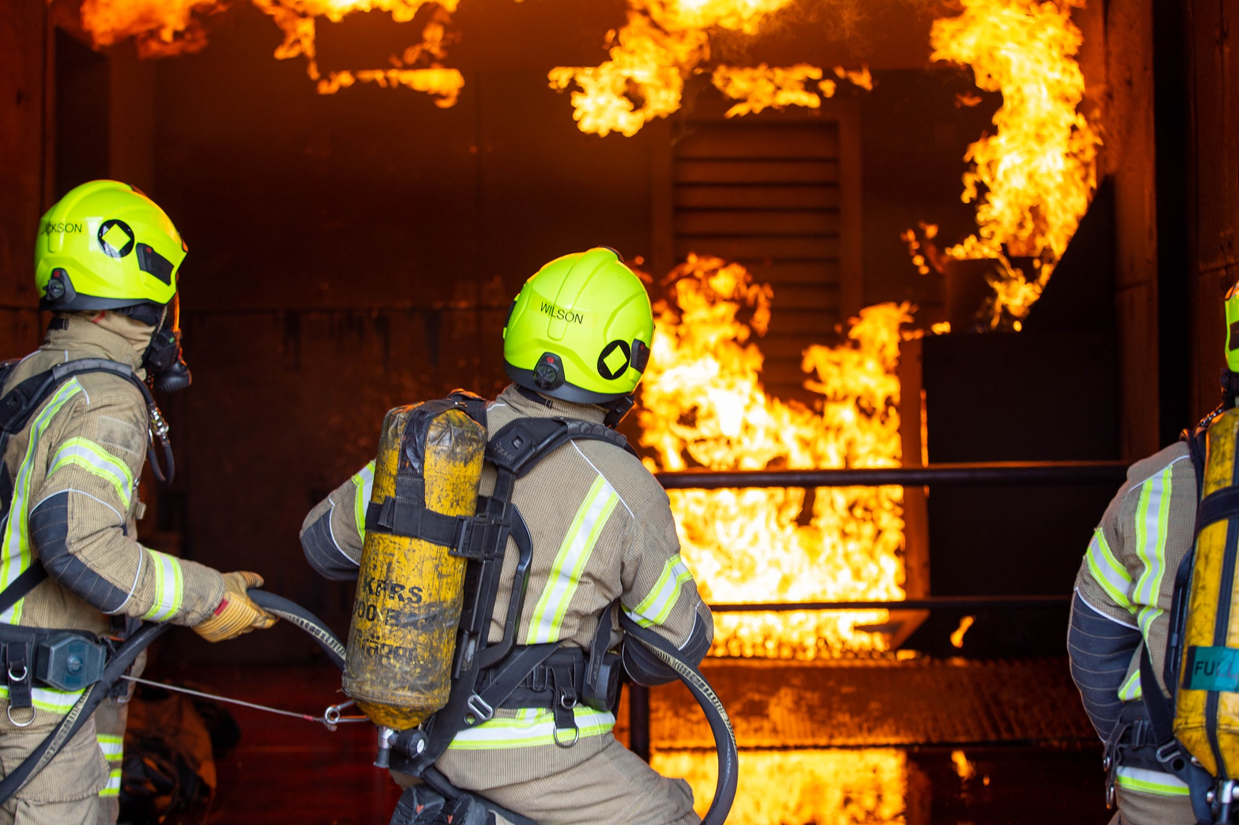
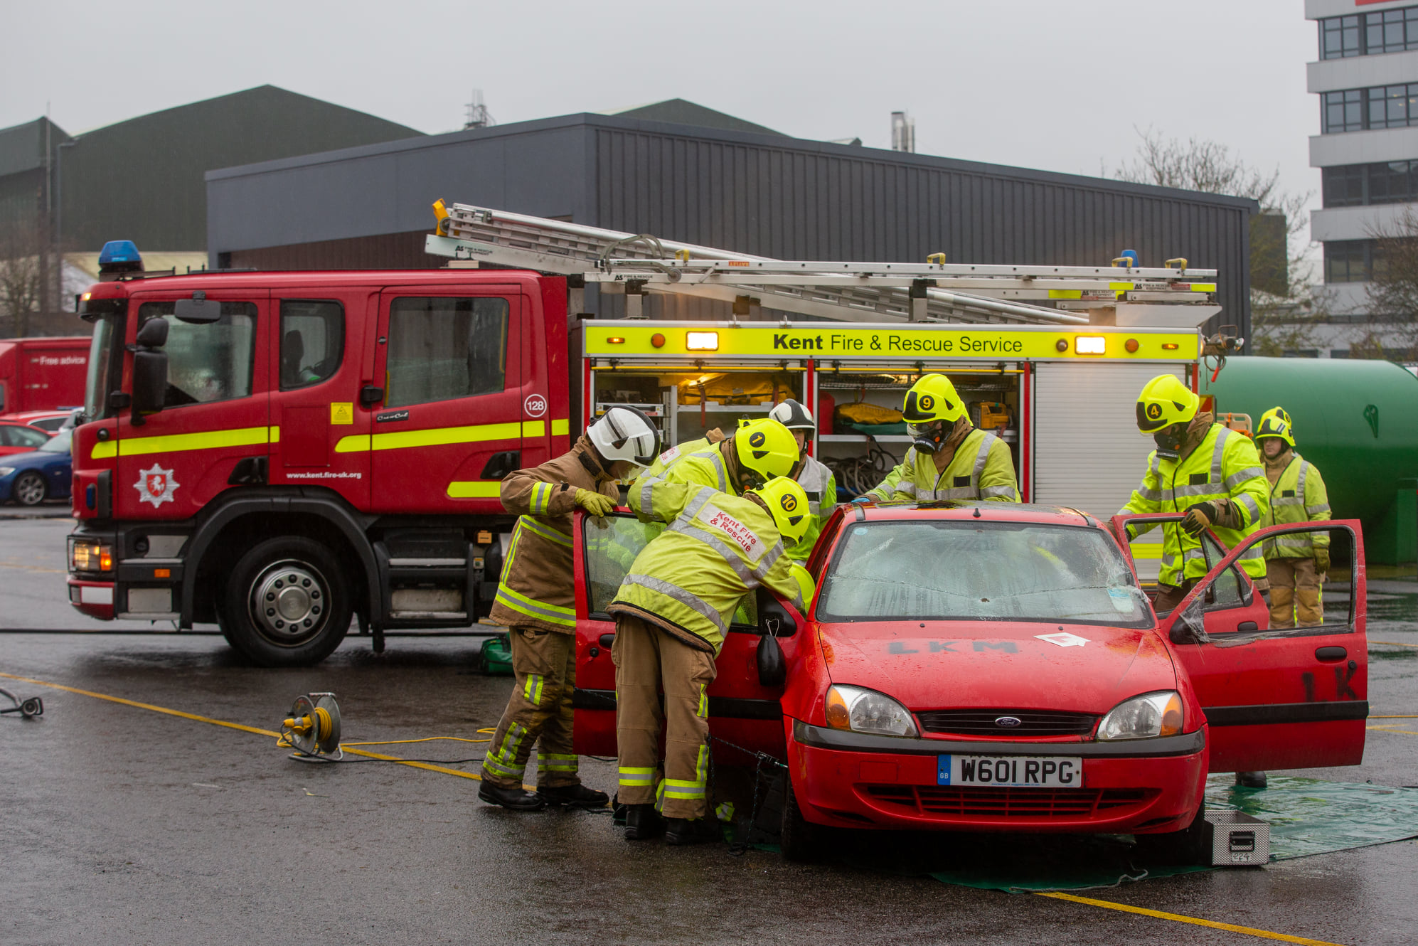
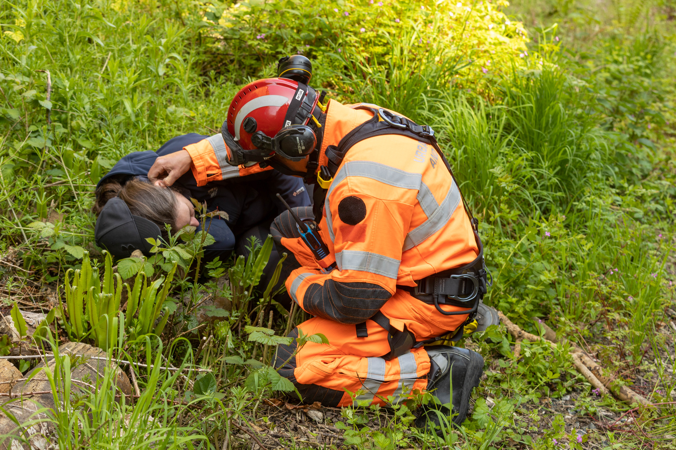



What we do
The fire service attends numerous types of incidents. Every job the service attends is different which requires highly trained individuals with high levels of expertise.
The fire service is most known for…
Did you know?
Attending road traffic collisions
Fighting fires and providing post incident support
Attending and supporting medical emergencies
We also have specialist teams trained and equipped to attend and help with inland water rescues.

Slide 20

Kent Fire and Rescue has a number of fire stations across Kent
5 of KFRS’s stations have a specialist water rescue crew
Rochester
Whitstable
Larkfield
Tonbridge
Folkestone
Map of
Kent

Slide 21
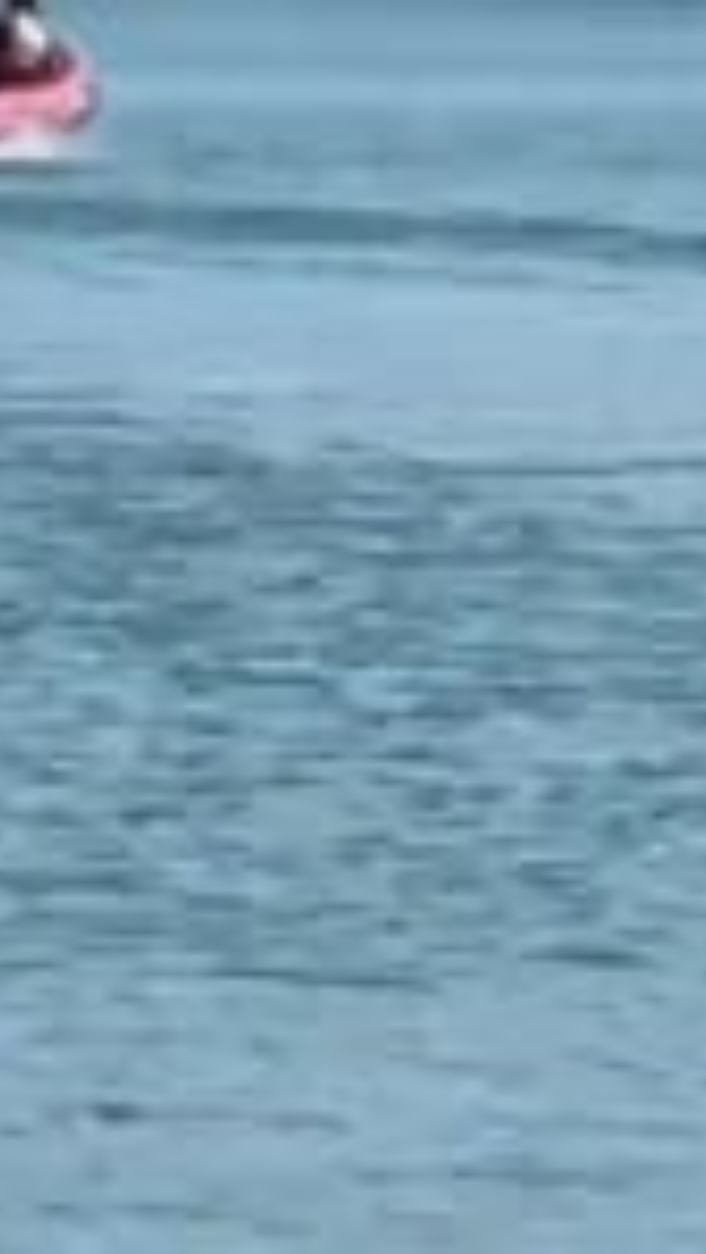




What we use
Our water rescue teams are equipped with specialised equipment that is used in water emergencies. This includes:
Dry suits: Keeps the individual warm in cold water and protects them from contaminants.
Floatation device: To float above the surface enabling the individual to access the water safely.
Inflatable boat: Helps to access the area safely and quickly reach the person in trouble.
Throw line: Helps to bring someone back to safety.

Slide 22
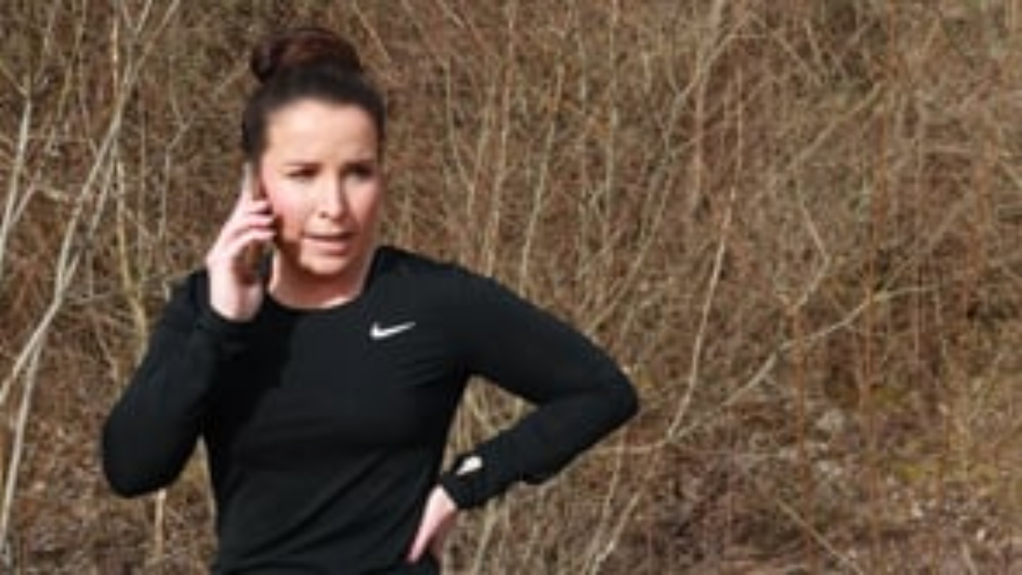
So, if you have an inland water emergency remember…
What number should you call?
What service should you ask for?
What does the operator need to know?

Slide 23


Re-cap
How does the fire service help your community?
What specialist equipment do firefighters use in water emergencies?
Who should you ask for when calling 999 in an inland water emergency?

Slide 24
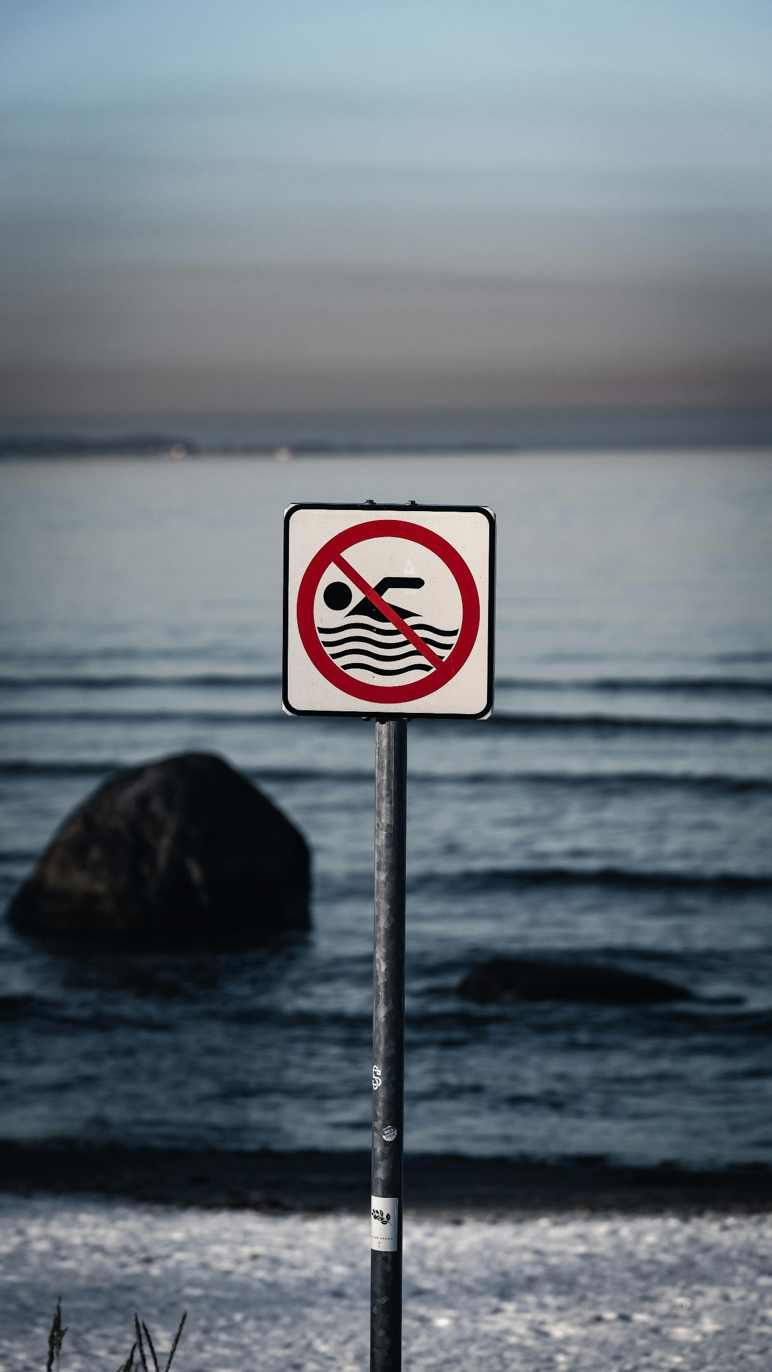
03
Water Safety
Let’s talk about how you can keep yourself and others safe around water

Slide 25
We want you to come away from today’s session…
Understanding the water safety code and how it can keep you safe
Identifying the safety signs designed to keep you safe around water
Knowing what cold-water shock is and how to float to live

Slide 26



The Water Safety Code
Knowing the key parts of the Water Safety Code can help you keep yourself and others safe!
If it doesn’t feel safe, have the confidence to speak up and say something to prevent serious consequences.
Stop and Think
Float
Stay Together
Call 999

Slide 27







What can you see?
Water Safety Signs are designed to warn you of the dangers. It’s important to consider these signs and their messaging, so you can keep yourself and others safe.
What do you think these signs mean?
LET’S TALK
What are the potential consequences of ignoring this sign?

Slide 28

What can you see?
Water Safety Signs are designed to warn you of the dangers. It’s important to consider these signs and their messaging, so you can keep yourself and others safe.
What do you think these signs mean?
LET’S TALK
What are the potential consequences of ignoring this sign?

Slide 29

What can you see?
Water Safety Signs are designed to warn you of the dangers. It’s important to consider these signs and their messaging, so you can keep yourself and others safe.
What do you think these signs mean?
LET’S TALK
What are the potential consequences of ignoring this sign?

Slide 30

What can you see?
Water Safety Signs are designed to warn you of the dangers. It’s important to consider these signs and their messaging, so you can keep yourself and others safe.
What do you think these signs mean?
LET’S TALK
What are the potential consequences of ignoring this sign?

Slide 31

What can you see?
Water Safety Signs are designed to warn you of the dangers. It’s important to consider these signs and their messaging, so you can keep yourself and others safe.
What do you think these signs mean?
LET’S TALK
What are the potential consequences of ignoring this sign?

Slide 32

What can you see?
Water Safety Signs are designed to warn you of the dangers. It’s important to consider these signs and their messaging, so you can keep yourself and others safe.
What do you think these signs mean?
LET’S TALK
What are the potential consequences of ignoring this sign?

Slide 33





Cold water shock
A body of water below 15 degrees is referred to as cold water.
The average UK temperature for open water is 12 degrees – even in the summer!
Cold Water
Shock causes:
Your blood pressure to increase from restricted blood flow
Your heart rate to increase
Your breathing to increase uncontrollably
Your body to panic

Slide 34

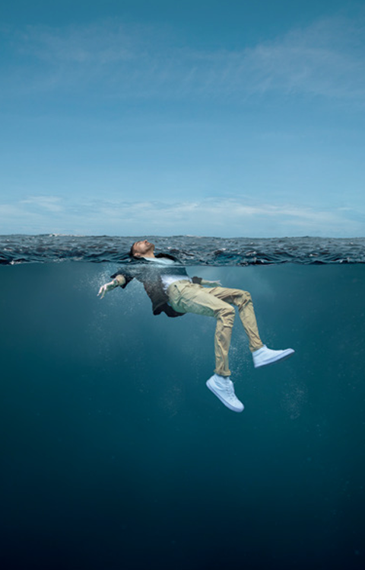
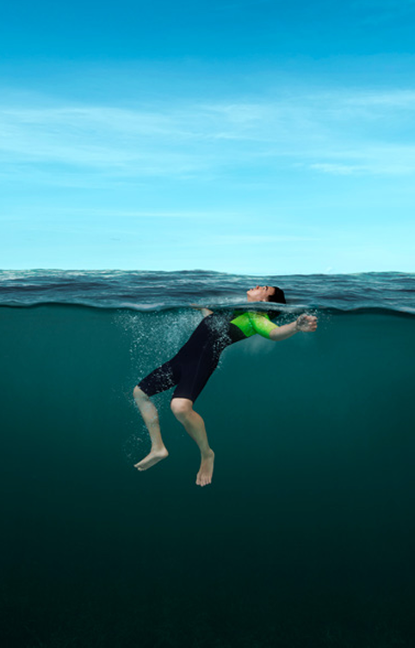
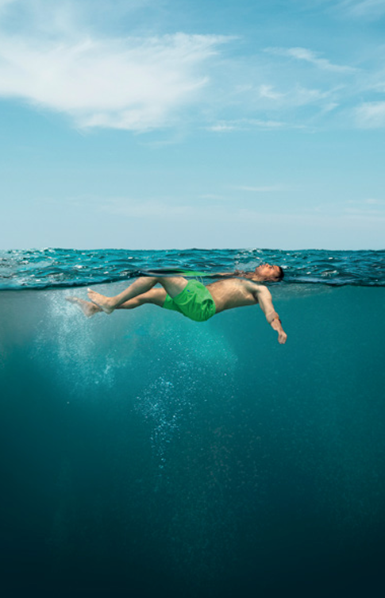
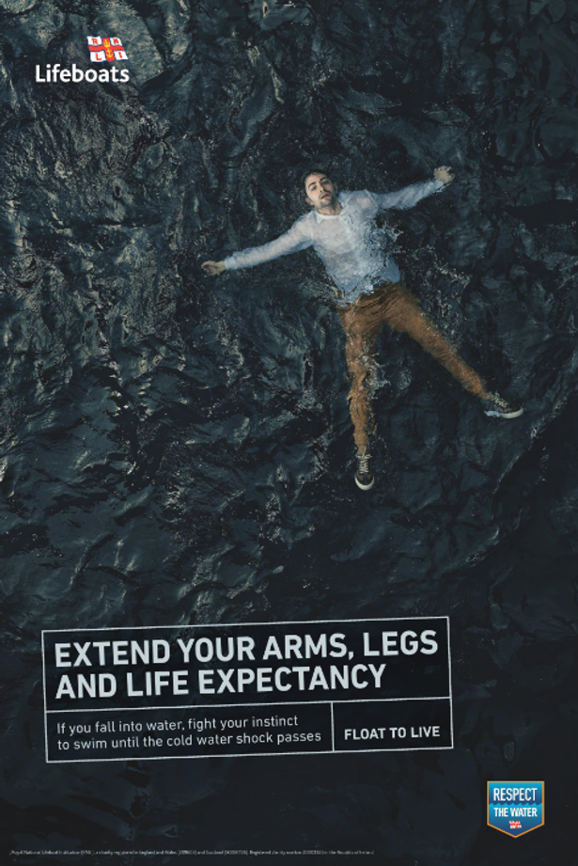

Float to Live
If you or someone you’re with ever gets in trouble in the water, remember float to live.
1
2
3
4
Tilt your head back
submerging your ears.

Slide 35

Float to Live
If you or someone you’re with ever gets in trouble in the water, remember float to live.
1
2
3
4
Tilt your head back
submerging your ears.
Relax
and control your breathing.

Slide 36

Float to Live
If you or someone you’re with ever gets in trouble in the water, remember float to live.
1
2
3
4
Tilt your head back
submerging your ears.
Relax
and control your breathing.
Move your hands and legs
to help you stay afloat.

Slide 37

Float to Live
If you or someone you’re with ever gets in trouble in the water, remember float to live.
1
2
3
4
Tilt your head back
submerging your ears.
Relax
and control your breathing.
Move your hands and legs
to help you stay afloat.
Your legs may sink – that’s OK! Everyone floats differently.

Slide 38
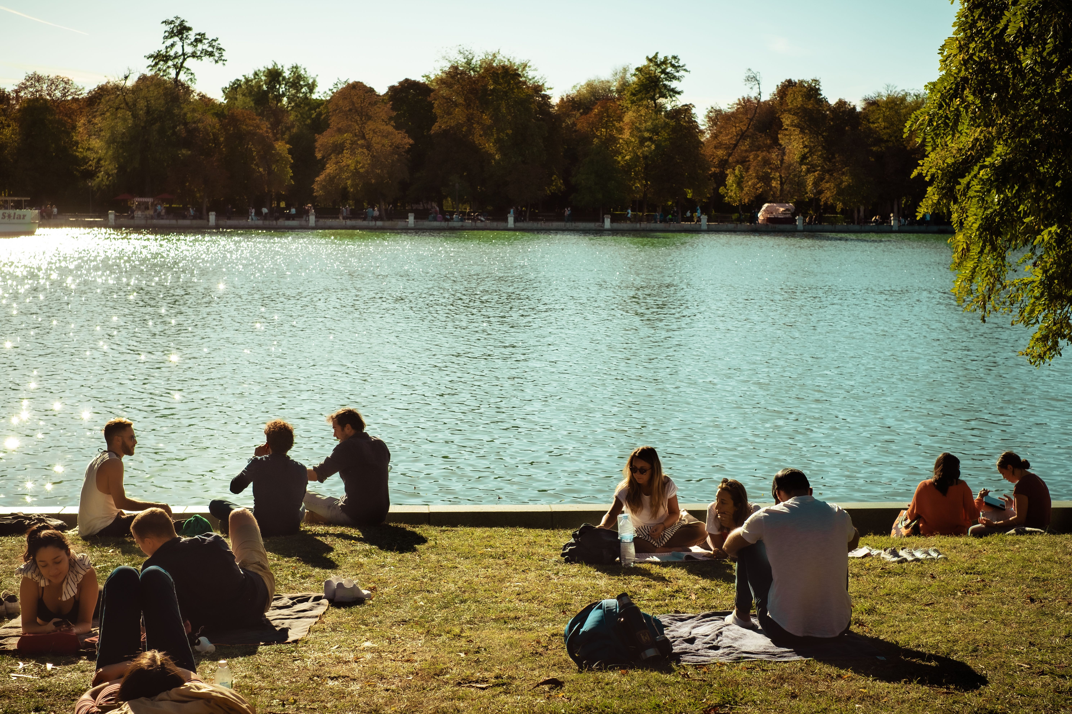
Staying safe
Every year, people across the UK witness water‑related emergencies.
In the warmer months, areas around water increase in population.
Open grassy spaces, picnic areas and cafes contribute to a busy area.
It’s important to remember the potential hazards around inland water and what you can do to keep yourself and others safe.
So, what can you do to help?

Slide 39
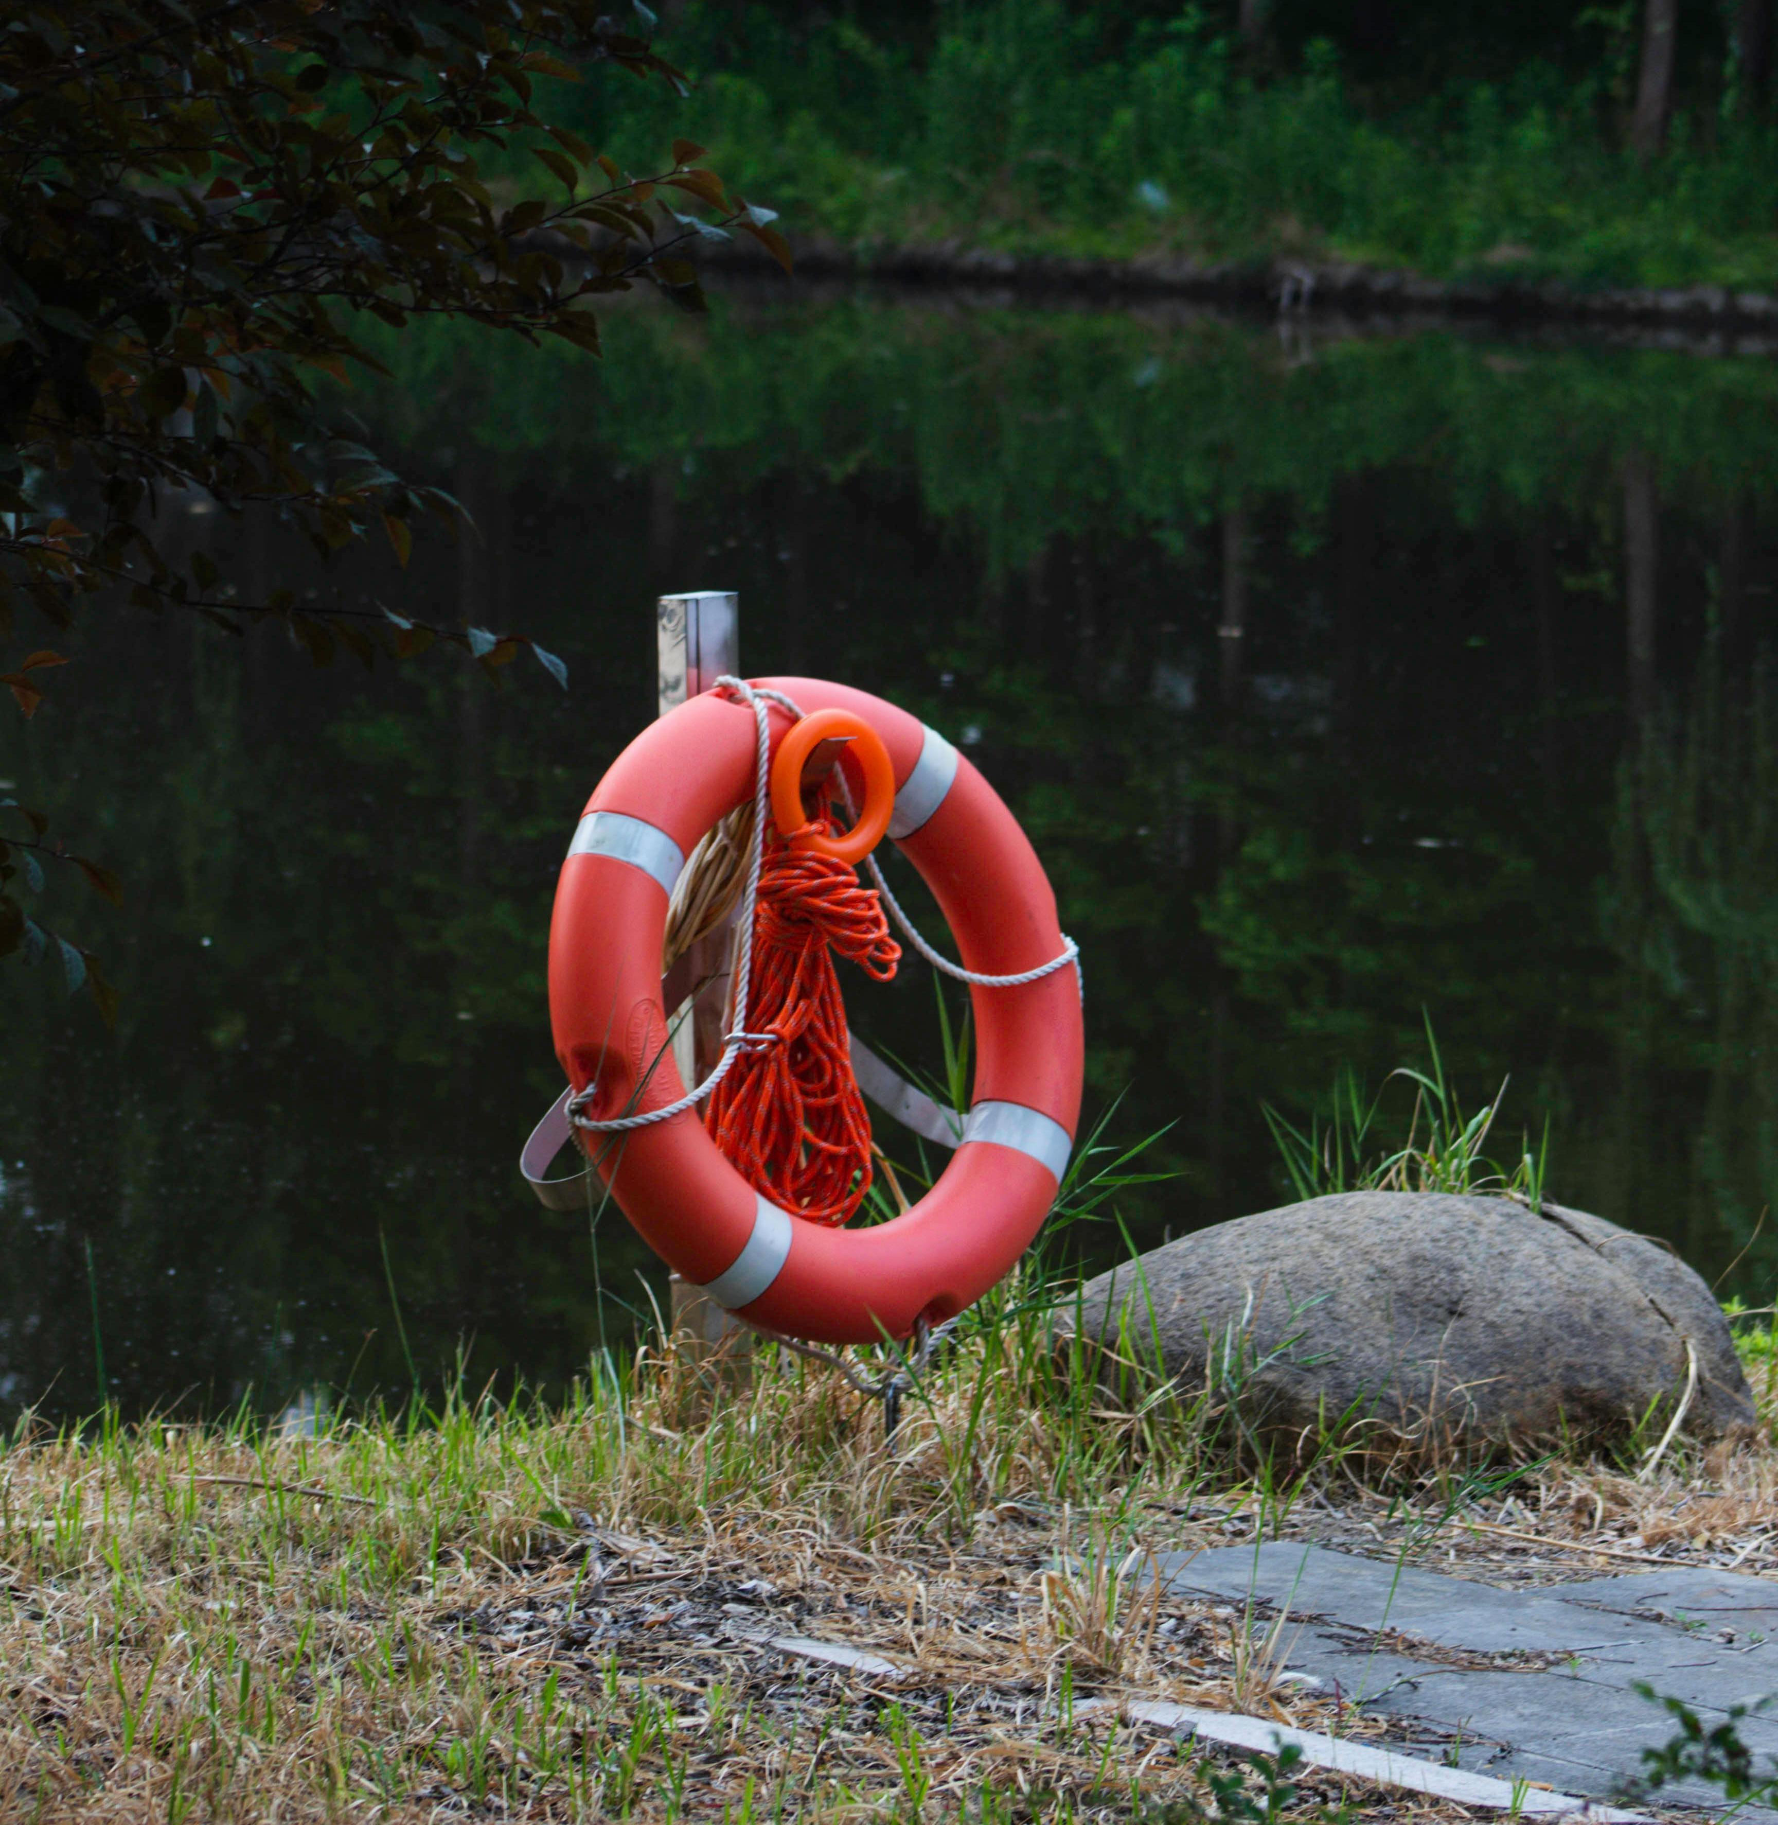
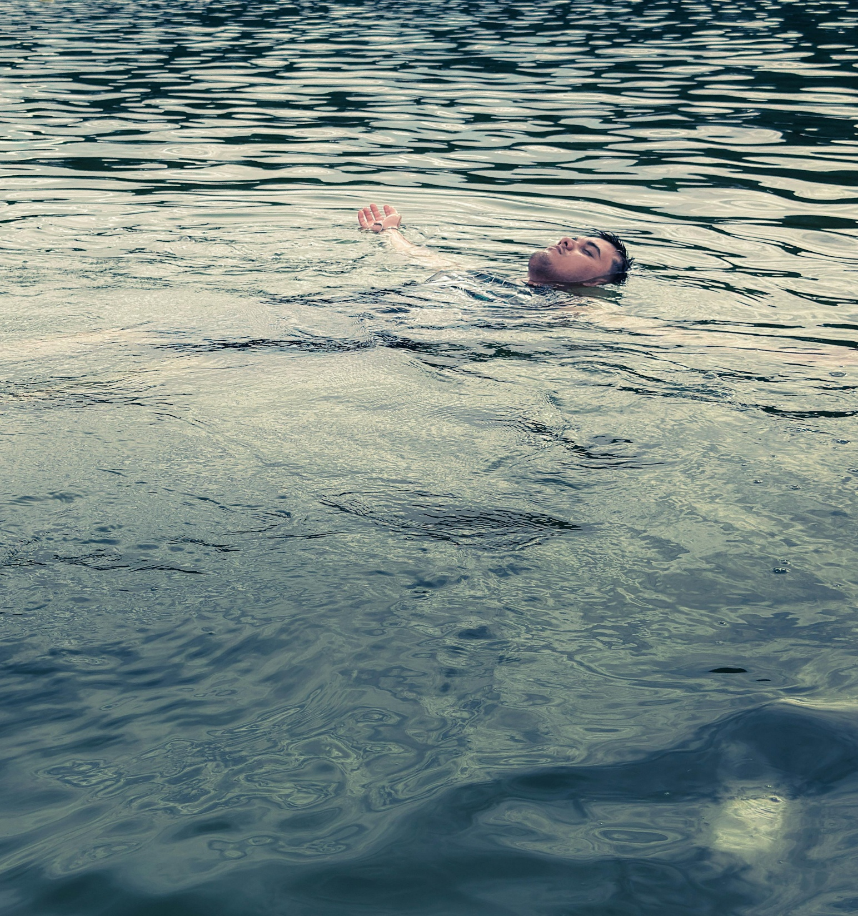
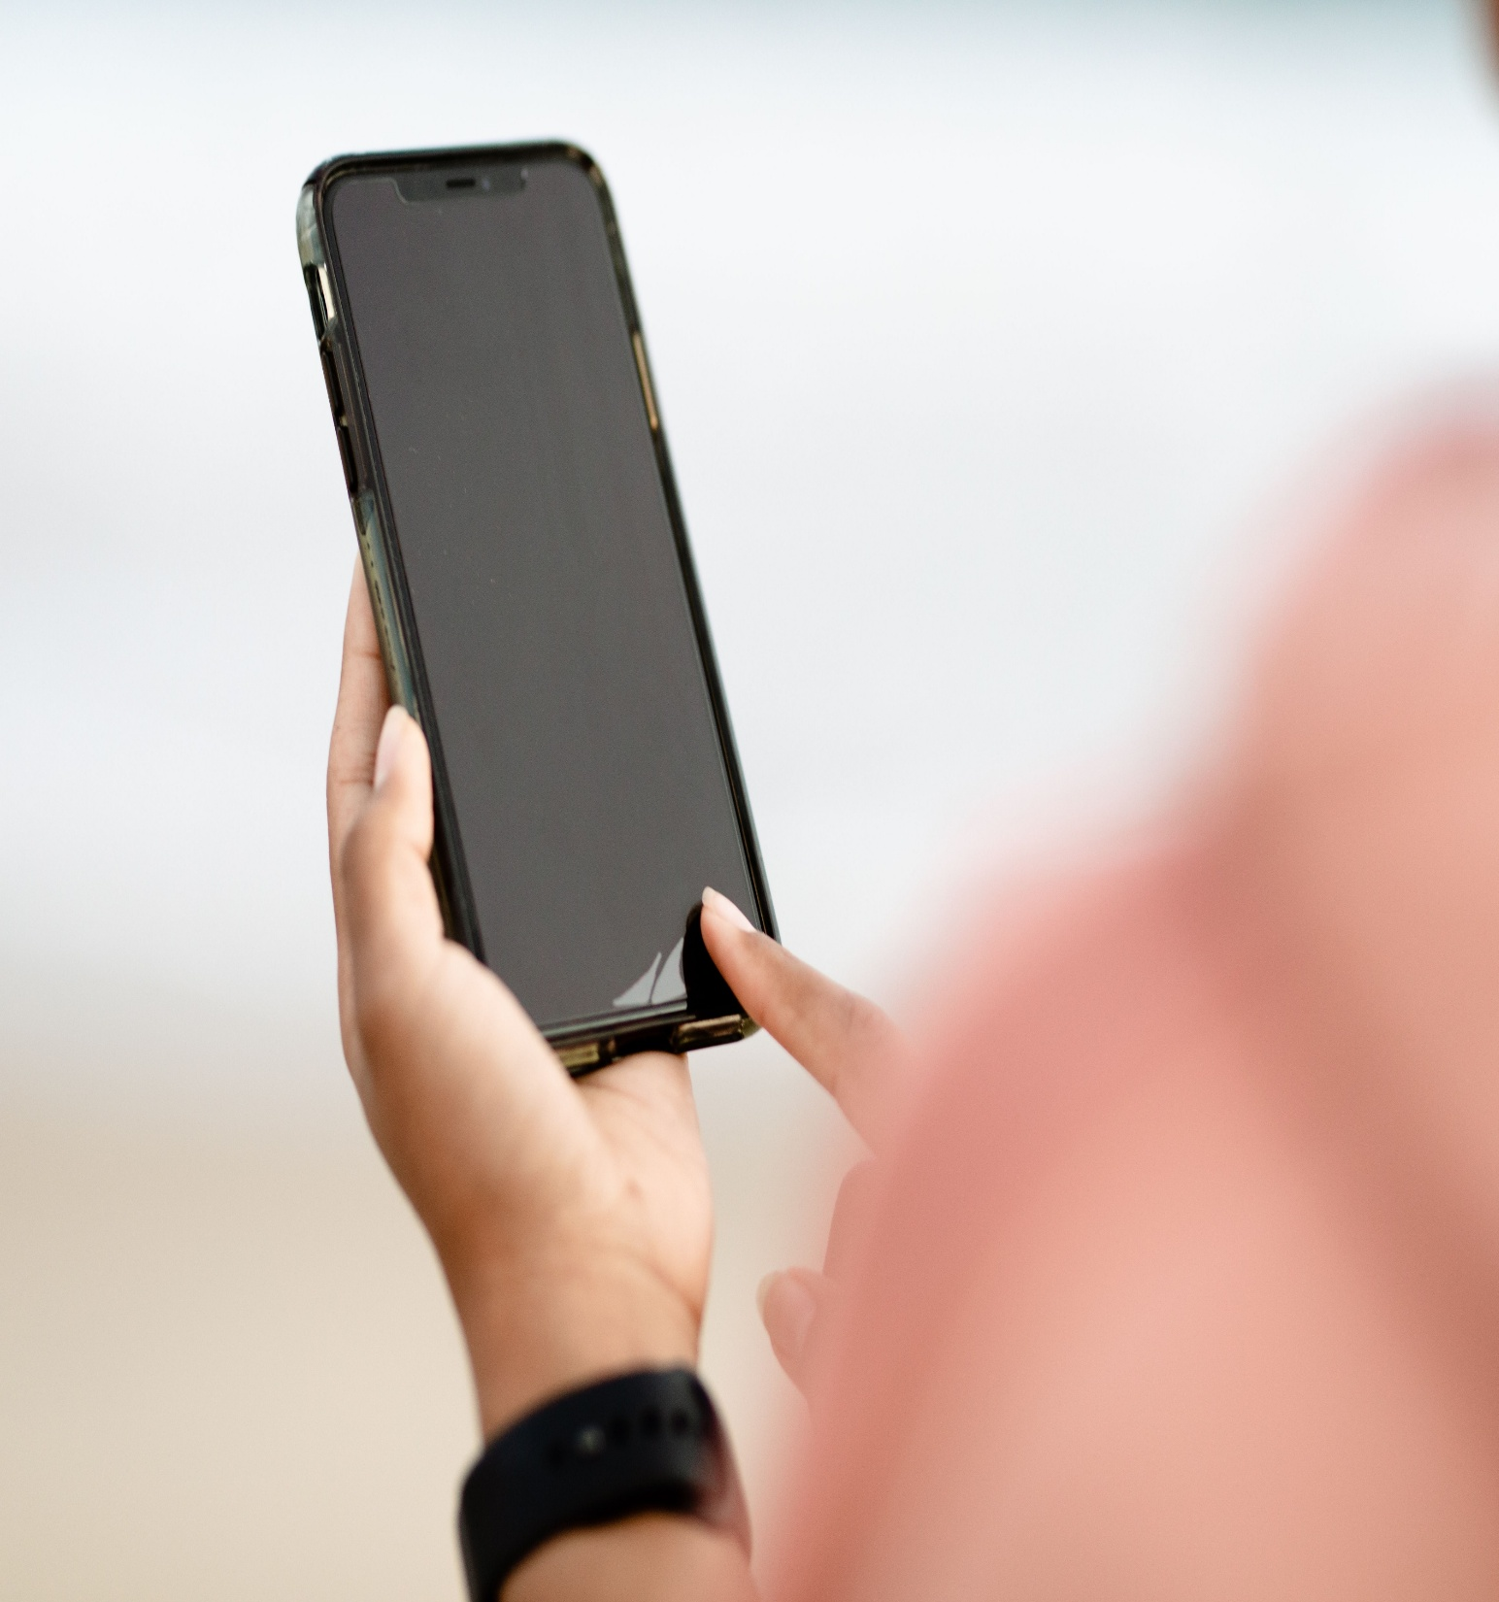
Phone
For inland water emergencies it’s important to make the right call.
PHONE • FLOAT • THROW •
If you see someone in trouble in the water, call 999 immediately and ask for the fire service.

Slide 40

Float
The person in the water may panic due to shock or injury.
PHONE • FLOAT • THROW •
If you see someone in trouble in the water tell them to stay calm and float.
Demonstrate how to float using hand gestures

Slide 41

Throw
Floatation devices can be found around highly populated areas of water.
PHONE • FLOAT • THROW •
If someone is in trouble in the water use rescue equipment to help them float until emergency services arrive.
RLSS UK: How to perform a Throwing Rescue | Videos & Movies on Vimeo
Rescue equipment can be anything that floats, even something like a football.

Slide 42
Re-cap
Name a part of the water safety code
What should you be aware of around inland water?
What happens to your body during cold water shock?

Slide 43
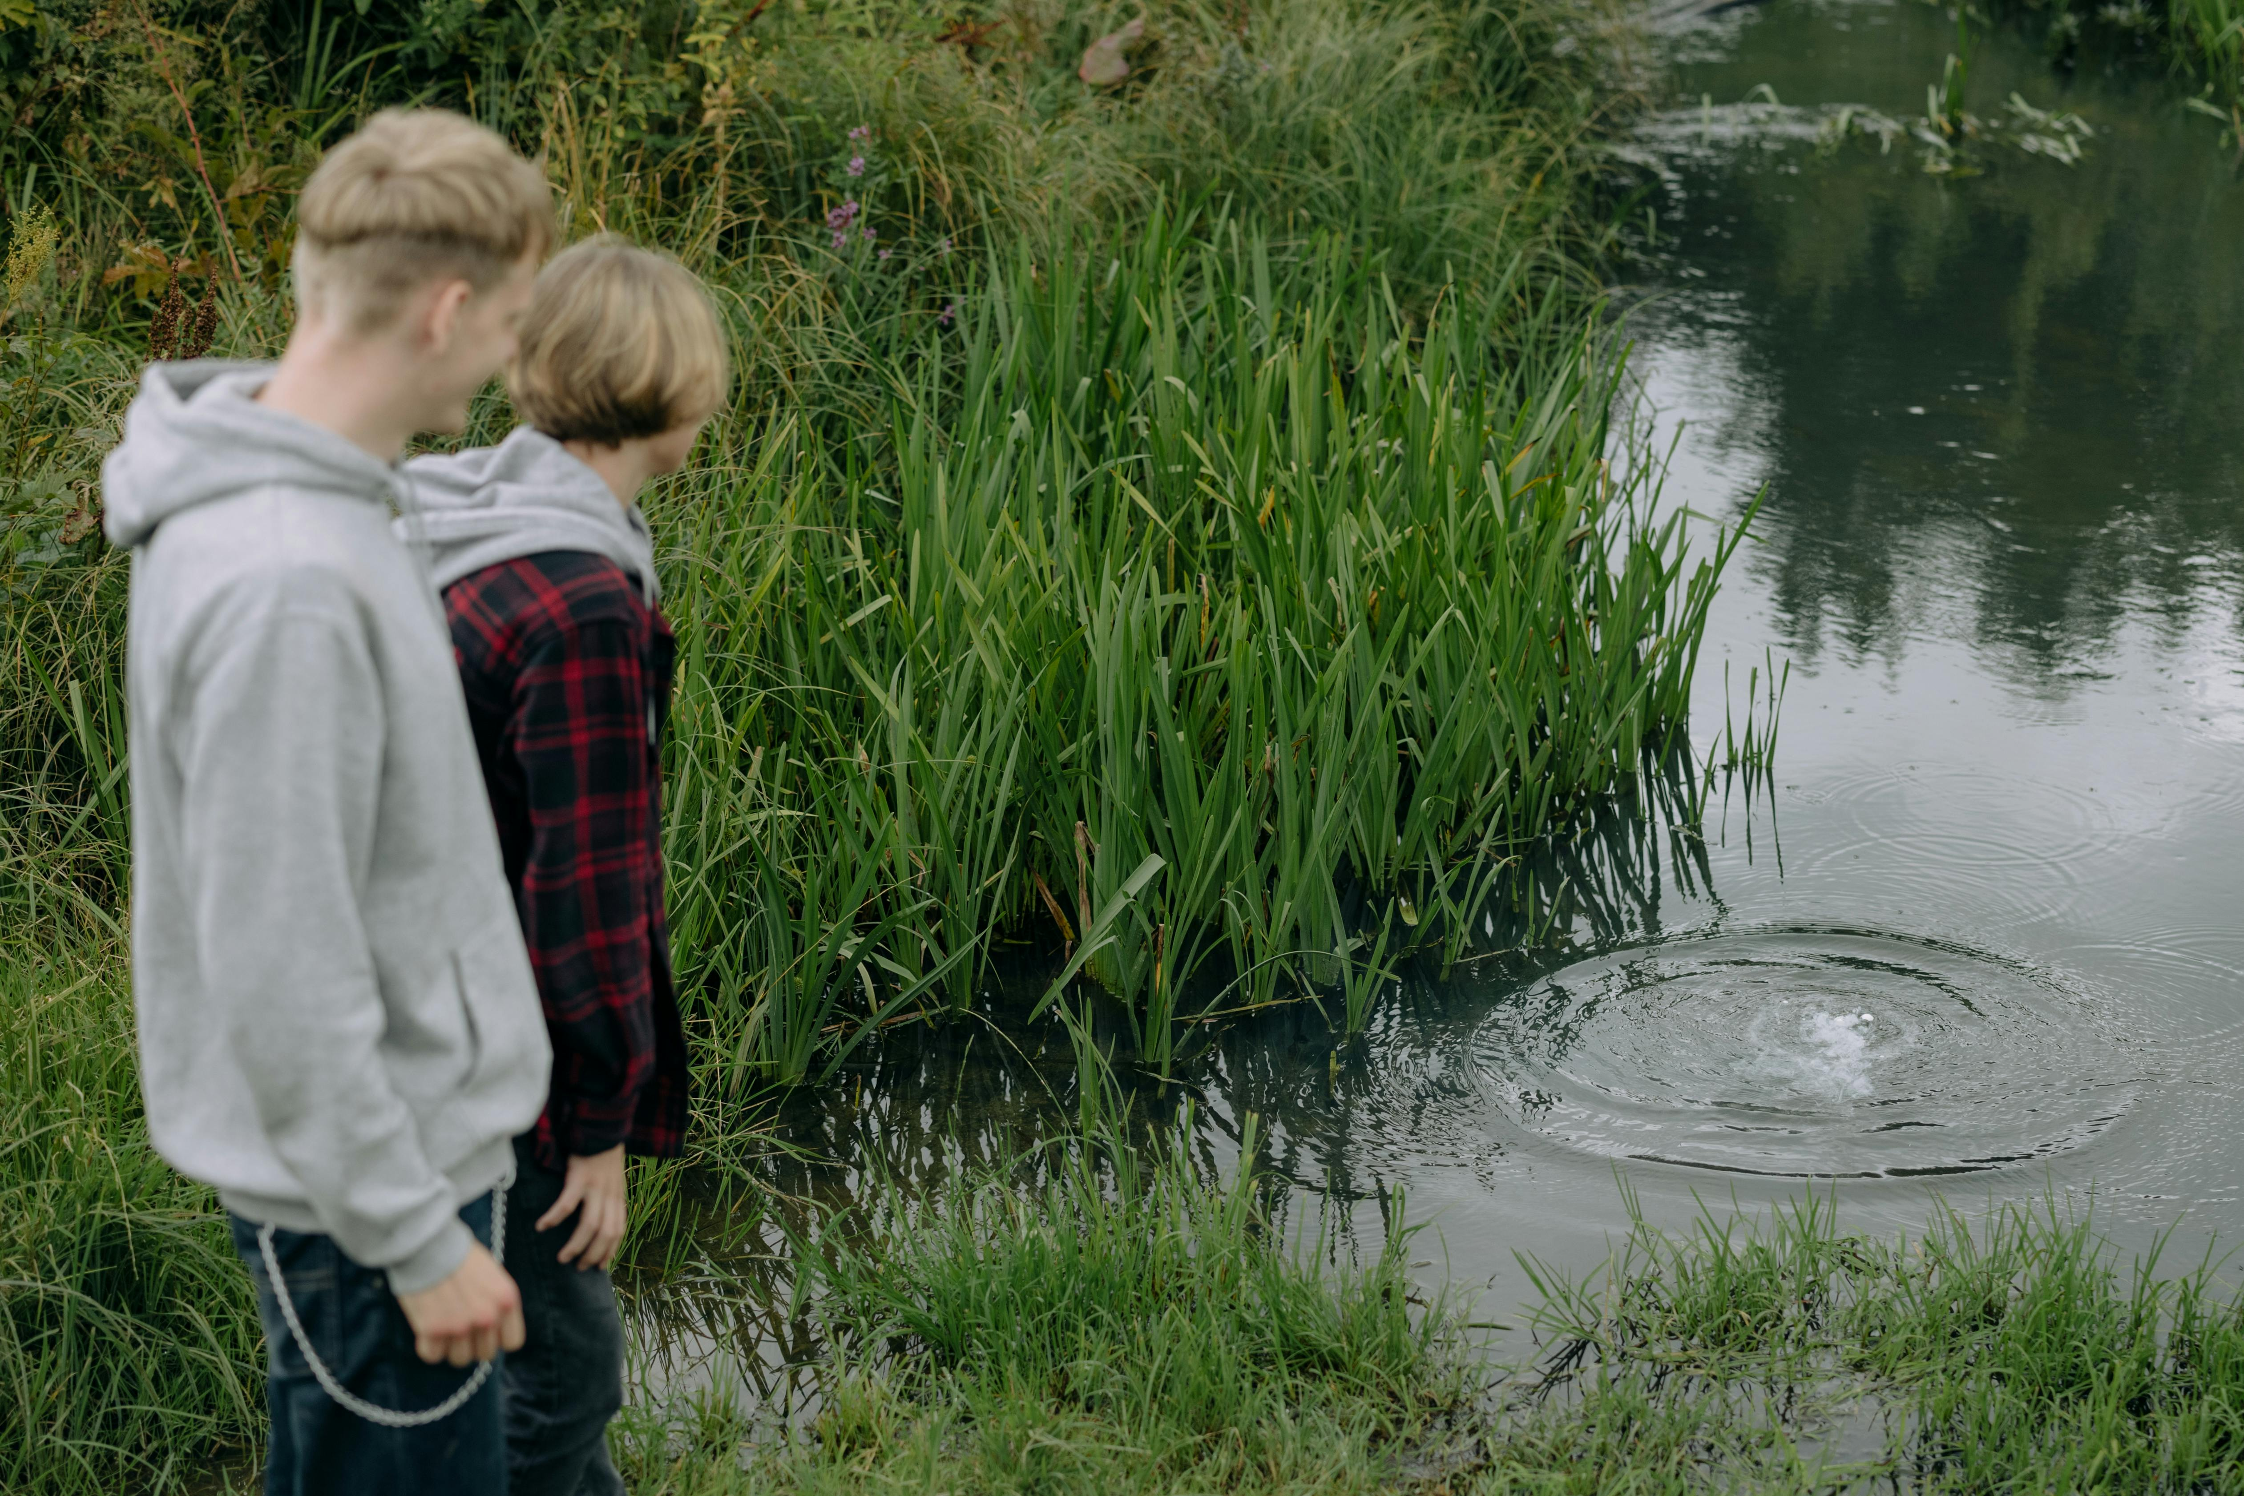
04
The ‘FEEL’ strategy
Let’s talk about how situations make you FEEL and what you can do

Slide 44
We want you to come away from today’s session…
Knowing what a risk is and identifying risky situations
Understanding how consequences affect you and others
Understanding the ‘FEEL’ strategy to keep yourself and others’ safe

Slide 45
Think of a risky situation. What makes it risky?
What is a risk?
Noun
A situation involving exposure to danger
“standing close to the bonfire was too much of a risk”

Slide 46
about risky situations…
LET’S TALK
It’s important to be aware of the choices you make and how they might affect you.
Reveal each situation below, discuss the risks and how you can keep yourself safe.
1
3
You accidentally kick the football into the lake. Your friends encourage you to try and retrieve it.
2
Your friends are making plans in the group chat to go jumping in some water where you won’t get told off.
One of your friends decides to throw litter into the water.
Every risk you take will have a consequence

Slide 47
What is a consequence?
What is a consequence?
Noun
A result or effect, typically one that is unwelcome or unpleasant
“the choice they made can have a serious consequence”
Discuss what a consequence is and think of an example
LET’S TALK
How can you prevent yourself and others being hurt or injured in a risky situation?

Slide 48
Focus on yourself and put yourself first
Each decision you make will have an effect
Have an excuse prepared
Make sure to leave the situation
F
E
E
L
!
If a situation is making you uncomfortable remember our strategy
How does it make you FEEL?
THE FEEL STRATEGY

Slide 49
Focus on yourself and put yourself first
Each decision you make will have an effect
Have an excuse prepared
Make sure to leave the situation
F
E
E
L
THE FEEL STRATEGY

Slide 50
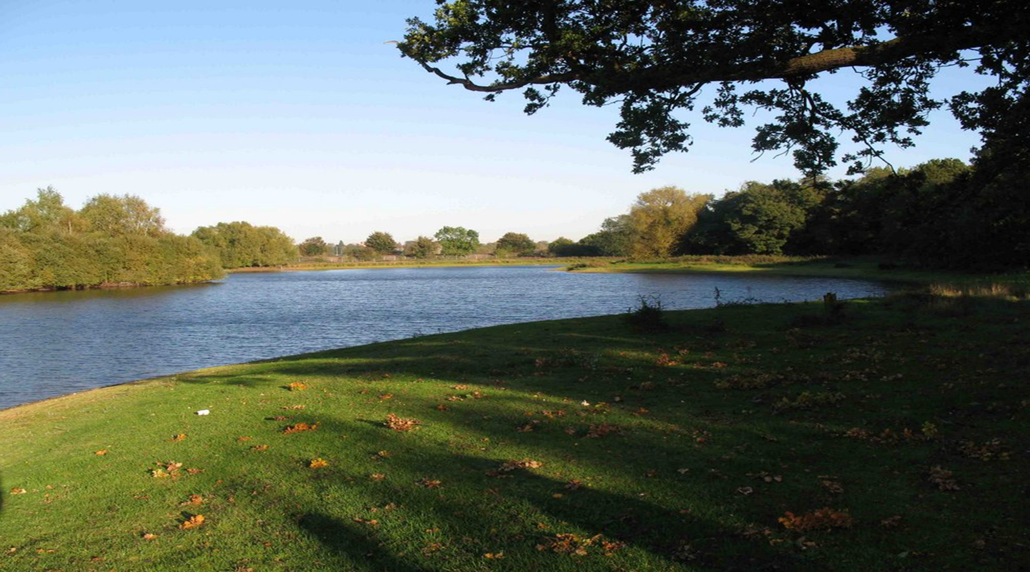
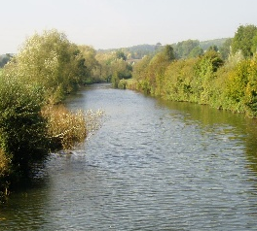
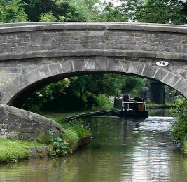
Focus
Effect
Excuse
Leave
CASE STUDY
You and your friends find a lake on a warm day and the water looks calm. Your friends decide to jump in the lake for a swim. You go to join them because it looks fun and then you notice the ‘No Swimming’ sign.
How would that make you FEEL?
Your friends are playing football at the local park. One of your friends kicks the ball too hard, and it falls into the nearby river. It looks close to the edge and your friend tries to retrieve it.
How would that make you FEEL?
Your friends meet another group from school, but you don’t know everyone there. You notice some of that group are older and are encouraging others to jump in the water.
How would that make you FEEL?
!
Let’s break down FEEL more on the next slide

Slide 51
Here’s an example of how we’ve used FEEL
Focus
Effect
Excuse
Leave
CASE STUDY
Is it safe?
What is the consequence of staying?
What can you say to prevent a consequence?
Can you use your excuse to leave?
Is it safe to be there?
Will it cause harm or put you in danger?
Can you say or do something that allows you to leave?
Have you got the confidence to keep yourself safe and leave the situation?
!
You've focused on yourself and decided it's not safe.
There could be serious consequences if someone ignores the potential dangers.
You make an excuse and say you need to go to dance/football practice.
You ask your friend if they want to join and you leave the group.
Here’s an example of how we’ve used FEEL

Slide 52



Focus
Effect
Excuse
Leave
THE FEEL STRATEGY
It’s the summer holidays; you and your friends make plans to meet up.
You tell your friend it’s too risky.
You get your phone out and pretend someone has messaged you.
You tell your friend that you need to leave and encourage them to join you.
When you arrive there’s someone in your group that you don’t know. That person tells you all about a hidden spot with a lake and a rope swing.
How would that make you FEEL?
The group decide that it will be fun, especially as it’s a hot day.

Slide 53
What is the positive effect of leaving the situation?
LET’S TALK
What excuse could you make to leave the situation?

Slide 54

Re-cap
Give an example of a risky situation and how you would stay safe
Name a consequence of risky behaviour
What does FEEL stand for?

Slide 55

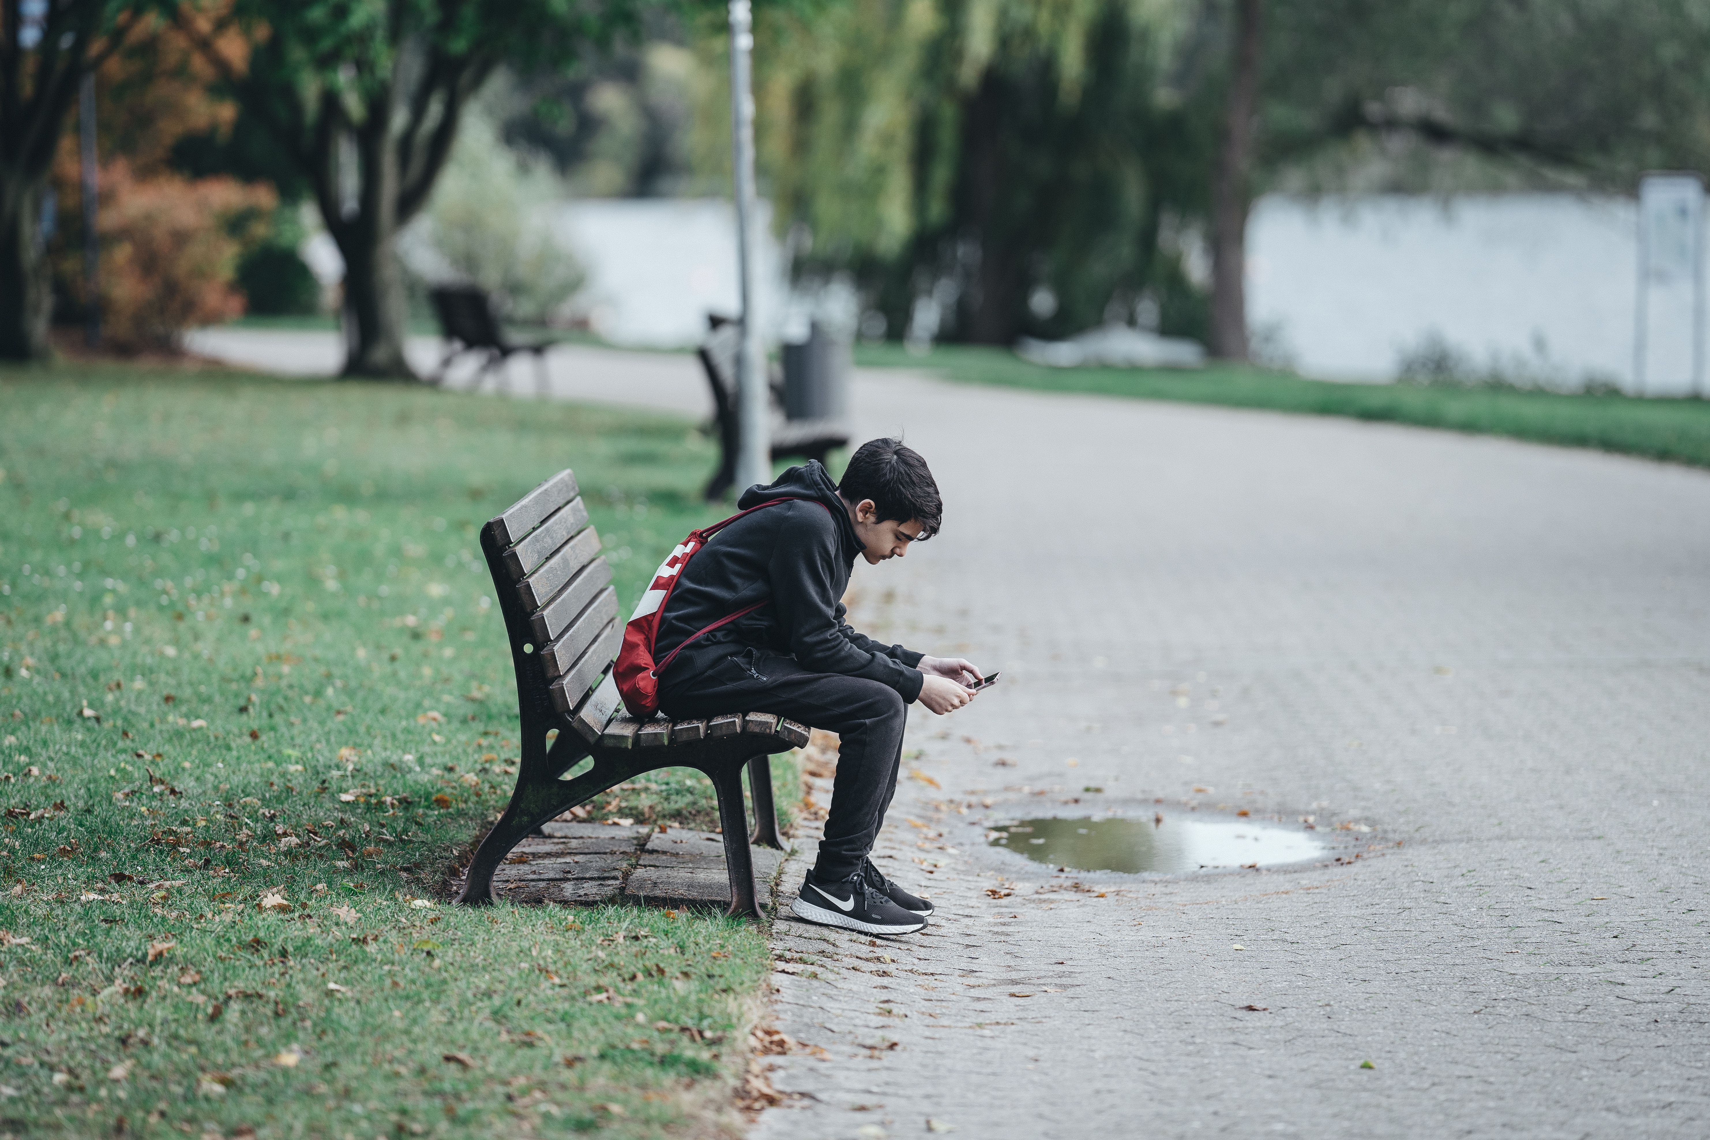
It’s down to you
Kent Fire and Rescue get called to water emergencies each year.
This could be reduced by staying safe around water, looking out for each other and following the water safety code.
If you have any concerns about people you know being unsafe around inland water, tell your teachers or a trusted adult to contact us.
Remember to

