Slide 1
Financial Statements
2022/23

Slide 2
Annual Financial Statements
Prepare, audit and publish a set of accounts - Legislation.
Accounts signed off by Audit - 30 September 2023 - Legislation.
CIPFA’s Code of Practice on Local Authority Accounting UK sets out basis of accounts - so comparable across LA’s
Accounts must be approved by this Committee
Local Audit and Accountability Act 2014 sets out the roles and responsibilities for the audit of LA’s

Slide 3
Narrative Report
Organisational Overview & External Environment
Objectives and Strategies
Performance and Outlook
Use of Resources
Explains Some of the Key Financial Information
Narrative Report

Slide 4
Comprehensive Income and Expenditure (CIES)
Sets out the income and expenditure of the Authority in line with accounting practice, rather than amounts to be funded from Council Tax
Whilst some headings will be similar to those you may have seen in budget monitoring and the outturn report other statutory accounting adjustments that you may not have seen will be included in the figures, such as;
  Depreciation – A charge that shows the annual reduction in the value of assets on the asset register.
  Revaluations – Annual adjustment where the Property Portfolio has been revalued
  Pensions – Adjustment to reflect an estimate of actual current service costs
  Disposals – Losses or gains on the value of assets held against the actual price achieved
The other side to these entries can be seen in the Movement in Reserves Statement (MIRS) where they are reversed out and adjusted against unusable reserves so as not to impact on the budgeted figure and on the Council Tax Payer.

Slide 5
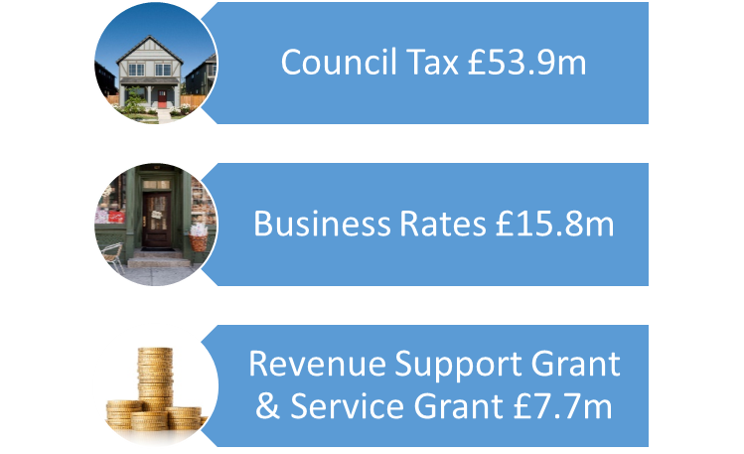
Money we received in 2022/23- £77.4m

Slide 6
Where the money was spent - £78.2m
£49.7m Frontline Response
£6.8m Keeping you safe at home and work
£21.6m Supporting Frontline Services
£0.1m Pensions and Financing Costs

Slide 7
Year End Outturn 2022/23
Expenditure
£78.2m
£0.1m Pensions and financing costs
£49.7m Frontline response
Income
£77.4m
£53.9m Council Tax
£15.8m Business Rates
£6.7m Revenue Support Grant
£1m Services Grant
£21.6m Supporting Frontline Services
£6.8m Keeping you safe at home at work
£0.8m
Overspend

Slide 8
Where Did We Overspend?
£1.4m Unbudgeted pay awards
£237k Utility Costs
£822k Vehicle servicing, maintenance, fuel
Offset against
-£1m extra investment income
-£641k Other non-pay underspends

Slide 9
Movement In Reserves Statement
Shows a breakdown of all the changes in the Authority’s reserves from year to year.
It includes:
  Statutory Transfers – Made as a result of accounting regulations such as Depreciation, Revaluation, Pension adjustments. Reserve movements are usually made to the unusable reserves
  Voluntary Transfers – Made as a result of the Authority’s decisions, such as movement from usable reserves.

Slide 10
Usable Reserves - £45.5m
£3.9m General Reserves – maintained at 5% of Net Revenue
£31.8m Earmarked Reserves – Money set aside for future planned expenditure (Infrastructure Reserve) or to meet potential budget pressures
£9.8m Capital Receipts Reserves – Proceeds from the sale of land of assets

Slide 11
Balance Sheet
A snap shot in time as at the 31 March each year
Shows the Authority’s financial position
Sets out the following:
  What the Authority owns (assets)
  What the Authority is owed (debtors)
  What the Authority owes (creditors)
  The resources it has left to support future services (usable reserves)

Slide 12
Summary Financial Position

Slide 13
What the Authority Owns (Assets)
£125m physical assets
£12.7m owed to KFRS (Debtors)
£45.6m Cash and Investments

Slide 14
What the Authority Owes (Liabilities)
£12.6m owed (Creditors - Suppliers & Collection Fund)
£1.9m Loans (£0.7m) and Provisions (£1.2m)
£643m Net Pension Liabilities

Slide 15
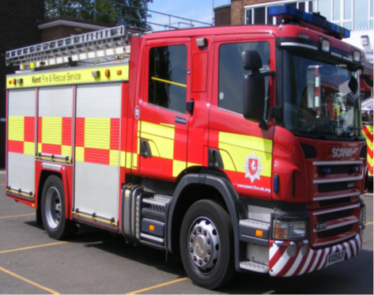
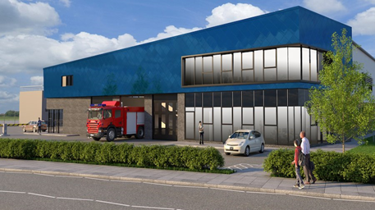
Expenditure on our Assets (Capital)
During 2022/23 the Authority spent £4.2m on capital projects, most of which was spent on premises, IT systems, vehicles and equipment.

Slide 16
Summary Statement of Accounts
In order to make our accounts more accessible we now publish a shortened version on the intranet alongside the full set of accounts.
Summary statement of accounts 2022-23 | Kent Fire and Rescue Service (fire-uk.org)

Slide 17
Audit of the 2022/23 Accounts
Grant Thornton Audit Plan to A&G Committee April 2023
Expected date for Audit - July 2023
Auditor has advised date cannot be achieved
Minister Lee Rowley attended Select Committee July 2023 with published proposals in a letter to address the significant backlog of LA audits committees.parliament.uk/publications/40932/documents/199432/default/
DLUHC consulting over the Summer Period.
Likely implementation of proposals from December 2023
Grant Thornton awaiting DLUHC directions before committing to dates as will need to prioritise backlog audits
Kent Fire Audit could be sometime in 2024!!!!

Slide 18

Questions

