Slide 1
Kent and Medway Fire and Rescue Authority
C3. Information Update
16 October 2025

Slide 2
A. Inspection update
October 2025
For further information please contact:
Nicola Harryman, Head of Data and Intelligence and KFRS Service Liaison Officer for HMICFRS

Slide 3
The Authority went through the full round three inspection during March and April 2025. On 14 August 2025 HMICFRS published the results of that inspection. The full report can be found here.
We are thrilled to report that the results of this inspection continue to place the Authority in the top three performing services in the country. Overall, HMICFRS commended the Authority on its strong performance and congratulated our performance in keeping people safe and secure from fire and other risks.
The Authority achieved an additional outstanding grading in this inspection for protecting the public through fire regulation which is a reflection of the investment in our protection work. The adequate scores are a new grading banding for this round of inspections.
Outstanding | Good | Adequate | Requires Improvement | Inadequate
Understanding the risk of fire and other emergencies | Preventing fires and other risks | Responding to fires and other emergencies
Protecting the public through fire regulation | Responding to major and multi-agency incidents | Ensuring fairness and promoting diversity
Making the FRS affordable now and in the future | Making best use of resources | Managing performance and developing leaders
 | Promoting the right values and culture
 | Getting the right people with the right skills

Slide 4
The main findings from the inspection are as follows:
  The service is outstanding in how it understands, collects and uses community risk information to make sure staff are well prepared to respond to incidents.
  The service is outstanding at protecting the public through the regulation of fire safety.
  The service also shows outstanding future financial planning to make sure it is affordable and sustainable now and in the future, and maintains value for money through detailed project planning and monitoring.
  The service has well defined values and a positive working culture where equality, diversity and inclusion are recognised and understood by everyone
  The service needs to do more to improve the availability of its on-call response.
  The service should make sure all staff feel confident raising concerns.

Slide 5
The Authority received five areas for improvement to be considered. An action plan to address these will be created and shared with Members regularly through Authority meetings.
  Quality assurance of prevention activity to ensure home fire safety visits are carried out to an appropriate standard
  Improve availability of on-call crewed fire engines
  Assure itself that its response cover including its mix of crewing and duty systems provides the most effective and efficient response for the public
  Make sure robust processes are in place to carry out equality impact assessments and review any actions agreed as a result
  Ensure it is transparent and fair when appointing and promoting staff
The Authority also received five areas of innovative or promising practice. These were:
  Use of 3D cameras to enhance understanding and sharing of risk information.
  Adaptation of prevention work for children and young people with additional needs
  Robustly reviewing projects to make sure they achieve their goals and clear benefits mapping
  Service-wide training scenarios improve learning and development while promoting inclusivity
  Service-wide focus on prevention and community safety initiatives promotes staff inclusion

Slide 6
B. Performance update
October 2025
For further information please contact:
Nicola Harryman, Head of Data and Intelligence and KFRS Service Liaison Officer for HMICFRS

Slide 7
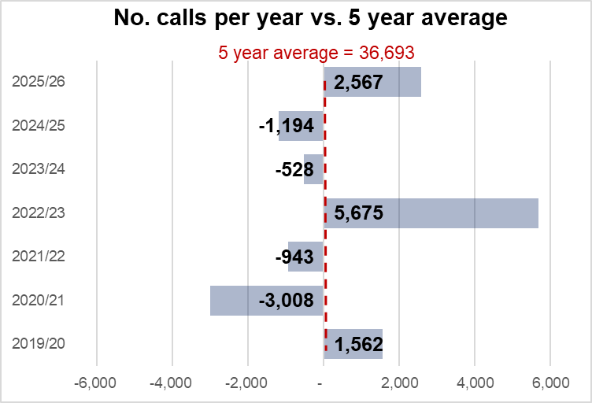
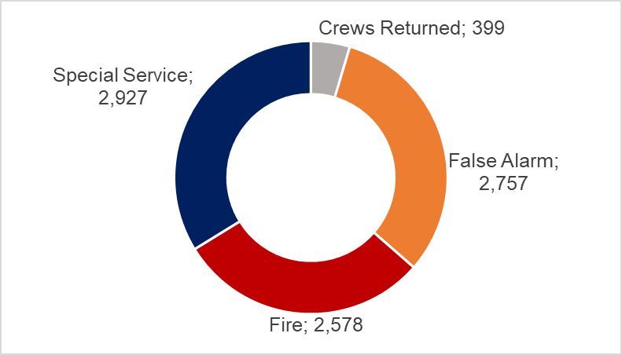
Overview of the Authority’s performance for April – August 2025
Emergency Calls
Between April and August 2025, 17,856 emergency calls were received in Authority’s control room. It is evident that call volumes vary year to year. Low call volumes in 2020/21 and 2021/22 were affected by the pandemic. The high numbers recorded in 2018/19 and 2022/23 are linked to hot summers increasing outdoor fires and related calls. Last year’s call volumes were higher than the previous year and are predicted to be higher than the five-year average
Incidents Attended
The calls received into the Control room resulted in mobilising to 8,661 incidents between April and August 2025
The majority of fires attended were outdoor and rubbish fires
23% of special service incidents were to gain entry, and a further 20% were to assist other agencies.
Most of the false alarms attended were to automatic fire alarms in domestic properties.
Please note: these figures include over the border attendances which are not included in performance indicator reporting. They will not match the totals shown on subsequent slides

Slide 8
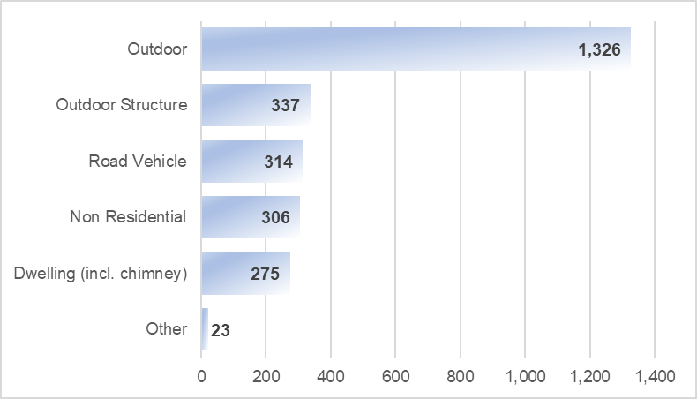
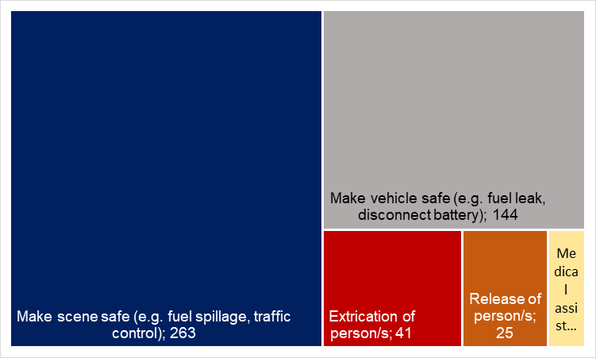
Road Traffic Collisions
485 road traffic collisions were attended (excluding those where no action was needed) between April and August 2025. The vast majority of incidents have needed our attendance to make either the scene or the vehicle safe only.
Fire Incidents
Attended 2,581, fires of all types; which is 25% more than the same period the year before, owing to warmer, drier weather and subsequently more outdoor fires.
Attended 232 accidental fires in the home (not including chimney fires); which is slightly higher than the number attended in the previous year (219). This Authority reported the lowest ever number of fires in the home in 2023/24, and despite the increase last year, overall the number of fires in the home remains low.
Accidental fires account for 60.9% of the total fires attended. As a result of these fires, one person has died, six people suffered serious injuries and 27 people have suffered ‘slight’ fire-related injuries.
Four people have been slightly injured in deliberate fires
As a result of these incidents three people died and 55 were seriously injured.

Slide 9


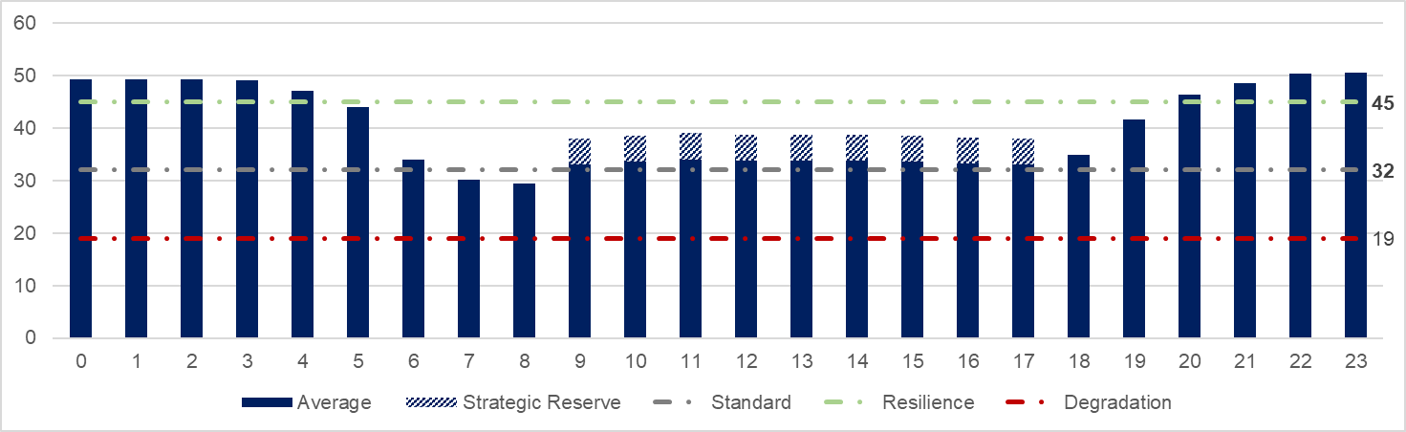
Response times
% Emergency urban incidents within 9 minutes (target 75%)
Average time from mobilisation to attendance – 7 minutes 57 seconds
  % Emergency rural incidents within 15 minutes (target 75%)
Average time from mobilisation to attendance – 12 minutes 50 seconds
Availability
So far this year the average number of fire engines available has been 34 during the day (9am-6pm) and 44 in the evening (6pm to 9am). We aim to have 32-44 fire engines available, known as our standard operating level. We often exceed this level at night.
3.8% of all contracted hours have been lost due to sickness. Operational colleagues have lost 4.2% of contracted hours to sickness and employees in Customer Service teams have lost 3.1%.

Slide 10
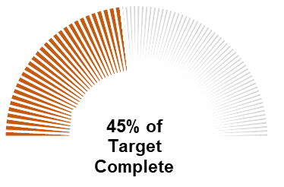
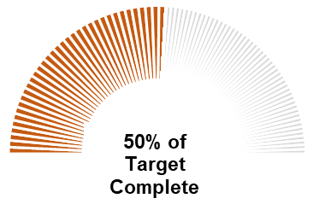
Home Fire Safety Visits and Safe & Well Visits
6,781 Home Safety Visits carried out
45.2% of the target of 15,000
5,010 Safe and Well Visits carried out
50.1% of the target of 10,000
Building Safety
99.4% of building consultations received (817 of 822) were completed within 21 days.
531 audits were carried out in total, of which 306 were satisfactory and 226 were unsatisfactory in outcome.

Slide 11
C. Response and resilience update
October 2025
For further information please contact:
Matt Deadman, Director – Response and Resilience

Slide 12
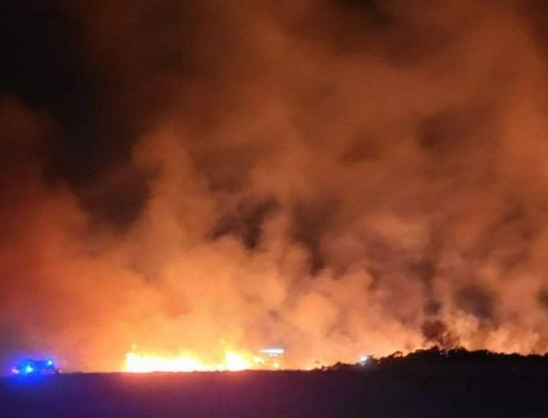
Notes on Operational Response
Major incident support to Dorset & Wiltshire
In August we received a request to support Dorset & Wiltshire Fire and Rescue Service to fight a fire on Holt Heath. DWFRS declared a major incident. The fire was burning for a week. 72 hectares were burnt. Kent Fire and Rescue Service provided fire fighting resources, including our new wildfire vehicles (see slide “Fleet and Equipment Services”).
DWFRS subsequently wrote to the Service thanking our colleagues for their professionalism and dedication throughout the incident.
Emergency Cover Review
We have started an emergency cover review. This will use historic data and future forecasting to determine whether we have the right resources in the right places. Fire Authority members will be kept informed of the progress of the review, with any recommendations for change planned to come to the summer 2026 meeting of the Authority.

Slide 13
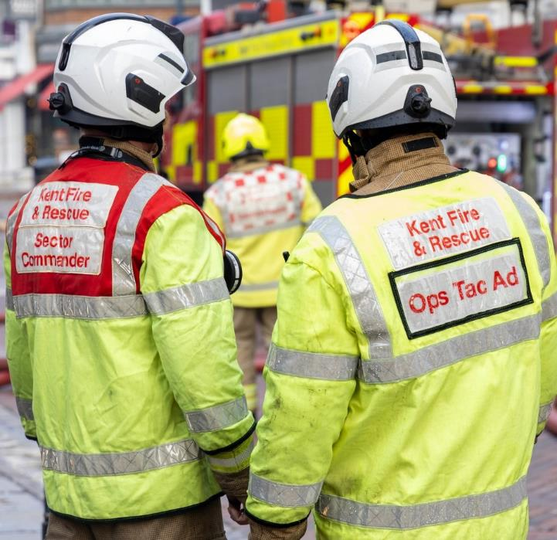
Service delivery
Replacement workforce planning system
In September we signed a contract with Fire Service Rota to supply the replacement for our workforce planning system. This system tracks the skills and availability of our operational colleagues, ensuring we have the right people in the right place to deliver fire cover.
The new system will help us provide better data to make resourcing decisions, as well as providing a better user experience for our on call colleagues. We anticipate that the new system will help improve on call fire engine availability as it will be easier for colleagues to enter additional hours and will help identify where we have shortfalls.
On-Call Availability
Our project to boost on-call fire engine availability continues to make progress. Since the last meeting we have reviewed our pilot initiative, using colleagues more flexibly across stations in their local area. This has seen an increase in availability. We are currently reviewing whether to roll this out more widely. We have also seen great results with targeted recruitment in on call areas and have brought 2 cohorts of on call fire fighters through their initial training This will lead to increased availability on on call stations.

Slide 14

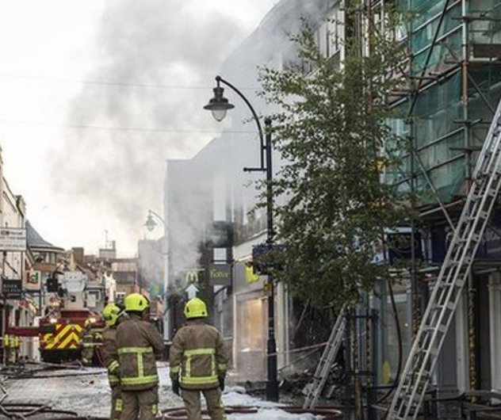
Operational policy & capability
Marauding Terror Attack
We were recently audited by National Resilience (the sector body for coordinating national capabilities) on our Marauding Terror Attack arrangements. We were pleased with the outcome, which highlighted that overall we have good arrangements in place. We were assessed as being fully compliant with national standards in 6 out of 8 areas, with the remaining 2 areas identified as low-risk non-compliance. We are developing a plan to address those areas.
High Rise Incidents
HMICFRS stated that “the Service is well prepared to deal with a fire in a tall building”. This follows a significant amount of work, learning from the Grenfell Tower Inquiry recommendations, to embed a new process for managing information about people trapped in buildings.
We are now working with partner services to share this information across control rooms to improve our resilience for large call volumes.

Slide 15
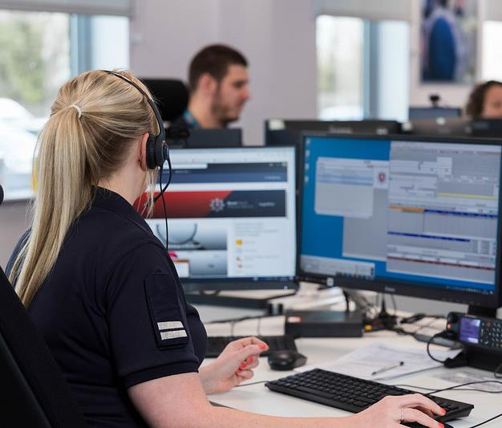
Resilience
Water provisions – work continues between KFRS, NFCC, Water UK and MHCLG relating to risks identified around the lack of water (flow and pressure) for firefighting – New National Guidance published. We are also looking to introduce more bulk water carriers into the Service, as well as putting bigger water tanks on any new fire engines we buy, to make sure crews have the water they need in the early stages of an incident.
The NFCC Business Continuity & Resilience Group (chaired by KFRS) meet monthly with MHCLG to discuss emerging risks.
Work continues through the KFRS Security Steering Group (SSG) around station security following a spate of thefts of rescue equipment.
We are introducing an “on call resilience officer” duty rota, using the colleagues we already have within the resilience team, to provide out of hours support for significant and major incidents. This will help free up operational officers to attend the scene of the incident, which is a better use of their skill sets.

Slide 16
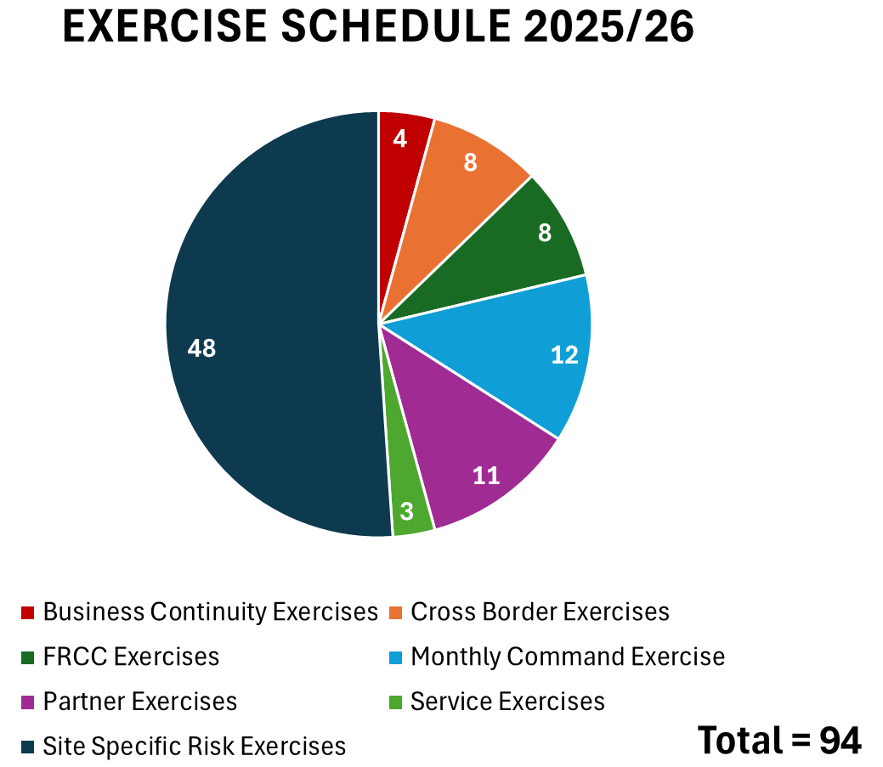
Resilience through exercises
Key Exercise Information:
We have made improvements to our exercise planning process, to better capture information relating to working with other services.
We are on track to deliver the 94 exercises that we have planned for the (calendar) year. We have delivered 46 since April.
KFRS are at the centre of planning for a large multi-agency mass evacuation exercise in 2026. This will be the annual exercise for the Kent and Medway Resilience Forum.
We have signed a new memorandum of understanding with Essex Fire and Rescue to conduct a joint programme of exercises each year.
In July we conducted our Service level exercise, testing our response to an incident involving the notional death of a colleague in the line of duty. We were able to provide assurance on the policies and processes that we have in place to manage such an event should it occur.

Slide 17
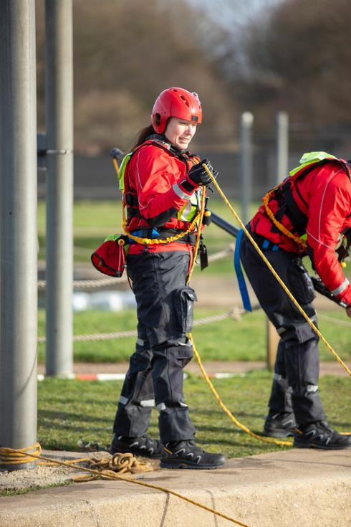
Technical training and professionalism
We have introduced a new command exercise programme. Each month colleagues at all command levels, from firefighter to strategic commanders, participate together in an online command exercise. This exercise uses immersive simulation software to develop realistic scenarios. In its inspection, HMICFRS highlighted this as “promising practice” to be shared with the rest of the sector. We remain committed to developing a wide range of training tools to cater for the diverse range of learning styles our colleagues have.
A programme to develop a ‘tiered’ approach to training facilities has now finished and those training facilities are now live. This means that training facilities – from large scale training venues to smaller local training facilities – are now spread across KFRS so that all of our stations have easy access to the training facilities they need.
The build of our new live fire training facility in Ashford is progressing well and is now 50% complete. This is expected to go live in 2026 and will offer our firefighters one of the most adaptable training facilities in the country.
We have been undertaking a project to ‘lean review’ our processes in training, ensuring that all such process are mapped, and any inefficiencies identified and addressed. This work is well underway and already reducing time spent on administration.

Slide 18
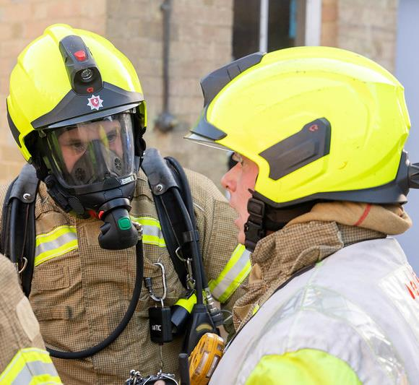
Assurance and professionalism
Our operational learning process is recognised as being one of the best in the country. HMICFRS stated that “the service has a robust process to evaluate operational performance”.
To further improve our ability to learn, we are reviewing how we assess and communicate learning outcomes from incidents. We are developing a new thematic approach to capturing data, to ensure that any changes we make are supported by a weight of evidence, as well as aligning the way we rate our performance to the national HMICFRS inspection model. We believe this will give us better insights into our performance and allow for more evidence led evaluation of our effectiveness.
We have also introduced ‘command reviews’. These are focused interviews with the key commanders involved in an incident, aimed at evaluating decision making in a supportive environment. Initial feedback has been positive with commanders reporting that they feel more able to raise where things went wrong and how they could improve, as well as identifying areas of good practice.

Slide 19
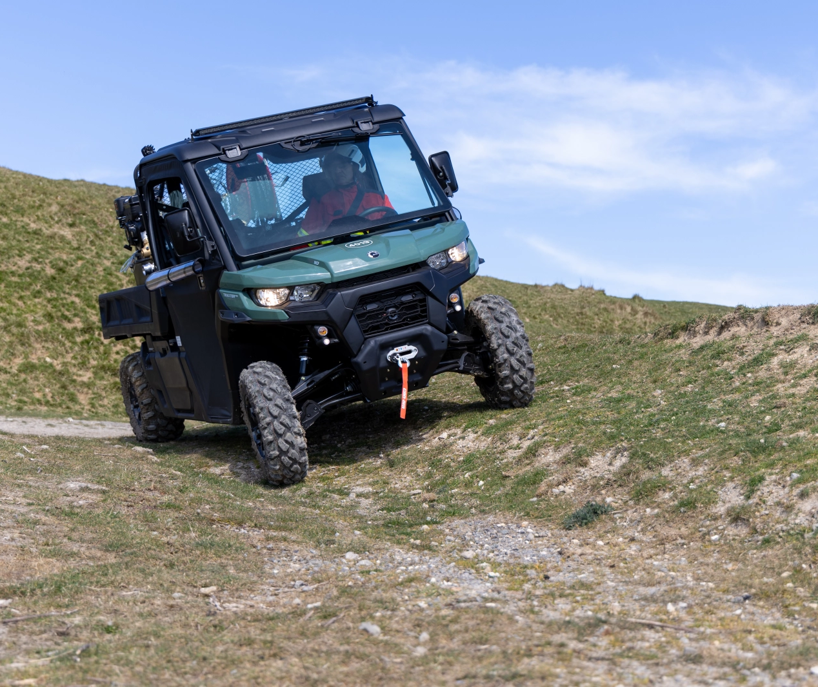
Fleet and equipment services
Over the summer, as part of our plan to improve our capability to respond to wildfire incidents, we took delivery of new Utility Terrain Vehicles (UTVs). These have been to many operational incidents over the summer and have already proven their worth in helping firefighters access remote incidents, such as grass fires. These vehicles replace our previous All Terrain Vehicles. These new vehicles are simpler to operate and maintain, resulting in a reduction in the amount of training and vehicle maintenance required. This will result in a more efficient financial spend, as well as freeing colleague time for other important activities.
We have introduced a range of cordless power tools and lighting. Using modern battery technology, these tools offer improved capability. They are lighter than our previous tools, more portable, and the lighting will help provide a safer working environment. The decision on what tools to purchase has been based on direct feedback from our firefighters, as well as analysing previous incident data.

Slide 20
D. Protection, prevention and engagement update
October 2025
For further information: please contact
Jon Quinn, Director – Protection, Prevention and Customer Engagement

Slide 21
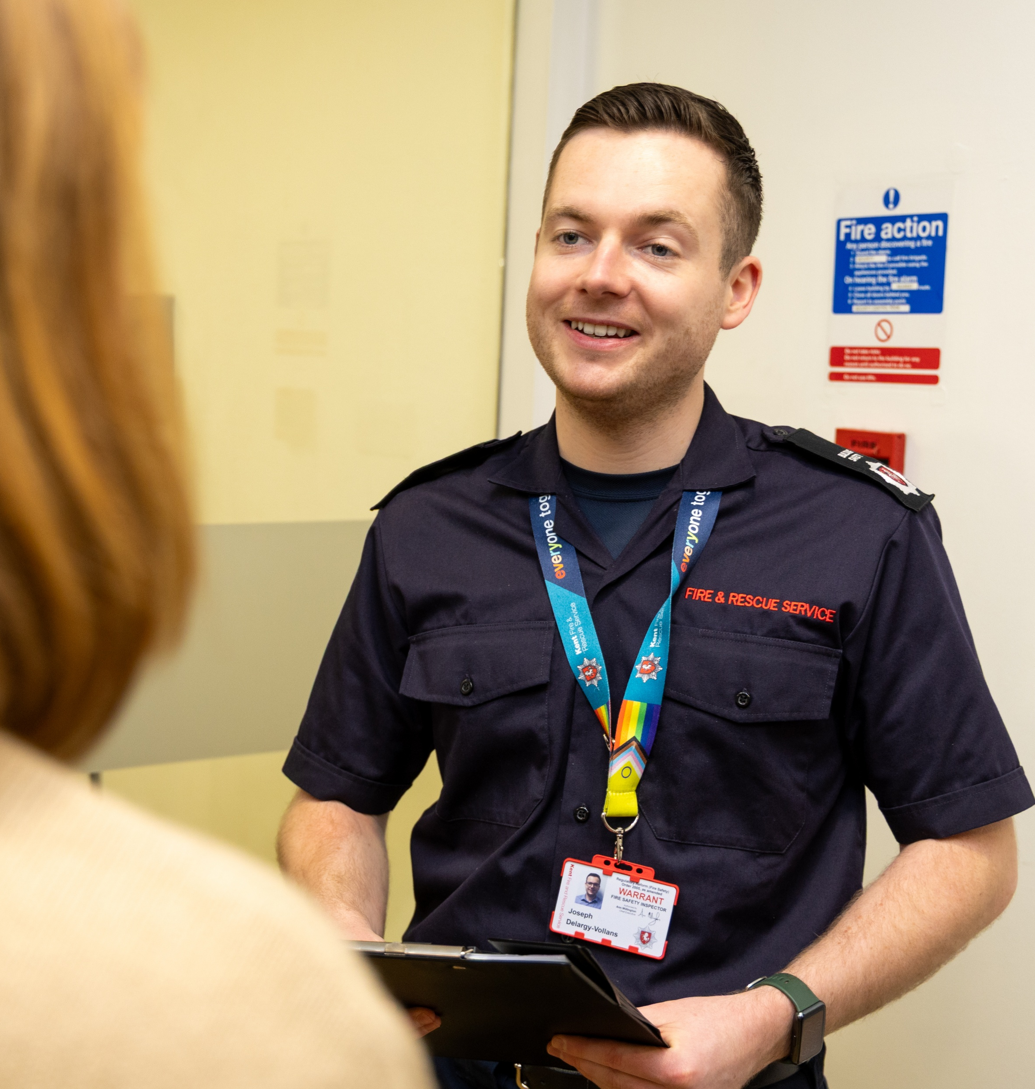
Building Safety
Our Building Safety teams achieved ‘outstanding’ in the HMICFRS report published in August – one of the first fire and rescue services to be awarded ‘outstanding’ at protecting the public through fire regulation.
KFRS continues to deliver the new risk-based intervention programme, which we launched on 1 April 2025. This uses new National Fire Chiefs Council methodology for both risk ratings and intervention planning. This made KFRS one of the first organisations to adopt this new approach, and now has developed into something we are also shaping nationally for fellow FRS.

Slide 22
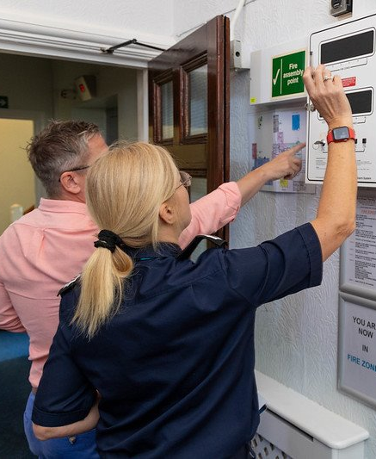
Building Safety
We have rolled out fire safety training for all incident commanders, with the first face-to-face course delivered in September 2025.
The training aligns with the National Competency Framework for Fire Safety Regulators and is designed for colleagues who are not fire safety specialists. It is primarily aimed at operational crews conducting fire safety checks at medium-risk premises across the county.
The L2 Skills for Justice-accredited course is being delivered in person to all Level 1 incident commanders from September 2025 onwards.

Slide 23
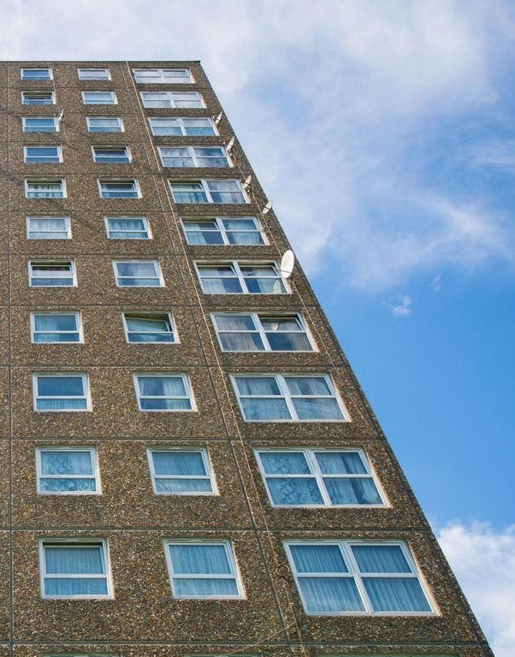
Building Safety
KFRS continues to work with the Ministry of Housing, Communities and Local Government (MHCLG) on issues relating to buildings in remediation and mitigating measures.
Throughout 2025, quarterly meetings have been held with MHCLG and local authorities to identify buildings in remediation, assess inherent risks, and monitor progress. This process ensures KFRS crews have the most up-to-date tactical and risk information, while residents in these buildings are proactively offered Home Fire Safety Visits through joint work with the Customer Safety teams.
The team are also researching, training and implement updates in Policy, Guidance and legislation, which includes:
  Fire Safety Act 2021
  Fire Safety (England) Regulations 2022
  Section 156 of Building Safety Act

Slide 24

Successful prosecution
Miller Food and Wine Limited, based in Lower Stone Street, Maidstone, was sentenced at Medway Magistrates' Court on 3 September 2025, following a prosecution by Kent Fire and Rescue Service (KFRS).
The prosecution followed an inspection by KFRS officers in March 2022, which identified significant fire safety concerns, including the absence of essential fire precautions and breaches in compartmentation of the building, which posed a serious risk to life in the event of a fire.
The business pleaded guilty to 10 offences under the Regulatory Reform (Fire Safety) Order 2005, including failure to comply with a restriction imposed by Prohibition Notices.
The company was ordered to pay a total of £62,000 in penalties, comprising of £18,000 for the initial failures, a further £24,000 for breaching the Prohibition Order, £18,000 in costs, and a £2,000 victim surcharge.

Slide 25
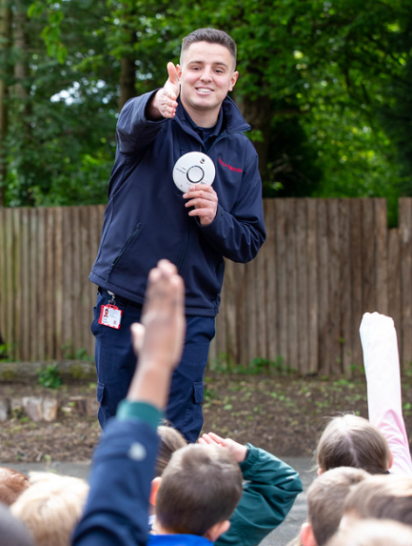
Customer Safety
During the academic year September 2024 to July 2025, the Education team delivered safety sessions to 395 schools;176 Fire Safety Intervention (formerly firesetter intervention) visits to young people and 125 fire safety talks to community groups across the county.
Fire Cadets from both Ramsgate and Rochester cohorts came together to compete in the National Fire Cadet Games held in South Wales. The team, consisting of Crew and Watch Manager Fire Cadets, placed 4th out of 32 Fire and Rescue Services. This is the first time KFRS have been represented at the Games.

Slide 26
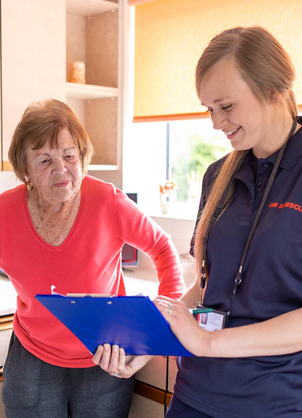
A new cohort, consisting of 20 young people, will begin the Fire Cadet course in September. Run from Rochester Fire Station, the participants will have the opportunity to gain valuable experience and life skills alongside both new and existing Fire Cadet Volunteers.
The Education team worked with Child Centred Policing to run Summer Aspire sessions – a targeted initiative to educate young people who were known to have entered derelict buildings in key parts of the county.
The Safe and Well team has a new Partnership and Referral Coordinator, who is promoting our prevention services and home fire safety visits. As well as information sharing with partners the coordinator will continue to ensure we receive detailed referrals for people most at risk from fire. They will focus on working with health partners, sharing fire safety messages and encouraging the use of equipment we provide to keep customers safe in their homes.

Slide 27

Safe and Well Officers now ask specific questions to identify veterans and families of former or current serving members of the armed forces community, to raise awareness of support that can be accessed, and to make referrals.
Safeguarding training is refreshed every three years. Colleagues in management roles across all KFRS teams, Designated Safeguarding Officers and HR colleagues attended a one-day scenario-based course for those who need an in depth understanding of how to safeguard an adult or child at risk, because their role includes making decisions. Colleagues found the course interactive, and the practical activities and case examples reminded the groups of their responsibilities and the importance of safeguarding across KFRS.

Slide 28
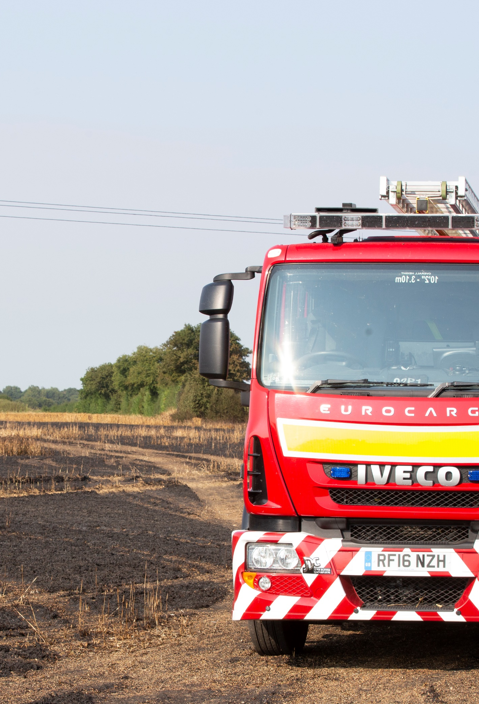
Community Intelligence & Partnerships
We supported the development of a comprehensive wildfire prevention package, including a dedicated website section, enhanced risk mapping, and new content for our prevention plan. We are also contributing to the National Fire Chiefs Council's Wildfire Prevention Toolkit, aligning our efforts with national best practices.
Alongside our new community intelligence form, we've developed a risk scoring system to help identify areas most at risk or within key target groups. This data-led approach allows us to proactively allocate resources and provide support where it's needed most.
Deliberate fires process has been streamlined to better identify emerging trends, and we are regularly working alongside community safety partners to tackle ASB related deliberate fires.

Slide 29
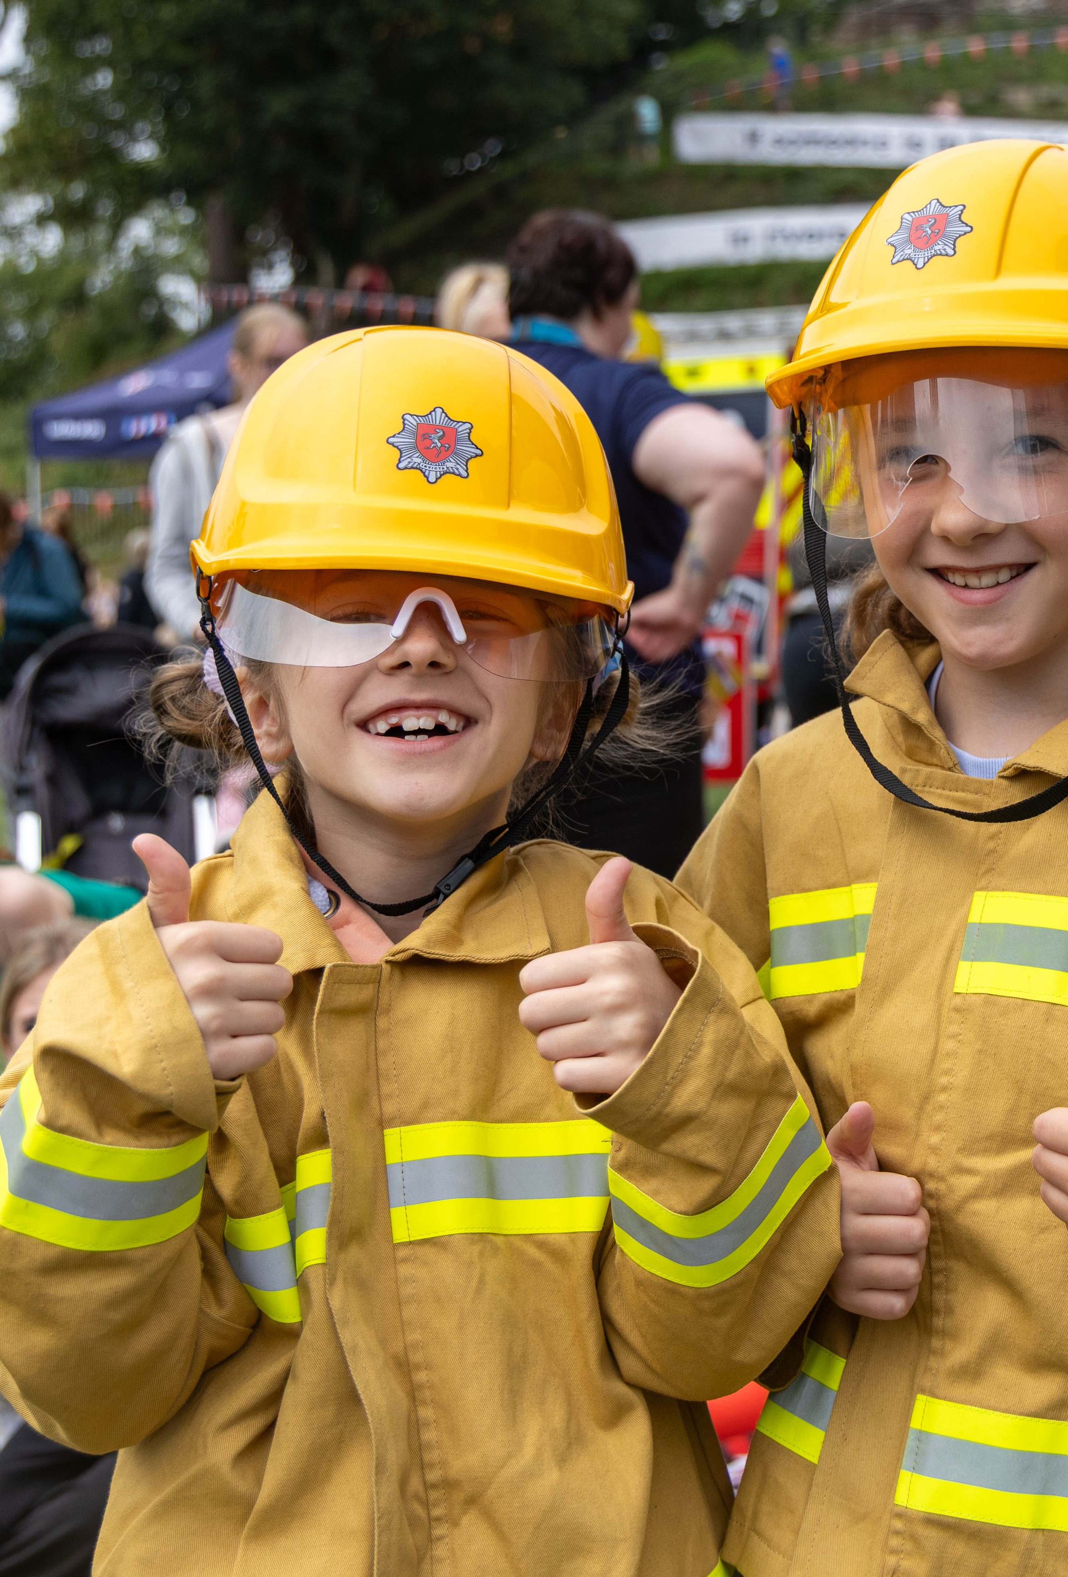
We have established regular multi-agency meetings in most districts to tackle the risks associated with derelict buildings and are currently working on over 130 buildings. This collaborative approach brings together key partners, including police, local councils, and responsible agencies, to identify and mitigate potential risks.
Following our recent survey on the use, safety, and disposal of rechargeable electricals and lithium-ion batteries, we are pleased to report that the data analysis is now completed, and the final report has been published.
Since July, the CIP team has engaged with more than 200 people in focused, in-person groups for our Community Risk Management Plan (CRMP) rural consultation. By directly targeting coastal and rural communities we're ensuring their needs shape the consultation's findings.

Slide 30

Engagement
Our Engagement team is responsible for creating fire, road and water safety campaigns and content; promoting ‘warn and inform’ messages providing accurate and timely information to the public during major incidents (e.g., fires, floods, or hazardous material spills); organising community events, providing our website and intranet and running the KFRS volunteers’ team.
Volunteering
We said a big 'THANK YOU' to our amazing volunteers during Volunteers week this summer. Every member of the team received a hand-written thank you card and we hosted a special thank you evening to show our appreciation and to help our volunteers feel valued and special – we truly couldn't do what we do without the team we have.
Every year our volunteers give us so much and this year is no exception. Volunteers have supported nearly 100 events, Our Volunteer Response Team (VRT) has so far attended 140 incidents to support customers; and our Cadet Volunteers have helped young people at over 60 sessions.

Slide 31
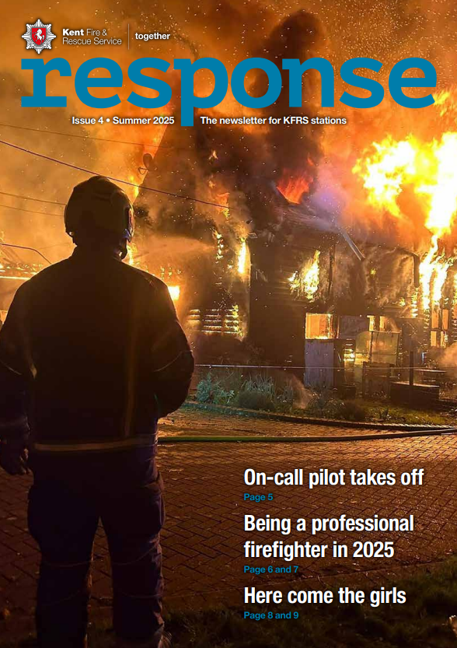
Communications and Marketing
Alongside our new approach to promoting awareness of wildfires with our 'Wildfire Warning' rating. We launched our new rural safety campaign – Prepare, Act, Protect. It was launched at the Kent County Show and along with digital content to support businesses and people who live in rural Kent on our website, we also have some helpful literature and keyrings that give people access to life saving information to support rural Kentish life.
We've published spring, summer and autumn editions of our 'Response' magazine that is aimed at our operational colleagues. Every edition supports our crews in culture, learning from incidents and showcasing KFRS innovation.
We've also promoting our new smoke alarm expiry date campaign which is running throughout 2025 that aims to raise awareness of the need to replace smoke alarms that are over 10 years old. We're also promoting the 'Make the right call' campaign about calling 999 if people are in trouble in inland water like lakes and rivers.

Slide 32
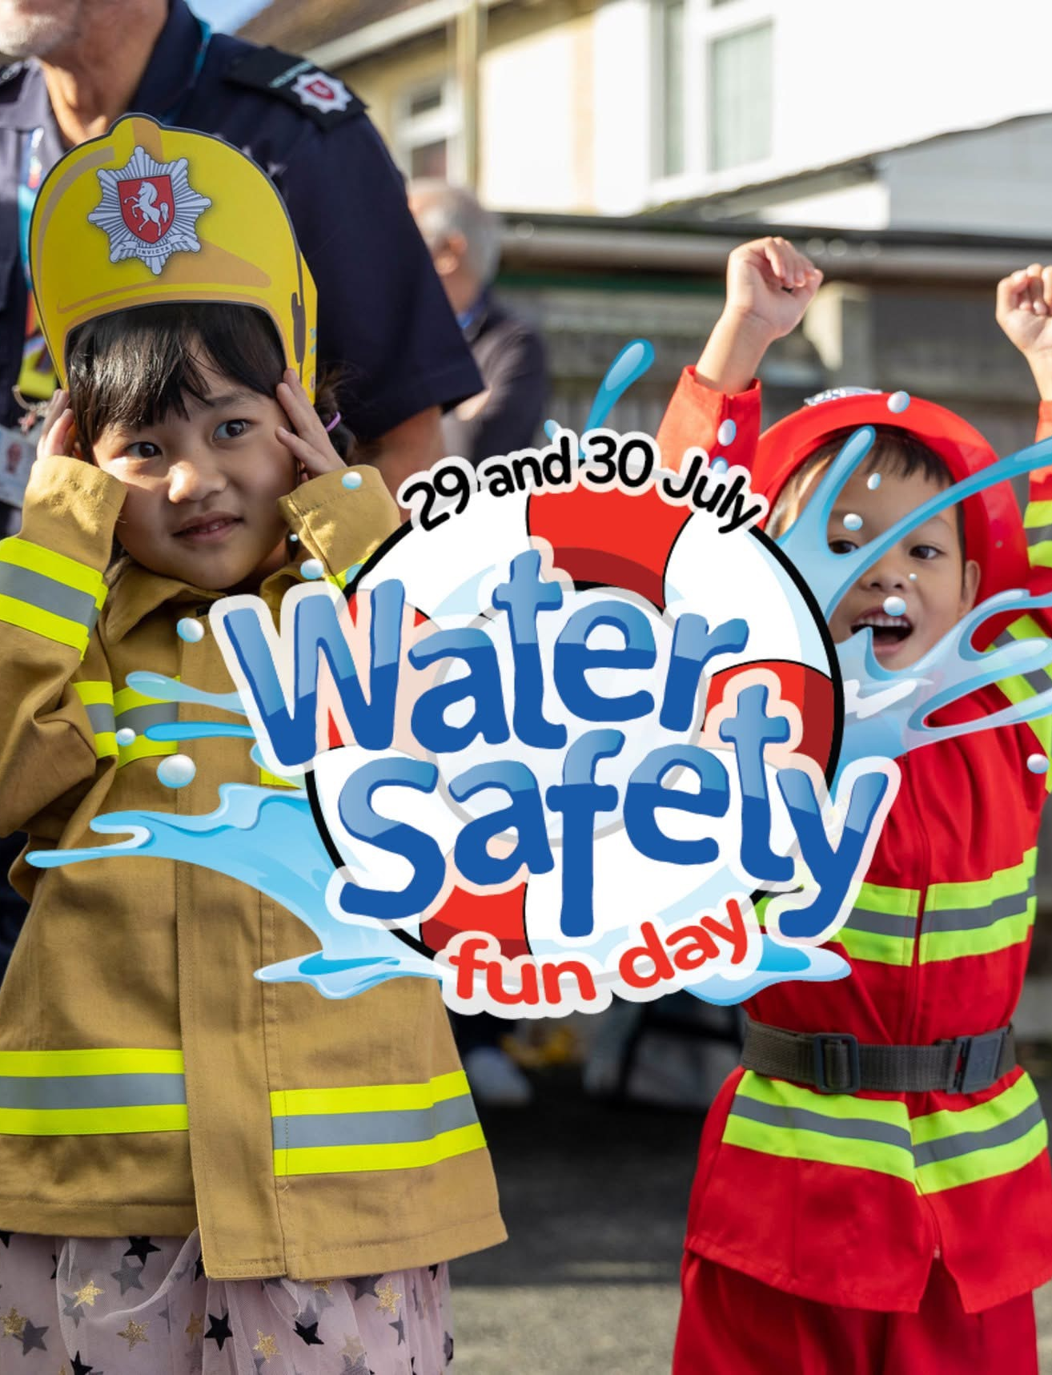
Events
Following on from the successes of testing new event formats in 2024, we delivered brand new events in 2025. Our fire station open days once again focused on reaching families living in Ramsgate and Isle of Sheppey. Our 'Safer Thanet Day' and 'Safer Sheppey Day' took place in early summer.
We also delivered a large two-day event to promote water safety in the grounds of Tonbridge Castle, next to the River Medway in July. The event was a multi-agency collaboration and involved demonstrations, plenty of fun learning for children and promote important messages around water risks. This event saw more than 6,000 people attend.
Our new events this year have attracted over 10,000 people.
We also supported lots of large community events across the county including The County Show to promote our rural safety campaign.

Slide 33
E. Freedom of information request update
October 2025
For further information please contact:
Kirsty Driver, Information Officer

Slide 34
Freedom of Information update 2025/26
*Q2 is currently incomplete as it covers the period from 01/07/2025 to 15/09/2025.
**Although this is not a requirement in the Cabinet Office Code of Practice for Freedom of Information Requests 2018, it is reported to Members as part of our commitment to transparency and good governance.
.
 | 2025/26
 | Q1 | Q2 | Q3 | Q4* | Total
The number of requests received during the period | 44 | 44 | 0 | 0 | 88
The number of the received requests that have not yet been processed | 0 | 13 | 0 | 0 | 13
The number of the received requests that were processed in full | 44 | 31 | 0 | 0 | 75
The number of requests where the information was granted in full | 21 | 15 | 0 | 0 | 36
The number of requests where the information was refused in full | 8 | 5 | 0 | 0 | 13
The number of requests where the information was granted in part and refused in part | 15 | 11 | 0 | 0 | 26
The number of requests received that have been referred for internal review | 0 | 0 | 0 | 0 | 0
Number of data subject access requests** | 1 | 4 | N/A | N/A | 5

Slide 35
Freedom of Information end of year update 2024/25
**Although this is not a requirement in the Cabinet Office Code of Practice for Freedom of Information Requests 2018, it is reported to Members as part of our commitment to transparency and good governance.
 | 2024/25
 | Q1 | Q2 | Q3 | Q4 | Total
The number of requests received during the period | 38 | 25 | 42 | 47 | 152
The number of the received requests that have not yet been processed | 0 | 0 | 0 | 0 | 0
The number of the received requests that were processed in full | 38 | 25 | 42 | 47 | 152
The number of requests where the information was granted in full | 27 | 16 | 26 | 20 | 89
The number of requests where the information was refused in full | 2 | 0 | 4 | 10 | 16
The number of requests where the information was granted in part and refused in part | 9 | 9 | 12 | 14 | 44
The number of requests received that have been referred for internal review | 2 | 0 | 1 | 0 | 3
Number of data subject access requests** | 4 | 4 | 4 | 3 | 15

Slide 36
F. Annual update on Members’ standards and allowances
October 2025
For further information please contact:
Kirsty Driver, Information Officer

Slide 37
Standards
Under the Localism Act 2011 all local authorities ‘must promote and maintain high standards of conduct’ by their Members.
As part of this the Authority receives an annual report on Members’ Standards.
Pleasing to report that no complaints related to breaches of the Code of Conduct made since the last meeting.
To date, the Authority has never received an allegation of misconduct by a Member.
Regular contact is maintained between the Independent Person and the Clerk to the Authority. This includes:
being in receipt of electronic agendas for all meetings of the Authority and Audit and Governance Committee.
annual attendance at this meeting and any other relevant meetings
keeping the Authority updated on relevant information that is published in relation to Local Government Standards in Public Life

Slide 38
Member Allowances
Allowances and Expenses Paid to Members during 2024/25 financial year - In order to meet the requirements of the 2003 Regulations, it is a legal requirement that the Authority publishes each year details of the allowances and expenses which it has paid to each of its Members during the preceding year.
A schedule which lists each Member and the allowances and expenses they were paid by the Authority in accordance with its Members’ Allowances Scheme during the 2024/25 financial year (1 April 2024 to 31 March 2025) can be accessed here for Members’ information.

