Slide 1
Medium-Term Financial Plan
(MTFP)
2027/28 – 2030/31
Funding outlook, budget pressures, and indicative savings requirements
15 October 2026

Slide 2
Purpose and decisions required
Members are asked to:
  Agree the assumptions being used to develop the Medium-Term Financial Plan (MTFP);
  Note the potential range of funding available;
  Note the savings requirement under each scenario; and
  Consider these implications alongside the Council Tax consultation report later on the agenda.

Slide 3
Executive Summary
The 2026/27 net revenue budget is £102.7m.
The Government settlement reduces cash funding by £0.8m in 2027/28 and a further £0.9m in 2028/29.
Net pay, inflation and other pressures add approximately £17.6m to the base budget over the planning period.
Other identified savings and additional income reduces pressures by approximately £1.5m.
To balance the budget the remaining savings to be identified across the planning period are:
  £16.3m under scenario 1; or
  £3.2m under scenario 2.
A balanced budget must be set each year.
Assumptions on Council Tax increases are the principal cause for the difference between the two scenarios.

Slide 4
2026/27 Revenue Budget - Funding
Funding:
Council Tax (67%) = £68.9m
- Households located in Kent and Medway
Business Rates (10%) = £10.2m
- Business premises located in Kent and Medway
Non-specific Government Grants (23%) = £23.6m
Revenue Support Grant (RSG)
Top-up Grant
= £102.7m
This is the budget for the year 2026-27

Slide 5
2026/27 Revenue Budget - Summary
(All figures are £’000) | Response and Resilience | Prevention and Protection | Internal Services | Pensions, Financing and Other Costs | Total Net Budget
Subjective:
Employee Pay Costs | 61,207 | 8,732 | 12,595 | 0 | 82,534
Other Employee Costs | 18 | 0 | 1,486 | 0 | 1,504
Direct Pension Costs | 0 | 0 | 0 | 2,252 | 2,252
Premises Costs | 52 | 13 | 5,458 | 0 | 5,523
Transport Costs | 2,081 | 16 | 372 | 0 | 2,469
Supplies and Services | 3,455 | 695 | 5,833 | 28 | 10,011
Capital Financing | 0 | 0 | 0 | 4,227 | 4,227
Reserve Transfers | -232 | -34 | -182 | -42 | -490
Income | -3,619 | -384 | -316 | -994 | -5,313
Net Budget for 2026/27 | 62,962 | 9,038 | 25,246 | 5,471 | 102,717
80% of net revenue budget spent on pay
Spend primarily in support of operational response
Operational training
FF injury pensions
Fire station running costs
Operational equipment
Mobilising systems and hardware
Replacement operational vehicles
70% of budget spend is directly charged to frontline
These figures exclude one-off revenue infrastructure spend and the offsetting drawdown from the infrastructure reserve

Slide 6
2026/27 Revenue Budget - Income
The £5.313m income budget is comprised of the following:
  Specific government grants - £4.032m
  Investment income - £994k
  Solar panel feed-in tariff income - £20k
  Rental of masts to telecoms companies - £118k
  Sales of obsolete vehicles and equipment (proceeds <£10k) - £40k
  Insurance recoveries - £20k
  Cross border recharging - £15k
  Apprenticeship levy drawdown - £74k

Slide 7
Brief note on charging
Fire Authorities are very limited in what services they can charge for and cannot charge for their core, statutory duties.
The Fire and Rescue Services Act 2004 outlines the following core activities, which are considered essential public services and therefore, not chargeable:
Attending Fires
Emergency Response
  Road Traffic Collisions
  Rescuing people or animals where there is an immediate threat to life
  Flooding incidents that pose a danger to life
  Hazardous materials spillages where a threat to life or health exists
  Rescues from water or other emergencies involving trapped individuals
  Building collapse or other structural incidents
  Providing emergency medical assistance
  Fire Safety Promotion including providing advice and fitting smoke alarms
  Enforcement of Fire Safety Law including the issuance of enforcement notices
Fire Authority Trading Companies > must be ‘function-related’ > many have been dissolved

Slide 8
Funding Outlook

Slide 9
Key Funding Considerations
- 2027/28 (short-term) Planning Scenarios
Component | Scenario 1: Lower Funding | Scenario 2: Higher Funding | Note
Fair Funding Assessment | Reduced by £0.8m | Reduced by £0.8m | As per multi-year Settlement
Council Tax Charge | No Increase | £4.95 Increase in Band D (c. 5%) | Referendum limit £5 Every 1% equates to c. £650k
Council Tax Base | 0.75% Increase | 1.50% Increase | Every 1% equates to c. £650k
Collection Funds | No Surplus | £0.6m Surplus

Slide 10
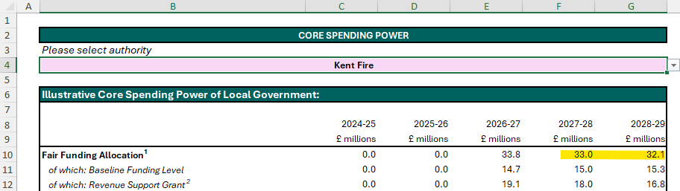
2026/27 Multi-Year LG Finance Settlement –
Fair Funding Allocations for 2027/28 and 2028/29
Core Spending Power Information Table 26-27 to 28-29
2027/28 - £0.8m reduction
2028/29 - £0.9m reduction
Combined base funding reduction £1.7m (cash-terms)
If 2026/27 £33.8m uplifted by 2% est. inflation > 2028/29 = £35.2m
So real-terms funding reduction (2026/27 to 2028/29) = £3.1m

Slide 11
Funding Changes for 2027/28 | Scenario 1 (Lower Funding) C Tax Base +0.75% C Tax Charge +£0 |  | Scenario 2 (Higher Funding) C Tax Base +1.5% C Tax Charge +£4.95
 | Change Assumption | 2027/28 Impact £’m | Change Assumption | 2027/28 Impact £’m
Fair Funding Assessment (FFA) and Business Rates | As per m-year settlement | -0.8 | As per m-year settlement | -0.8
Council Tax Base | +0.75% | 0.5 | +1.5% | 1.0
Council Tax Charge (Band D) | No increase | 0.0 | +£4.95 | 3.4
Collection Funds | No surplus | -0.6 | £0.6m surplus | 0.0
Total Potential Funding Changes from 2026/27 to 2027/28 |  | -0.9 |  | 3.6
Total Potential Funding Available for 2027/28 |  | 101.8 |  | 106.3

Slide 12
Funding for 2028/29 to 2030/31 – Planning Assumptions | Change Assumption (each year) | 2028/29 Impact £’m | 2029/30 Impact £’m | 2030/31 Impact £’m
Scenario 1 – Lower Funding
FFA and Business Rates | Per m-year settlement (2029/30 > +2%) | -0.9 | 0.6 | 0.7
Council Tax Base | +0.75% | 0.5 | 0.5 | 0.5
Council Tax Charge | +£0 | 0.0 | 0.0 | 0.0
Collections Funds | No surplus or deficit | 0.0 | 0.0 | 0.0
Total Potential Funding Change from Prior Year |  | -0.4 | 1.1 | 1.2
 | NET REVENUE BUDGET | 101.4 | 102.5 | 103.7
Scenario 2 – Higher Funding
FFA and Business Rates | As per m-year settlement / +2% | -0.9 | 0.6 | 0.7
Council Tax Base | +1.5% | 1.1 | 1.2 | 1.2
Council Tax Charge | +£4.95 (2029/30 > +2%) | 3.5 | 1.5 | 1.6
Collections Funds | £0.6m surplus | 0.0 | 0.0 | 0.0
Total Potential Funding Change from Prior Year |  | 3.7 | 3.3 | 3.5
 | NET REVENUE BUDGET | 110.0 | 113.3 | 116.8

Slide 13
Principal Budget Pressures and
Savings

Slide 14
2027/28 to 2030/31 – Budget pressures and savings
Pay awards (every 1% adds around £800k pressure to the budget)
  2027/28 - 2026/27 pay awards settled at 3.3% / 3.8% (budgeted 3%)
  2027/28 - 3% pay award assumption
  2028/29 - 2030/31 - 2% pay award assumption
Inflation
  Contractual commitment, Actual increase or 3%
Working with Budget Managers to identify Savings and Pressures
Investment Income / Grants
  2026/27 budget £1m
  Increased investment income has offset increased costs recently - but this will reduce as cash balances are utilised to fund planned expenditure, resulting in a budget pressure in later years

Slide 15
Pay-related budget pressures and savings – 2027/28 to 2030/31
CONFIRMED PROVISIONAL | 2027/28 Impact £’m | 2028/29 Impact £’m | 2029/30 Impact £’m | 2030/31 Impact £’m
2026/27 pay award – Budget 3% v Settled at 3.8% (Ops) and 3.3% (Support) | 0.5
Future years pay awards and increments – 3% for 2027/28 then 2% each year | 2.4 | 2.0 | 1.9 | 1.9
Reduce WT-PT and On-call Station Pay Budgets | -0.6
Other pressures – new posts and other adjustments | 1.1
Other savings – posts deleted / restructures | -0.9
Net impact on base budget | 2.5 | 2.0 | 1.9 | 1.9

Slide 16
Non-pay budget pressures / reduced income – 2027/28 to 2030/31
CONFIRMED PROVISIONAL | 2027/28 Impact £’m | 2028/29 Impact £’m | 2029/30 Impact £’m | 2030/31 Impact £’m
Annual contribution to ST&P Reserve | 0.2
Contributions to unfinanced capital spend (ALF and ARC) - MRP |  | 0.9 | 0.9 | 0.4
Firefighting Equipment Contract | 0.5 | 1.4
Training and Conference Fees and Training Equipment | 0.1
HR Legal Support | 0.1
IT Budgets | 0.4
Fleet – Fuel and Repairs | 0.1
FF Pensions Administration Costs | 0.1
Property – General Refurbishment and Compliance Works / ARC Rates | 0.2 |  | 0.4
Inflation and other base budget reviews | 1.0 | 0.9 | 0.8 | 0.9
Net impact on base budget | 2.7 | 3.2 | 2.1 | 1.3

Slide 17
Budget savings / additional income - 2027/28 to 2030/31
CONFIRMED PROVISIONAL | 2027/28 Impact £’m | 2028/29 Impact £’m | 2029/30 Impact £’m | 2030/31 Impact £’m
Additional Investment Income | -0.1
Reduction in cost of Smoke Alarms | -0.1
IT Telephone costs | -0.1
Removal of Voluntary Revenue Provision | -0.7
Other minor savings identified from base budget reviews | -0.2 | -0.1 | -0.2
Net impact on base budget | -1.2 | -0.1 | -0.2 | 0.0

Slide 18
One-off Budget Adjustments – 2027/28 to 2030/31
CONFIRMED PROVISIONAL | 2027/28 Impact £’m | 2028/29 Impact £’m | 2029/30 Impact £’m | 2030/31 Impact £’m
General Reserves Adjustment | 0.1 | 0.2 | 0.2 | 0.2
Wholetime FF Trainee Recruitment Pay Budget | -0.6
Other one-off budgets | 0.3
One-off impact on budget | -0.2 | 0.2 | 0.2 | 0.2

Slide 19
Summary MTFP – 2027/28 to 2030/31
Scenario 1 – Lower Funding (no Council Tax increase) | 2027/28 | 2028/29 | 2029/30 | 2030/31 | Total
Base Budget b/f | 103.7 | 102.0 | 101.2 | 102.3
Pay related budget pressures/savings (tbc) (slide 16) | 2.5 | 2.0 | 1.9 | 1.9
Non-pay budget pressures/reduced income (tbc) (slide 17) | 2.7 | 3.2 | 2.1 | 1.3
Savings/Additional income – identified (tbc) (slide 18) | -1.2 | -0.1 | -0.2 | 0.0
Base Budget Savings Req. – options to be considered | -5.7 | -5.9 | -2.7 | -2.0 | -16.3
Base Budget c/f | 102.0 | 101.2 | 102.3 | 103.5
One-off Budgets (tbc) (slide 19) | -0.2 | 0.2 | 0.2 | 0.2
Net Revenue Budget | 101.8 | 101.4 | 102.5 | 103.7
Scenario 2 – Higer Funding (£4.95 / 2% CTax increase) | 2027/28 | 2028/29 | 2029/30 | 2030/31 | Total
Base Budget Savings Req. – options to be considered | -1.3 | -1.7 | -0.5 | 0.3 | -3.2
Base Budget c/f | 106.5 | 109.8 | 113.1 | 116.6
Net Revenue Budget | 106.3 | 110.0 | 113.3 | 116.8
It is a legal requirement to set a balanced budget i.e. Net Revenue Budget = Funding

Slide 20
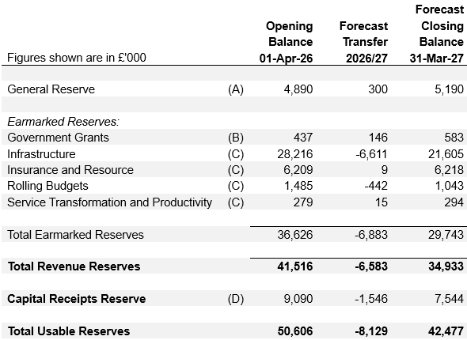
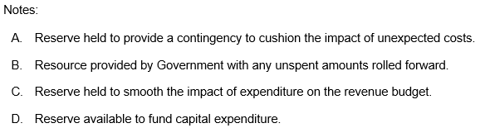
2026/27 Forecast Reserve Balances

Slide 21
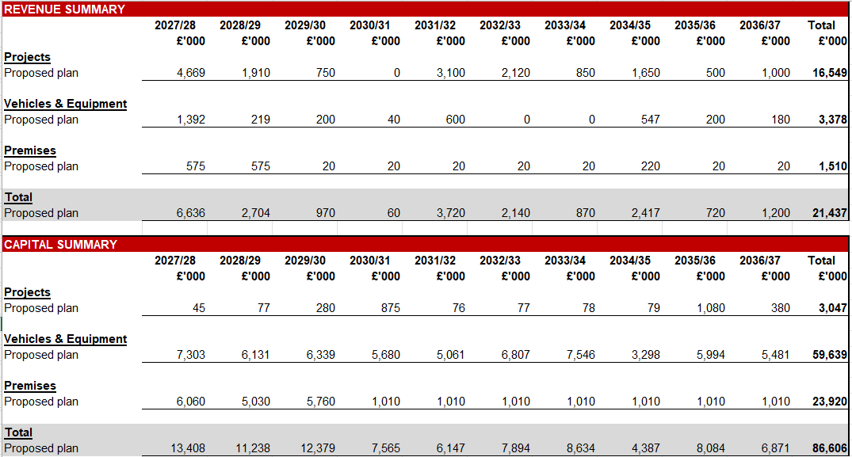
Draft 10-Year Capital and Revenue Infrastructure Plan
Not finalised - for indicative purposes only

Slide 22
Recap on Council Tax
£ Band D Council Tax
Charge
for 2026-27
Annual Bill
£ increase in Band D Council Tax
for 2027-29
Annual Bills
£ increase in Band D Council Tax
for 2029-31
Annual Bills
Impact on Band D Council Tax Charge
Weekly Bill
Council Tax income generated from £ increase
Level of expected savings required 2027-31
£99.81
The Fire charge equates to around 4% of the average Council Tax bill
£0
£0
£0
£0
£17m
£4.95
(£5 referendum limit)
2% (assumed referendum limit)
£0.09 – 2027-29
£0.04 – 2029-31
£3.5m - 2027-29
£1.5m – 2029-31
£4m
KCC = £1,758.60 (71%)
District or Borough = £310.84 average (13%)
Medway Council = £1,949.59 (84%)
Kent Police = £285.15 (12%)
As the Kent Fire charge represents only 4% of the total Council Tax bill, a £4.95 annual increase on the Kent Fire Band D charge equates to a 0.2% annual increase in the overall Council Tax bill.

Slide 23
Recommendation:
Members are asked to:
  Agree the assumptions being used to develop the Medium-Term Financial Plan (MTFP);
  Note the potential range of funding available;
  Note the savings requirement under each scenario; and
  Consider these implications alongside the Council Tax consultation report later on the agenda.

